Slide 1
Master of Business Administration
International Marketing
International Marketing Mix

Slide 2
Learning Outcomes
To learn about Marketing Mix in the International context
To explain how marketers formulate their marketing strategies in the international marketing context.

Slide 3
Standardisation vs Adaptation
When entering an international market, companies choose to market their products or services in a standardized or adapted (localized) way.
A standardization strategy ensures consistency in all aspects of the brand. For example, the company will use the same packaging, design, and staff uniform in every location.
According to Vrontis et al. (2009), the extent of standardisation in international marketing depends on the following five factors: target market, market position, nature of product, environmental and organisational factors.
Adaptation strategy implies changing various aspects of products and services to a considerable extent in order to meet the needs of consumers in international markets taking into account their differences (Chung, 2009).

Slide 4
International Marketing Mix
The international marketing mix strategy involves the use of different marketing instruments to achieve positive financial results by a company operating on international or global markets.
International marketing applies marketing principles to other countries.
Marketing in different countries may require different marketing mixes since varied customer needs.
To meet these different customer needs firms will have to engage with necessary adaptation strategies

Slide 5
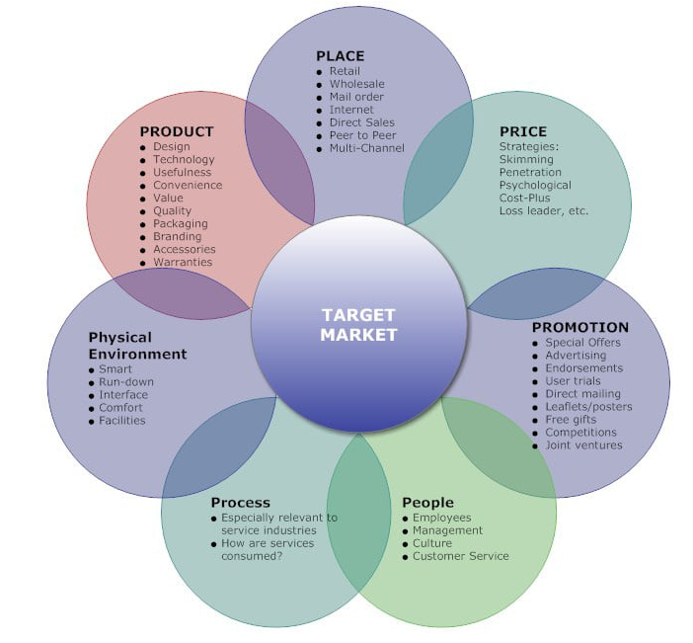

Slide 6

PRODUCT
Standardization strategy is used to full extent by many global businesses across wide range of industries such as Adidas, Nike, Coca-Cola Company, Unilever, Johnson & Johnson and others.
The strategy of adaptation allows global businesses to respond to changes in local marketplace in rapid manner.
These changes may be political, economical, social or technological; nevertheless, relevant business processes may be subjected to modifications to eliminate or at least to minimise negative impacts of these changes.
Product adaption for the international market can increase overall cost to business and also weakens the brand image
Global brands such as Coca-Cola, Nike have adapted a standardized approach since they have a strong brand image.

Slide 7
Different product strategies
Catering the same standardized product and promotion worldwide
Catering the same product, but adapting promotion to local needs.
Change the product offer in the international market
Develop a new product for the international market

Slide 8

PRICE
A well established brand in one market may be new in another , this may lead to wide price variations.
Competitive pressures varies in different international markets.
Pricing on an international scale is a complex task. As well as taking into account traditional price considerations such as fixed and variable costs, competition and target groups

Slide 9
The factors to be considered in pricing
The cost of transport
tariffs or import duties, purchase tax (VAT)
exchange rate fluctuations
personal disposal incomes of the target market
the currency they want to be paid in and
the general economic situation of the country and how this will influence pricing.
Customers willingness to pay.
The internet has created further challenges as customers can view global prices and purchase items from around the world.
This has increased the level of competition and with it pricing pressures, as global competitors may have lower operating costs.

Slide 10
Pricing strategies
Competition pricing. When a company tries to differentiate itself from its competition, it can change the price, making it higher or lower, to achieve the planned result.
Skimming pricing. This is a strategy where the price is set high from the start. It is very popular in electronic and tech companies, where the initial price slowly decreases over time, after the release date. It gives a possibility of introducing the product in steps to different layers of the market.
Penetration pricing. This is something opposite to a skimming strategy. It starts with a low price to penetrate the market, usually with a product that already exists in the market. It helps to gain sales and market share. In the future, the price may be raised.
Cost Plus pricing. This strategy is applied when, in order to determine the final price, a percentage is added to the costs as a profit margin.
Premium pricing. This means setting up a price at a higher level to establish the exclusiveness of a high-quality product. Premium brand stores or luxury cars are a great example.

Slide 11

PLACE
International logistics plays a major role in international sales and production activities.
Distribution in national markets such as the United Kingdom will probably involve goods being moved in a chain from the manufacturer to wholesalers and onto retailers for consumers to buy from.
In an overseas market there will be more parties involved because the goods need to be moved around a foreign market where business practices will be different to national markets.
For example in Japan there are approximately five different types of wholesaler involved in the distribution chain. Businesses will need to investigate distribution chains for each country they would like to operate in.
They will also need to investigate who they would like to sell their products and services to businesses, retailers, wholesaler or directly to consumers.
The distribution strategy for each country a business operates in could be different due to profit margins and transportation costs.

Slide 12
Direct or indirect distribution channel used for physical distribution
Joint ventures are popular when entering foreign markets. This way reduces the cost of distribution channels.
Distribution obstacles need careful assessment before entering a foreign market.
Communication and coordination is facilitated by online networks.

Slide 13

PROMOTION
Advertising messages in countries may have to be adapted because of language, political climate, cultural attitudes and religious practices. For example a promotional strategy in one country could cause offence in another.
The level of media development and availability will also need to be taken into account.
Ex: Is commercial television well established in your host country? What is the level of television penetration? How much control does the government have over advertising on TV, radio and Internet? Is print media more popular than TV?
Before designing promotional activity for a foreign market it would be expedient to complete a PEST analysis so that you have a complete understanding of the factors operating in the foreign market you would like to enter.

Slide 14

PEOPLE
Having talented people who know the local market is crucial for international marketing.
This could include having a person or staff who is originally from the target market or host country, engaging an in-country advisor or salesperson, or opening a local office.
These people will know the local language and culture and help you adapt your product, packaging and other details properly to the local market.

Slide 15

PROCESS
This is about the activities involved in delivering your products or services.
An effective process helps you to:
- achieve repeatable and consistent customer service levels
- save time and money by increasing your operational efficiency.
Effective, efficient, accurate and user-friendly business processes for ordering, delivery, IT and production, and communication are key for international marketing.

Slide 16
Some processes to consider in the international Market
Are the logistics in your main distribution channel cost-efficient?
How are your scheduling and delivery logistics?
Will your third-party retailers run out of product at critical times?
Do you have enough staff to cover busy times?
Do items ship reliably from your website?

Slide 17

PHYSICAL ENVIORENMENT
This refers to all existing and potential features customers see when engaging with your business.
Physical evidence:
- is the tangible proof that establishes credibility
- includes the look and feel of your business branding
- spans the physical and digital environment.

Slide 18
Physical evidence may be:
- a retail store
- interior design
- layout of the company website
- a business website
- online ratings and reviews
- the uniforms and behaviour of employees.

Slide 19
GROUP TASK
Identify an international firm and explain how the firm apply seven (7) elements of extended marketing mix in any international market.

Slide 20
THANK YOU !

