Slide 1

Future of Welsh Policing
Week 7
2025

Slide 2

Week 7
Future of Policing in Wales-
Future Operating Environment 2040 trends

Slide 3
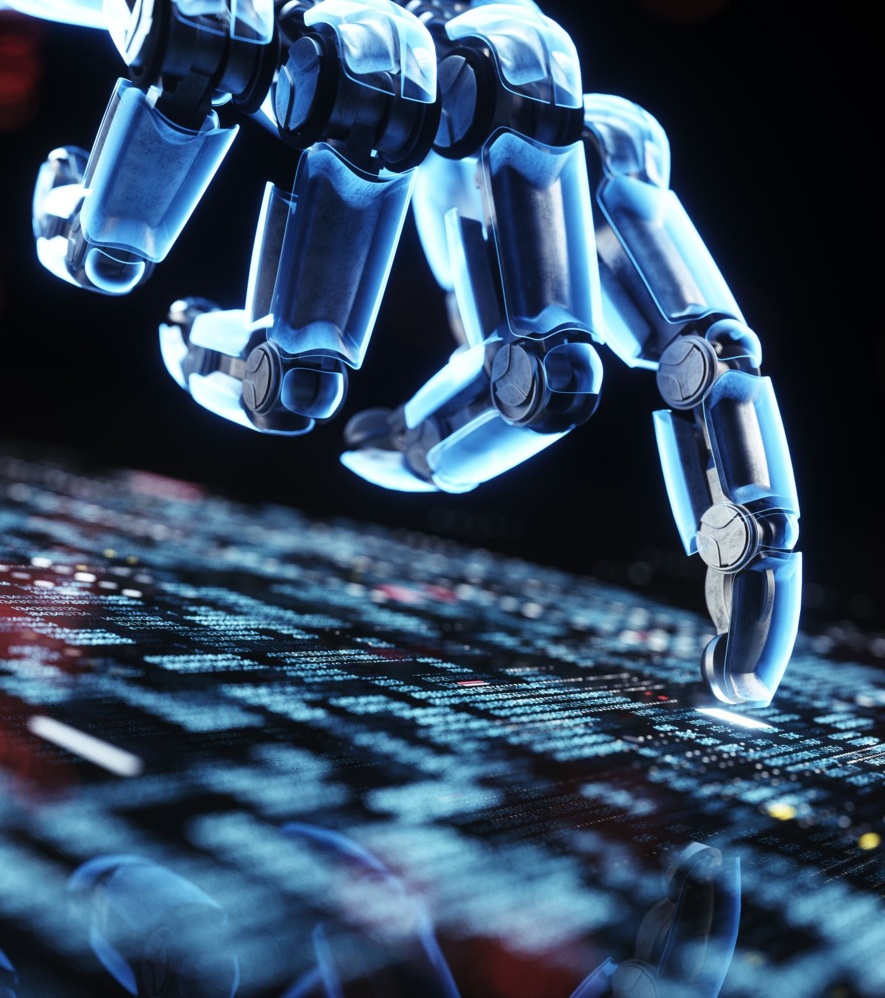
Future of Policing
Our world is changing
On top of issues such as terrorism and cyberattacks, climate change could give rise to severe disruption.
Emerging technologies - artificial intelligence, robotics, biotechnology and quantum computing
Could it divide society?
Silence freedom of speech?
See an increase in inequality?
Empower people?
Send disinformation?
Trends such as nationalism increase?

Slide 4
Strategic plans are needed
An ever-changing world needs ever evolving policing
Next 20 years police will need to:
-Anticipate threats
-Think about policies
-Consider interventions that address issues quickly to ensure success is achieved
-Mitigate contemporary issues
CoP - Key trends and implications up to 2040
  10 trends

Slide 5
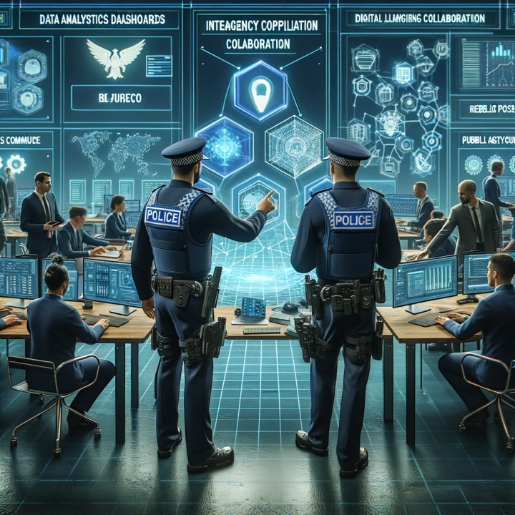

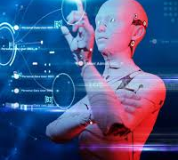
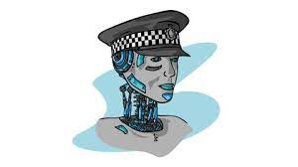
What are the predicted trends of the future?

Slide 6
What is the Future operating Environment 2040?
The College of Policing, through a process of interviewing and surveying 80 analysts, scientists, technologists and policing practitioners have published a new Future Operating Environment analysis for 2040.
Uses scenario exploration to inform future practices in policing
Explored through 4 scenarios- points to five future challenges, to help stress-test and future-proof policing decision-making

Slide 7
Scenario testing
Fragile Seams – disruption and social tension caused by inequality, technology and climate change
Pandora’s Box – economic and environmental disasters undermining social order
Green Reset – a restructured global economy
Black Mirror – mass surveillance technology

Slide 8

Fragile Seams
This scenario explores a world growing increasingly fragile in the face of rising inequality, global warming and disruptive technologies. The scenario highlights the difficulties in responding to future demands for security (both virtual and physical) as societal tensions increase, new technologies create new threats and efforts to tackle divisive issues make limited headway.
The scenario underscores the difficult choices policing might face in the context of global and domestic conditions that cause inequalities to widen, crime levels to increase and climate change to become increasingly disruptive.

Slide 9
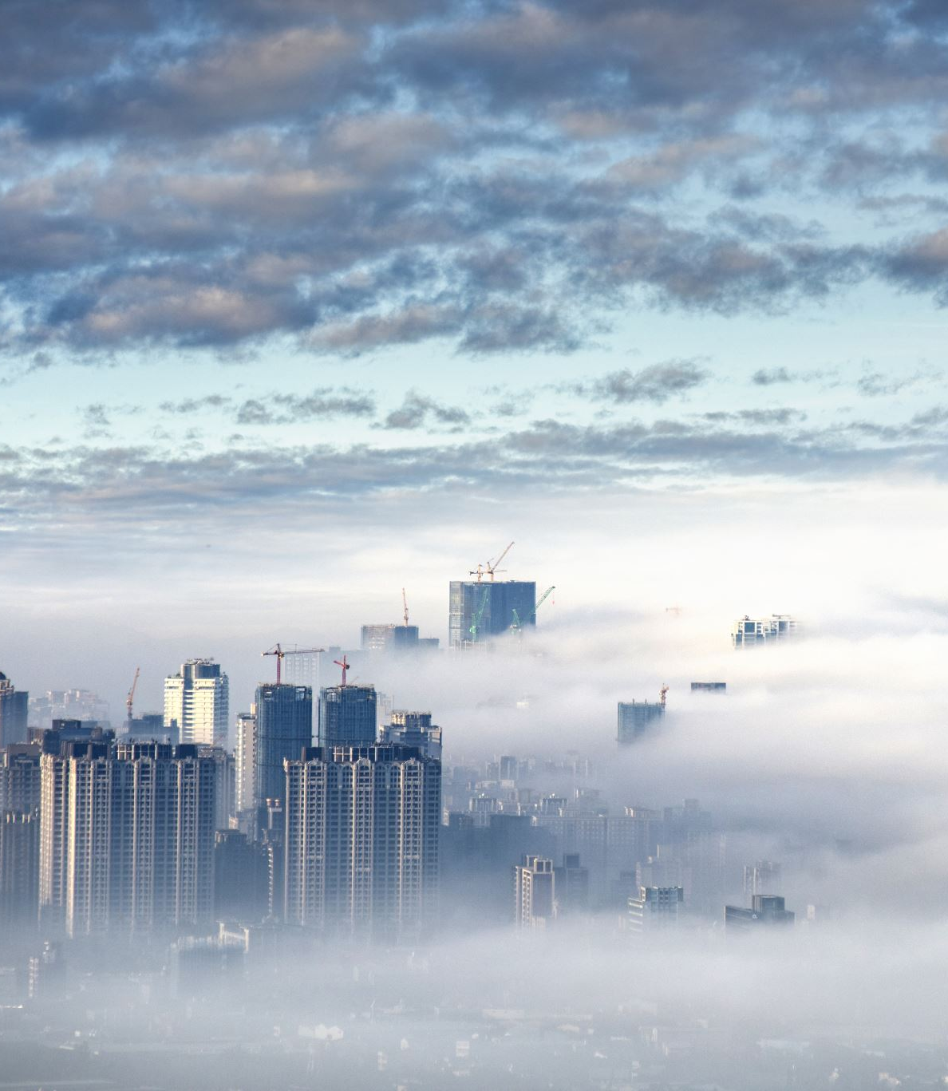
Pandora’s box
This scenario explores a shock prone world in which economic and environmental disasters compound and feed each other, pushing the economy into recession, putting the social contract under strain and creating favourable conditions for criminals.
The scenario highlights the possible consequences of systemic breakdown, including weak governance, widespread job loss and high levels of paranoia and mistrust. The scenario emphasises the pressure that such conditions would put on the police and highlights the choices that would either bring stability or exacerbate tensions.

Slide 10
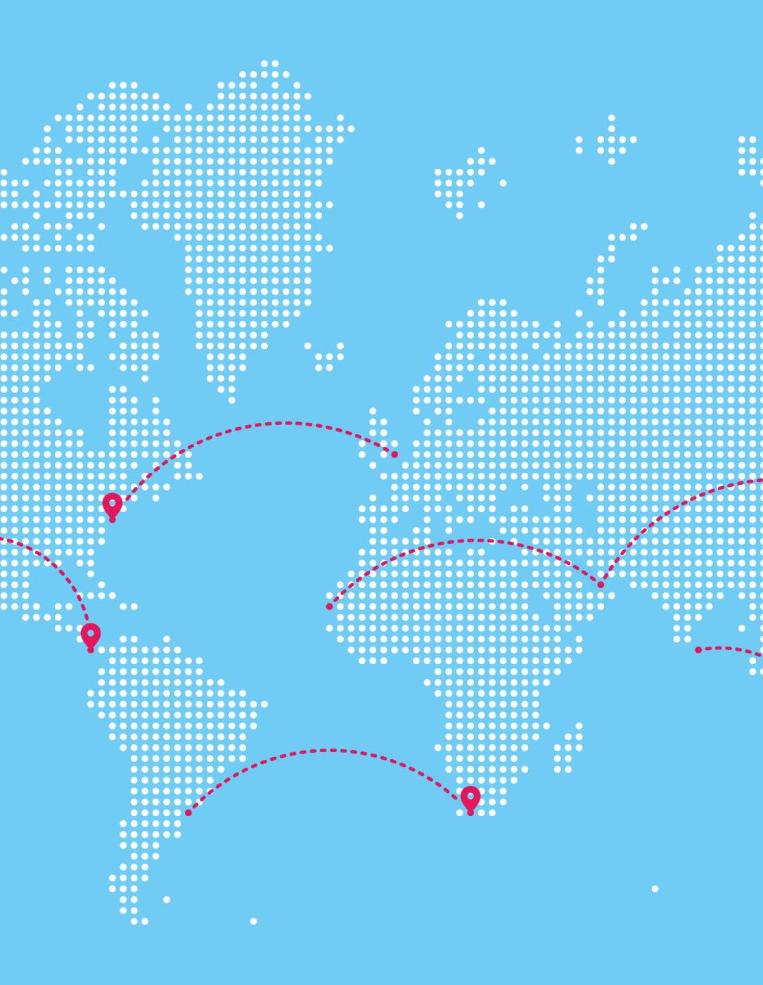
Green Reset
This scenario explores the issues surrounding a restructuring of the global economy that leads to a more sustainable and equitable world. The scenario describes how a shift to post-materialist values, a more interventionist state and new modes of production and consumption give rise to a new relationship between people and planet.
The scenario considers the changing nature of the police role as this transition takes place, focusing on what new threats, challenges and demands might emerge and which old ones might recede.

Slide 11

Black Mirror
This scenario explores the emergence of a high-tech world characterised by mass surveillance and high-levels of technological convergence. The scenario describes how advances in ‘next generation’ technologies help to address some of society’s most pressing problems but also increase the power of technology companies in ways that some people find unacceptable.
The scenario considers the benefits and risks of operating in an emerging surveillance society as well as the challenges of keeping pace with rapid technological advances.

Slide 12
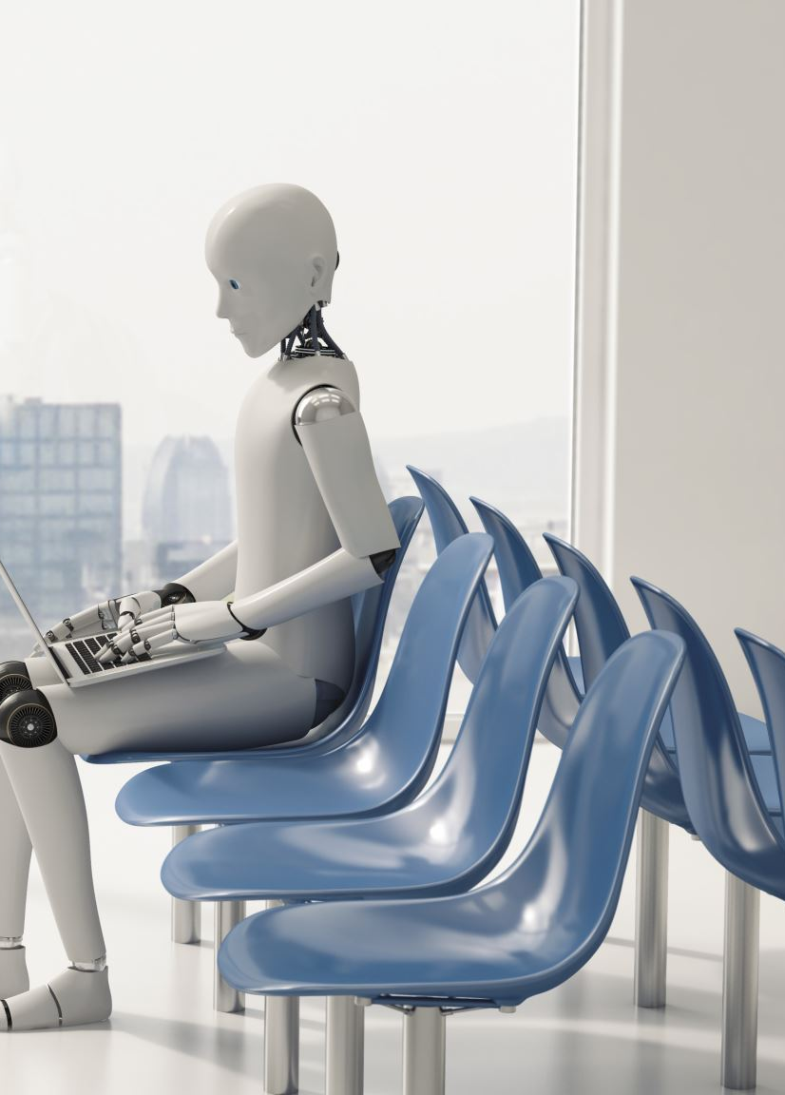
Challenges identified
Balancing the benefits and risks of artificial intelligence in an emerging surveillance society
Policing digital disinformation
Building trust in a digital era
Shaping the future police workforce
Operating in conditions of increasing complexity

Slide 13
10 Key trends and implications

Slide 14
Trend 1
Rising inequality and social fragmentation
-Inequality within countries is rising. Even in the world’s most developed nations, living standards have fallen, wage growth remains low and the gap between rich and poor has reached record levels
-Gap between the haves and have-nots is increasing in terms of income, attainability, wealth, education, social mobility and political advantage
-Inequality can lead to polarisation, rise in violence and disorder

Slide 15
Trend 2
An expanding and unregulated information space
-With advances in technology creating new opportunities for mass manipulation
-The manipulation of information online is emerging as a major threat to public life
-Conspiracy theories, ‘fake news’ and propaganda are used to pollute online information environments and artificially shape public opinion.
- Impact on freedoms?

Slide 16
Trend 3
A changing trust landscape
-The relationship between institutions and the citizens they serve is under pressure
-Scandal, widening inequalities and populist attacks on the relevance and accountability of prominent institutions
- Inability to keep up with technological advancements in a world where transparency is needed

Slide 17
Trend 4
Technological change and convergence
-Advances in technology could cause criminal behaviour to become increasingly two-tiered.
-Traditional crimes may need enormous technical know-how from the police
-Cybercriminals develop advanced tools and other packaged services which are then sold or rented 'Crime as a service' - OSC

Slide 18
Trend 5
A larger, older, more diverse population
-A growing population creates greater demand on services
-Iincrease in numbers with vulnerability with crimes e.g. cybercrime, romance fraud
-Global challenges such as climate change, resource scarcity and regional conflict are likely to drive increasing migration in many parts of the world including the UK and Wales

Slide 19
Trend 6
Harnessing artificial intelligence
-Increasing the use of AI to investigate crime
-To plan resources, improve problem solving
-Double edged sword?

Slide 20
Trend 7
Workforce automation
-Advances in robotics, machine learning, data analytics and affective computing mean that growing swathes of work can be automatable
-Aautomation could boost productivity, reduce human involvement in potentially harmful activities and free up time for alternative pursuits that allow for the development of new skills and contribute to greater wellbeing
-Do we need humans to do certain roles?

Slide 21
Trend 8
Economic transitions
-Possible weak economic growth post Brexit
-Prudent investment in science and technology will be necessary to mitigate threats and identify and realise opportunities
-Preparation for recession- difficult decisions

Slide 22
Trend 9
Growing influence of non-state actors
-Non-state actors are becoming increasingly powerful both domestically and internationally (Musk, Tate?)
-Technology companies in particular are using their influence to gain control over more data, provide new public services and demand concessions from national governments
-In the absence of effective regulation, the opportunities afforded to criminals and other malicious actors to operate with a high level of anonymity will continue, or perhaps even increase.

Slide 23
Trend 10
Climate change, environmental decline and competition for resources
-Extreme weather events, grievances and protest movements could mutate into violent ideologies and mass mobilisations (Just stop oil?)
-Growing resource scarcity will affect many aspects of people’s lives and livelihoods- fraud, corruption
-Increasing global demand and competition for resources will drive international competition and could give rise to market volatility, geopolitical tensions and violent conflict

Slide 24

Thursday’s session
Delve deeper into police operation plans
Discuss ethical and contemporary issues
Future miscarriages of Justice
Bring with you any ideas for discussion ☺

Slide 25
Police futures https://science.police.uk/site/assets/files/3402/dstl_police_futures_-_a_taste_of_the_future_no_rdp_v4.pdf
Policing in England and Wales: Future Operating Environment 2040
Part 1 Key trends and implications out to 2040

Slide 26
CoP - Key trends
Technological Advancements
Climate Change and Environmental Challenges
Demographic Shifts
Economic Transitions
Social and Political Changes

Slide 27
Demographic Trends
Population Growth: Global population growth is slowing, with significant aging in developed countries and continued growth in developing regions
Urbanization: More people will live in urban areas, leading to megacities and increased demand for infrastructure
Migration: Increased migration due to economic opportunities and climate change impacts

Slide 28
Environmental Trends
Climate Change: Intensifying effects of climate change, including extreme weather events, rising sea levels, and biodiversity loss
Resource Scarcity: Growing competition for resources like water, food, and energy
Sustainability: Increased focus on sustainable practices and renewable energy sources

Slide 29
Economic Trends
Economic Shifts: The rise of emerging markets and a shift in economic power from the West to Asia
Inequality: Rising income and wealth inequality within and between countries3
Future of Work: Automation and AI transforming industries, leading to job displacement and the need for new skills

Slide 30
Technological Trends
Innovation: Rapid advancements in AI, biotechnology, and quantum computing
Digital Transformation: Increased connectivity and the expansion of the digital economy
Cybersecurity: Growing importance of cybersecurity as digital threats become more sophisticated

Slide 31
Societal Trends
Social Fragmentation: Rising inequality and social fragmentation, leading to increased polarization
Trust and Governance: Changing trust landscapes and the role of non-state actors
Health and Education: Challenges in sustaining improvements in health and education amid economic and environmental pressures

Slide 32
Rising Inequality and Its Implications – Trend 1
Global Trend: Inequality is increasing, even in developed nations.
Living Standards: Declining with low wage growth.
Income Gap: Record levels between rich and poor.
UK Outlook:
  Income & Wealth Inequality: Expected to rise until 2040.
  Consequences: Higher poverty rates, increased violence, and weakened social cohesion.
  Socio-Economic Polarization: Growing divisions in beliefs, values, and behaviours.
  Future Risks: Potential for more pronounced fault lines and rise of extreme ideologies.
Notes:
Even in the world’s most developed nations, living standards have fallen, wage growth remains low and the gap between rich and poor has reached
record levels. In the UK, already high levels of income and wealth inequality are likely to continue to rise out to 2040,
with implications for poverty rates, levels of violence and social cohesion. As well as becoming more unequal in socio-economic terms, the UK is also becoming increasingly polarised and tribal in its beliefs, values and behaviours. In the period to 2040, there
is an enduring, perhaps increasing, risk that existing fault lines
could become even more pronounced and that extreme or violent
ideologies could start to take hold

Slide 35
Trend 1 Implications for Policing
More unequal societies tend to be more violent.
Income inequality will likely increase levels of socioeconomic deprivation – leading to health and social problems such as drug abuse, anti-social behaviour & MH
New Identy based hate crime, radicalisation, protest and resistance to changes – divides become more pronounced will police be caught in the middle?
Pulbic trust in policing - Mistrust in the police – passed down through generations – public will consent?

Slide 36
Trend 2: An expanding and unregulated information space
The manipulation of information online is emerging as a major threat to public life.
Across the world rumours, conspiracy theories, ‘fake news’ and propaganda to pollute online information environments and artificially shape public opinion.
Advances in technology creating new opportunities for mass manipulation
A trend which will continue out to 2040, with many of the tactics which are harmful and unlawful

Slide 37
Implications for policing - Trend 2
Disinformation created and spread disinformation online – can police control these messages especially after an incident (terrorist/pandemic/attacks) - public protection
Technology becoming a powerful tool to commit offences such as fraud, harassment, blackmail
Once a single person now becomes spreading information easy to victims families or to the unknown.
Fake news has led to vigilantism and other forms of violence - effects felt by ordinary citizens, economic systems and over all disruption
Responding to incidents of false or misleading information could expose policing to claims that it is acting to limit freedom of speech or expression – unjustified arrests
Ensuring the safety, integrity and wellbeing of the police workforce - protect officers and staff from disinformation

Slide 38
Trend 3: A changing trust landscape
Many Western nations are experiencing chronically low levels of public trust in government.
In 2019, the Edelman Trust reported that in 12 out of 26 countries, less than 50% of citizens trusted government, business and media to ‘do what is right’.
In the UK, the figure was just 42%.
New demands for fairness, transparency and environmental sustainability are putting pressure on existing forms of governance
Pressure, weakened by scandal, widening inequalities

Slide 39
Implications for policing – Trend 3
Trust in police
In 2019, 55% of the public had confidence that ‘the police and local council are dealing with the anti-social behaviour and crime issues that matter in the local area’,
Following years 2018 - 59%; 2017 61%
Police conduct, some traditional policing approaches undermine public trust
Efffictive community relations and pulbic safety – gaps need to be bridged
Society that could become profit-driven private actors rather than state run

Slide 40
Trend 4: Technological change and convergence
AI
Intelligent mobility
Synthetic biology
Sensors
3D/4D priniting
robots, nanotechnology
virtual reality
By 2040, energy, transport, information and systems will be closely linked by sensors of all kinds, making the movement of people and goods easier, more efficient and more environmentally sustainable.
More control on People?

Slide 41
Implications for policing – Trend 4
Advances in technology could cause criminal behaviour to become increasingly two-tiered.
Those traditional crimes may need enormous technical know-how from the police
Cybercriminals develop advanced tools and other packaged services which are then sold or rented 'Crime as a service' - OSC
Policing will need to weigh the risks of new technologies against their benefits to the core policing mission
Yet, VR could increase the realism, efficiency and cost-effectiveness of a wide range of police training packages

Slide 42
Trend 5: A larger, older, more diverse population
By 2040, the UK population will be larger, older and more diverse – more demand on public services
Implications for policing:
Vulnerability – victims of crime including online vulnerabilities
Police may need further training and reskilling opportunities to support.

Slide 43
Trend 6 - Harnessing Artificial Intelligence
As AI matures it will spur advances in other technical fields
Fast pace
Implications for policing
AI has the potential to vastly improve policing’s ability to prevent crime, manage its resources more efficiently and coordinate fast-moving responses to major incidents.
Implications: AI can enhance predictive policing, data analysis, and operational efficiency, but also raises ethical and privacy concerns

Slide 44
Trend 7: Workforce automation
Automation could boost productivity, reduce human involvement in potentially harmful activities
People may become surplus to requirements
May need further upskilling
Implications: Automation could change the nature of police work, requiring new skills and potentially reducing the need for certain roles

Slide 45
Trend 8: Economic transitions
UK post-Brexit economic realignment
Low carbon economy
Low productivity

Slide 46
Global economy is becoming more fragile as globalisation evolves and economic power shifts
Implication for policing
will impact crime patterns and the resources available for policing

Slide 47
One Welsh police Force?

Slide 48


Scotland Police /
Police Service Northen Ireland

Slide 49
Since its merger
Police Scotland formed in 2013 with the merger of eight regional forces and two specialist agencies
Employs 23,000 people across a one third of the UK’s geographical area.
Since its merger- 73% said they had trust in the police (SHS, 2023)
Technical hitches with staff pay, holiday entitlements and methods
Notes:
Police Scotland is the national police service for Scotland, established on April 1, 2013. It was formed by merging eight regional police forces into a single, unified service
Police in Scotland have very high levels of public service motivation, an academic survey of almost 7,400 officers and staff has found. - Police Scotland

Slide 50
Why?
Efficiency and Cost Savings: By merging the eight regional police forces into one, the Scottish Government aimed to reduce duplication of services and achieve significant cost savings. It was estimated that this move would save around £1.7 billion over 15 years
Standardisation: A single police force allows for more standard policing practices across Scotland – same service everywhere.
Improved Coordination and Resource Allocation: With a unified structure, Police Scotland could coordinate responses to major incidents and allocate resources more effectively.
Enhanced Accountability and Governance: The creation of Police Scotland was accompanied by the establishment of the Scottish Police Authority, which oversees the force and ensures accountability.

Slide 51
Against One Force
Loss of Local Accountability and responsiveness. Decisions made national rather than local where community-specific issues can be addressed.​
Operational Independence would one force have political pressures ​
Community relations may be missed. Having centralised structures may lose connections with communities
Significant changes in governance, management and operation procedures
Potential for Bureaucracy: having one single force. Decision making becoming
slower
Diverse needs of areas one force will struggle to address differences.

Slide 52
Police Scotland Problems
A decade of Police Scotland - fewer officers, more work - BBC News

Slide 53


Could the plans be achieved with 1 force?
Discuss
Notes:
committees.parliament.uk/writtenevidence/126306/pdf/

Slide 54
One Welsh Police Force?
Yes – Chief Constable Richard Lewis has said this should be in place by 2030.
Expressed his personal view that forming one national police force for Wales would bring "sound operational benefits" and could be the "next natural step" for achieving efficiencies
Jeremy Vaughan, the Chief Constable SWP stated that for a single Welsh police force to work effectively, policing would need to be devolved to the Welsh Government.
Acknowledged potential efficiencies but also highlighted challenges in maintaining local service delivery and the need for political will to support such a transition

Slide 55
Sources
Policing in England and Wales: Future Operating Environment 2040
Policing would need to be devolved for one Welsh police force to work says South Wales Chief Constable
Preparing for the devolution of policing in Wales [HTML] | GOV.WALES
Chief gives personal views on forming one Welsh police force

Slide 56
Future challenges In Policing
Challenge 1: Balancing the benefits and risks of AI in an emerging surveillance society
Challenge 2: Policing digital disinformation
Challenge 3: Building trust in a digital era
Challenge 4: Shaping the future police workforce
Challenge 5: Operating in conditions of increasing complexity

Slide 57
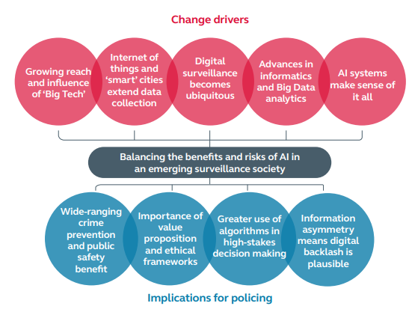
Challenge 1: Balancing the benefits and risks of AI in an emerging surveillance society

Slide 58
Challenge 1
“We’re not living in the 21st century in policing at the moment. For us to be a proper part of the future, we’ve got to get our act together on things like AI, to use it to our advantage”
What is the value proposition for using AI and ‘human profiling’ systems across different policing activities?
How can policing ensure that it uses AI in a way that builds rather than undermines public trust

Slide 59
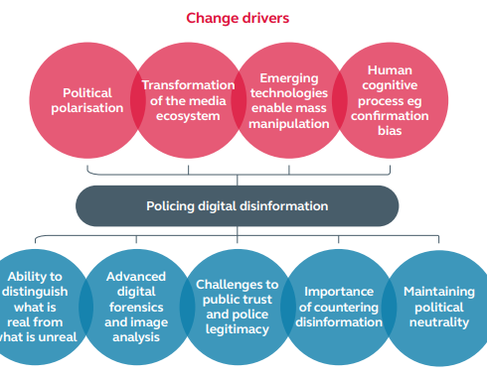
Challenge 2: Policing digital disinformation
“The amount of disinformation that’s out there could really impact our ability to build public trust”
The use of disinformation to artificially shape public opinion online is likely to grow in both scale and sophistication
What role might police communications play in countering the effects of disinformation on social cohesion, police legitimacy and operational integrity?

Slide 60
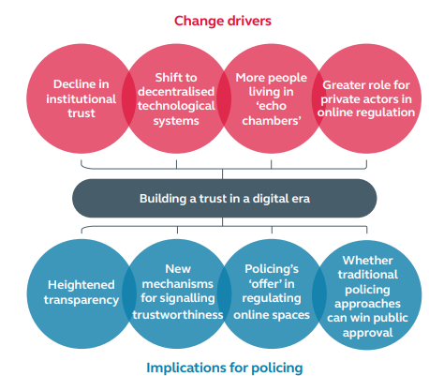
Challenge 3: Building trust in a digital era
“If we aren’t able to give people the outcomes they want, if we aren’t able to keep up with new crime trends, if we aren’t able to make ourselves relevant in the digital space, we’ll lose public trust.”
Is policing’s current approach to digital engagement capable of building public trust in the digital era?
What is the future role of policing in regulating online spaces – both in terms of enforcing regulation and investigating breaches?

Slide 61
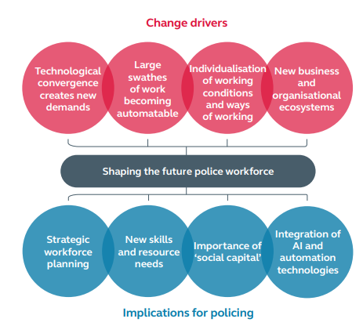
Challenge 4: Shaping the future police workforce
“What are the skill types that we need going forward? The skills that may require more investment but will enable us to get upstream of things?”

