Slide 1
BA Applied Leadership and Management in the Workplace
Module: BMSK5013
Knowledge and Information Management Skills for the Workplace

Slide 2
Blended Learning ​
Session 1

Slide 3

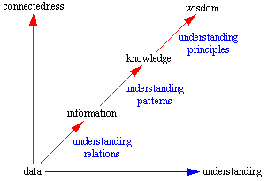
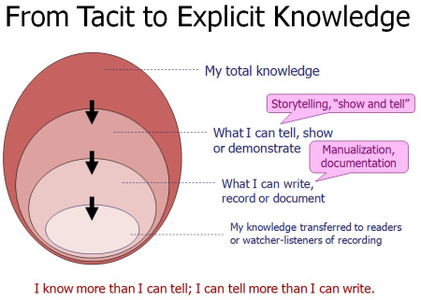
Recap
BMSK5013 - Module Objectives
BMSK5013 - The Assignment
Data, Information, Knowledge………
Information Resources
Knowledge Continuum Pyramid
The Knowledge Coupling, ‘IT and People’
Tacit – Explicit Knowledge

Slide 4
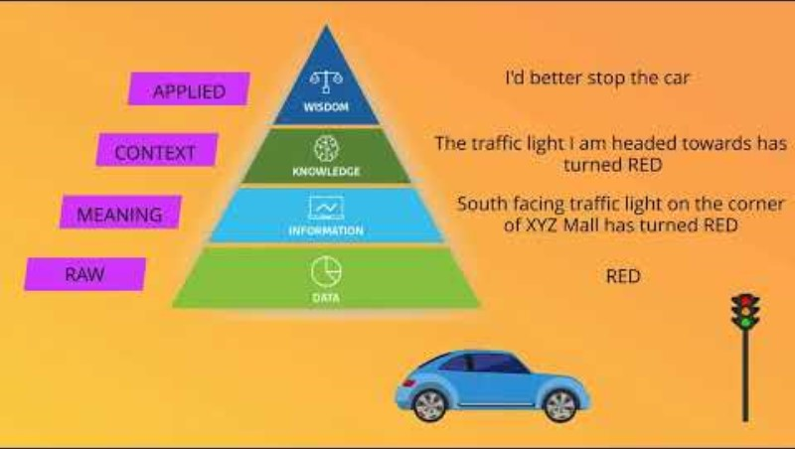
Data, Information, Knowledge & Wisdom
Notes:
https://www.youtube.com/watch?v=SNMkEZJbin8

Slide 5
Two Types of Knowledge
Tacit
knowledge that is stored in our head
Explicit
which is recorded in some way so that many other people are potentially able to access it.
Notes:
Think about learning to ride a bike….or being taught to ride a bike…….how much was explicit knowledge? How much was tacit? How would you share your tacit knowledge with a learner?

Slide 6
How we Share Knowledge
Tacit Knowledge
Ask
Tell
Knowledge
Pull
Knowledge
Push
Search
Share
Explicit Knowledge
Notes:
When knowledge is Tacit, it can only be shared if we ‘ask’ about it, or choose to ‘tell’ others about it. Explicit knowledge is theoretically ‘in the open’ and can thus be ‘searched’ for, or actively ‘shared’. Depending upon the approach, we can either think of this as ‘knowledge pull’ or ‘knowledge push’.

Slide 7
The challenges of tacit knowledge.
Tacit knowledge represents personal knowledge obtained as a result of the direct interaction between individuals and their environment
Represents an excellent reservoir of intangible resources from which the organizations can gain a major competitive advantage.
To manage tacit knowledge: provide a platform for employees to create it and facilitate the sharing of such knowledge among employees using tools and various methods:
Storytelling
On the Job Training
Mentoring
Lessons Learned
Shadowing
Wiki

Slide 8
Potential Challenges of Tacit Knowledge
It leaves when it’s owner leaves!
It can lead to re-inventing the wheel, wasting time, money and other resources
It can lead to misunderstandings when colleagues are not aware of reasons for action
It is not publicly tested, therefore it is unlikely to be altered or built upon.
To overcome the above:
Storytelling enables employees to relate stories, including the what and how.
On-the-job training and shadowing are related tools. In shadowing, the student watches the teacher execute a task, and in on-the-job training, the teacher watches the student work.
Mentoring provides the opportunity to pass not only tactical knowledge but also culture from experienced staff to younger people.
Writing internal wikis enables staff to explain pertinent details of the work and explain why different decisions are made.
Lessons learned enable the lab manager to establish a learning culture and take advantage of both positive and negative outcomes for learning for the whole organization.

Slide 9
Potential Challenges of Tacit Knowledge
Worst case scenario leading on from this is that it may not be ‘knowledge’ but a sense of certainty built on a hunch or from a deeply held belief
How to effectively capture tacit knowledge……

Slide 10

Why should you be interested in Knowledge Management today?
K3CubedLtd
http://www.youtube.com/watch?v=5iTPg5SrD2M
Notes:
Where do ‘Ideas’ fit into Knowledge Management? Gary Hamel 1. Obedience 2. Diligence 3. Intellect – all expected…….4. Initiative 5. Human Creativity 6. Passion & Zeal. Have a look at Management Innovation – Gary Hamel.

Slide 11

Quotes - Food for Thought
“It’s not the strongest of the species that survive, not the most intelligent, but the ones most responsive to change.” Charles Darwin
“If you always do what you always did, you will always get what you always got.” Mark Twain
“If you want to see change, be the change you want to see.” Ghandi

Slide 12

Can you see the Knowledge?
Knowledge is like the wind
You can’t easily see it, but it’s there
It’s elusive
It’s effects can be far reaching.

Slide 13
What is Knowledge?
Information?
is a collection of facts – it is explicit, definable, recordable
Knowledge?
is created and exists in the human mind, after insight or learning is applied to information.

Slide 14
What is Knowledge?
Information?
is a collection of facts – it is explicit, definable, recordable
Knowledge?
is created and exists in the human mind, after insight or learning is applied to information.

Slide 15
What is Knowledge Management (KM)?
Finding, creating, using, sharing, transferring, keeping and reusing knowledge
Getting the right knowledge to the right person at the right time, to enable them to do their job effectively.

Slide 16
KM is about working together
Connection
Collection
Communication
Conversation
Collaboration
Corporation
Cohesion
Community
Commitment

Slide 17
KM is about working together
Connection
Collection
Communication
Conversation
Collaboration
Co-operation
Cohesion
Community
Commitment

Slide 18

Everyone has something to learn, everyone has something to share.
What knowledge do you have?
Where is it?
Who else holds it?
What happens to it?
Is it shared and accessible to others?

Slide 19
The Concept of KIM
The concept of KIM in terms of information leading to knowledge and then management of knowledge is relatively recent
The combination of development technologies, knowledge workers/professionals and collaborative technologies, have facilitated a significant move forward in the potential for knowledge sharing.

Slide 20
The Concept of KIM
There is an immense amount of information, and information resources, available to organisations in the networked environment of the modern workplace. However, this information needs to be effectively managed if it is to be turned into knowledge
‘Knowledge is what we know’ or ‘Information in context’. Knowledge Management is ‘Sharing what we know for a positive effect’

Slide 21
KIM Definition
Knowledge Management encompasses the creation and subsequent management of an environment, which encourages knowledge to be created, shared, learned, enhanced, organised and utilised for the benefit of the organisation and its customers.
The Welsh Assembly Government’s KIM Strategy

Slide 22
KIM Definition
Knowledge Management is the explicit and systematic management of vital knowledge - and its associated processes of creation, organisation, diffusion, use and exploitation - in pursuit of business objectives.
The Welsh Assembly Government’s KIM Strategy

Slide 23
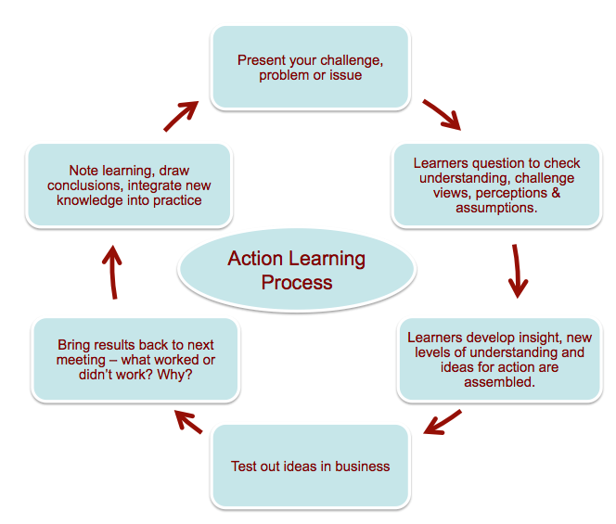
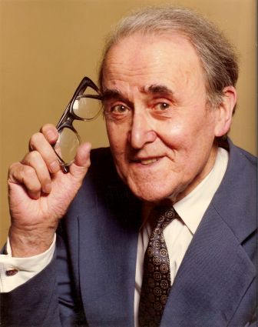
A Thought
Learning = Programmed knowledge + Questoning
Notes:
Professor Reginald Revans – Industrial Management Professor – Learning = Programmed Knowledge + Questioning (closed, open, objective, relative)
Action Learning ‘happens in the workplace’. Can this help turn tacit into explicit knowledge? Or knowledge into wisdom?

Slide 24

Knowledge management, an organisation’s weapon of choice
K3Cubed Ltd
http://www.youtube.com/watch?v=zUVZn44WT_c

Slide 25

Summary
Take 5 minutes to reflect upon tonight – what have you learnt?
Any key areas you want to research further?
What can help you with your assignment?
What can help you in your career?

Slide 26

Good Knowledge Resources
Nick Milton
  http://www.knoco.com
David Gurteen
  http://www.gurteen.com
Other Links:
  http://www.knowledge-management-tools.net
  http://www.henley.ac.uk/kmforum/
End of online delivery session – Any questions?
Homework: review videos & complete online task sheet

