Slide 1
Problem Question:
Rachel, who suffers from schizophrenia, was on her way home after watching a horror movie at her friend’s house. She realised that she had missed dinner and was hungry, so she decided to break into a local food retailer’s warehouse with the intention of finding something to eat. When Rachel reached the warehouse, she found that the door was unlocked, so she went inside. It was very dark inside the warehouse, but she could see a light in the distance. As she headed towards the light, she heard something approaching her. Affected by the movie, Rachel believed that it was a demonic spirit who wanted to kill her. In reality, it was Hans, the security guard, who was investigating the noise made by Rachel when she entered the warehouse. Rachel hid behind some boxes and, when Hans reached her, she jumped out from behind the boxes, collided with Hans and they both fell to the floor. Hans dropped his heavy-duty torch when he fell. Rachel picked up the torch and hit Hans violently over the head with it a number of times. Hans died from his injuries. Rachel left the warehouse without taking any food.
Advise Rachel of her potential liability together with any defences that may be available to her (25 marks)
Notes:
Murder
Rachel has caused the death of Hans in both fact and law. ‘But for’ Rachel’s actions, Hans would not have died: White (1910) and Rachel’s actions were the operating and substantial cause of Hans’s death: Smith (1959). The first offence to consider would be murder.
The definition of murder is the unlawful killing of a human being with malice aforethought. There is no problem here with the AR being satisfied as Rachel caused the death of Hans. The problem for the prosecution would be proving that she did it with malice aforethought which means an intention to cause death or GBH: Vickers (1957). As we are told that Rachel hit Hans a number of times, violently, with his torch, it could be argued that she intended to cause GBH, this would be sufficient MR for murder. Rachel would not be charged with involuntary manslaughter as her actions satisfy the AR and MR of murder.
Potential defences
It is likely that Rachel will be charged with murder. However, due to her schizophrenia, she may be able to plead the partial defence of diminished responsibility or the defence of insanity.
Diminished responsibility
Diminished Responsibility under s2 HA, as amended by s52 C&JA, occurs when, at the time a person kills another, he was suffering from an abnormality of mental functioning arising from a medical condition which substantially impaired his ability to understand the nature of his conduct or form a rational judgement and/or exercise self-control. The abnormality of mental functioning must have arisen from ‘a recognised medical condition’. This includes psychiatric, psychological and physical conditions. In the original defence it was D’s general responsibility that had to be substantially impaired. In the amended defence the substantial impairment has to be of D’s ability to understand the nature of his conduct or form a rational judgement and/or exercise self-control. S52(1)(1)(c) adds that the abnormality for mental functioning provides an explanation for acts and omissions.
Rachel suffers from schizophrenia, which is likely to constitute an abnormality of mental functioning arising from a medical condition: Seers (1984). The defence should be able to prove that this substantially impaired Rachel’s judgement or ability to exercise self-control. This will provide an explanation for Rachel’s actions if it causes, or is a significant contributory factor, in her carrying out the actions. It would be for the jury to decide whether the schizophrenia caused, or was a significant contributory factor in causing, her to kill Hans. The burden of proof would lie with Rachel on the balance of probabilities.

Slide 2
Answer:
Murder
Rachel caused the death of Hans.
White [1910]
Smith [1959]
Vickers [1957]
Potential defences
Diminished responsibility (S.2 Homicide Act)
Insanity.
Seers [1984]

Slide 3
Non-fatal offences against the person

Slide 4
Battery
Battery is the intentional or reckless infliction of unlawful personal violence upon the victim (Rolfe [1952]). The elements of the offence are as follows:
there was some conduct on the part of the defendant;
the victim suffered unlawful personal violence;
this was inflicted as a result of the defendant’s conduct; and
the defendant intended or was reckless to causing the unlawful personal violence.

Slide 5
TASK 1: Battery
Elton, aged 16, went to meet his younger sister from school. He rode his skateboard into the crowded playground. In his attempt to stop suddenly and avoid hitting anyone, his board careered away from his feet and bounced forward where it brushed past Deana, one of the mothers, slightly touching her.
Consider whether Elton committed a battery.

Slide 6
Assault
The defendant commits an assault where they intentionally or recklessly cause the victim to apprehend immediate unlawful personal violence (Fagan [1968]). The elements of the offence are as follows:
there was some conduct on the part of the defendant;
the victim apprehended immediate unlawful personal violence (a battery);
this was caused as a result of the defendant’s conduct; and
the defendant intended or was reckless to causing the apprehension of unlawful personal violence.

Slide 7
Task 2: Assault
Rocky was taking his son to his karate lesson when the wing mirror of his car was ripped off by a passing car driven by Chas. At the next set of traffic lights Rocky caught up with Chas, wound down his window and asked Chas to pull over so that they could swap insurance details. Chas refused. Rocky suddenly became angry. Rocky very aggressively said to Chas: ‘If it was not for the fact that I have my son in the car I would get out and punch you in the face’. Chas ignored Rocky, which provoked Rocky even further. Rocky then said: ‘If you do not pull over, I am going to hit you’. Chas was not bothered by this and said: ‘Whatever’.
Consider whether Rocky committed an assault.

Slide 8
Assault occasioning actual bodily harm
s47 OAPA 1861 provides that: ‘Whosoever shall be convicted on indictment of any assault occasioning actual bodily harm shall be liable to imprisonment for not more than five years’. The elements of the offence are as follows:
the defendant committed an assault or battery (i.e. a base offence);
that resulted in the infliction of ABH to the victim.

Slide 9
Task 3: s.47 ABH
Julia, who had suffered years of domestic abuse, left her husband Robert and went to live in a women’s refuge. Robert tracked Julia down and sent her a parcel. When she opened it, she found an invitation to her own funeral and a voodoo doll in her own image full of pins. This really freaked Julia out and she believed that Robert was outside and about to kill her. Julia was scared to leave the house and her fear developed into mild depression which required medication.
Consider whether Robert can be convicted of the s47 OAPA 1861 offence.
Notes:
As the question involves ABH, you must first consider the assault.
Define the offence and state that it is a common law offence but the mode of trial and penalty is provided in s.39 CJA..
Actus reus: apprehension of an immediate battery. Since Ireland v Burstow [1998] the conduct can be through words, conduct or both, so the fact that R did not confront Julia personally does not prevent there being an assault. The test is subjective and all that mattered is that she believed Robert was outside waiting for her.
Mens rea: Intention to assault J or recklessness (Venna 1975). It was probably R’s intention to assault J, but failing this it was not virtually certain result but R was at least subjectively reckless to assaulting J (Savage; Parmenter 1991).
Now proceed to discuss ABH – define and consider the AR: The first requirement is that an assault or battery can be established (this has been done above), V must then have suffered actual bodily harm (Miller 1954 – defines as any injury or hurt calculated to interfere with the health and comfort of the victim).
Chan Fook 1994 said this can be some form of psychological harm = AR established
Mens rea: this is merely the MR of the initial assault, there is no MR to the ABH.
R is guilty of assaulting J, the harm amounts to ABH therefore R is guilty.

Slide 10
Wounding and inflicting grievous bodily harm without intent
s20 OAPA 1861 provides that: ‘Whosoever shall unlawfully and maliciously wound or inflict any grievous bodily harm upon any other person, either with or without any weapon or instrument, shall be guilty of a misdemeanour, and being convicted thereof shall … be liable to imprisonment for not more than five years’. The elements of the offence are:
there was unlawful conduct on the part of the defendant;
another person suffered a wound or GBH as a result of the defendant’s conduct; and
the defendant maliciously inflicted the wound or GBH.

Slide 11
Wounding and causing grievous bodily harm WITH intent
s18 OAPA 1861 provides that: ‘Whosoever shall unlawfully and maliciously by any means whatsoever wound or cause any grievous bodily harm to any person with intent to do some grievous bodily harm to any person or with intent to resist or prevent the lawful apprehension or detainer of any person, shall be guilty of [an offence triable only on indictment], and being convicted thereof shall be liable to [imprisonment for life]’. The elements of the offence under s18 are as follows:
there was unlawful conduct on the part of the defendant (by any means);
a person suffered a wound and/or GBH as a result of the defendant’s conduct; and
the defendant intended to cause GBH or to resist or prevent the lawful apprehension or detainer of any person.

Slide 12
TASK 4: S.20
In the following examples decide whether the harm caused is ABH, GBH or wounding:
(1) Paul sent hate mail to Pippa causing her to believe that she was going to be attacked by him. As a result of this, Pippa developed a psychiatric condition where she thought that everyone was trying to kill her. Pippa had to be admitted to a psychiatric hospital for a year and received very strong drugs; and
(2) Ronald had an argument with David in his 6th form design and technology class. Ronald grabbed a compass and stabbed David in the hand, which drew a few spots of blood.

Slide 13
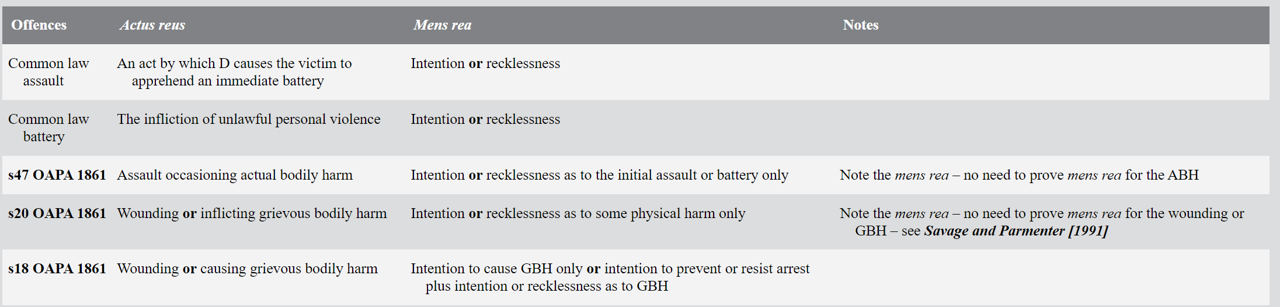
NFAOAP – Recap from lecture

Slide 14
Consent in relation to offences against the person

Slide 15
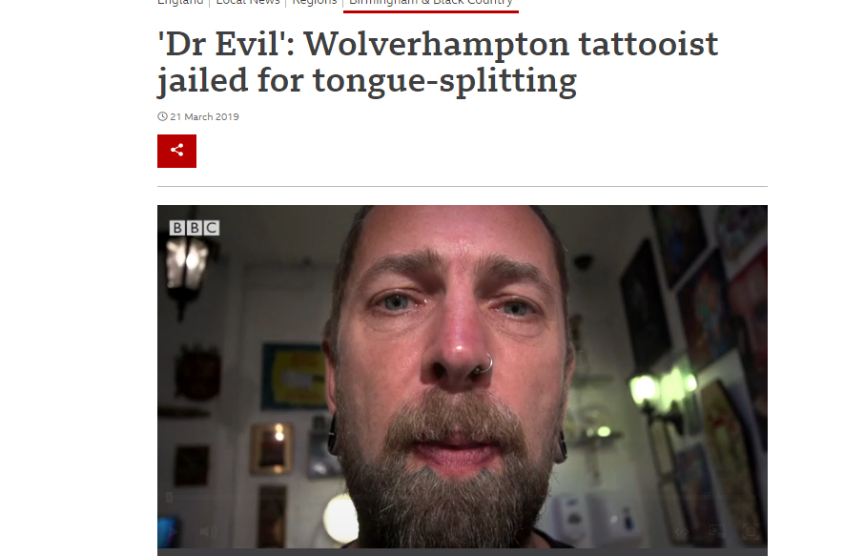
'Dr Evil' tattooist jailed for more than three years for carrying out ear and nipple removals
Notes:
https://www.bbc.co.uk/news/uk-england-birmingham-47658303
This case illustrates an important point when considering the defence of consent; it is generally unavailable to any offence against the person that results in bodily harm. As will be seen, there are many exceptions to this general rule, but agreeing to be wounded for body modification is not one of them.

Slide 16
CONSENT
In relation to offences against the person, to establish the defence it must be shown that:
The person consenting was able to consent (capacity)
Consent was actually given
The consent given was valid ( a true consent)

Slide 17
General rules on consent
Brown [1993] sets out the general rules on whether consent can be used as a defence to non-fatal offences.
Consent can be a defence to assault or battery which does not involve ABH or greater harm;
Consent is not a defence in situations where D causes V ABH or greater harm, unless one of the exceptions (discussed on the next slide) apply.
Notes:
In effect what this means is that generally consent is not available to offences under ss18, 20 or 47 OAPA 1861.

Slide 18
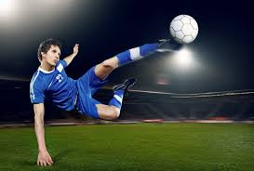

CONSENT
GENERAL RULE: V CANNOT CONSENT TO ANY INJURY WHICH AMOUNTS TO ABH OR WORSE
EXCEPTIONS: In certain circumstances, consent can be a defence even when injury is caused.
Sporting activity
Medical treatment
Religious purposes
Therapeutic purposes
Cosmetic purposes

Slide 19
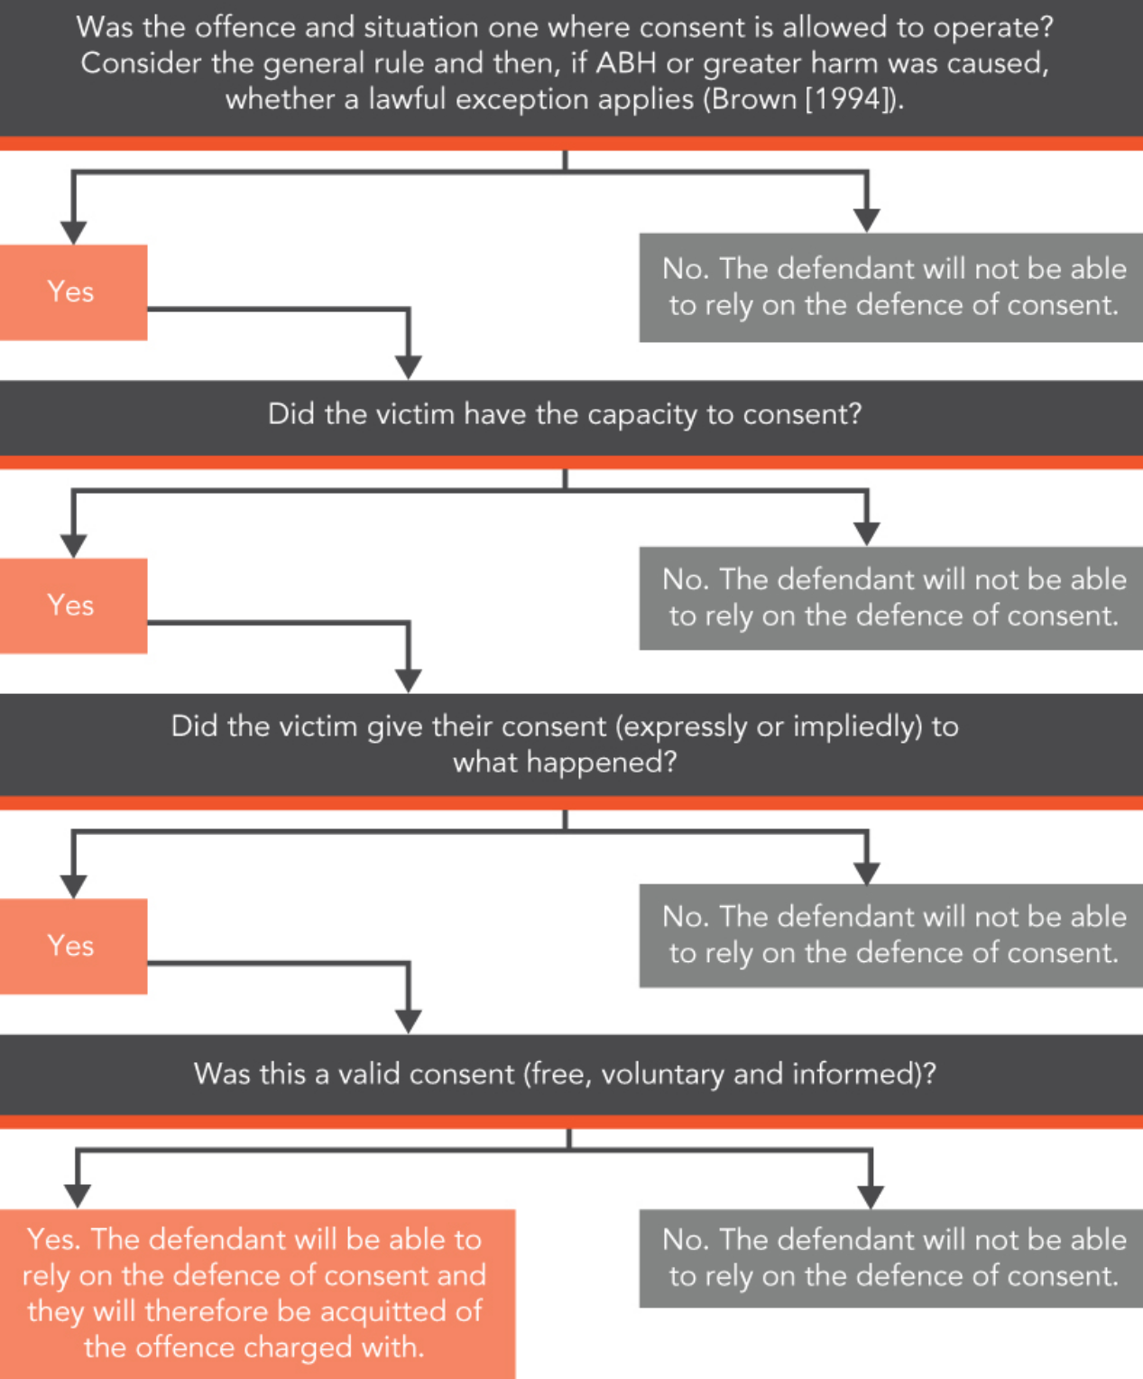

Slide 20
What is wrong with the current law?
Outdated
The structure of OAPA 1861 is unsatisfactory
For example, the maximum penalty for both s20 and 47 is five years imprisonment, even though s20 is seen as much more serious offence.
- OAPA 1861 uses different words in different sections

Slide 21

Is there a need for reform?

Slide 22
Draft Bill 1998
Proposed:
A logical hierarchy of violent offences in plain English
However, it also replicates the defect in the present law of the gap between lowest level offence and ABH.
Notes:
The Home Office’s 1998 draft bill proposed a logical hierarchy of offences of violence in plain English, which would have been a great improvement on the present law.
However, it also replicates one of the defects of the present law: there is a huge gap between the lowest level offence (currently common assault; maximum 6 months) and the next one up assault occasioning actual bodily harm (ABH); maximum 5 years.
One way in which the 1998 draft bill changes the law from the 1861 Act, rather than just simplifying and reforming it, is by expanding the offence of threats to kill to also include threats to cause serious injury.

Slide 23
Law Commission report 2015
OPTION 1: Charging the lowest level offence, which guarantees fast and cheap trial in magistrates’ court but would not appropriately label the offender as someone who has caused actual injury
OPTION 2: Charging an offence which reflects the harm caused, but risks the Crown Court trial. This is considerably more expensive, and unnecessary in the less serious cases.
AGGRAVATED ASSAULT
Notes:
A lot of offences against the person in practice, involve relatively low levels of injury being caused.
In such cases, prosecutors have a choice:
OPTION 1: Charging the lowest level offence, which guarantees fast and cheap trial in magistrates’ court but would not appropriately label the offender as someone who has caused actual injury
OPTION 2: Charging an offence which reflects the harm caused, but risks the Crown Court trial. This is considerably more expensive, and unnecessary in the less serious cases.
The Law Commission recommends adding in a new summary-only offence of aggravated assault. This would be triable only in a magistrates court and carry a maximum sentence of 12 months. The new offence would appropriately label those who do more than mere assault, since they cause injury, but who don’t deserve a sentence of more than 12 months.

Slide 24

Summary

