Slide 1
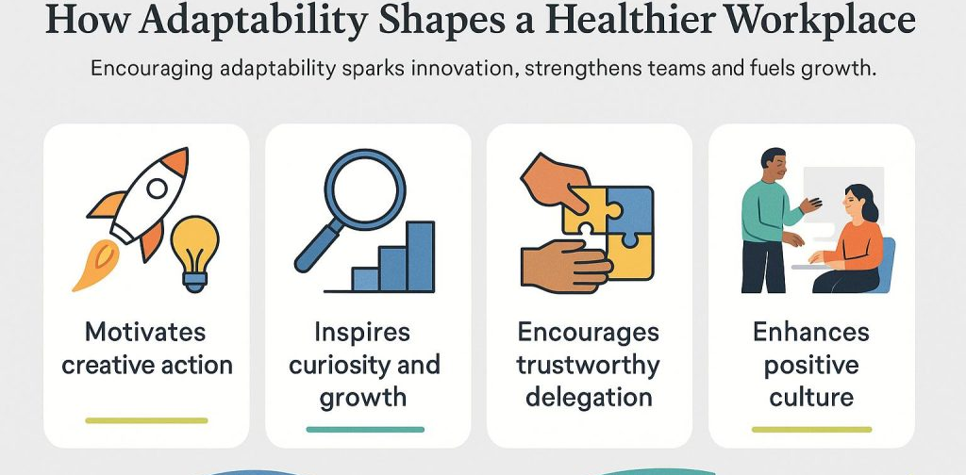
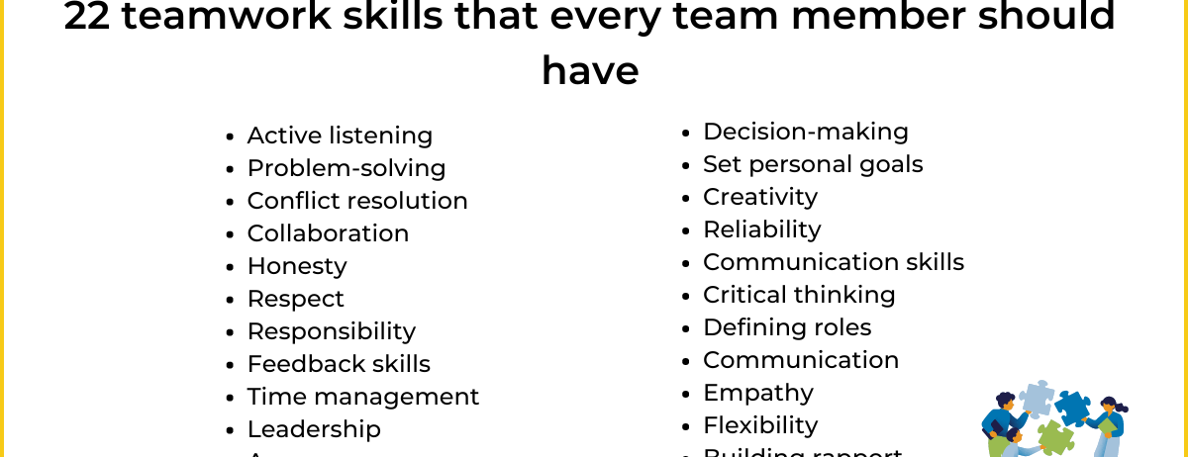
Collaborative Learning Builds Global Adaptability
Collaborative Learning is an opportunity to develop flexibility, adaptability and perspective taking, all essential skills needed for working in a rapidly changing global business environment that brings with it many different perspectives. (Supena, Darmuki and Hariyadi, 2021).
Working as a member of a collaborative team helps prepare learners to deal with unpredictable circumstances and work together to achieve common goals. (Lipponen, 2023).

Slide 2

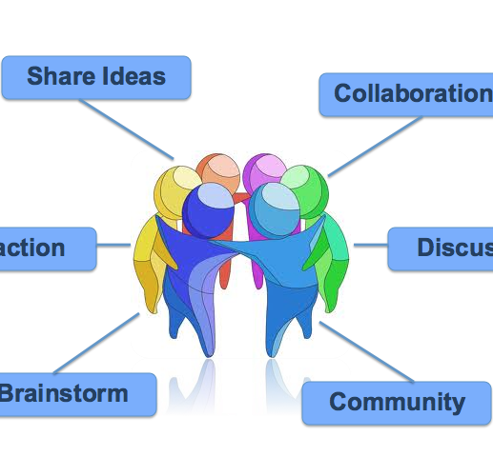
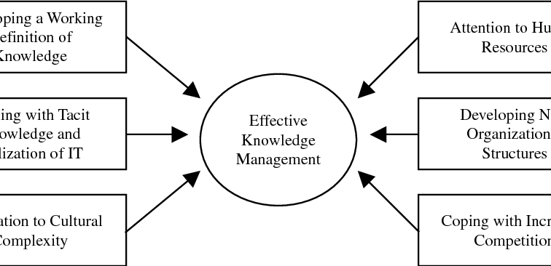
Knowledge Sharing as a Competitive Global Asset
Collaborative Learning promotes knowledge sharing, which is increasingly important to achieve competitive advantage by utilising the knowledge assets of global companies by enabling the sharing of knowledge to maintain innovation and competitiveness. (Nonaka and Takeuchi, 1995).
Global Collaboration is about accelerating collective intelligence, because of effectively collaborating with others, thereby providing greater response to Global Business Challenges. (Singh, 2009).

Slide 3



Technology Strengthens Global Collaboration
Smart learning environments and digital tools assist learners to develop the skills necessary to participate in global remote teams such as coordination, negotiation and synchronous/asynchronous communication. (Cheung et al., 2021).
Utilising data to analyse collaborative learning behavior assists in improving team performance and providing for scalable collaborative models in global organisations. (Yan et al., 2025).

Slide 4



Cognitive and Social Gains for Global Workforces
Collaborative Learning fosters the development of higher order thinking and creates the ability to analyse and create in complex global markets. (Xu et al., 2023).
By participating in group interactions, learners develop social presence and emotional intelligence, which are essential to communication in multicultural settings. (Crompton, Wolters and MacPherson, 2022).

Slide 5

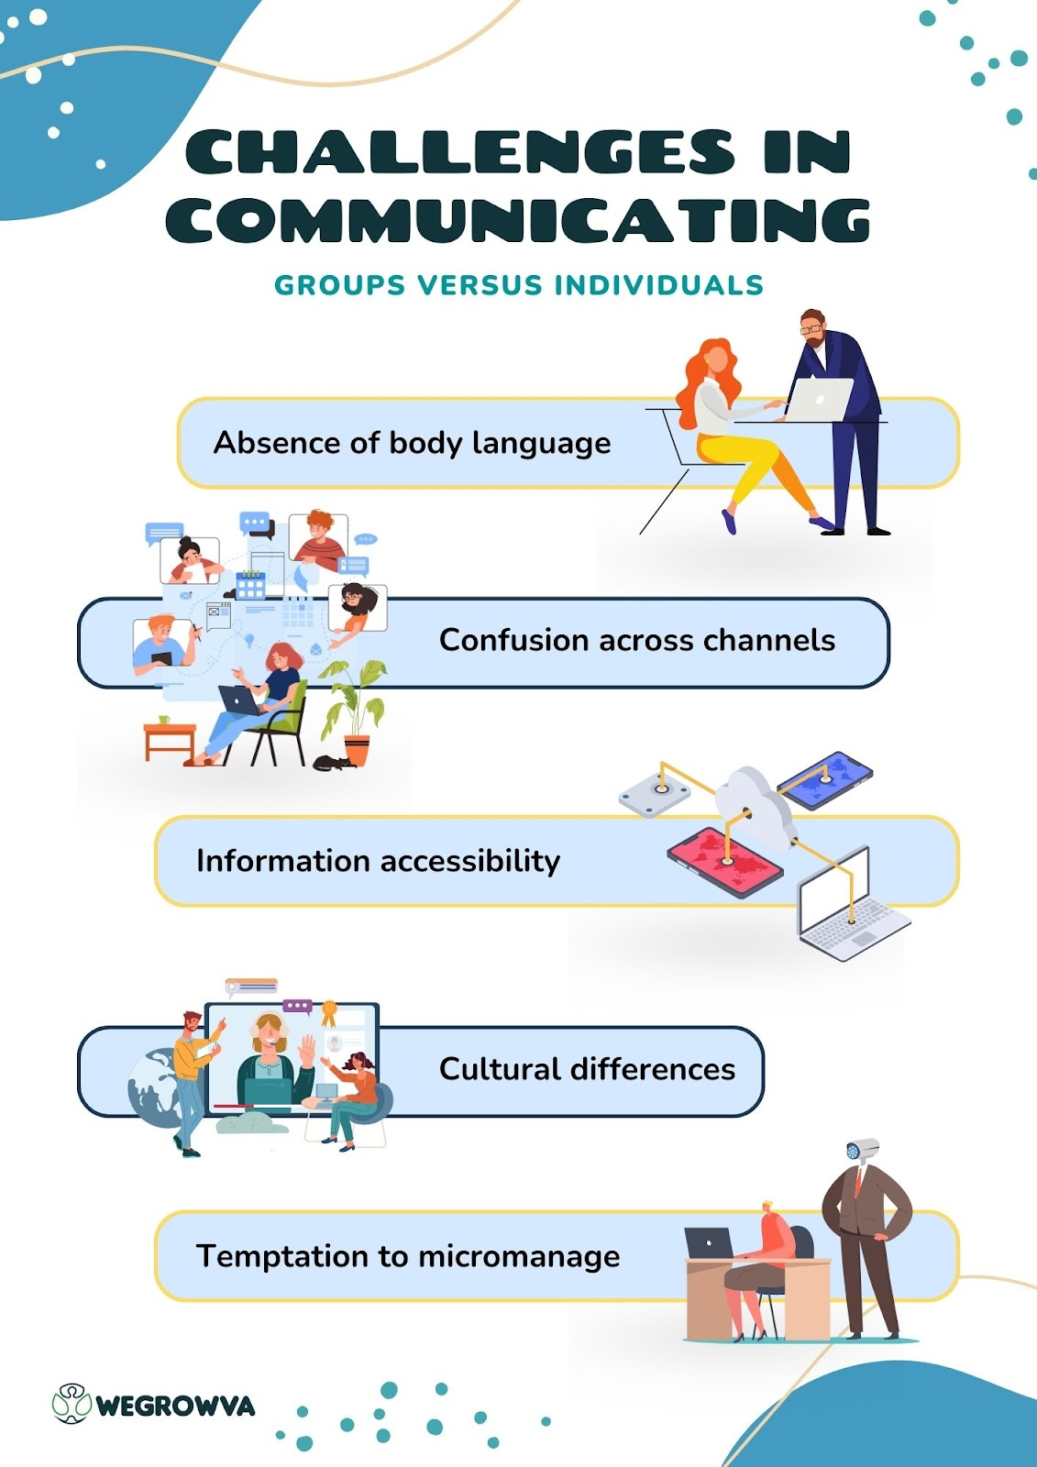

Challenges in Global Collaborative Environments
Global Collaborative work challenges include cultural misinterpretations, unequal participation and delayed communication, challenges that are magnified in a global business team. (Knoche, 2022).
By addressing the above challenges through structured role definitions and clear collaboration protocols global teams can be made more effective. (Boud, Cohen and Sampson, 1999).

Slide 6

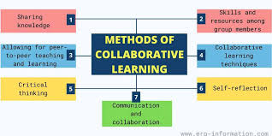

Preparing Global Leaders Through Collaboration
Collaborative Learning develops the key leadership qualities e.g., negotiating, active listening and group coordination that are required to manage international diverse teams. (Lee and Bonk, 2014).
Allowing learners to become engaged in the shared decision-making process builds confidence and competence in the leadership role within a global setting. (Stahl, 2006).

Slide 7
References
Boud, D., Cohen, R., & Sampson, J. (1999). Peer learning and assessment. Assessment & Evaluation in Higher Education, 24(4), 413–426.
Cheung, S. K., Kwok, L. F., Phusavat, K., & Yang, H. H. (2021). Shaping the future learning environments with smart elements: Challenges and opportunities. International Journal of Educational Technology in Higher Education, 18(1), 16.
Crompton, C. J., Wolters, M. K., & MacPherson, S. E. (2022). Learning with friends and strangers: Partner familiarity does not improve collaborative learning performance in younger and older adults. Memory, 30(5), 636–649.
Knoche, H. T. (2022). Thinking about cooperative learning: The impacts of epistemic motives and social structure on cooperative learning environments. International Journal of Management Education, 20(2), 100643.
Lee, H., & Bonk, C. J. (2014). Collaborative learning in the workplace: Practical issues and concerns. International Journal of Advanced Corporate Learning, 7(2), 10–17.
Lipponen, L. (2023). Exploring foundations for computer-supported collaborative learning. In Computer Support for Collaborative Learning (pp. 72–81). Routledge.
Nonaka, I., & Takeuchi, H. (1995). The knowledge-creating company: How Japanese companies create the dynamics of innovation. Oxford University Press.
Singh, P. J. (2009). The nature and effectiveness of collaboration between firms, customers and suppliers. Supply Chain Management, 14(3), 189–200.
Stahl, G. (2006). Group cognition: Computer support for building collaborative knowledge. MIT Press.
Supena, I., Darmuki, A., & Hariyadi, A. (2021). The influence of 4C learning model on students’ learning outcomes. International Journal of Instruction, 14(3), 873–892.
Xu, E., Wang, W., & Wang, Q. (2023). The effectiveness of collaborative problem solving in promoting students’ critical thinking: A meta-analysis. Humanities and Social Sciences Communications, 10(1), Article 1.
Yan, L., Gasevic, D., Echeverria, V., Jin, Y., Zhao, L., & Martinez-Maldonado, R. (2025). Integrating latent class analysis to uncover multimodal learning patterns in collaborative learning. LAK Conference Proceedings.
Yang, X. (2023). A historical review of collaborative learning and cooperative learning. TechTrends, 67(4), 718–728.

