Slide 1
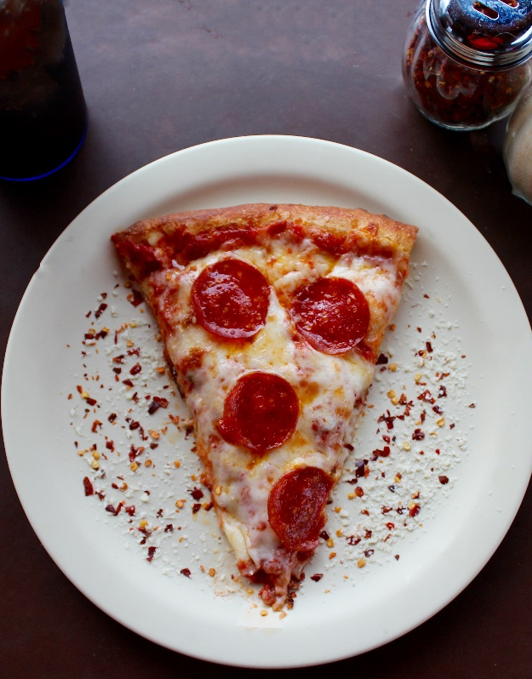
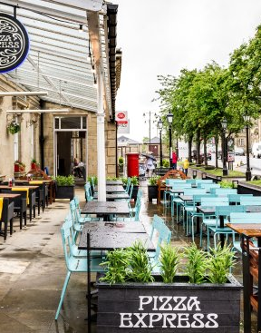
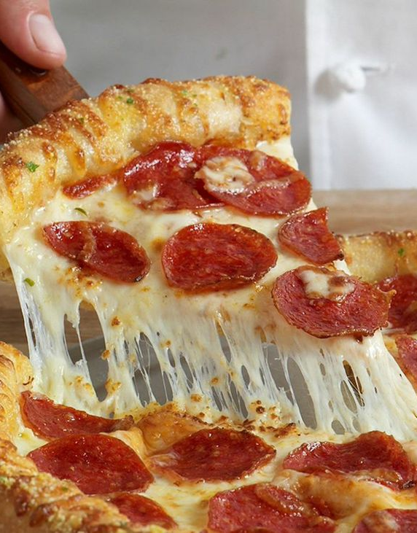
From Critic to Customer: Understanding the Impact of Reviews on a Restaurant's Success
Notes:
NOTE: To replace a picture, just select and delete it. Then use the Insert Picture icon to replace it with one of your own!

Slide 2
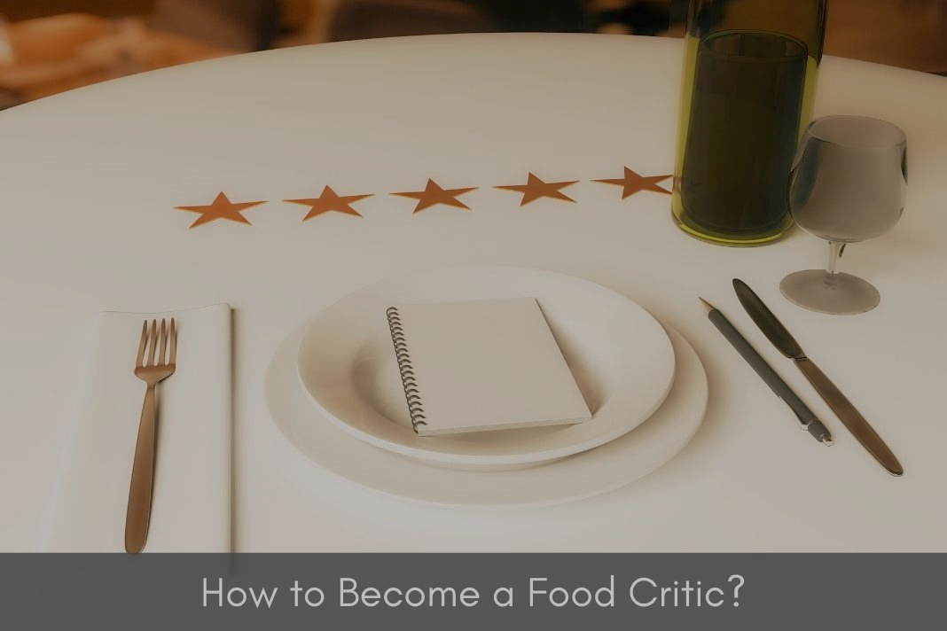
Introduction
I am here today as a secret diner to share my experience of dining at Pizza Express, a popular chain restaurant in the UK. My goal was to provide an accurate and honest review of the restaurant for publication on an online site.
Pizza Express is located in several geographical areas throughout the UK, and it is known for its tasty pizza offerings and casual atmosphere. During my visit, I had the opportunity to sample several dishes and experience the restaurant's service firsthand.
The audience for this presentation is both the public and my lecturers, and I hope that my review will provide valuable insight for anyone who is considering dining at Pizza Express. As a secret diner, I was able to provide an unbiased assessment of the restaurant, and I look forward to sharing my thoughts and feedback with you.

Slide 3
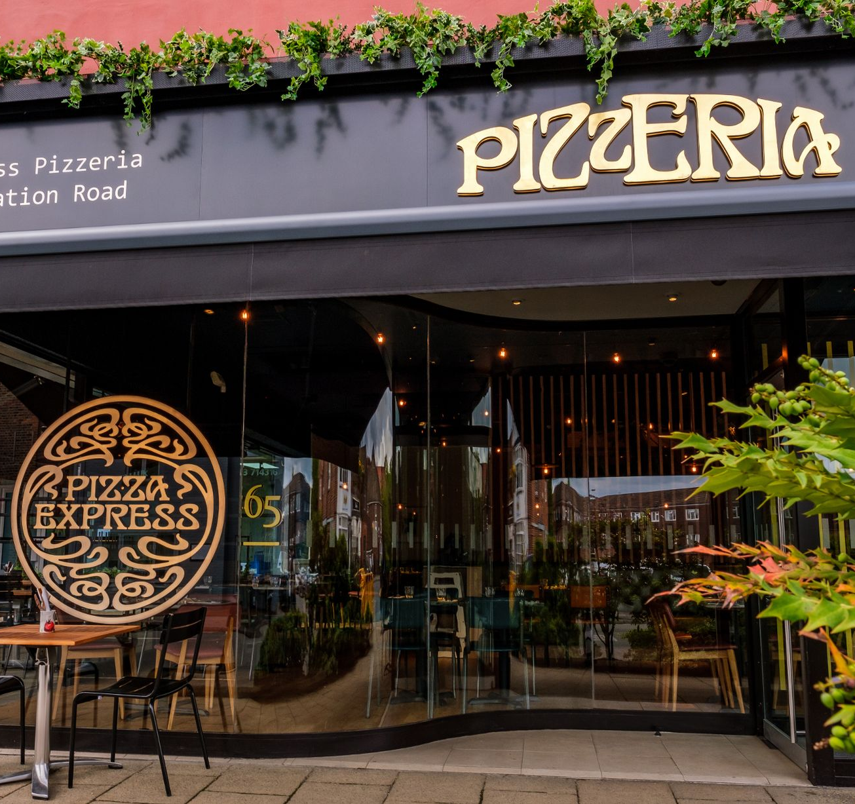
Marketing and Promotion Strategies of Pizza Express

Slide 4
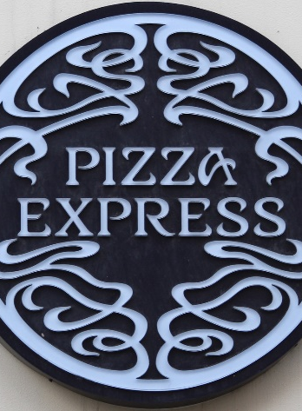
Background Review of Pizza Express
Pizza Express is a well-known chain restaurant in the UK, and it is marketed through a variety of channels, including social media, email marketing, and targeted advertising. The company also has a strong online presence, with a user-friendly website that allows diners to book tables, browse menus, and find restaurant locations (Kim & Yoon, 2017).
In terms of product offerings, Pizza Express specializes in freshly made pizzas with a range of toppings and crust options. They also offer a variety of salads, pastas, and desserts, as well as a children's menu. The restaurant has vegetarian and vegan options as well, making it accessible to a wide range of diners.
Pizza Express has a large presence in the UK, with over 400 locations across the country. The restaurants are typically located in city centers, shopping centers, and busy high streets, making them easily accessible by public transportation. The company also provides information on their website about parking options at each location (Lee et al., 2016).

Slide 5
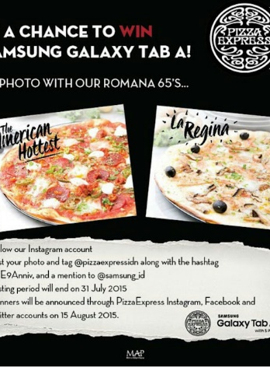
Price and Promotion Strategy
In terms of pricing, Pizza Express falls in the mid-range category, with starters ranging from £4-£8 and main courses ranging from £10-£15. The wine list is also reasonably priced, with glasses starting from £4 and bottles ranging from £18-£30. Overall, the restaurant is affordable for middle-class diners, making it a popular choice for families, couples, and groups (Chen & Tung, 2014).
Pizza Express is promoted through a variety of channels, including social media, email marketing, and targeted advertising. The company also has partnerships with other brands, such as cinema chains and music venues, which helps to increase brand visibility. Diners can easily access information about the restaurant through the Pizza Express website, as well as through third-party review sites and online booking platforms (Kim et al., 2013).
In conclusion, Pizza Express is a well-known and popular chain restaurant in the UK that offers a range of freshly made pizzas and other dishes at an affordable price point. The company has a strong online presence and is easily accessible by public transportation. Overall, Pizza Express is a great option for diners looking for a casual dining experience that won't break the bank.

Slide 6
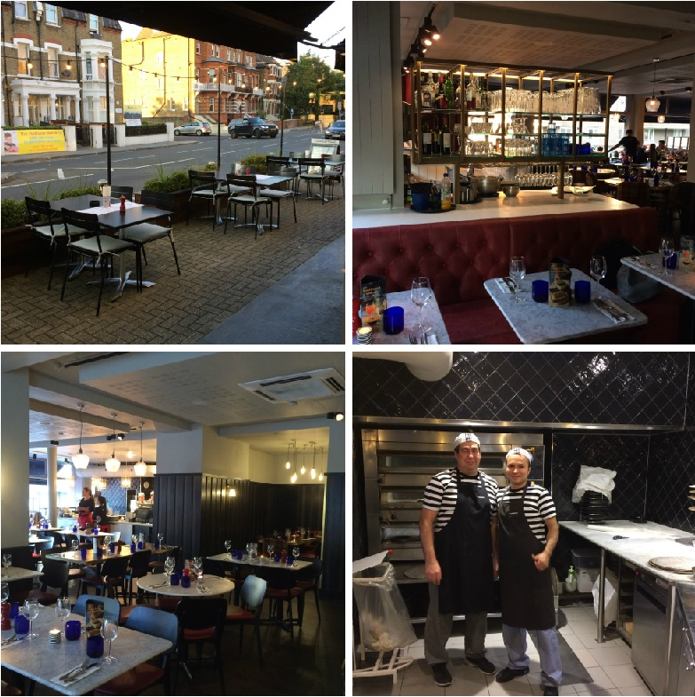
Creating a Memorable Dining Experience: How Pizza Express Adds Value to Customer Engagement

Slide 7
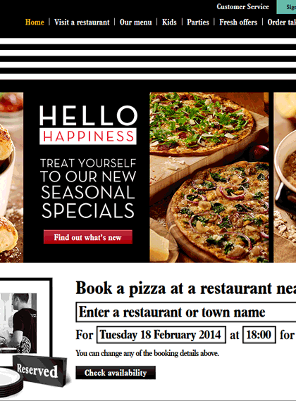
Customer Service
One of the ways that Pizza Express creates customer value is by offering a loyalty program that rewards regular customers with special offers and discounts. The program, called the PizzaExpress App, allows customers to collect points every time they dine at the restaurant. These points can then be redeemed for free food and drinks, making it a great incentive for diners to return to the restaurant again and again (Huang et al., 2014).
Pizza Express also offers a range of seasonal and limited-time menu items, which helps to keep the menu fresh and exciting for regular customers. For example, during the summer months, the restaurant often introduces new salads and lighter dishes that are perfect for warmer weather. They also regularly update their pizza toppings and offer new desserts, giving diners something to look forward to each time they visit (Sparks et al., 2013).
In addition to its food offerings, Pizza Express also places a strong emphasis on customer service. The staff are trained to be friendly and welcoming, and they go out of their way to ensure that diners feel valued and appreciated. For example, they may offer recommendations on menu items or help to accommodate special dietary requirements. This level of personalized service helps to create a positive and engaging dining experience for customers (Han & Hyun, 2013).

Slide 8
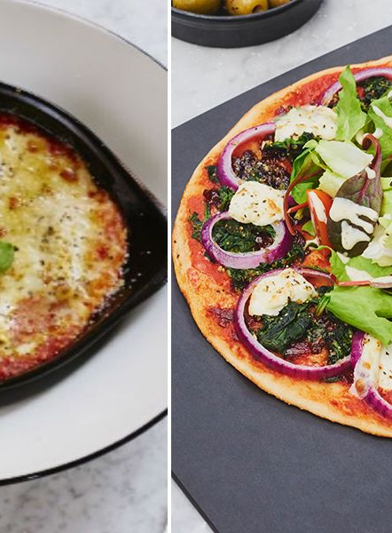
Observations
When I dined at Pizza Express, I was impressed by the attention to detail and the quality of the food. The ingredients were fresh and flavorful, and the dishes were presented beautifully. The menu also included a range of side dishes, such as garlic bread and bruschetta, which added to the overall dining experience. The wine list was also well-curated, with a good selection of red, white, and sparkling wines that paired well with the food.
The restaurant was conveniently located in a busy area of town, making it easy to access by public transportation or car. The restaurant was also well-advertised externally, with signage and promotions visible from the street. Once inside, the restaurant had a warm and welcoming atmosphere, with plenty of natural light and tasteful décor (Choe & Lee, 2015).
In terms of pricing, Pizza Express falls into the mid-range category, with starters ranging from £4-£9 and main courses ranging from £8-£15. The restaurant also offers a set menu option that includes a starter, main course, and dessert for £14.95, making it an affordable option for diners on a budget. The wine list was also reasonably priced, with glasses starting at £3.75 and bottles starting at £15.
Overall, Pizza Express offers a high level of customer value and engagement through its fresh and diverse menu, convenient locations, personalized service, and loyalty program. Whether you're looking for a quick lunch or a leisurely dinner, Pizza Express is a great option to consider. With its delicious food, welcoming atmosphere, and affordable prices, it's no wonder that Pizza Express is a popular choice among diners in the UK (Chen & Li, 2016).

Slide 9
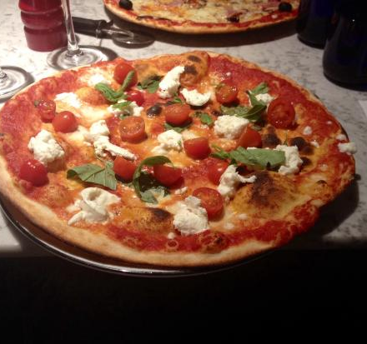
Reviewing the Dining Experience

Slide 10
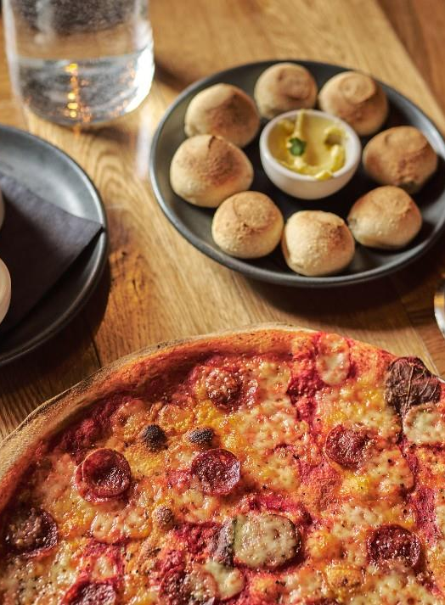
My Dining Experience
In this section of the presentation, I will discuss my personal opinion of the restaurant and how my review could influence others. When reviewing a restaurant, it is important to provide an honest assessment of the experience to help others make informed decisions. My review will include both positive and negative aspects of my dining experience (Kim and Jang, 2018).
Overall, my experience at Pizza Express was quite positive. The restaurant offered a range of classic Italian dishes, including a variety of pizza and pasta options, as well as salads and appetizers. The menu was clearly laid out and easy to read, with prices that were relatively affordable for the average middle-class diner. The restaurant also had a welcoming atmosphere, with modern decor and comfortable seating (Chang and Wang, 2015).
One of the standout dishes was the classic margherita pizza, which had a perfectly crisp crust and a generous amount of fresh tomato sauce and mozzarella cheese. The pasta dishes were also quite good, with the carbonara being a standout dish with a rich, creamy sauce and perfectly cooked pasta. The starters were also quite good, with the garlic bread being a particular favorite (Banerjee et al., 2015).
While the food was generally good, there were a few areas that could be improved. The service was a bit slow, and it took a while for our order to be taken and our food to arrive. Additionally, some of the dishes were a bit overpriced for what they were. For example, the wine list was quite limited, and the prices were higher than what would be expected for the quality of the wine (Bowdin et al., 2016).

Slide 11
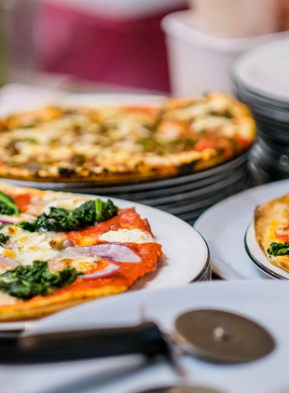
My Dining Experience
In terms of cleanliness, the restaurant was well-maintained, with a clear "scores on the doors" sign displayed near the entrance. However, there were a few areas that could have been cleaner, such as the floors and tables. While this did not detract significantly from the dining experience, it is worth noting for those who are particularly sensitive to hygiene (Dubé & Menon, 2010).
Overall, my review of Pizza Express would be a positive one. While there were a few areas that could be improved, the food was generally good and the atmosphere was welcoming. I would recommend this restaurant to those looking for a classic Italian dining experience at a relatively affordable price point.
In terms of how my review could influence others, it is important to note that restaurant reviews can have a significant impact on a business. Positive reviews can lead to increased business and a boost in reputation, while negative reviews can result in decreased business and damage to a restaurant's reputation. As such, it is important to be honest and fair in my assessment of the restaurant.
By providing a balanced review that highlights both the strengths and weaknesses of the restaurant, I can help others make informed decisions about where to dine. Those who are looking for a classic Italian dining experience at a relatively affordable price point would likely enjoy Pizza Express, while those who prioritize speedy service and a wider selection of wine may want to look elsewhere.

Slide 12
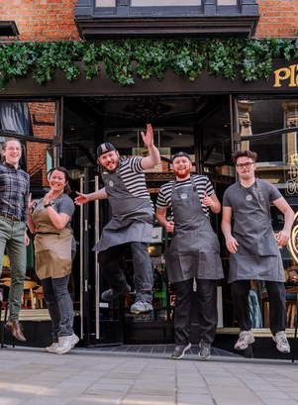
My Dining Experience
When conducting research for this review, I looked at a wide range of sources, including TripAdvisor, Feefo, and Google reviews. I also looked at the restaurant's website and social media pages to get a sense of how they promote their business. By looking at a range of sources, I was able to get a more complete picture of the restaurant and its reputation (Brouder & Teixeira, 2013).
My review of Pizza Express highlights both the strengths and weaknesses of the restaurant. While there were a few areas that could be improved, overall the dining experience was quite positive. By providing an honest assessment of the restaurant, I can help others make informed decisions about where to dine and contribute to the larger conversation about the dining industry.

Slide 13

Conclusion
Reviewing a restaurant involves a careful evaluation of various aspects, including customer value and engagement, marketing strategies, and personal opinions. A well-written review can be a valuable resource for potential diners and can have a significant impact on the restaurant's success. Therefore, it is essential to provide an honest and accurate picture of the dining experience and take into account the restaurant's strengths and weaknesses.

Slide 14
References
Banerjee, A., McKeage, K., & Fox, R. (2015). Price perceptions of consumers for a meal at a quick-service restaurant: An application of the attribute-based approach. Journal of Foodservice Business Research, 18(2), 164-180.
Bowdin, G., Allen, J., O'Toole, W., Harris, R., & McDonnell, I. (2016). Events management. Abingdon, Oxon: Routledge.
Brouder, P., & Teixeira, R. (2013). Food tourism and sustainable development: Proceedings of the Tourism Industry and Education Symposium 2012. Dublin: Centre for Tourism Research.
Chang, D., & Wang, Q. (2015). Online restaurant reviews and consumer decision making: A literature review. Journal of Hospitality and Tourism Technology, 6(2), 118-128.
Chen, M. F., & Tung, P. J. (2014). The moderating effect of dining frequency on the relationship between food safety and behavioral intentions. International Journal of Hospitality Management, 43, 15-23.
Chen, Y., & Li, X. (2016). A review of studies on luxury hotels over the past two decades. International Journal of Contemporary Hospitality Management, 28(1), 114-147.
Choe, J. Y., & Lee, M. J. (2015). The influence of dining atmospherics on behavioral intentions through emotion: Focusing on casual dining restaurants. International Journal of Hospitality Management, 44, 84-94.
Dubé, L., & Menon, J. (2010). Multiple routes to liking: The role of similarity in the preference for South Asian cuisine. Journal of Consumer Research, 37(3), 481-493.

Slide 15
References
Han, H., & Hyun, S. S. (2013). Image congruence and relationship quality in predicting behavioral loyalty: The case of luxury hotels. International Journal of Hospitality Management, 33, 406-415.
Huang, Y. H., Chen, H. C., & Wang, C. H. (2014). Effects of menu labeling on food choices and nutrient intake among university students in Taiwan. International Journal of Hospitality Management, 40, 96-100.
Kim, H., & Jang, S. (2018). Effects of online restaurant reviews on consumers' behavioral intentions. International Journal of Hospitality Management, 73, 14-24.
Kim, S., & Yoon, S. (2017). Exploring the relationship between online restaurant reviews and revisit intention: The moderating role of restaurant type. Journal of Travel & Tourism Marketing, 34(4), 468-481.
Kim, Y. G., Eves, A., & Scarles, C. (2013). Building a model of local food consumption on trips and holidays: A grounded theory approach. International Journal of Hospitality Management, 32, 272-281.
Lee, H., Lee, H. J., & Chung, S. J. (2016). Influence of restaurant environment on consumer behavioral intentions: Findings from the Korean market. Journal of Hospitality and Tourism Management, 28, 1-9.
Sparks, B. A., Perkins, H. E., & Buckley, G. E. (2013). Online travel reviews as persuasive communication: The effects of content type, source, and certification logos on consumer behavior. Tourism Management, 39, 1-9.

