Slide 1



Literacy
Children, Young People & the media

Slide 2

Contents
This week…..
We are going to look at what it means to be media literate and it’s growing importance.
Defining Media Literacy
“The ability to access, analyse, evaluate and communicate messages in a wide variety of forms”
(Aufderheide 1992)

Slide 3
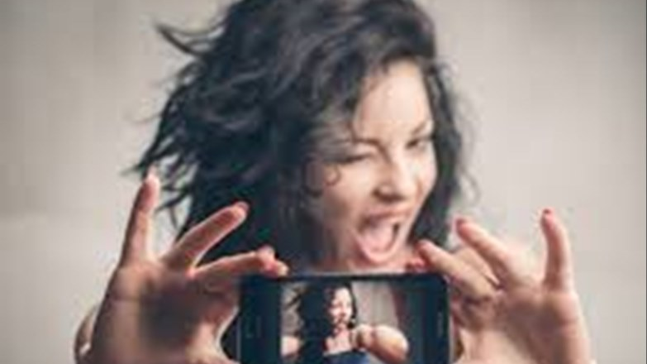
Further Definitions
According to Silverblatt (2013)
Media Literacy incorporates:
Critical thinking skill that is applied to
source of much of our information
the channels used for mass communication
Furnishing individuals with the tools to make
independent choices
Furnishing insight into the impact of various
contexts on the construction of media and its’ messages

Slide 4
Important Literacy concepts
Understanding the process of mass communication
An awareness of the impact of the media on the individual and society
An awareness of media content as a “text” that provides insight into our contemporary culture and ourselves
The development of strategies with which to analyse and discuss media messages
In the case of media communicators: the ability to produce effective and responsible media messages

Slide 5
Challenges
The cultivation of enhanced enjoyment, understanding, and appreciation of media content
The ability to comprehend, interpret and construct messages, using the different “languages” of media
Anticipating changes in the media landscape

Slide 6
Traditional v Digital
There is an argument that children and young people need to be media literate for all forms of media
In the UK we have strict codes of contact when it comes to advertising to children however there have been numerous calls to ban advertising to children under 11 completely.

Slide 7
Applicability and Enforcing
What is the current approach to modern media
Is it possible to ban advertising to those under 11 ?
Given accessibility and ubiquity of digital media, is it possible to ban advertising ?
What is the reason for your answer ?

Slide 8
“Research has linked growing commercial pressures on children to higher rates of depression, lower self-esteem and to mental health problems but that it is very difficult to prove such a link.”
Source: J Kent, Leave our kids alone campaign

Slide 9
Theory
According to Malamuth, Linz and Yao (2005) “the internet provides “motivational”, “disinhibitory” and “opportunity” aspects that make it somewhat different from traditional media in terms of it’s potential impact”.
(Cited in Children, Adolescents and the media (2014) 3rd edition, pg403)

Slide 10
Motivational
Refers to the desire and drive to be online
  Always on
  Easy access
More opportunity for engagement
Has the ability to inspire increased learning ?

Slide 11
Disinhibitory
Content is largely unregulated
  Studies show that extreme forms of violent and/or sexual content are more prevalent on the internet
  Why is this the case ?
Participation can be private and anonymous
More difficult for parents/guardians to monitor.
  Consider generational divide here
  Barriers to monitoring ?

Slide 12
Opportunity
People are more reachable and available
  Social Media
  Video Games
In relation to cyberbullying and child sexual exploitation the identity of the perpetrator can be disguised.

Slide 13
The importance of media literacy
Needs parental/guardian support
Free and open conversations
Closing the participation gap between parents and children and young people
Parents need to consider their own digital foot prints and the ones they create for their children.

Slide 14

Resources for staying safe online
https://www.webwise.ie

Slide 15
Consider the following…
In the case of media communicators: the ability to produce effective and responsible media messages
How is this achieved ?

Slide 16
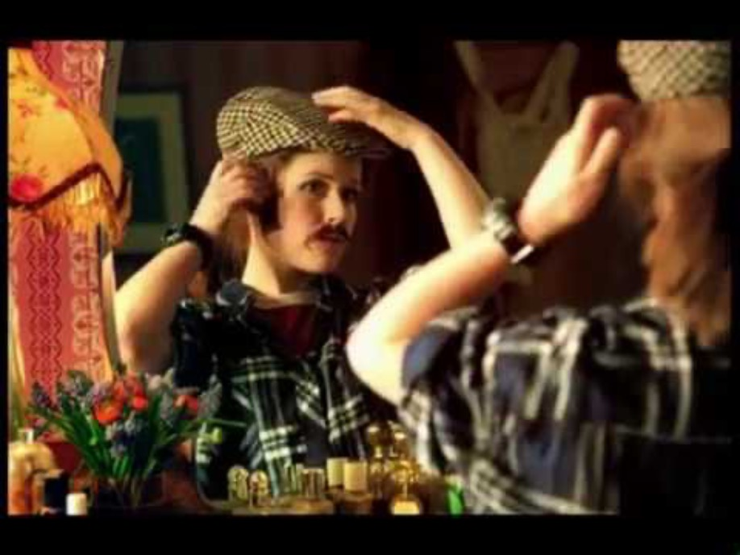
What is the message here
Consider this advert……

Slide 17

Educational Reinforcement
The Experiment…
What about the men?
https://www.youtube.com/watch?v=- _I17cK1ltY

Slide 18

The men ?

Slide 19
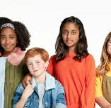
Dove Self-Esteem Project
What’s the point?
Discuss in groups your thoughts on the Dove campaign, consider:
The purpose
The impact of the campaign
The messages
Social responsibility

Slide 20

Responsible Advertising ?
#likeagirl
https://www.youtube.com/watch? v=XjJQBjWYDTs

Slide 21

Future Thoughts
Children’s Commissioner’s Growing Up
Digital Taskforce
“these interventions would give children and
young adults resilience, information and power,
and hence open up the internet to them as a
place where they can be citizens not just users,
creative but not addicted, open yet not
vulnerable to having their personal information
captured and monetised by companies”
https://www.youtube.com/watch?v=mq-BWUt2_t4&feature=youtu.be

Slide 22
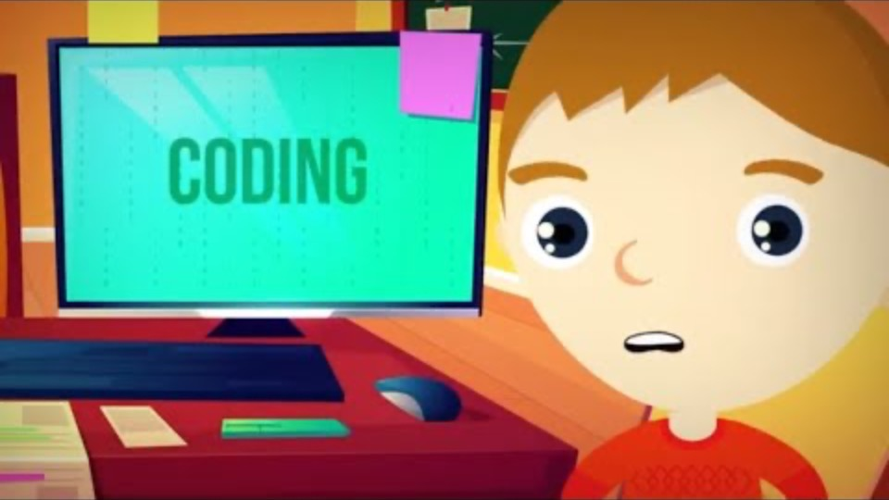
Further Future thoughts
Consider this…….

Slide 23
Personal Thoughts
For the previous video:
  Who is the advert aimed at ?
  What is the purpose for this video ?
  What impact is this likely to have ?
  How does this promote media literacy ?
  Is there a difference between this and older generations ?

Slide 24
Research
https://www.getsafeonline.org/safeguarding-children/
http://parentinfo.org/
http://wisekids.org.uk/wk/
http://www.internetmatters.org/
http://juniorachievementradio.com/86-empathy-dead/
http://micheleborba.com/

Slide 25
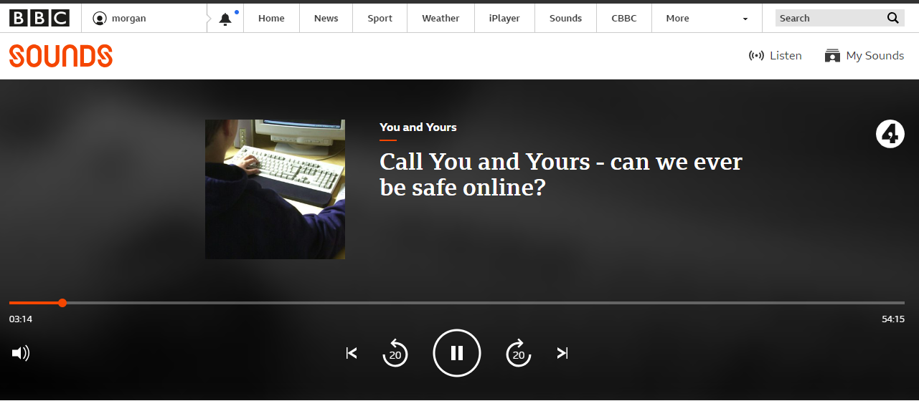
PLEASE ENSURE YOU LISTEN TO THIS DEBATE…
https://www.bbc.co.uk/sounds/play/b01qdvlm

Slide 26
Tasks for the week…..
…Familiarise yourself with the variety of social media platforms available.
This is of particular benefit to your second assignment !
What regulations are in place for young people ?
Read : - Growing up Digital – A report of the growing up Digital taskforce January 2017 – On moodle
Watch: - https://www.youtube.com/watch?v=feQJndK_z6o
Review: - https://www.bbc.co.uk/cbbc/curations/growing- up-digital

