Slide 1
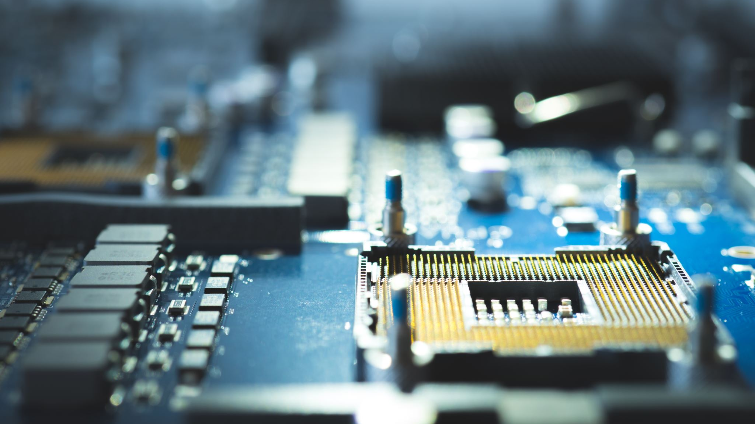
PC IN DA DESK
The boys

Slide 2
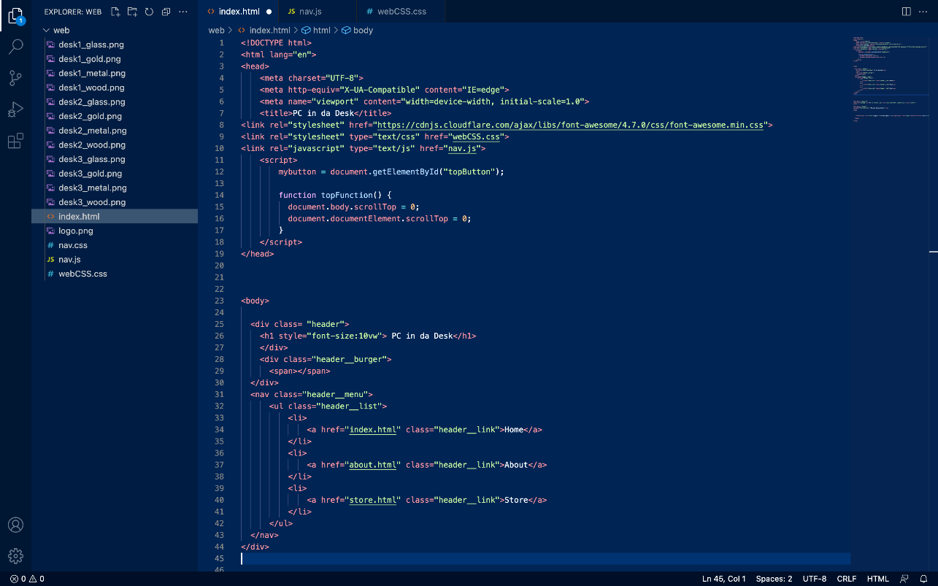
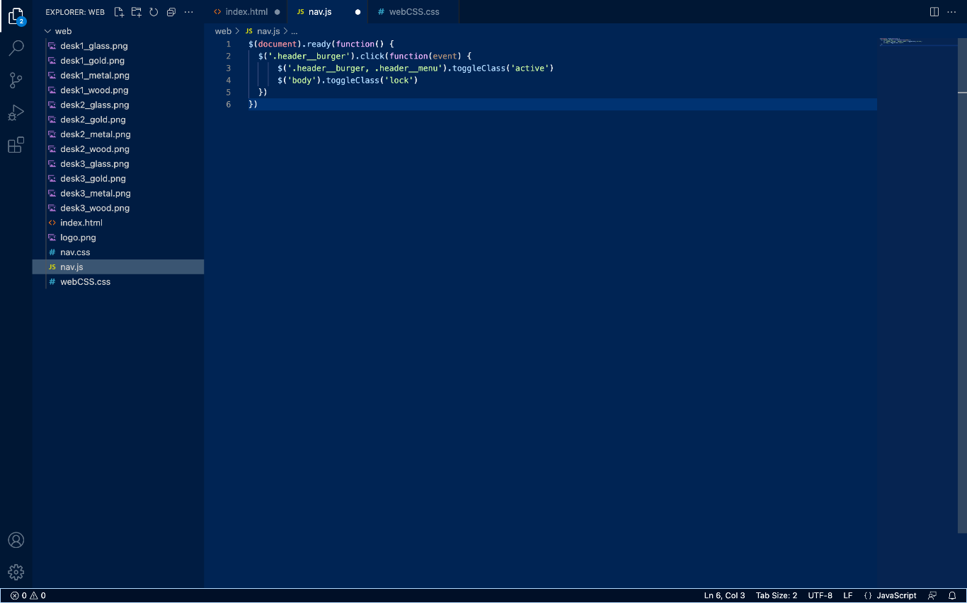
JS for responsive navigation bar
HTML file

Slide 3
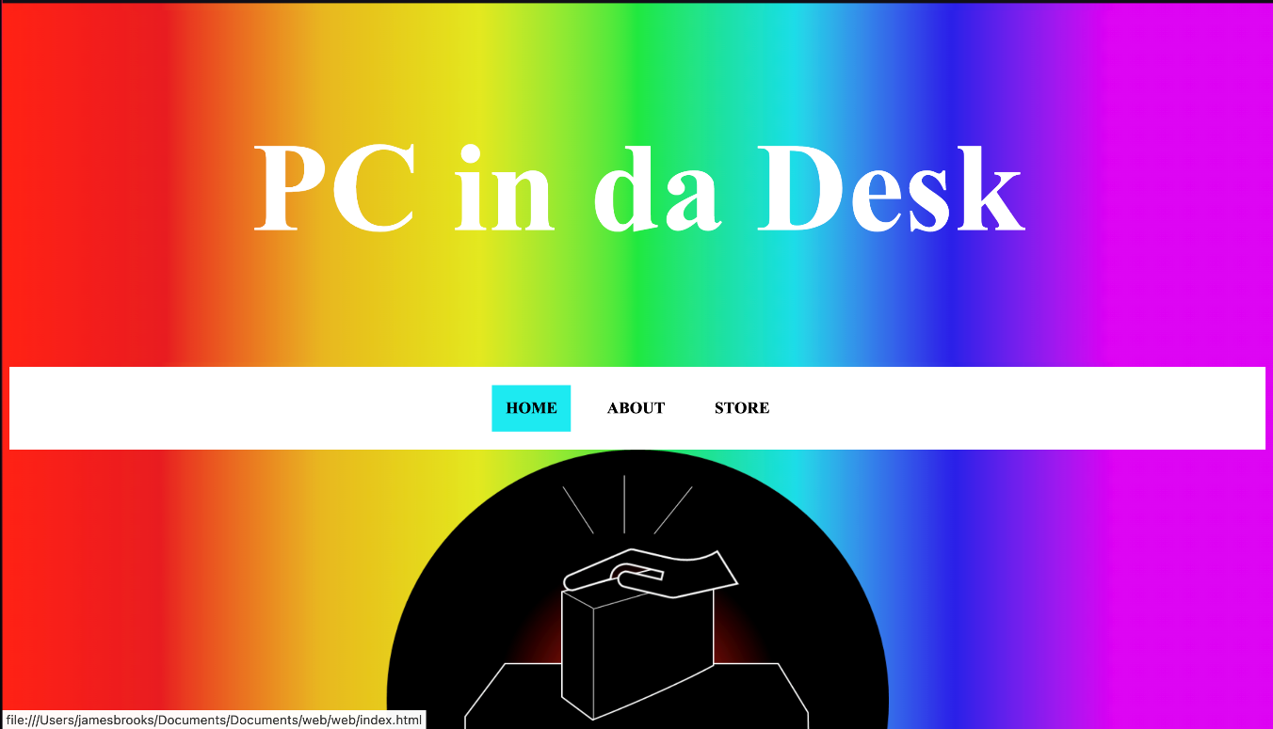
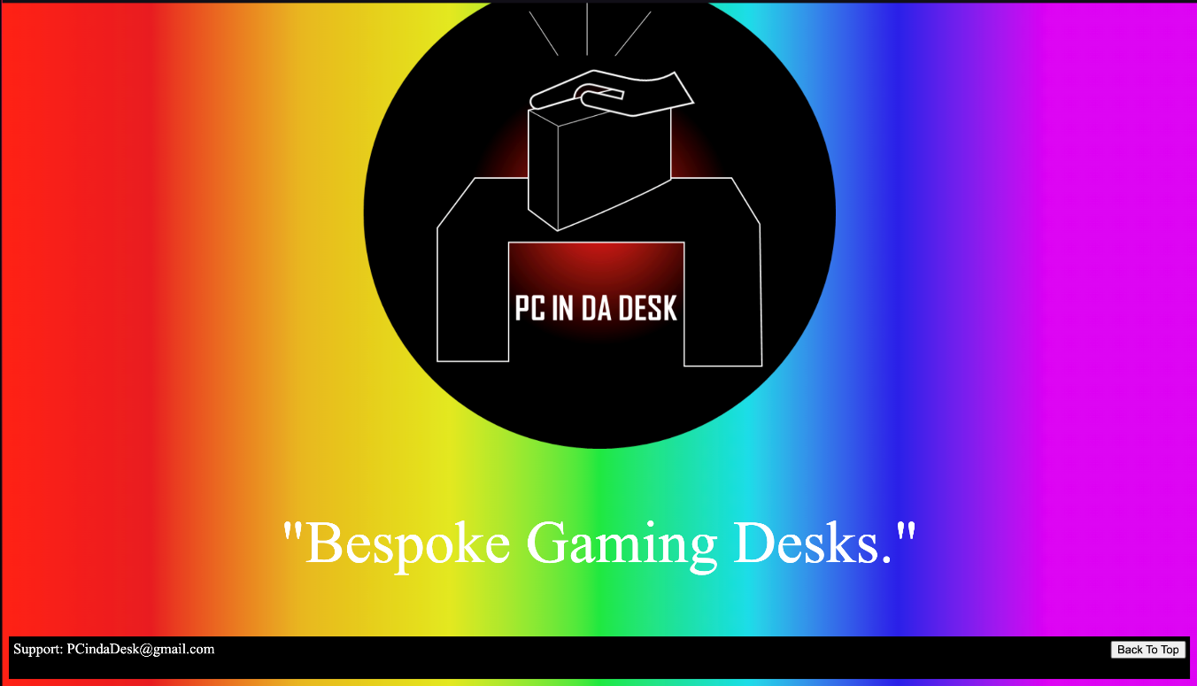
Development – Early Stages

Slide 4
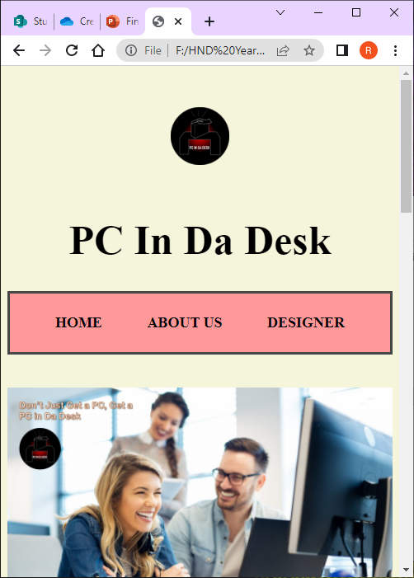
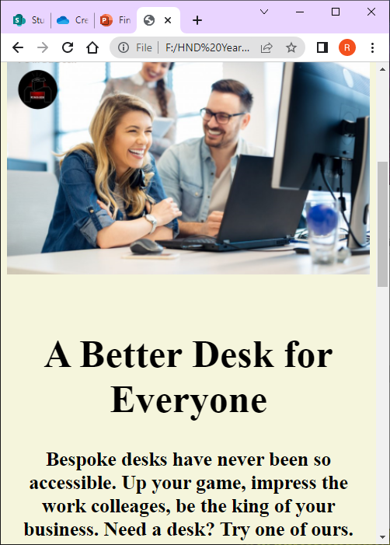
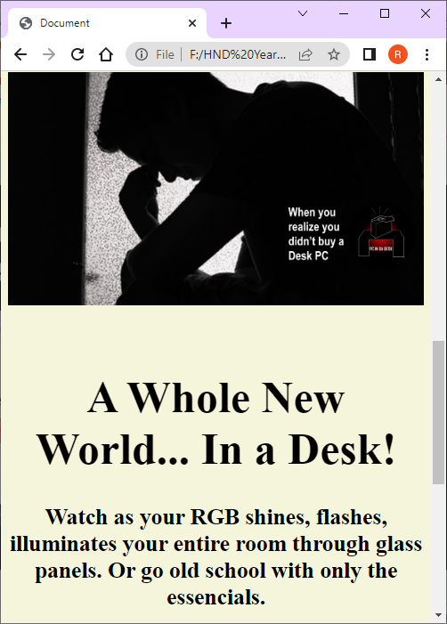
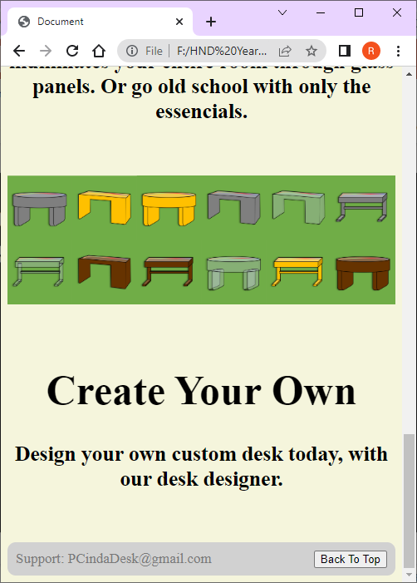
Demo – index page made by James, css by Sam, Designs by Rhys

Slide 5
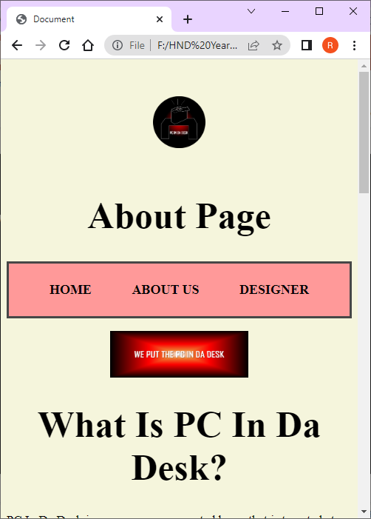
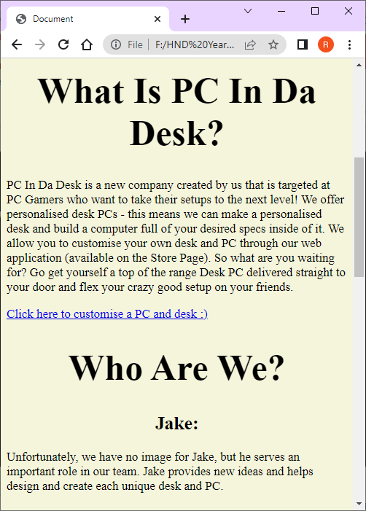
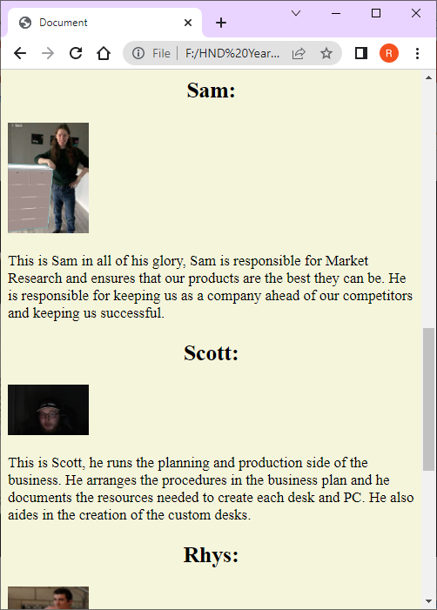
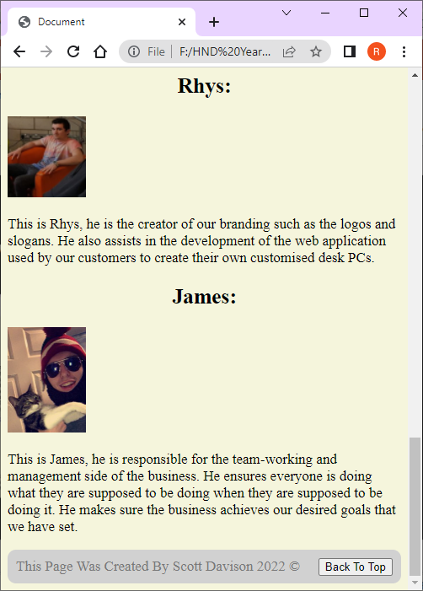
Demo – About page made by Scott, css by Sam, Slogan by Rhys

Slide 6
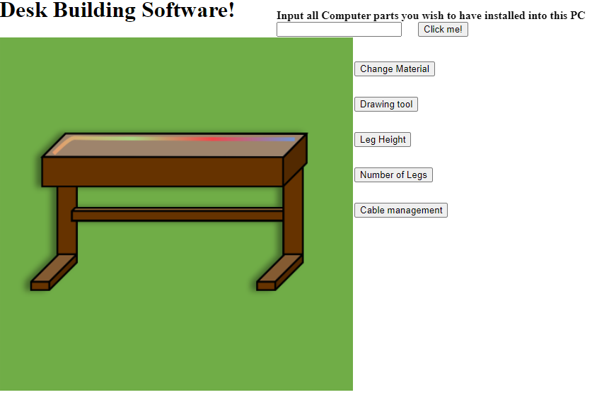
Demo – Desk Designer made by Jake

Slide 7


Idea
Jake’s side of the project

Slide 8
Idea – What is the product
PCinDaDesk is both a product and a software.
Customers use the software provided to create a specification, which craftsmen use to create the desk.
The customers may choose from any of the materials that we provide.
The primary focus in this section is the software.
Jake’s side of the project

Slide 9
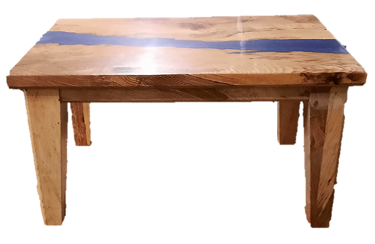
Idea - Design
This is an example of what can be done with materials, whilst the pc parts are absent, it shows what can be done with different materials.
This specific example uses Spalted Ash and coloured resin to create a river table.
Examples like this personify our USP
Jake’s side of the project

Slide 10
Idea - USP
Bespoke!!!
Variety of different materials available.
To our knowledge, there are no other major manufactures of bespoke computer desks.
[1] https://www.optimizely.com/optimization-glossary/unique-selling-point/
Jake’s side of the project

Slide 11
Idea – Initial requirements and design specifications
Requires design of working software.
Most manufacturing equipment is already available.
Customers are required before we can create any products.
Jake’s side of the project

Slide 12
Prototype
Key features of software for final version:
Website based
High level of customisation
Good performance on all computers
Parameters customers cannot breach
Link with in-house database for part availability
Customer login, to save work or submit it to computer creators
Bug free experience
Augmented Reality integration
Jake’s side of the project

