Slide 1

MODULE CODE AND TITLE:
BMSW5007 Building a Sustainable Marketing Relationship
Presentation
Student name: Mariana-Adela Sugar | Student id:2244011 | Date:11/12/2024

Slide 2

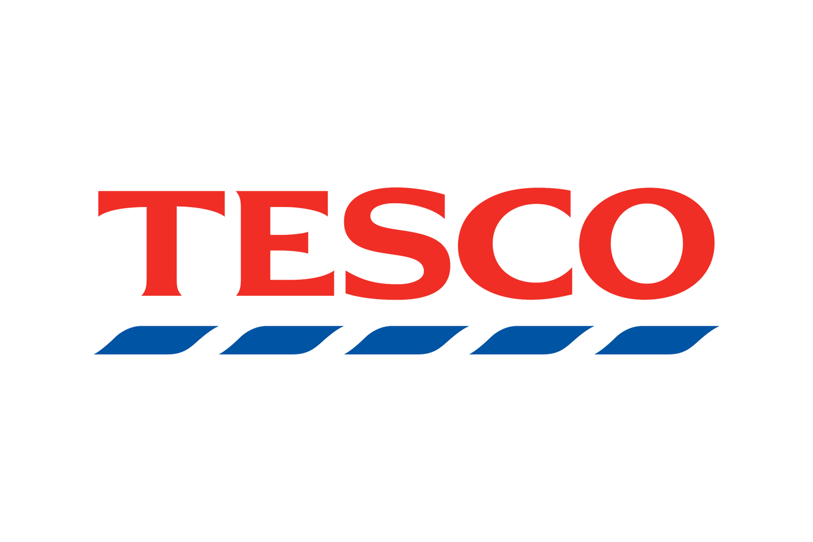
Introduction
  Evaluates Tesco's digital and social media engagement in CRM (Aiello et al., 2020).
  Highlights the role of digital and social media in CRM for direct interaction and loyalty building.
  CRM now depends on personalization and fostering long-term relationships (Aiello et al., 2020).
  Structure: Definitions, analysis of Tesco's strategies, evaluation, and recommendations.
  Goal: Explore how these strategies sustain customer relationships.
Notes:
This presentation critically evaluates Tesco’s digital and social media engagement in sustaining customer relationships to determine its importance in current marketing strategy. Customer Relationship Management (CRM) has become digital and social media driven, with the ability for organisations to directly interact with customers, personalise their experience and build long term loyalty (Aiello et al., 2020). Initial definitions of the concepts of digital and social media in the context of CRM will then be presented followed by an analysis of Tesco’s engagement strategies. It will then evaluate the success of these initiatives and suggest future improvement.

Slide 3

Digital and Social Media in CRM Definitions
  Digital media: Platforms like emails, websites, and apps for direct communication (Makos, 2024).
  Defined as “electronic mediums enabling interaction with stakeholders” (Smith et al., 2021).
  Social media: Interaction-focused platforms like Facebook, Twitter, and Instagram (Seyfang and Gilbert-Squires, 2019).
  Two-way communication builds relationships and fosters inclusion (Seyfang and Gilbert-Squires, 2019).
  Enables data collection for tracking preferences and predicting customer needs.
Notes:
Communication platforms and technologies that use digital formats to deliver content and to interact with audiences are called digital media. It consists of tools like emails, websites, and applications for mobile, which help with direct communication and personalised user experience (Makos, 2024). Digital media is academically known as “electronic mediums that provide information and foster collaboration between organisations and their stakeholders” (Smith et al., 2021). Industry examples include Tesco’s website for online shopping, and apps that provide real time updates and loyalty rewards.
However, social media is different from the platforms built to facilitate interaction, content sharing and networking. Tesco can connect to customers through promotions, feedback, and community engagement with examples such as Facebook, Twitter, and Instagram. Social media, however, is a two way communication model like digital media, allowing users to talk directly to or with other users and businesses. It helps build relationships and makes one feel included (Seyfang and Gilbert-Squires, 2019).
CRM is greatly dependent on digital and social media to improve customer interaction and experience and to gather important data about consumer behaviour (Seyfang and Gilbert-Squires, 2019). This data helps businesses such as Tesco to track preferences and predict needs, build loyalty and ensure longevity.

Slide 4

Tesco Digital and Social Media Strategies Overview
  Website and app facilitate e-commerce, deliveries, and exclusive offers (Seyfang and Gilbert-Squires, 2019).
  Clubcard integration rewards customer loyalty with redeemable points (Arefin et al., 2024).
  Email marketing delivers personalized promotions based on shopping history.
  Social media platforms manage customer inquiries, feedback, and trust-building (Aiello et al., 2020).
  Data analytics using Clubcard insights enable tailored marketing campaigns (Griva et al., 2018).
Notes:
Tesco uses different digital platforms to make the customer experience better and elevate their loyalty. Primary channels for e-commerce are its website, mobile application, where customers can easily shop online, schedule deliveries and enjoy exclusive offers (Seyfang and Gilbert-Squires, 2019). The Tesco app integrates Tesco's loyalty programmes, the Clubcard, so that customers can earn points on purchases that can be redeemed for discounts to encourage brand loyalty. Email marketing helps Tesco send personalised messages and targeted promotions based on shopping history and preferences.
Tesco interacts with customers on multiple social media platforms. To resolve issues quickly, Facebook and Twitter announcements, customer enquiries, and feedback are managed (Aiello et al., 2020). Instagram is used to spread visual content like new products and campaigns. Direct interaction builds customer trust and engagement.
Tesco Clubcard collects customer behaviour data, making it an important channel for digital platform integration (Arefin et al., 2024). Tesco analyses Clubcard data for buying habits and trends. This data is used to create relevant, engaging marketing campaigns using advanced analytics (Griva et al., 2018).
For Tesco, digital and social media have been strategic instruments for establishing a coherent ecosystem that puts customers at the centre, reinforces relationships and improves performance of the whole organisation.

Slide 5

Digital Media Engagement: Critical Evaluation
  Targeted emails promote relevant products based on customer data (Naidoo and Gasparatos, 2018).
  Real-time app notifications keep customers updated on offers and deliveries.
  Personalization boosts satisfaction and loyalty (Ruiz-Real et al., 2018).
  Privacy concerns arise from extensive data collection (Vadakkepatt et al., 2021).
  Technical issues such as app crashes harm the customer experience.
Notes:
To engage and increase relationship with customers, Tesco uses different digital media strategies. Targeted email campaigns are one of the key methods that use email tailored to the individual preferences and shopping history (Naidoo and Gasparatos, 2018). All these campaigns focus on promoting relevant products and discounts to increase the chance of customer engagement. In addition, Tesco’s mobile app pushes real time notifications to notify customers about their personalised offers, delivery status and product availability so that customers are always up to date.
These strategies have tremendous benefits. Customer data driven personalization improves satisfaction by meeting individual needs (Ruiz-Real et al., 2018). With data driven marketing, Tesco is able to develop highly relevant promotions, generating loyalty and repeat purchase. In addition, the mobile integration of the Tesco app and Clubcard enables consumers to have a seamless omnichannel experience, as they are able to effortlessly move from online to in-store and vice versa (Seyfang and Gilbert-Squires, 2019).
Although, however, there are some downsides. One reason for the privacy concerns is that the collection and analysis of customer data is extensive. If you rely too much on automation for your email and app interactions, you risk having generic experiences if personalization fails, which will cause disengagement (Vadakkepatt et al., 2021). Technical problems, like app crashes, app freezes, or a website going down, break trust and taint the entire customer experience.
Despite the substantial advantage that Tesco’s digital media strategies bring to engagement and loyalty, they are critical to address these challenges (Tesco PLC, 2024). To continue to capitalise on the potential of digital media, customer trust must be maintained and that means transparent data policies, personalization, and solid technical infrastructure.

Slide 6
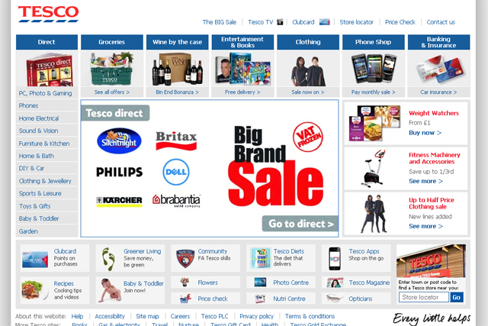
Social Media Engagement Critical Evaluation
  Twitter ensures quick responses, enhancing trust (Griva et al., 2018).
  Sustainability campaigns align with customer values (Vadakkepatt et al., 2021).
  User-generated content (reviews and contests) fosters community involvement.
  Negative reviews or backlash can harm reputation if poorly handled (Arefin et al., 2024).
  High resource demands for content creation and monitoring reduce efficiency.
Notes:
Tesco strengthens customer relationships through various social media strategies. On Twitter, Tesco responds to customer enquiries and complaints quickly. This immediate interaction shows attention and builds trust (Griva et al., 2018). Tesco also promotes sustainability and community support through campaigns. Customers align with Tesco's social responsibility, so these campaigns reflect customer values. User-generated content like testimonials, reviews, and contests can also engage users in brand communication.
These methods have many advantages. Tesco uses social media to promote its brand and engage with customers (Vadakkepatt et al., 2021). Ethical values attract socially conscious consumers who boost brand image and customer loyalty. It's also a good way to ask for user-generated content and build community involvement, which makes customers feel like they're part of a community and the brand values them.
Social media doesn't work for Tesco. Poorly handled negative customer reviews or public backlash can damage a company's reputation and trust. Maintaining engagement across multiple platforms requires customised marketing strategies because each platform has different audience expectations (Arefin et al., 2024). High-quality content and interaction monitoring require skilled personnel and technology, which can reduce operational efficiency.
Tesco's social media strategies build customer relationships and brand awareness, but they need improvement. Actively managing negative feedback, using scalable social media tools, and staying consistent can help Tesco improve its social media engagement and customer relationships.

Slide 7
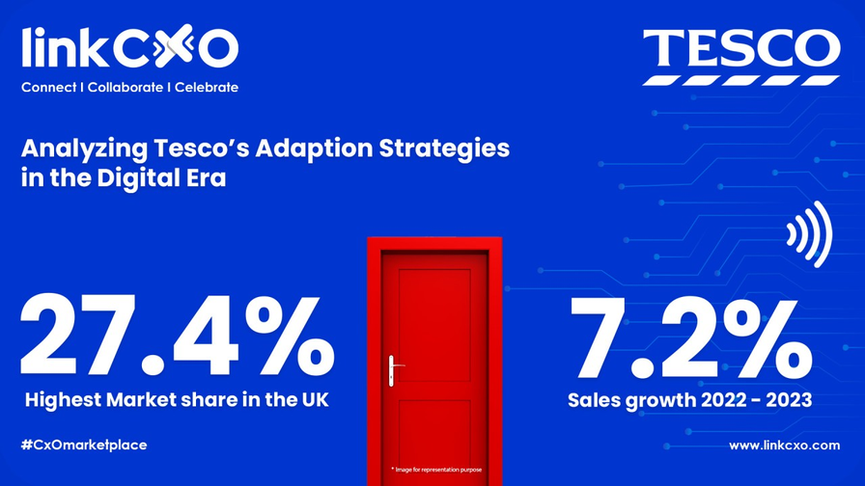
Tesco Digital and Social Media Strategies Success Assessment
  Digital engagement has grown Tesco’s customer base (Arefin et al., 2024).
  Clubcard loyalty program boosts retention and repeat purchases.
  Social media campaigns increase sales during peak seasons (Seyfang and Gilbert-Squires, 2019).
  Sustainability campaigns positively resonate with eco-conscious customers.
  Technical failures and lack of AI integration limit competitive edge (Makos, 2024).
Notes:
Tesco strengthens customer relationships through various social media strategies. On Twitter, Tesco responds to customer enquiries and complaints quickly. This immediate interaction shows attention and builds trust (Griva et al., 2018). Tesco also promotes sustainability and community support through campaigns. Customers align with Tesco's social responsibility, so these campaigns reflect customer values. User-generated content like testimonials, reviews, and contests can also engage users in brand communication.
These methods have many advantages. Tesco uses social media to promote its brand and engage with customers (Vadakkepatt et al., 2021). Ethical values attract socially conscious consumers who boost brand image and customer loyalty. It's also a good way to ask for user-generated content and build community involvement, which makes customers feel like they're part of a community and the brand values them.
Social media doesn't work for Tesco. Poorly handled negative customer reviews or public backlash can damage a company's reputation and trust. Maintaining engagement across multiple platforms requires customised marketing strategies because each platform has different audience expectations (Arefin et al., 2024). High-quality content and interaction monitoring require skilled personnel and technology, which can reduce operational efficiency.
Tesco's social media strategies build customer relationships and brand awareness, but they need improvement. Actively managing negative feedback, using scalable social media tools, and staying consistent can help Tesco improve its social media engagement and customer relationships.

Slide 8

Suggestions for Improvement
  Enhance transparency in data collection and privacy policies (Ruiz-Real et al., 2018).
  Invest in AI to personalize customer experiences dynamically.
  Expand video content on Instagram and YouTube to drive engagement.
  Regular updates to apps and websites ensure seamless functionality (Griva et al., 2018).
  Monitor competitors’ strategies for innovation and benchmarking.
Notes:
Tesco should focus on improving its digital and social media strategies by prioritising actionable changes that resolve its current challenges and leverage emerging opportunities. The first thing the company can do, is improve data transparency and privacy policy, how they can collect and use customer data to build trust as well as meet evolving regulatory requirements (Ruiz-Real et al., 2018). Artificial intelligence (AI) can also be invested into to further personalise customer interactions and turn campaigns into more dynamic, individualised experience.
By expanding the use of video content on systems like Instagram and YouTube, video content has the potential to draw in much more engagement than written content. Tesco should also set up a regular schedule for updating its apps and websites to make them smoother, eliminate technical problems, and improve user experience (Griva et al., 2018). Tesco should also lastly be actively monitoring the strategies of competitors, benchmarking their performance to find out the areas of innovation and be in a competitive position in the market.
The improvements we propose will not only fill gaps but will put Tesco at the forefront of digital and social media engagement, building lasting customer relationships and driving long term business success.

Slide 9
Conclusion
  Tesco effectively uses CRM, digital, and social media for customer engagement.
  Strengths include personalized email campaigns, loyalty programs, and responsiveness.
  Challenges include privacy concerns, resource allocation, and consistency.
  Innovating with AI and improved transparency ensures sustainable growth.
  Continuous adaptation is crucial to thrive in a competitive market.
Notes:
Tesco relies on Customer Relationship Management (CRM) and digital and social media to personalise campaigns and engage customers in new ways. Its targeted email campaigns, loyalty programs, and social media responsiveness make Tesco strong. However, data privacy, resource allocation, and platform consistency must be addressed. Tesco must innovate with AI and transparency to maintain and grow customer relationships in a competitive and dynamic market.

Slide 10
References
Aiello, L.M., Quercia, D., Schifanella, R. and Del Prete, L. (2020) 'Tesco Grocery 1.0, a large-scale dataset of grocery purchases in London', Scientific data, 7, p.57.
Arefin, S. et al. (2024) 'Retail Industry Analytics: Unraveling Consumer Behavior through RFM Segmentation and Machine Learning.' 2024 IEEE International Conference on Electro Information Technology (eIT)., pp.545–51.
Griva, A., Bardaki, C., Pramatari, K. and Papakiriakopoulos, D. (2018) 'Retail business analytics: Customer visit segmentation using market basket data', Expert Systems with Applications, 100, pp.1–16.
Makos, J. (2024) Tesco SWOT Analysis: 39 Factors Affecting the Retailer. Available at: https://pestleanalysis.com/tesco-swot-analysis/ (Accessed: 15 November 2024).
Naidoo, M. and Gasparatos, A. (2018) 'Corporate environmental sustainability in the retail sector: Drivers, strategies and performance measurement', Journal of Cleaner Production, 203, pp.125–42.
Ruiz-Real, J.L., Uribe-Toril, J., Gázquez-Abad, J.C. and de Pablo Valenciano, J. (2018) 'Sustainability and retail: Analysis of global research', Sustainability, 11, p.14.
Seyfang, G. and Gilbert-Squires, A. (2019) 'Move your money? Sustainability transitions in regimes and practices in the UK retail banking sector', Ecological Economics, 156, pp.224–35.
Tesco PLC (2024) Tesco. Available at: tesco.com (Accessed: 15 November 2024).
Vadakkepatt, G.G. et al. (2021) 'Sustainable retailing', Journal of Retailing, 97, pp.62–80.
Notes:
Aiello, L.M., Quercia, D., Schifanella, R. and Del Prete, L. (2020) 'Tesco Grocery 1.0, a large-scale dataset of grocery purchases in London', Scientific data, 7, p.57.
Arefin, S. et al. (2024) 'Retail Industry Analytics: Unraveling Consumer Behavior through RFM Segmentation and Machine Learning.' 2024 IEEE International Conference on Electro Information Technology (eIT)., pp.545–51.
Griva, A., Bardaki, C., Pramatari, K. and Papakiriakopoulos, D. (2018) 'Retail business analytics: Customer visit segmentation using market basket data', Expert Systems with Applications, 100, pp.1–16.
Makos, J. (2024) Tesco SWOT Analysis: 39 Factors Affecting the Retailer. Available at: https://pestleanalysis.com/tesco-swot-analysis/ (Accessed: 15 November 2024).
Naidoo, M. and Gasparatos, A. (2018) 'Corporate environmental sustainability in the retail sector: Drivers, strategies and performance measurement', Journal of Cleaner Production, 203, pp.125–42.
Ruiz-Real, J.L., Uribe-Toril, J., Gázquez-Abad, J.C. and de Pablo Valenciano, J. (2018) 'Sustainability and retail: Analysis of global research', Sustainability, 11, p.14.
Seyfang, G. and Gilbert-Squires, A. (2019) 'Move your money? Sustainability transitions in regimes and practices in the UK retail banking sector', Ecological Economics, 156, pp.224–35.
Tesco PLC (2024) Tesco. Available at: tesco.com (Accessed: 15 November 2024).
Vadakkepatt, G.G. et al. (2021) 'Sustainable retailing', Journal of Retailing, 97, pp.62–80.

