Slide 1
LCLM4003 Effective Teamwork and Communication
Assignment 2: Group Presentation
Martha Assis - ID No. 2440395
David Brescan - ID No. 2439097
Rayane Cesconetto - ID No. 2440636
Ricses Dacuyan - ID No.2438233
Stanica Roxana Dediu - ID No. 2441417
Lecture: Xavier Matieni

Slide 2
Overview
1. Introduction
2. Company Background
3. Physical Barrier - Martha
4. Language Barrier - David
5. Attitude/Age Barrier - Rayane
6. Psychological Barrier - Ricses
7. Perceptual Barrier - Roxana
8. Conclusion
9. References

Slide 3
Introduction
At Flight Foods Ltd, poor communication has led to operational issues such as hygiene failures, staff confusion, and customer complaints.
This presentation explores key communication barriers affecting the organisation’s performance, including:
Physical Barrier
Language Barrier
Attitude/Age Barrier
Psychological Barrier
Perceptual Barrier
We will analyse each barrier with examples from the case, supported by relevant communication theories and practical solutions.

Slide 4
Company Background
Flight Foods Ltd
Industry: Food manufacturing – ready meals for airline clients
Employees: Around 40 staff aged 16–60
Workforce: Multicultural team from five cultural backgrounds
Environment: Noisy, fast-paced factory floor with strict hygiene requirements
Management: Led by Gary, a stressed manager under pressure to improve performance
Issues Faced: Airline complaints about food quality, hygiene, and packaging errors

Slide 5

Physical Barrier
Physical barriers are problems around us and make communication hard.
According to Liraz (2019), noise physical separation between sender and receiver are physical barriers.
These barriers create misunderstanding in effective communication.
Google (2025)

Slide 6
Communication Theory
Shannon and Weaver's Model (1949)
Based on (Shannon and Weaver,1949) this theory describes communication as a linear process.
Sender: the person who start the message: Gary.
Message: the information being transmitted: instructions.
Channel: the way the message reach the receiver: spoken words or written text.
Receiver: the person or group receiving the message: workers.
Noise: any disruption that block or distort the message: loud background noise.

Slide 7
Impact and Consequences
Barrier | Description | Impact and consequences
Noise | Background sound Machinery and staff chatter. | Reduces concentration distort the message leads to errors or delay in tasks.
Distance | Physical separation between sender and receiver Large fabric. | Delays feedback Increases misunderstanding
Physical barriers in communication include noise, faulty technology, and poor office layout (Guffey and Loewy , 2022)

Slide 8
Solutions to Physical barriers
Noise from Machinery | Install soundproof panels or acoustic barriers around loud equipment. Schedule quiet times for meetings away from production lines.
Staff chatting | Train staff on professional communication etiquette to reduce unnecessary chatter. Encourage structure breaks so social conversation don't interfere with work.
Distance ( large space) | Use devices like radios or mobile apps to instant communication across the fabric. Place notice boards and digital displays in key areas to share updates.
(Smith, 2019)

Slide 9
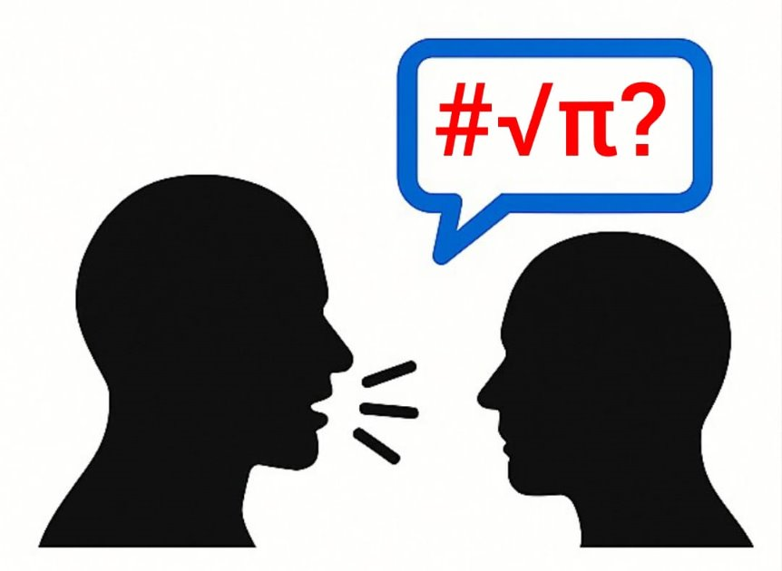
Language Barrier
The Language Barrier Problem
Workforce from 5 cultural groups
Many speak little or no English
Instructions often misunderstood
Manager forced to teach on the job
Gemini, 2005

Slide 10
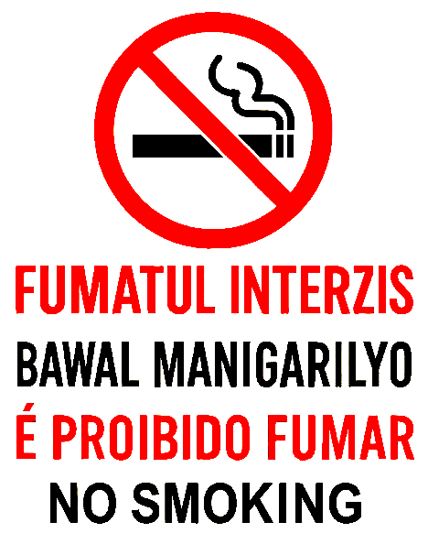
Language Barrier
Impact & Consequences
Undercooked food and poor packaging
Meat found in vegetarian meals
Loss of business from airline complaints
Safety and quality risks increase (Rojak & Handayani, 2023)
Gemini, 2005

Slide 11

Language Barrier
Solutions
Translate all signs and instructions
Use visual communication (icons, colours)
Provide structured, multilingual training
Appoint bilingual team leaders
Gemini, 2005

Slide 12

Attitude Barrier
Attitude barrier is when people's mindset or behaviour affect communication and performance.
In the case study there are attitude barrier that affect the workplace and the performance, such as:
Less cooperation.
Lower morale.
Less motivation.
vHealth Assured (2025)
ChatGPT (2025)

Slide 13
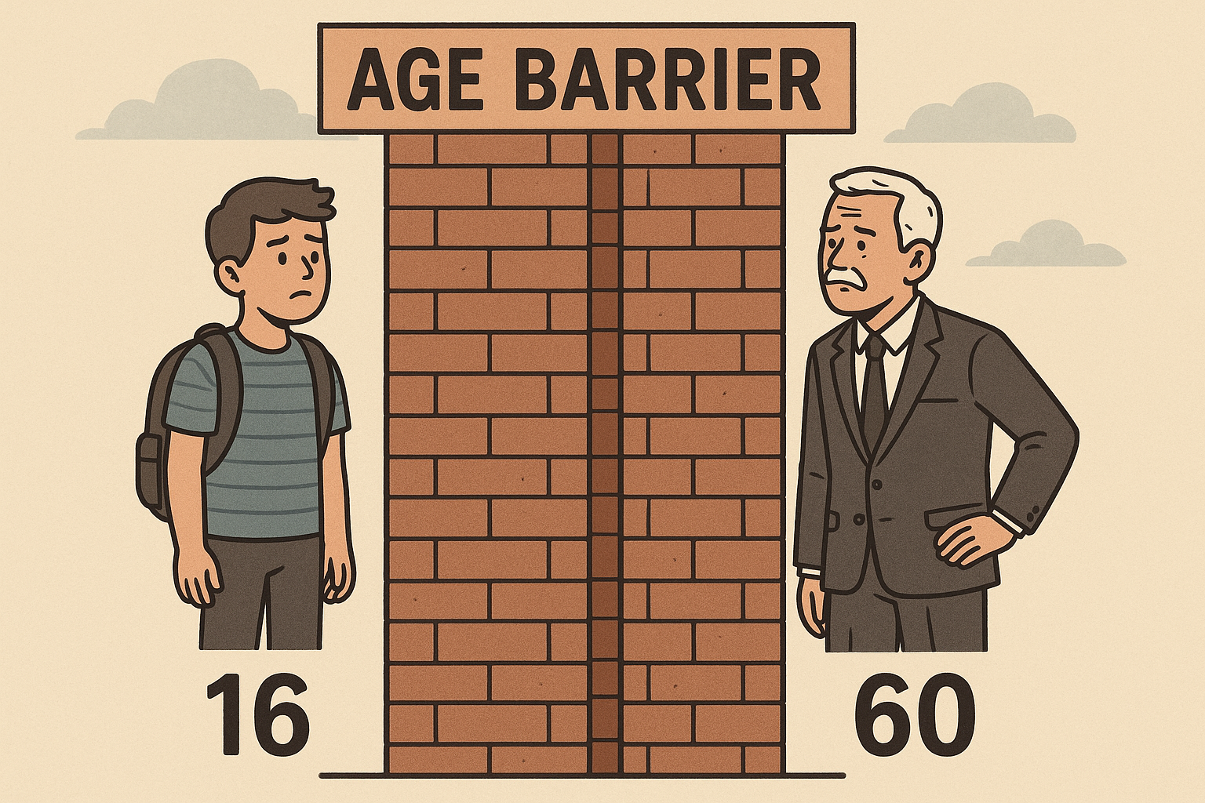
Attitude- Age Barrier
Age barrier are some limitations resulted for the age. Age can affect the behave and the way people think, and how they respond instructions and understand procedures.
At Flight Food, they have staffs between 16 to 60 years old, which creates challenges like:
Lower motivation.
Poor communication.
Misunderstanding.
Acas (2019)
(ChatGPT, 2025)

Slide 14
Berlo's Theory
Sender | Gary
Message | No clear information.
Channel | Sign, verbal communication.
Receiver | Old and young employees.
In this study case, Berlo's theory is being using to show that the communication can be effective when the following elements are working properly and together: SENDER, MESSAGE, CHANNEL and RECEIVER.
Communication Theory (2025)
Communication Theory (2025)

Slide 15
Flight Foods - Impacts and Consequences
Instructions | Different and slower ways to understand the instructions, resulting in delays.
Poor communication | Lack of English signs, verbal communication, resulting in misunderstanding.
Habits | Different works habits, resulting in lack of hygiene.
CIPD (2022)

Slide 16
Solutions
Improve communication
Instructions and procedures: writing and visual.
Adapt work tasks.
Provide feedback and coaching.
Luthans, F. (2011)

Slide 17
Psychological Barrier
Invisible mental blocks such as fear, stress, low confidence, and prejudice that silence voices, distort communication, damage teamwork, and ultimately weaken performance and workplace success

Slide 18
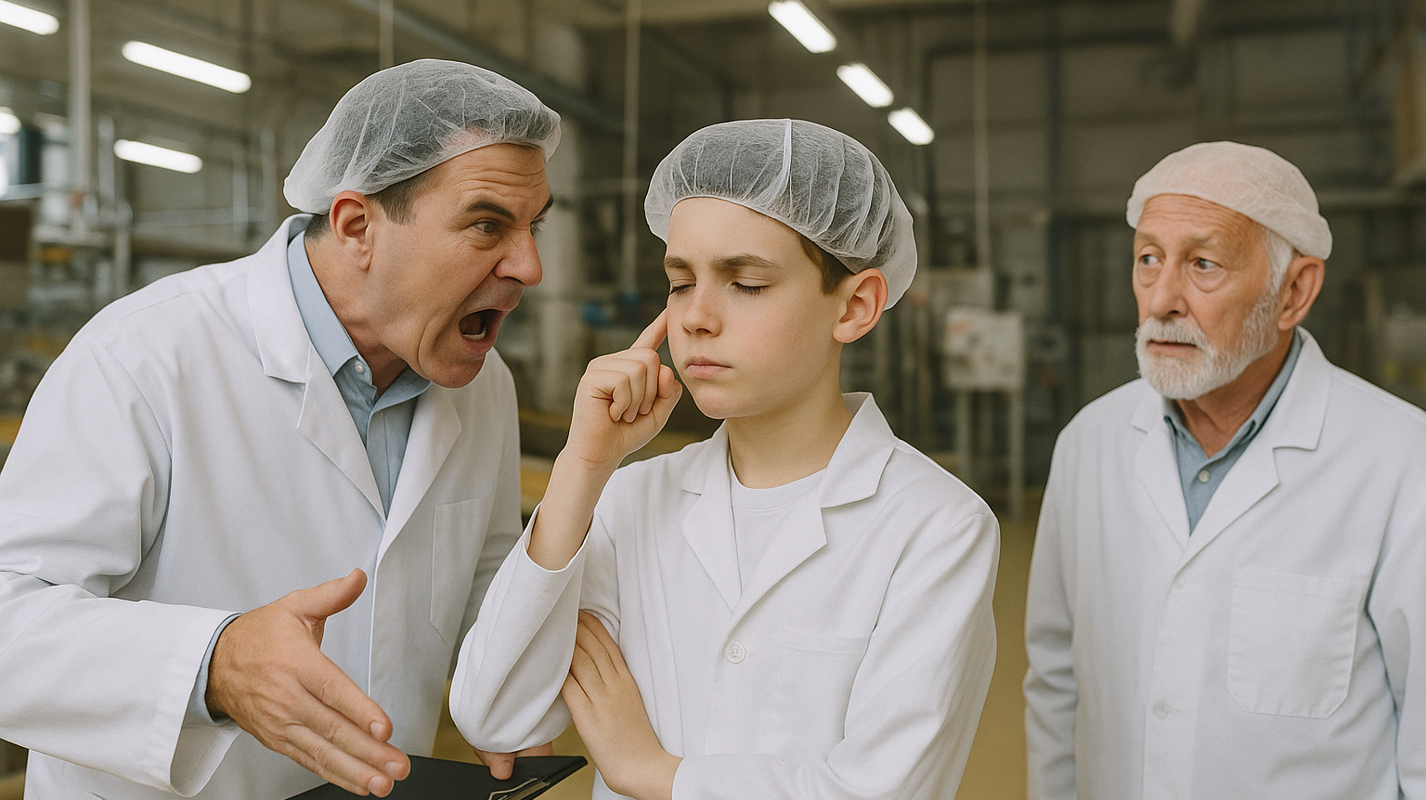
Psychological
Barrier
In workplaces, communication fails less often because of technology and more because of how people think and feel towards it.
Emotion Management within a workplace is important but sometimes it turns out to be uncontrollable.
Anger, Fear, Frustration, Confusions, and Happiness, are just some of the emotions that are mostly observed in a workplace that sometimes hinders the performance of an individual.

Slide 19
Impacts and Consequences
Given the age differences, the gap tends to be drawn bigger as the emotions may trigger it.
The way how young and old ones perceive things and how they act towards it are way different.
According to (Adler, Roman, & du Pre, 2016), emotionally charged individuals tend to misinterpret information, react defensively, and make irrational decisions, leading to misunderstandings and conflict in the workplace.
Mullins (2016) confirms that stereotyping creates unfair treatment, mistrust, and ineffective treatment, acting as a strong psychological barrier.

Slide 20
Impacts and Consequences
Employees with low confidence may avoid speaking up, sharing ideas, or asking for clarification.
Mullins (2016) also confirms that employees with negative work attitudes are more likely to reject feedback, ignore instructions, and resist teamwork.

Slide 21
-- Solutions --
Stress management
Well-being Support
Open and Supportive Communication
Confidence Building
Counselling and Empowerment
Equality and Diversity (Judge, Robbins, 2018)
Clear Feedback (Neville, 2018)
Active Listening

Slide 22
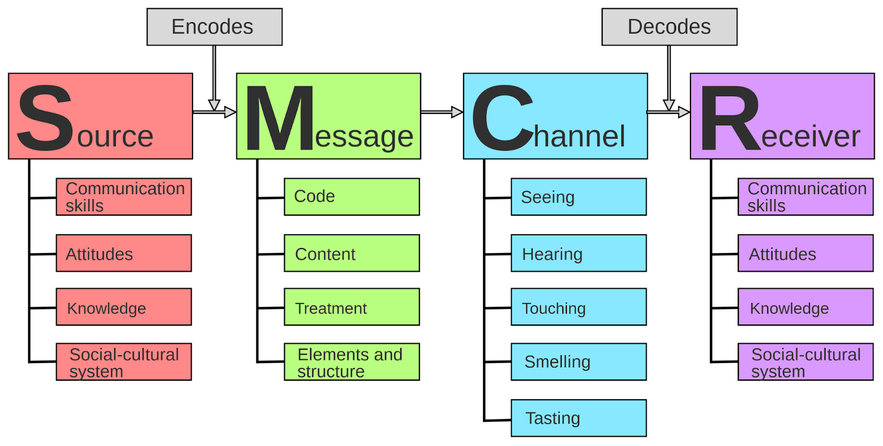

Berlo's Model
The Psychological connection from the sender and receiver can be either successful or distorted highlighting the way of how each side perceives the message.

Slide 23
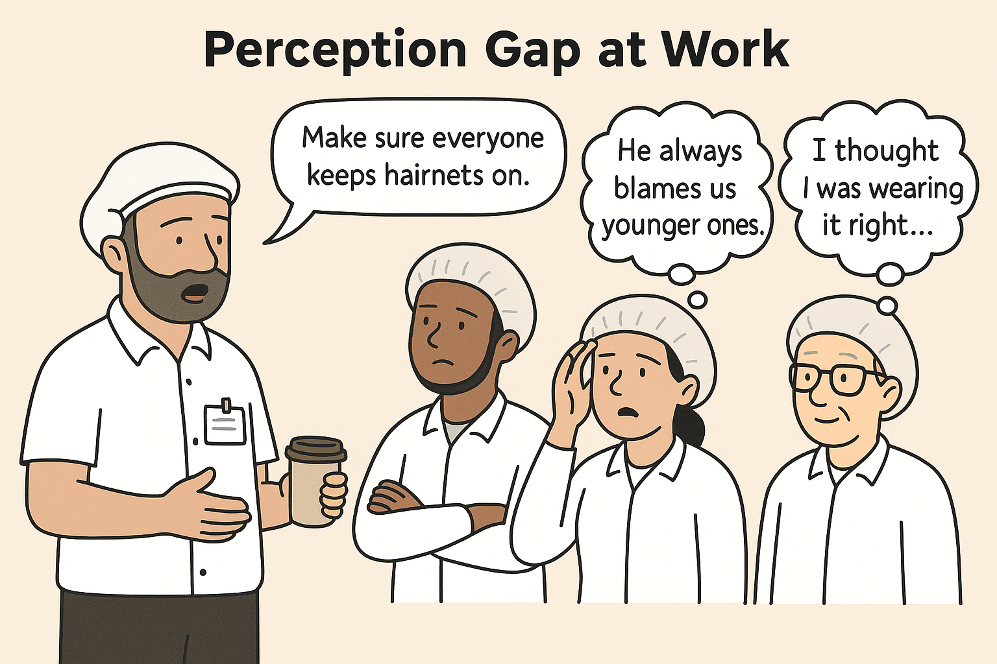
Perceptual Communication Barriers
Perceptual barriers arise when individuals interpret messages based on personal beliefs, emotions, or assumptions, causing misunderstandings (Gibson et al., 2012).
In this case, Gary assumes younger staff are careless and will interpret signs as he does. This leads to miscommunication, with hygiene rules being ignored.
Berlo’s SMCR model (1960) highlights how communication depends on both sender’s and receiver’s background and attitudes. At Flight Foods, the disconnect shows a failure in the ‘Receiver’ component.
Image generated by ChatGPT (2025).

Slide 24
Applying Communication Models to the Case
Berlo’s SMCR Model (1960)
Element | Example from Case
Source | Gary – stressed, assumes younger workers don’t listen
Message | Generic signs + verbal instructions (no feedback loop)
Channel | Mostly visual (signs); rushed face-to-face communication
Receiver | Workers interpret messages through filters like age, beliefs, and personality (Robbins and Judge, 2017)

Slide 25
Perceptual Barriers at Flight Foods Ltd.
Barrier Type | Short Meaning | Example from the Case
Projection | Assuming others think or behave like you | Gary believes workers are intentionally ignoring rules, but it might be a misunderstanding
Assumed Similarity | Expecting everyone to behave the same | Gary expects all staff to act like he would, ignoring their different backgrounds or education
Non-Verbal Cues | Body language and appearance affecting the message | Gary’s tired look and poor hygiene send mixed signals that contradict his hygiene reminders
Stereotyping | Judging people based on group identity | Gary assumes younger workers are less responsible without looking at individual behavior
Personal Filters | People interpret messages based on personal experiences | Staff interpret instructions differently; hygiene may not seem important to everyone equally

Slide 26
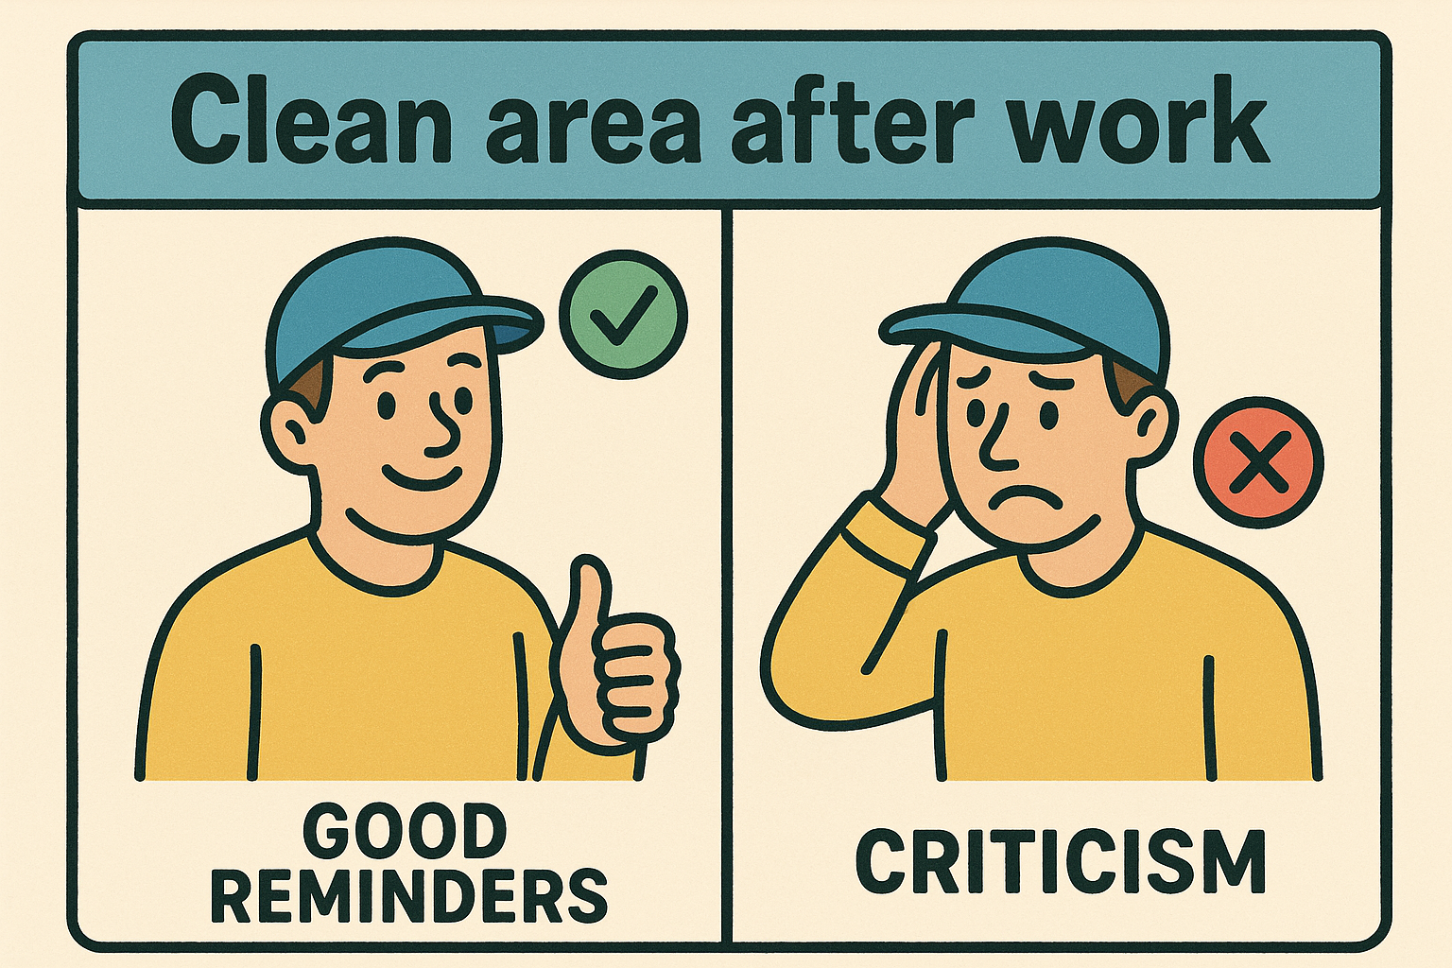
Impact and Consequences on Communication
Impact Area | Consequence at Flight Foods Ltd
Message Misinterpretation | Staff misunderstand or ignore hygiene signs due to unclear or biased communication
Low Motivation | Workers feel judged or unsupported, reducing engagement and teamwork
Compliance Failures | Hygiene rules are not followed, leading to unsafe food handling practices
Broken Trust | Staff-manager relationship weakens due to assumptions and lack of respect or clarity
Image generated by ChatGPT (2025).

Slide 27
Practical Solutions
Stereotyping
Encourage managers to assess staff based on individual behavior, not age groups
Projection & Assumed Similarity
Provide training in empathy and perspective-taking to understand staff diversity
Non-Verbal Conflicts
Ensure consistency between verbal messages and body language or personal hygiene
Personal Filters
Use interactive communication (e.g., face-to-face briefings) instead of passive signs
Selective Perception
Ask staff for feedback to confirm understanding and clarify unclear areas

Slide 28
CONCLUSION
Effective communication is vital for teamwork, safety, and smooth operations.
At Flight Foods Ltd, multiple communication barriers affected interactions between staff and management.
These barriers caused misunderstandings, low morale, hygiene risks, and loss of trust.
By encouraging empathy, clear feedback, and inclusive communication, these challenges can be addressed—leading to a safer and more collaborative workplace.

Slide 29
REFERENCES
Acas (2019) Age discrimnination: key points for the workplace. February 2019,; updated April 2024. Available at: https://www.acas.org.uk/sites/default/files/2024-04/age-discrimaination-key-points-for-the-workplace.pdf (Accessed: 07 December 2025).
Adler, R., Rodman, G. & du Pré, A. (2016) Understanding Human Communication. 13th ed. Oxford: Oxford University Press.
Berlo, D.K. (1960) The Process of Communication: An Introduction to Theory and Practice. New York: Holt, Rinehart and Winston.
CIPD (2022) Managing Age Diversity in the Workplace. Chartered Institute of Personnel and Development.
CommunicationTheory.org (2025) Berlo's SMRC Model of Communication. Available at: https://www.communicationtheory.org/berlos-smrc-model-of-communication/ (Accessed : 07 December 2025)
February 2019,; updated April 2024. Available at: https://www.acas.org.uk/sites/default/files/2024-04/age-discrimaination-key-points-for-
Gibson, J.L., Ivancevich, J.M., Donnelly, J.H. and Konopaske, R. (2012) Organizations: Behaviour, Structure, Processes. 14th ed. New York: McGraw-Hill Education.
Guffey, M.E. and Loewy, D., 2022. Business Communication: Process and Product. 9th ed. Boston: Cengage Learning.
Health Assured (2025) How to Manage Bad Attitudes in the Workplace. 18 July. Available at: https://www.healthassured.org/blog/negative-attitude-at-work/ (Accessed: 07 December 2025).
Liraz, M. (2019) How to Overcome Communication Barriers in the Workplace. Independently published.
Luthans, F. (2011) Organizational Behaviour McGraw- Hill
Mullins, L. (2016) Management and Organisational Behaviour. 11th ed. Harlow: Pearson.
Neville, C. (2018) Effective Learning Service Skills. London: Open University Press.
Robbins, S.P. and Judge, T.A. (2017) Organizational Behavior. 17th edn. Harlow: Pearson Education.
Rojak, O. B. & Handayani, Y. (2023) ‘The Correlations between Language Barriers and Occupational Safety and Health Communication in Indonesia’, International Journal of Occupational Safety and Health, 13(3), pp. 386–395.
Shannon, C.E. and Weaver, W., 1949. The Mathematical Theory of Communication. Urbana: University of Illinois Press.
Smith, D.A., 2019. Barriers to effective communication: 13 types & solutions. Making Business Matter. Available at: https://www.makingbusinessmatter.co.uk/barriers-to-effective-communication/ (Accessed 7 December 2025)

Slide 30
Thank you!
Questions and Discussions

