Slide 1
PASSIVE & ACTIVE FILTERS

Slide 2
WHAT IS THE PURPOSE OF A FILTER?
The purpose of a filter is to allow or prevent the passage of a given signal or signals depending on the frequency of those signals.
Filters are a set of electronic circuits that, either consisting solely of PASSIVE devices such as resistors, capacitors and inductors or consisting of ACTIVE devices such as amplifiers, as well as resistors and capacitors.

Slide 3
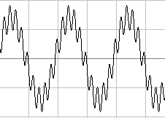
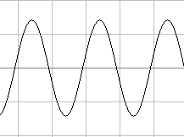
EXAMPLE OF A FILTER REMOVING UNWANTED NOISE/INTERFERENCE
INPUT PROCESS OUTPUT
FILTER
Required low frequency input sinusoid with unwanted high frequency noise.
Noise removed within the filter.
Required low frequency output sinusoid with the noise removed.

Slide 4
TYPICAL FILTER RESPONSES
A filter is characterised by its TRANSFER FUNCTION
A transfer function describes the way in which a filter will change the MAGNITUDE and PHASE of a frequency or range of frequency components within a signal.
The typical filter responses used are:
LOW PASS , HIGH PASS, BANDPASS and NOTCH.

Slide 5
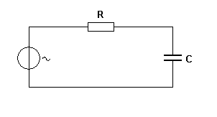
PASSIVE FILTERS
Passive filters consist of specific combinations of RESISTORS, CAPACITORS & INDUCTORS.
By combining these devices we can produce circuits that allow us to change the characteristics of a variety of different signals in a variety of different ways.
Example of a simple, passive, Low Pass Filter ( LPF )
LPF Frequency response
Vout
Vin
Vout
0dB (100%)
-3 dB (70.7%)
f_{c}
Log f

Slide 6
MEANING OF THE FREQUENCY RESPONSE CURVE
The frequency response curve defines the way in which the filter modifies the amplitude of the signal frequency components applied to the circuit.
The diagram shows that the output voltage of the circuit decreases (attenuates) progressively as the input frequency approaches close to f_{c} and continues to decrease but at a constant roll- off of -20dB per decade even though the amplitude of the input ( Vin ) remains constant.
The cut-off frequency (f_{c} ) is defined as the frequency at which the output voltage reduces by 3dB compared with its maximum output i.e. its – 3dB point. The -3dB point equates to 70.7% of maximum.

Slide 7
The low pass filter will filter out high frequencies from a signal. The point at which it starts is difficult to define, however, the -3dB point serves as an indicator.
By the time a given input reaches a frequency of f_{c} the signal will be attenuated by approximately 30% i.e. it is only approximately 70% of its original size.
This circuit may be used to filter high frequency noise from a low frequency signal, for example.
Low frequency signal plus attenuated high frequency noise.
Low frequency signal plus high frequency noise.
LPF

Slide 8
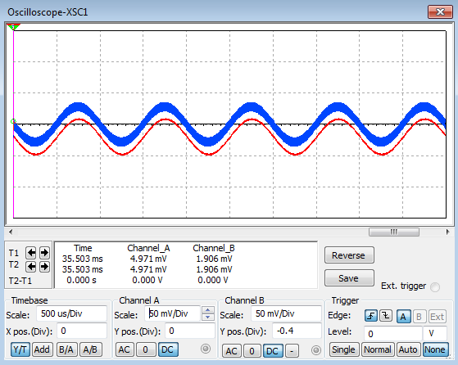
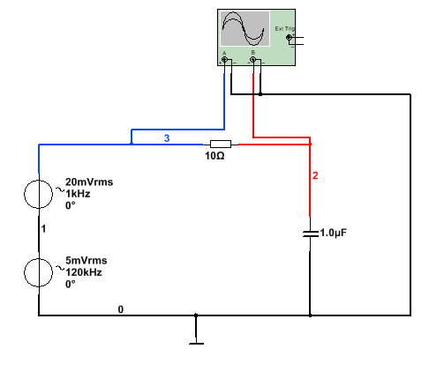
Signal
Noise
The blue trace = Vin
red trace = Vout
Notice reduction in high frequency component of Vout.
Low frequency component of Vout remains unchanged. Ref: LPF1passive.ms12

Slide 9
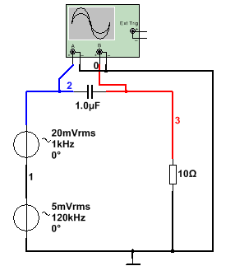
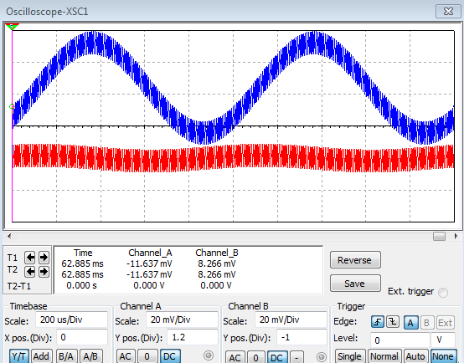
THE HIGH PASS FILTER
The high pass filter (HPF) works in such a way that it filters out the low frequencies and passes the high frequencies, i.e. it performs the opposite filtering function to a LPF.
Noise
Signal

Slide 10
From the above diagram we can see that this time it is the high frequency that forms the major component in the output and the low frequency has been greatly attenuated, but is just discernable.
The diagram below shows the frequency response for the HPF.
Vout
Ref:HPF1passive.ms12
0dB
-3 dB
Log f
f_{c}

Slide 11
CALCULATION OF f_{c}
The cut off frequency for both LPF and HPF is calculated in the same way, i.e.
f_{c} = 1/ (2.π.R.C)
For example in the circuits above, the cut-off frequency for both the LPF and HPF is given by:
f_{c} = 1 / ( 2.π.10.1.10⁻⁶) = 15.915 kHz.
MEMORISE THIS

Slide 12
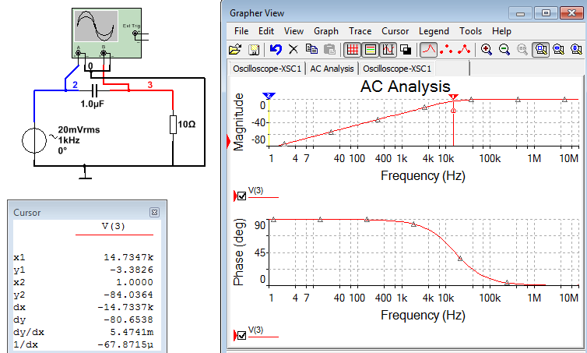
Phase shift is 0⁰ within passband but increases to 90⁰ in the stop band and is 45⁰ at fc.

Slide 13
BANDPASS FILTER CHARACTERISTIC
A simple Bandpass filter characteristic is shown below. It has been achieved by cascading a LPF and HPF.
Vout
0dB
-3 dB
fL
fu
Log f

Slide 14
It is possible to achieve a sharper response by a variety of means
A typical set of bandpass responses is as shown below:

Slide 15
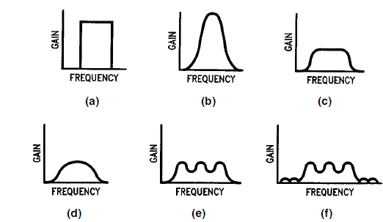
IDEAL AND TYPICAL BANDPASS RESPONSE CURVES

Slide 16
Curve a)
is what might be called an ``ideal'' bandpass response, with absolutely constant gain within the passband, zero gain outside the passband, and an abrupt boundary between the two. This response characteristic is impossible to realise in practice, but it can be approximated to varying degrees of accuracy by real filters.

Slide 17
Curves (b)through (f) are examples of a few bandpass amplitude response curves that approximate the ideal curves with varying degrees of accuracy. Note that while some bandpass responses are very smooth, other have ripple (gain variations in their passbands. Others have ripple in their stopbands as well.
The stopband is the range of frequencies over which unwanted signals are attenuated. Bandpass filters have two stopbands, one above and one below the passband.

Slide 18
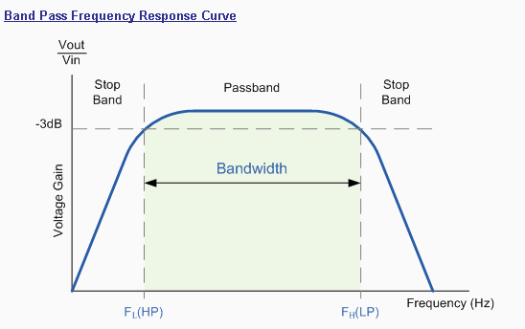
BB
Bandwidth (BW) = f_{U} -f_{L}
f_{L} f_{r} f_{U}

Slide 19

Resonant Frequency
The actual shape of the frequency response curve for any passive or active band pass filter will depend upon the characteristics of the filter circuit .with the curve above being defined as an "ideal" band pass response. The Resonant Frequency(ƒr) or "centre frequency", ƒc. is generally calculated as being the geometric mean of the two -3dB frequencies between the upper and the lower cut-off points with the resonant frequency (point of oscillation) being given as:
Where:
ƒ_{r} is the resonant or Centre Frequency
ƒ_{L} is the lower -3dB cut-off frequency point
f_{U} is the upper -3db cut-off frequency point

Slide 20
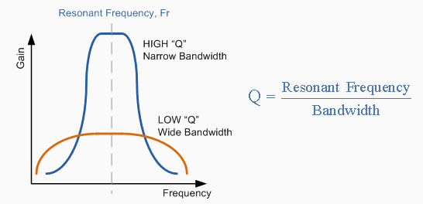
Suppose we want a bandpass filter with an upper cut-off frequency of 600 Hz and a lower cut-off frequency of 400Hz.
Since
Then = 489.9Hz

Slide 21
The "Q" or Quality Factor
In a Bandpass Filter circuit, the overall width of the actual passband between the upper and lower -3dB corner points of the filter determines the Quality Factor or Q-point of the circuit.
This Q Factor is a measure of how "Selective" or "Un-selective" the band pass filter is towards a given spread of frequencies. The lower the value of the Q factor the wider is the bandwidth of the filter and consequently the higher the Q factor the narrower and more "selective" is the filter.

Slide 22
Then for our simple example above the quality factor "Q" of the band pass filter is given as:
Q = Centre frequency / Bandwidth
Hence Q = 489.9Hz / 200Hz = 2.45 for the example given above. Note that Q is a ratio and has no units.

Slide 23
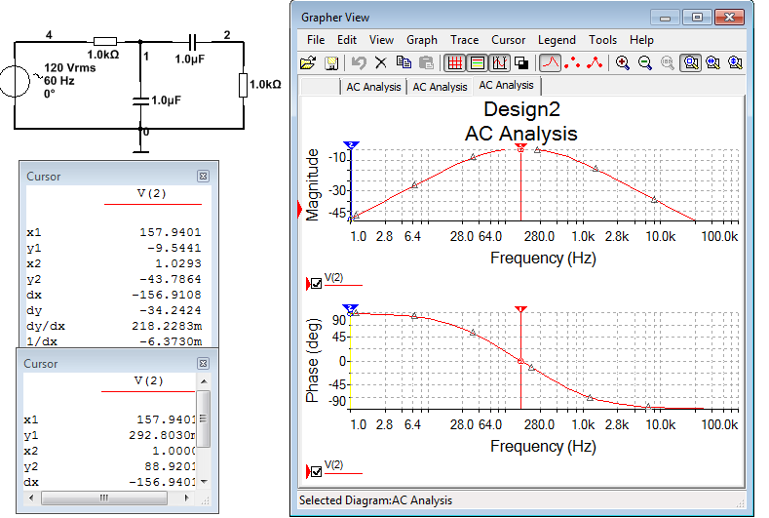
Simple Bandpass Filter Characteristic

Slide 24
NOTE: Active filters will not be assessed in the exam, however, passive filters is one of the many topics that may be examined in the exam.

Slide 25
ACTIVE FILTERS
Active filters are a combination of passive RC networks and op-amps.
They are used for relatively low frequency filtering and have advantages over their equivalent passive R,L,C filters.
Advantages include:
They do not use cumbersome coils at low frequency
Adjusting the Q or response shape can be achieved by adjusting resistors rather than coils.
They include gain and also do not load their outputs which are buffered from their loads due to low output impedance.

Slide 26
ACTIVE FILTERS
A simple way to make an active filter is to add an op-amp output stage to a passive filter. An example of an active low –pass filter is shown below.

Slide 27
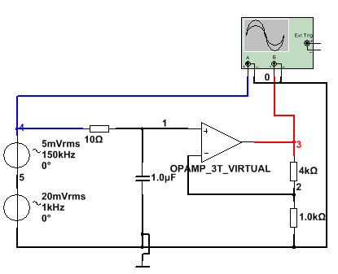
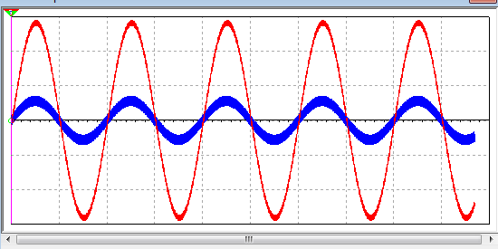
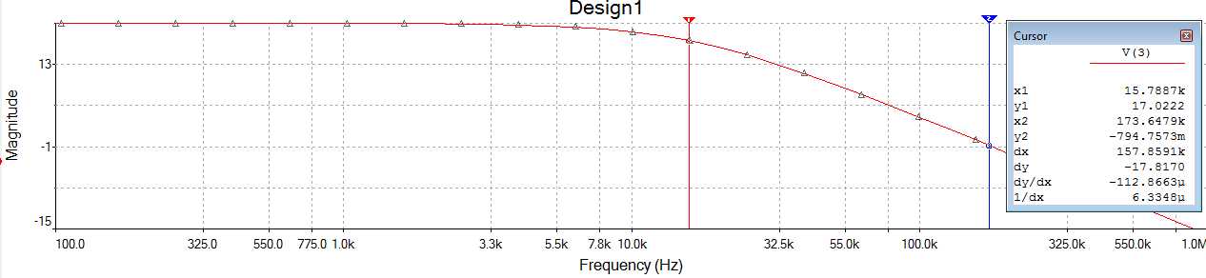
Ref:1PLPFactive.ms12

Slide 28
The diagram above shows a simple low –pass filter with the output both filtered and magnified. This is an example of a First Order Active Low-Pass filter.
If we wish to design for a sharper response so that the frequency response drop-off at a faster rate then we will need to move to a “higher order filter”, such as a “second order filter”.
An example of a second order filter is shown below:

Slide 29
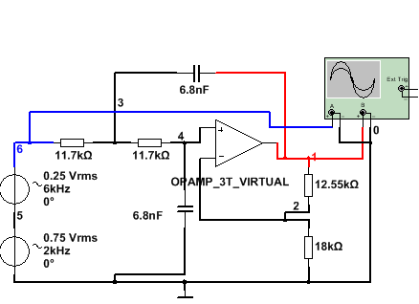
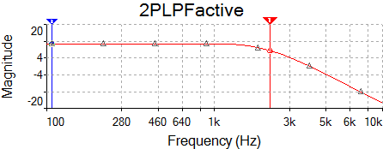
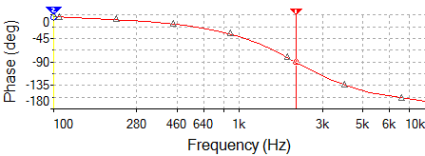
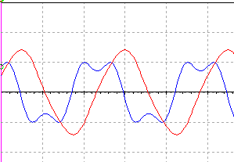
SECOND ORDER EQUAL COMPONENT SALLEN & KEY FILTER

Slide 30
The circuit above shows a complex input waveform being filtered by a Second Order Equal component Sallen & Key Low-Pass Filter.
A second order filter is characterised by two sets of RC networks, in this example a Sallen & Key topology has been used and equal values or R and C are used in the RC networks.
The cut-off frequency is again given by f_{c} = 1/ (2.π.R.C)
For the above example fc = 2kHz

Slide 31
The purpose of this filter example is to filter out the 6 kHz, third harmonic , from the complex input waveform which consists of a 2kHz and 6kHz components representing the fundamental and third harmonic of a symmetrical 2kHz square waveform.
There are a variety of way of designing the filter, some are mathematical and some are graphical. Some are simple “cook book” approaches, where the mathematical content and design approach is not necessarily given and some are software based. This allows design of such filters with the minimal of knowledge.

Slide 32
DESIGN APPROACH FOR THE EQUAL COMPONENT SALLEN & KEY FILTER
Determine the desired cut-off frequency (fc).
Choose the desired rate of roll-off, for a second order filter it will be 40dB/decade or 12 dB/octave.
If a faster roll-off is required then we can add an extra 20dB/dec by cascading another first order filter with the second order filter. A fourth order filter can be achieved by cascading two second order filters etc.
When fc has been determined, choose a suitable value for C and then calculate the required value of R using f_{c} = 1/ (2.π.R.C)

Slide 33
The next step is to determine the resistor values for the gain. For the circuit shown the gain K is given by
In addition to achieve the response shown it can be proved that K = 1.586
Therefore 0.586 must =
Suppose we choose R1 to be 18k then R2 would need to be 0.586 x R1 = 10.55k, as shown in the circuit above.

Slide 34
Suppose we wanted to filter out the 2kHz component and keep the 6kHzcomponent? This would require a High-Pass filter (HPF).
Fortunately this is a fairly simple exercise using the S & K filter. We simply swap the positions or the Rs and Cs in the frequency determining part of the circuit.
All we have to do now is decide on the new cut-off frequency, say 6 kHz, and determine the new values of R and C. Suppose we leave C alone and determine the new value for R.

Slide 35
From f_{c} = 1/ (2.π.R.C) we can determine R.
Hence R = = 1/ (2.π. f_{c}.C) = 3.9k
By substituting the new R value for R and swapping the Rs and Cs we get the HPF response shown below.
Note that the output waveform is the 6kHz but there is also some remnant 2kHz present as well. This is because the 6kHz component is much smaller than the 2 kHz. If their sizes were exchanged then we would see only the 6kHz getting through.

Slide 36
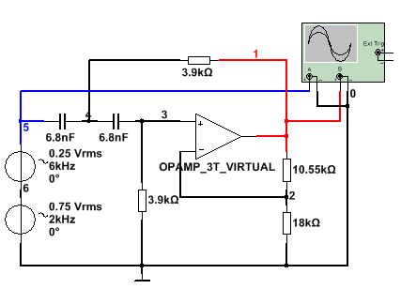
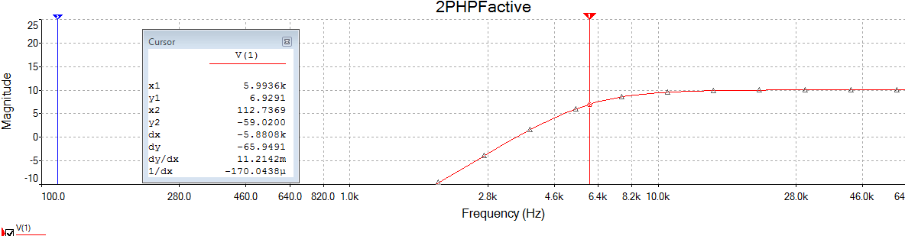
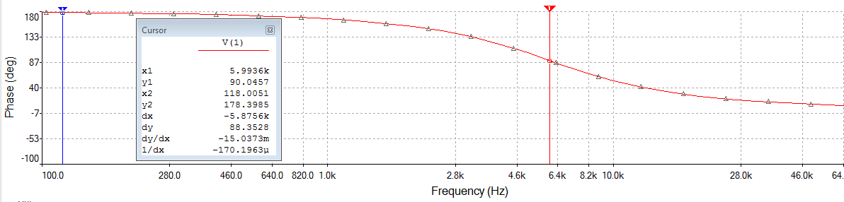
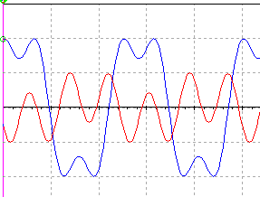

Slide 37
Alternatively, if we can make the filter more sensitive to the 6 kHz component we might be able to pick more of it out and less of the two kHz component, if we can also make the rate of roll-off greater.
This is exactly what has been done in the next diagram.
Note that R2 has been significantly increased, this has given rise to a peak in the response at approximately 6 kHz, in addition the rate of roll-off is quicker and less 2 kHz is getting through.

Slide 38
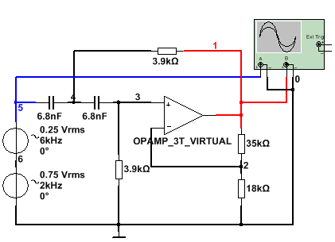
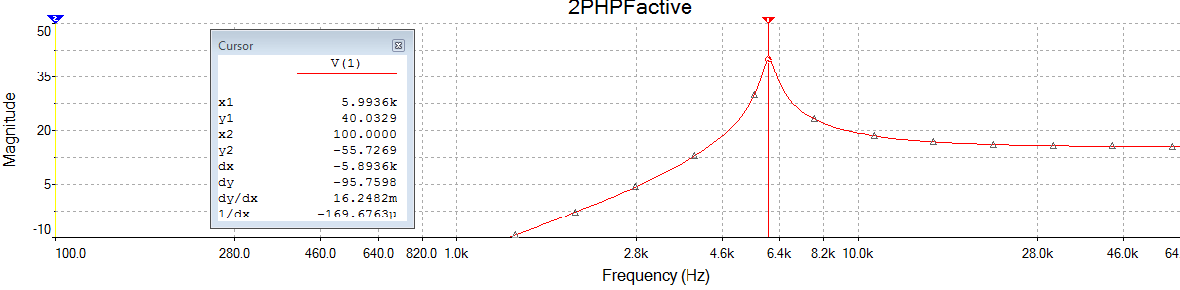
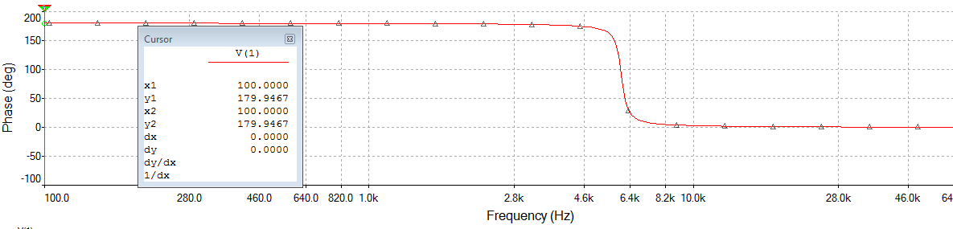
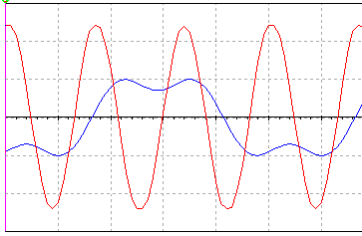

Slide 39
This peaked response is characteristic of what’s known as a Chebychev response. The previous flat response his known as a Butterworth response.
A Chebychev filter is therefore characterised by a peak in the passband and a faster roll-off rate into the stop band.
It should be obvious now that the ratio of R2/R1 is critical to the shape of the filter response and that R and C determine the cut-off frequency, independently of the shape of the response.

Slide 40
CLASSIC FILTER RESPONSES
There are three classic filter responses associated with these types of filters;
  The Bessel response: K = 1.27
  The Butterworth response: K = 1.586
  The Chebychev response: K = 2.234
  By changing the gain (K) we can easily change the response shape.

Slide 41
  It can be shown that the relationship between K and the required response shape is given by :
  d = 3 – K, or K = 3-d where d is known as the damping factor.
  The damping factor (d) determines the shape of the response in the region near to the cut-off frequency.
  The Bessel filter response has the highest damping of the three basic responses, then the Butterworth and finally the Chebychev.

Slide 42
Notice that if K = 3 then the damping is zero, this would make the peak in the Chebychev response go to infinity and the filter would go into oscillation.
For a Bessel filter K = 1.27 and d = 1.73
Butterworth K = 1.586 and d = 1.414
+3dB Chebychev K =2.234 and d =0.766
Graphs of a range of responses are shown on the next slide.
Note the frequency axis has been normalised to
ω = ω₀

Slide 43
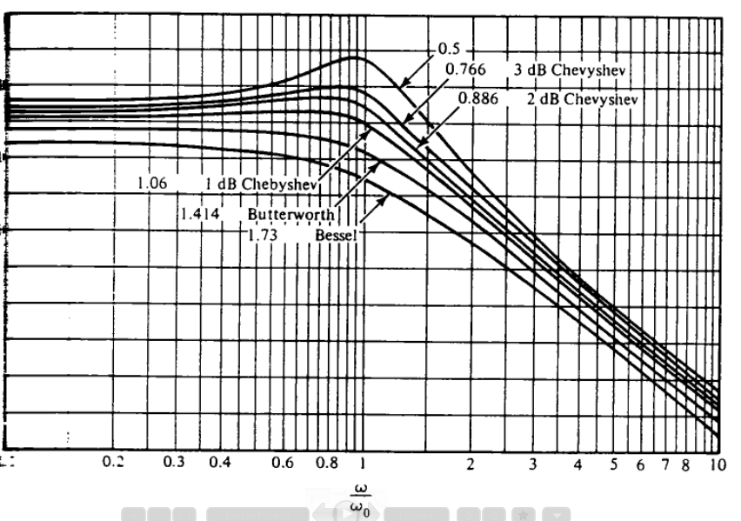
Gain
0 dB
-10 dB
-20
-30
-40

Slide 44
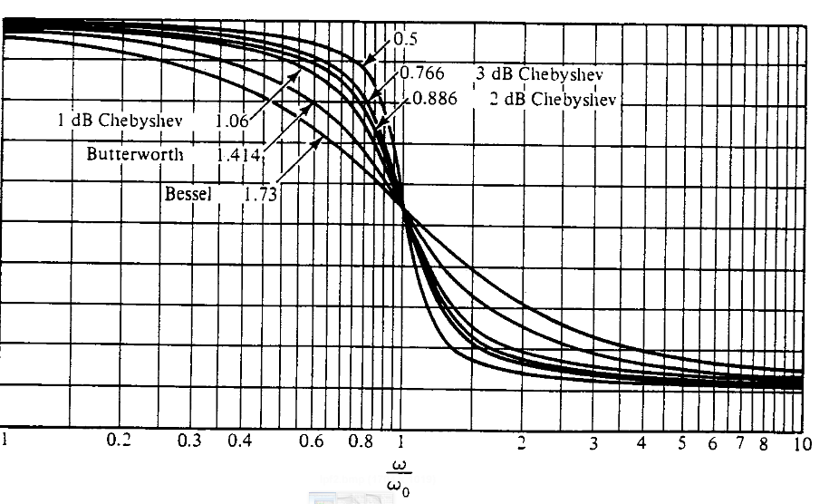
Phase
0
-20
-40
-60
-80
-100
-90 ⁰ at fc

Slide 45
The reason for normalising the response graphs is that all the important response information takes place within 1 decade above and below fc and therefore if we normalise the graph we centre the response at fc.
I have already given a set of steps to be followed in designing a S&K filter. However, it should be refined to include a decision on the type of response required.

Slide 46
One further step is required in the finalisation of the design. Imperfections within the op-amp give rise to some errors at the output. One of these errors is known as an offset current error.
Offset current problems manifest themselves as a small d.c. output voltage which will off-set the final output by some small amount.
To minimise this problem , not only must R2/R1 satisfy the gain requirement but also the resistance to ground on both inputs must be the same. This means that when looking out from both op-amp inputs the dc resistance to ground should be equal.

Slide 47
For example in the previous circuit diagram R2/R1 was 35k/18k = 1.94
To minimise offset current problems the ratio of R2/R1 should not only = 1.94 but the actual values of R2 and R1 should be such that their parallel value should equal the 3.9k resistance seen by the inverting input to ground.
Hence we can now produce two equations such that
R2/R1 = 1.94 eqn.1 and
( R1.R2) / (R1+R2) = 3.9k eqn.2

Slide 48
From the two equations above we find that R1 = 5.91k and R2 = 11.47k
All we need do now is replace the 18k resistor with 5.91k and the 35k resistor with 11.47k and the design will be complete.
NB: for a LOW-pass filter the same idea applies, i.e.
The d.c. resistance seen to ground, looking out from the inputs should be the same.
Therefore for a lpf the frequency determining resistance must equal the parallel resistance of the feedback resistors.

Slide 49
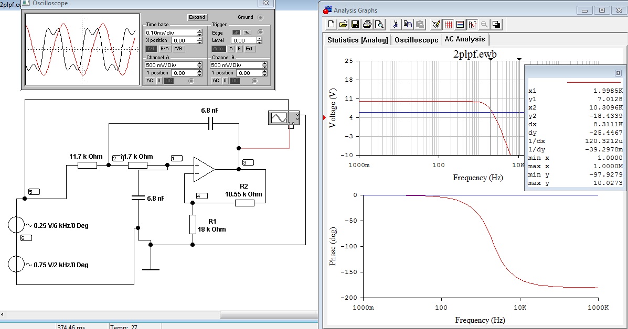
In this example, to design for minimum offset current, the
Sum of the two 11.7k resistors should be equal to the parallel combination of R1 and R2.
If not then the circuit is not designed for minimum offset current.

