Slide 1
Static Routing
Lecture 2

Slide 2
Static Routing Implementation

Slide 3
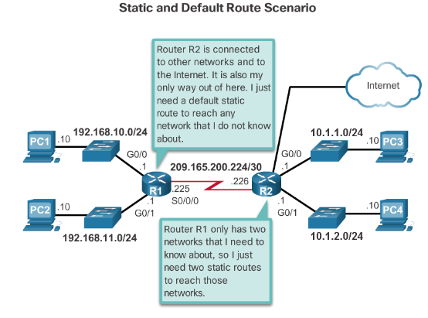
Static Routing
Reach Remote Networks
A router can learn about remote networks in one of two ways:
Manually - Remote networks are manually entered into the route table using static routes.
Dynamically - Remote routes are automatically learned using a dynamic routing protocol.

Slide 4
Why Use Static Routing?
Static routing provides some advantages over dynamic routing, including:
Static routes are not advertised over the network, resulting in better security.
Static routes use less bandwidth than dynamic routing protocols, no CPU cycles are used to calculate and communicate routes.
The path a static route uses to send data is known.

Slide 5
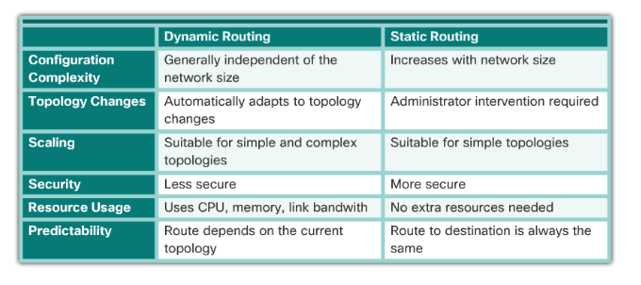
Comparison

Slide 6
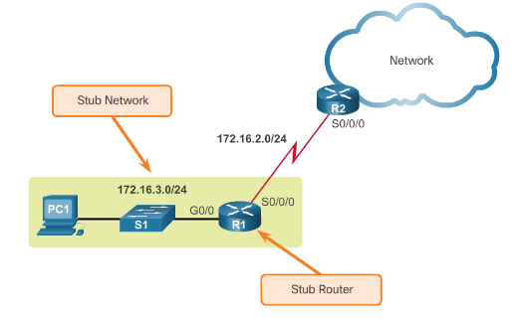
When to Use Static Routes
Static routing has three primary uses:
Providing ease of routing table maintenance in smaller networks.
Routing to and from stub networks. A stub network is a network accessed by a single route, and the router has no other neighbors.
Using a single default route to represent a path to any network that does not have a more specific match with another route in the routing table.

Slide 7
Static Route Applications
Static Routes are often used to:
Connect to a specific network.
Provide a Gateway of Last Resort for a stub network.
Reduce the number of routes advertised by summarizing several contiguous networks as one static route.
Create a backup route in case a primary route link fails.

Slide 8
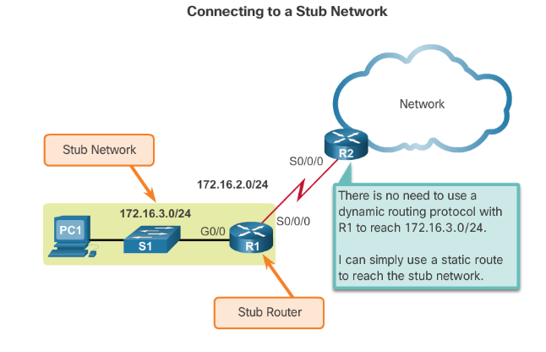
Standard Static Route

Slide 9
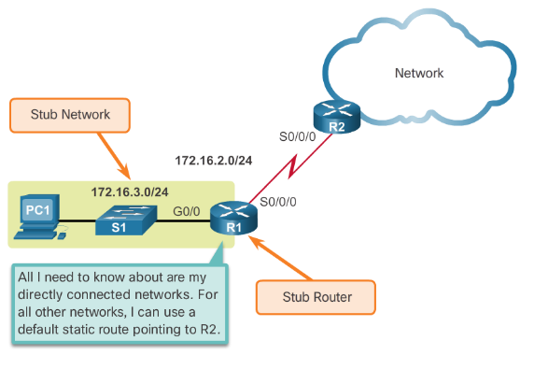
Default Static Route
A default static route is a route that matches all packets.
A default route identifies the gateway IP address to which the router sends all IP packets that it does not have a learned or static route.
A default static route is simply a static route with 0.0.0.0/0 as the destination IPv4 address.

Slide 10
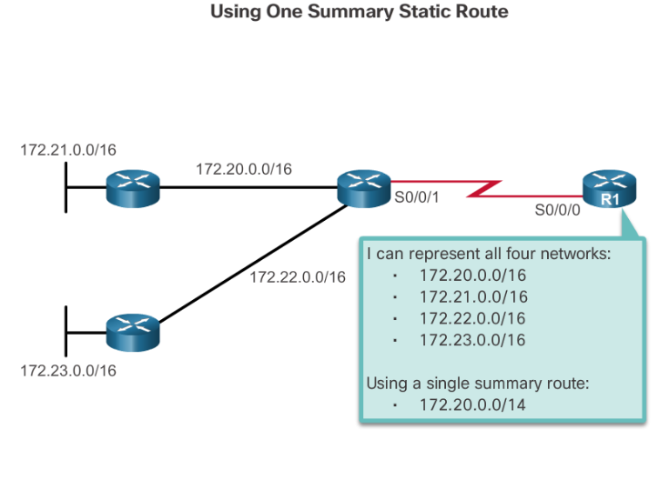
Summary Static Route

Slide 11
Configure Static and Default Routes

Slide 12
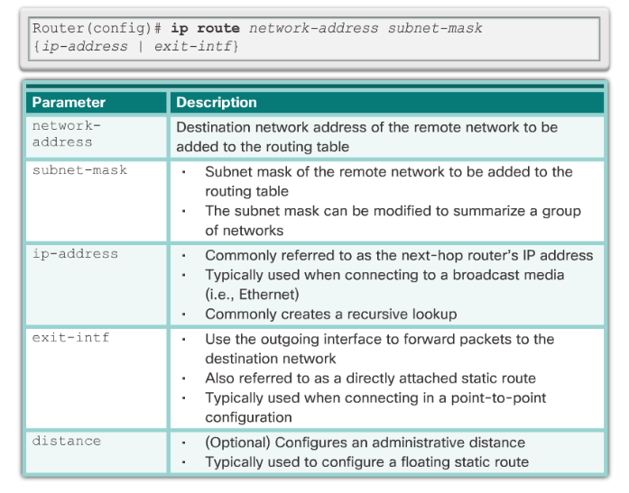
Configure IPv4 Static Routes ip route Command

Slide 13
Configure IPv4 Static Routes
Next-Hop Options
The next hop can be identified by an IP address, exit interface, or both. How the destination is specified creates one of the three following route types:
Next-hop route - Only the next-hop IP address is specified.
Directly connected static route - Only the router exit interface is specified.
Fully specified static route - The next-hop IP address and exit interface are specified.

Slide 14
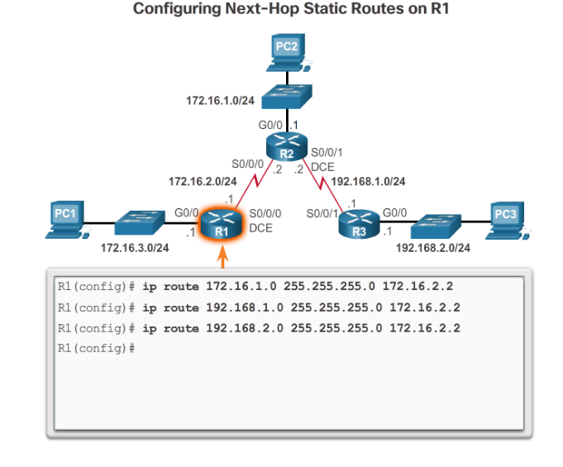
Configure IPv4 Static Routes
Configure a Next-Hop Static Route

Slide 15
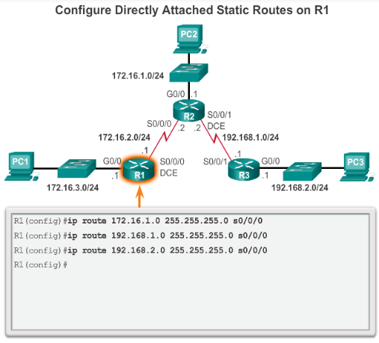
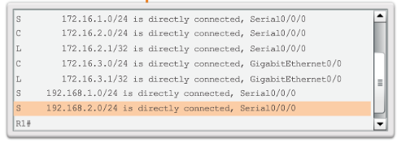
Configure Directly Connected Static Route

Slide 16
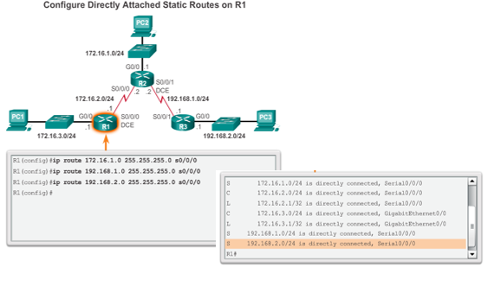
Configure Fully Specified Static Route

Slide 17
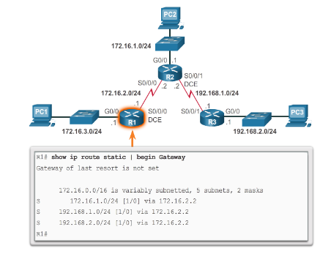
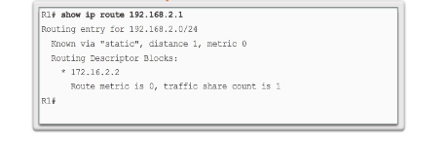
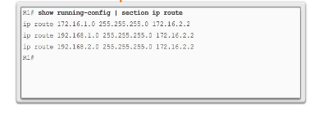
Verify a Static Route

Slide 18
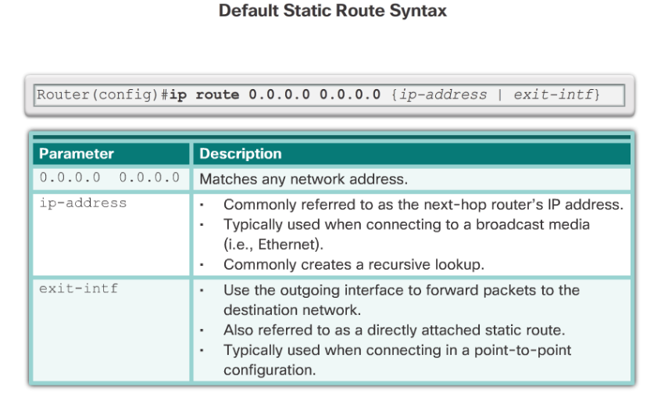
Default Static Route

Slide 19
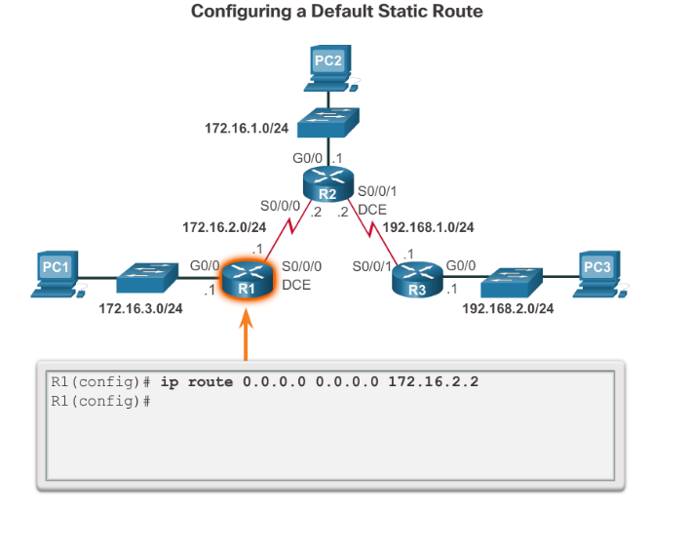
Configure a Default Static Route

Slide 20
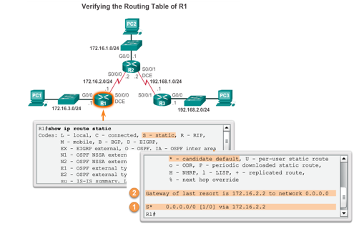
Verify a Default Static Route

Slide 21
IPv6 Static Routes

Slide 22
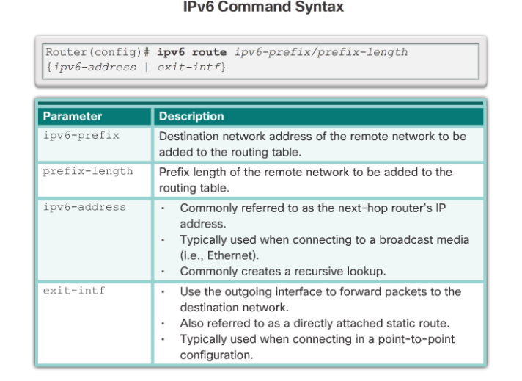
Configure IPv6 Static Routes
The ipv6 route Command

Slide 23
Configure IPv6 Static Routes
Next-Hop Options
Next-hop static IPv6 route - Only the next-hop IPv6 address is specified
Directly connected static IPv6 route - Only the router exit interface is specified
Fully specified static IPv6 route - The next-hop IPv6 address and exit interface are specified

Slide 24
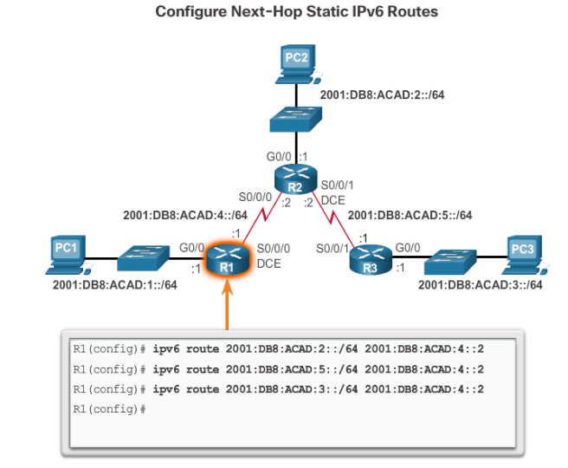
Configure Next-Hop Static IPv6 Route

Slide 25
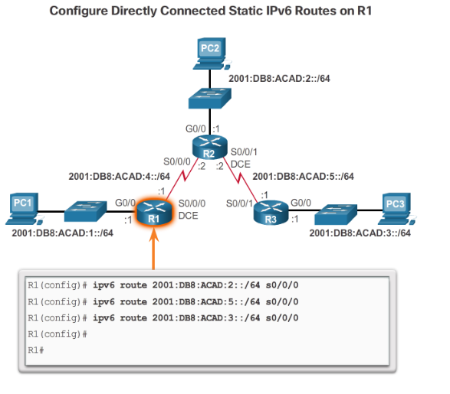
Directly Connected Static IPv6 Route

Slide 26
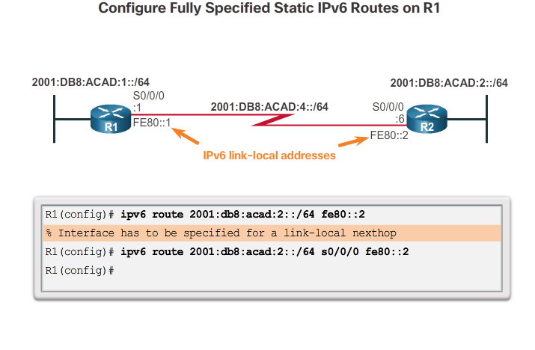
Fully Specified Static IPv6 Route

Slide 27
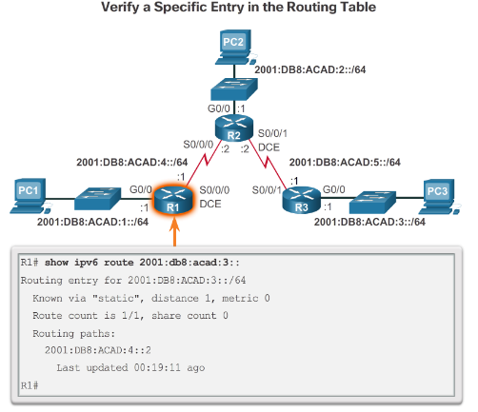
Verify IPv6 Static Routes
In addition to ping and traceroute, commands to verify static routes include:
show ipv6 route
show ipv6 route static
show ipv6 route network

Slide 28
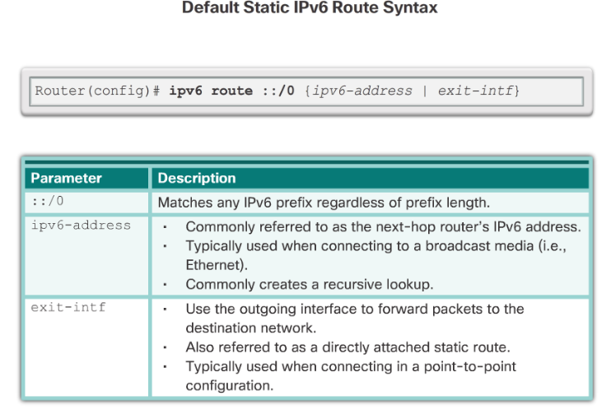
Default Static IPv6 Route

Slide 29
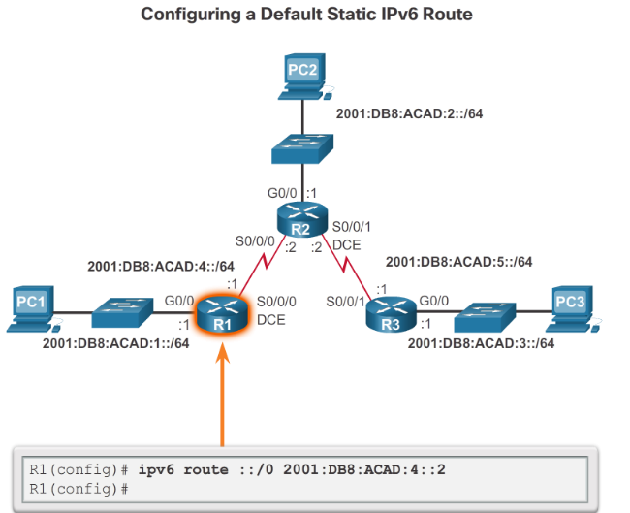
Configure a Default Static IPv6 Route

Slide 30
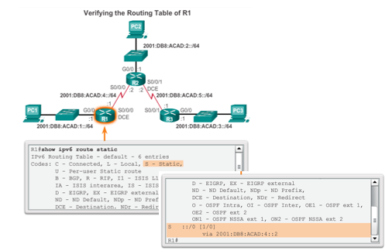
Verify a Default IPv6 Static Route

Slide 31
Floating Static Routes

Slide 32
Floating Static Routes
Floating static routes have an administrative distance greater than the administrative distance of another static route or dynamic routes.
The static route “floats” and is not used when the route with the better administrative distance is active.
If the preferred route is lost the floating static route can take over.

Slide 33
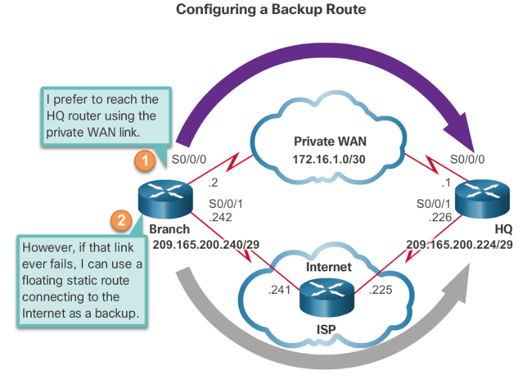
Floating Static Route

Slide 34
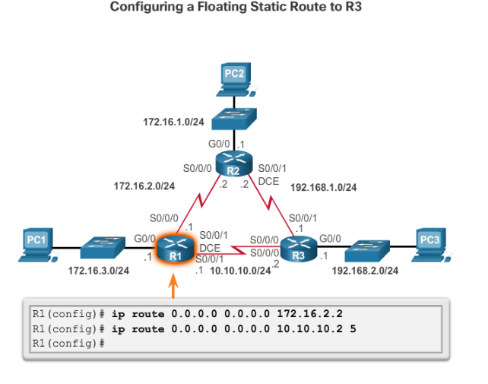
Configure an IPv4 Floating Static Route

Slide 35
Test the IPv4 Floating Static Route
To test a floating static route:
Use the show ip route command to verify that the routing table is using the default static route.
Use the traceroute command to follow the traffic flow out the primary route.
Disconnect the link or shutdown the primary interface(s). In the curriculum example the serial interfaces on R2 are shutdown.
Use a show ip route command to verify that the routing table is using the floating static route.
Use a traceroute command to follow the traffic flow out the backup route.

Slide 36
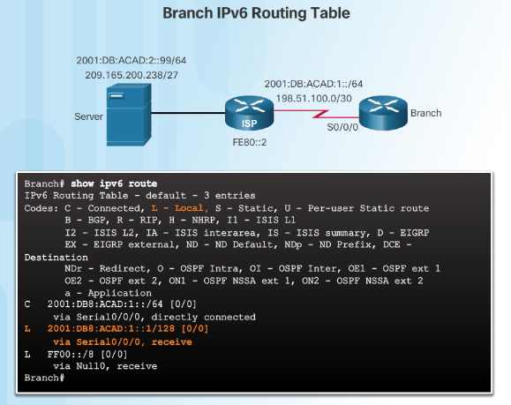
Automatically Installed Host Routes
A host route is an IPv4 address with a 32-bit mask or an IPv6 address with a 128-bit mask.
Automatically installed when an IP address is configured on the router.
The local routes are marked with “L” in the output of the routing table.

Slide 37
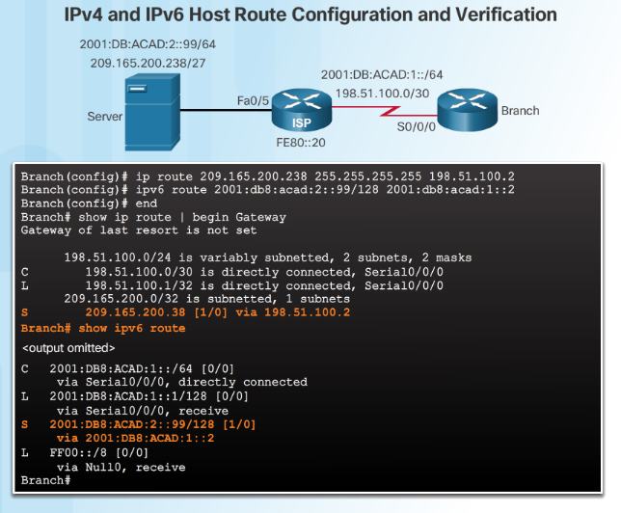
Configure IPv4 and IPv6 Static Host Routes

Slide 38
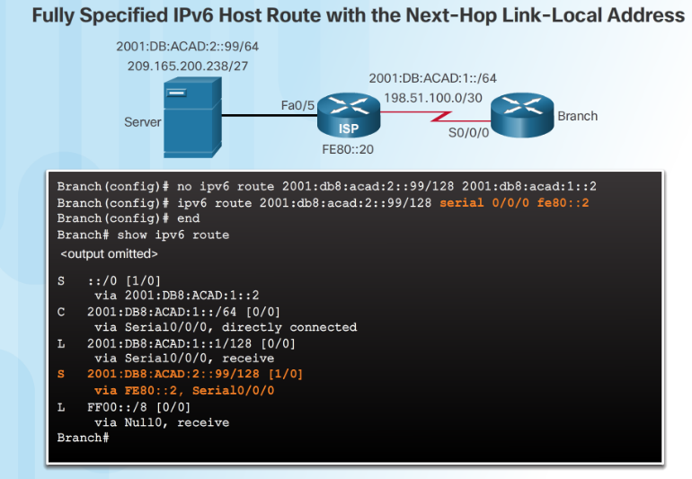
Configure IPv4 and IPv6 Static Host Routes

Slide 39
Troubleshoot Static and Default Route Issues

Slide 40
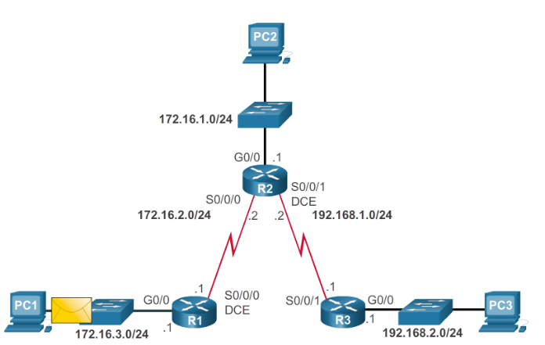
Packet Processing with Static Routes
Static Routes and Packet Forwarding

Slide 41
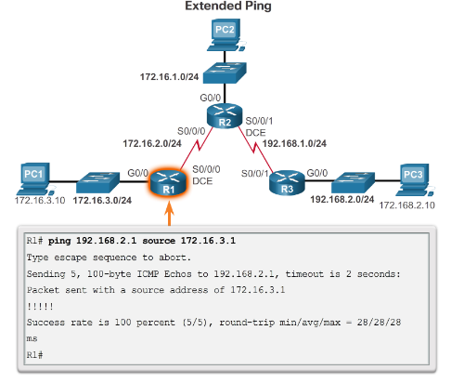
Troubleshoot a Missing Route
IOS troubleshooting commands include:
ping
Extended ping enables you to specify the source IP address for the ping packets.
traceroute
show ip route
show ip interface brief
show cdp neighbors detail

Slide 42
Solve a Connectivity Problem
Finding a missing (or misconfigured) route requires using the right tools in a methodical manner.
Use the ping command to confirm the destination can’t be reached.
A traceroute would also reveal the closest router (or hop) that fails to respond as expected. In this case, the router would then send an Internet Control Message Protocol (ICMP) destination unreachable message back to the source.
The next step is to investigate the routing table using the show ip route command. Look for missing or misconfigured routes.
Incorrect static routes are a common cause of routing problems.

Slide 43
Summary
  Explain the advantages and disadvantages of static routing.
  Explain the purpose of different types of static routes.
  Configure IPv4 and IPv6 static routes by specifying a next-hop address.
  Configure IPv4 and IPv6 default routes.
  Configure a floating static route to provide a backup connection.
  Configure IPv4 and IPv6 static host routes that direct traffic to a specific host.
  Explain how a router processes packets when a static route is configured.
  Troubleshoot common static and default route configuration issues.
Notes:
Summary

Slide 44
Terms and Commands
static route
administrative distance (AD)
stub network
default route
0.0.0.0/0
default static route
Gateway of Last Resort
more specific match
summary static route
floating static route
Notes:
Terms and Commands

Slide 45
Terms and Commands
exit-intf
next hop
recursive static route
recursive lookup
directly connected static route
CEF (Cisco Express Forwarding)
FIB (Forwarding Information Base)
fully specified static route
edge router
stub router
quad-zero route
::/0
destination network
ipv6 route command
Fully specified static IPv6 route
show ipv6 route
show ipv6 route static
show ipv6 route network
IPv4 Static Host Routes
IPv6 Static Host Routes
Extended ping
Notes:
Terms and Commands

