Slide 1

Phenomenology
Exploring the lived experience of imagination in an imagined space
Kylie Boon

Slide 2

What Is Phenomenological Research?

Slide 3

Qualitative research involves gathering and analyzing non-numerical data. It’s used to gain a better understanding of people’s beliefs, behaviors, attitudes, and experiences.
Phenomenological research (the study of phenomena) is qualitative research that aims to learn more about people’s lived experiences.
A phenomenon is defined as an observable fact or event.
When a researcher uses this methodology, they first have to define the phenomenon they’re studying. Then, they use their research methods to better understand how people experience the phenomenon or how it has impacted people.

Slide 4
When Should You Use Phenomenological Research?
You can use this type of research to find out how people perceive a certain situation or fact, or you can determine how a situation or fact has impacted them.

Slide 5
Methods
In-depth surveys
Focus groups
Questionnaires
Interviews
Analyzing personal texts
Observations
Case studies
Recordings
How Is Phenomenological Research Carried Out?
Because phenomenological research is a qualitative research approach, it involves speaking to or observing participants. Researchers can use some or all of the methods opposite.

Slide 6
Methodology: The overall approach or strategy used to conduct research. It outlines the principles and guidelines that guide the entire research process. The theoretical framework guiding the research, and the overall design of the study. It answers the question: "How will I approach my research?"
Method: Research method, on the other hand, refers to the specific techniques used to gather the data within the chosen methodology. Methods are the practical steps or procedures undertaken to answer research questions. They include activities such as surveys, experiments, interviews, and observations. Methods are the actionable steps taken to execute the research. They answer the question: "What specific steps will I take to collect data?"

Slide 7

Purpose of todays lecture…
Stress Testing Phenomenology.
Today you are researching the phenomena of the imagination, and how the mind operates in imagined spaces, like that of virtual reality.
The purpose of this research is to better understand immersive imagination.
To what extent is VR and effective means to investigate the psychological impact of a space?
How does culture affect interpretation, and is there evidence of collective memory?
What liminal environments are most effective in connecting with memory and evoking nostalgia?

Slide 8
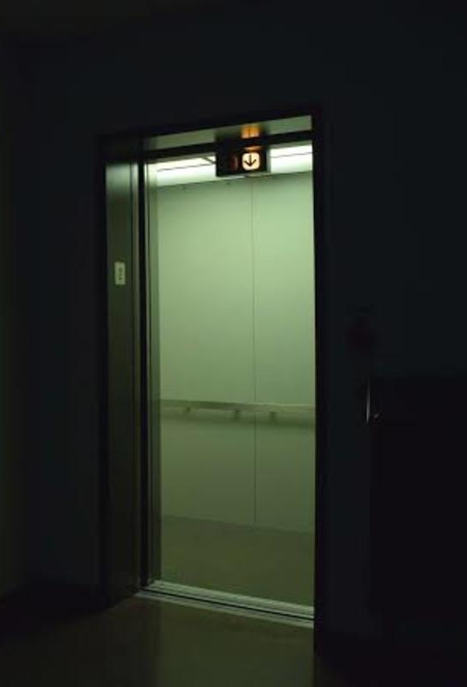


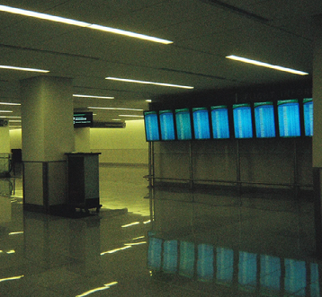


Slide 9

Liminal space refers to the place a person is in during a transitional period. It's a gap, and can be physical (like a doorway), emotional (like a divorce) or metaphorical (like a decision). In architecture, liminal spaces are defined as "the physical spaces between one destination and the next." Common examples of such spaces include hallways, airports, and backrooms. The word “limin” comes from the Latin word for threshold. But can also be associated with the notion of a boundary.

Slide 10
Stress Testing Phenomenology.
Researching the phenomena of the imagination, and how the mind operates in imagined spaces (VR).

Slide 11
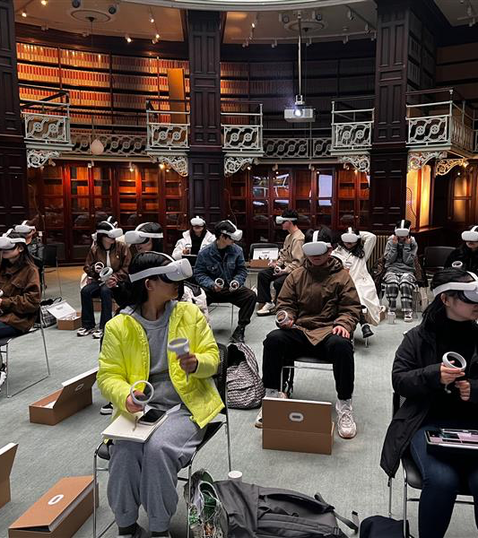
TASK: Stepping Into a New Reality
You are about to enter the VR space.
Before you do, you will receive a secret message.
Please read the instructions carefully and do not share your message with anyone.
Even after the experience, do not discuss its contents in class until instructed to do so.

Slide 12

What did you imagine?

Slide 13

Phenomenologists are interested in examining the underlying structures of consciousness and experience, typically emphasizing the crucial importance of the first-person perspective in understanding ourselves and the world around us.
For example, if we were to describe our experience of, say, looking at a bowl of fruit, typically we would rather passively describe the distinct objects we see: a banana, an apple, some oranges, the bowl itself.
But phenomenologists would encourage us to take a step back here. What do we actually experience when looking at the bowl of fruit? Is it just these distinct objects? Or is it rather a unified multitude of shapes, textures, colors, sounds, smells, the passing of time, our mood, perhaps a brief desire for an orange, the overpowering repulsion of a fruit we don’t like?
The point is that, when you think about it, our experience of the world is characterized wholly by intentionality.
Though we may typically describe our experiences as though we are mere subjects passively perceiving objects, we do not actually experience the world in this way. Rather we are immersed in whatever we are experiencing, existing in the world through an ever-shifting kaleidoscopic lens of memory, desire, mood, attention, inattention, intention.

Slide 14
Data Collection Method
Written reflections
(based on open ended questions).

Slide 15

Task: Write one sentence in response to each of these questions:
Did the space feel familiar or unfamiliar? Why?
How did you perceive time in the space?
How did the space make you feel, can you pinpoint something specific that made you feel that way?
Did you imagine a figure or though you saw a figure momentarily?
(be specific)
What did you imagine was in the space with you? (be specific in your description)
Did the experience link to a memory? If so, what memory?

Slide 16

Task: In teams discuss your found patterns.
Can it help you answer this question:
How does culture affect interpretation, and is there evidence of collective memory?
Collective memory: A shared pool of knowledge, experiences, or narratives among a group, community, or society. It shapes cultural identity and is reinforced through stories, traditions, etc.

Slide 17
Task: Write one sentence in response to each of these questions:
Did the space feel familiar or unfamiliar? Why?
How did you perceive time in the space?
How did the space make you feel, can you pinpoint something specific that made you feel that way?
Did you imagine a figure or though you saw a figure momentarily?
(be specific)
What did you imagine was in the space with you? (be specific in your description)
Did the experience link to a memory? If so, what memory?

Slide 18

Content Analysis
Is used to identify patterns in recorded communication. To conduct content analysis, you systematically collect data from a set of texts, which can be written, oral, or visual:
Books, newspapers, and magazines
Speeches and interviews
Web content and social media posts
Photographs and films
Content analysis can be both quantitative (focused on counting and measuring) and qualitative(focused on interpreting and understanding). In both types, you categorise or ‘code’ words, themes, and concepts within the texts and then analyse the results.

Slide 19

Define the units and categories of analysis
You need to determine the level at which you will analyse your chosen texts. This means defining:
The unit(s) of meaning that will be coded. For example, are you going to record the frequency of individual words and phrases, the characteristics of people who produced or appear in the texts, the presence and positioning of images, or the treatment of themes and concepts?
Analyse the results and draw conclusions
Once coding is complete, the collected data is examined to find patterns and draw conclusions in response to your research question.

Slide 20
Look at the words, phrases or themes in the text.
Record frequency of words, phrases, or treatment of themes.
Once this is done look for patterns.
Task Data Analysis:
You will use content analysis to review and explore the written reflection (your data).
You will look for patterns or repeated ideas that emerge in the text.

Slide 21
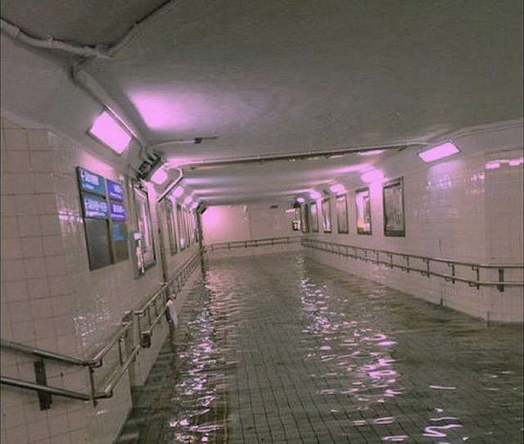
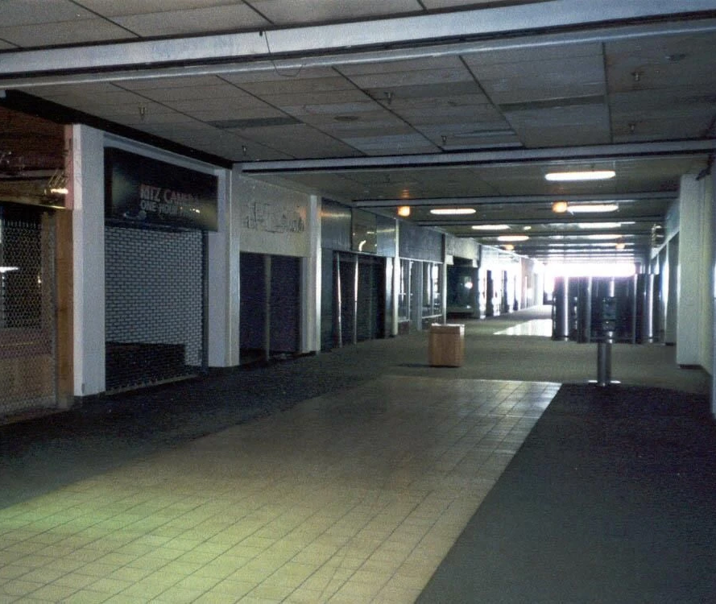
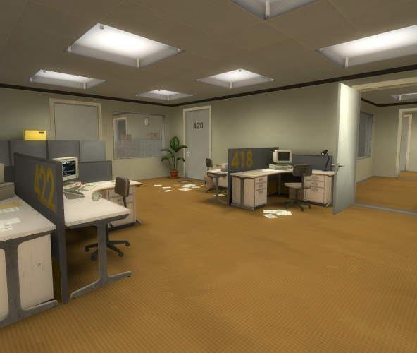
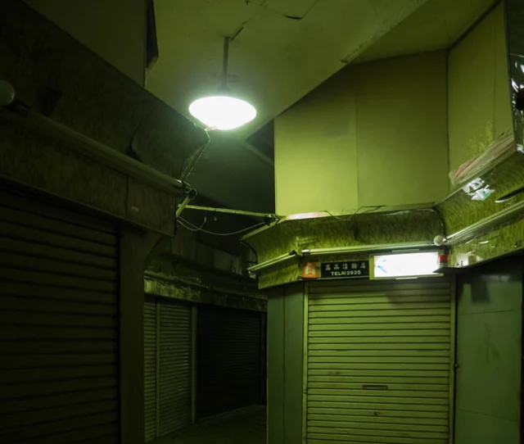
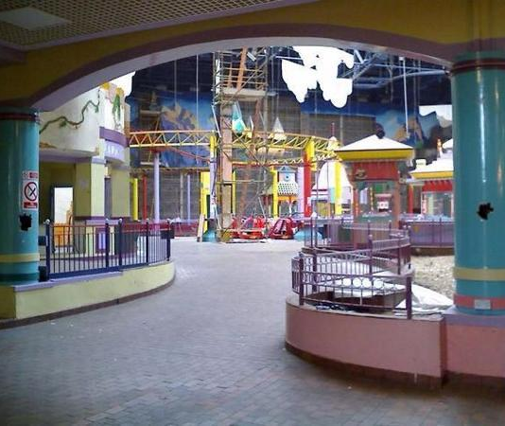
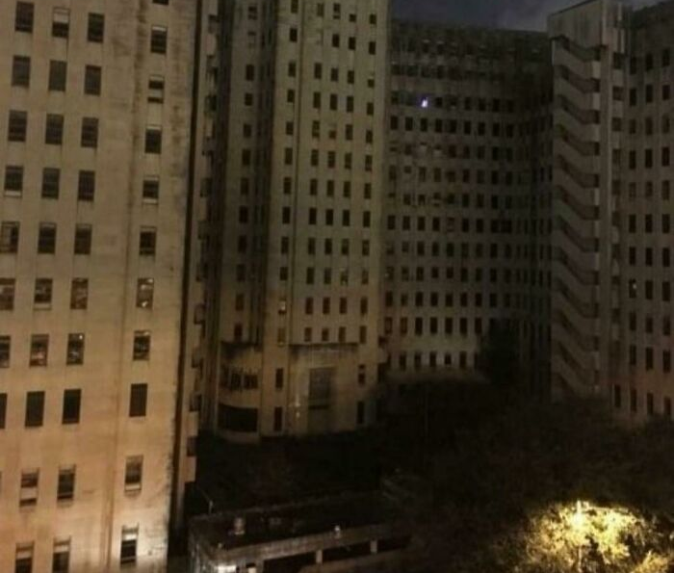
Can you connect this to the contemporary mindset?

Slide 22
Task: In teams discuss your found patterns.
Can it help you answer this question:
To what extent is VR and effective means to investigate the psychological impact of a space?

Slide 23
Task: Write one sentence in response to each of these questions:
Did the space feel familiar or unfamiliar? Why?
How did you perceive time in the space?
How did the space make you feel, can you pinpoint something specific that made you feel that way?
Did you imagine a figure or though you saw a figure momentarily?
(be specific)
What did you imagine was in the space with you? (be specific in your description)
Did the experience link to a memory? If so, what memory?

Slide 24
Look at the words, phrases or themes in the text.
Record frequency of words, phrases, or treatment of themes.
Once this is done look for patterns.
Task Data Analysis:
You will use content analysis to review and explore the written reflection (your data).
You will look for patterns or repeated ideas that emerge in the text.

Slide 25
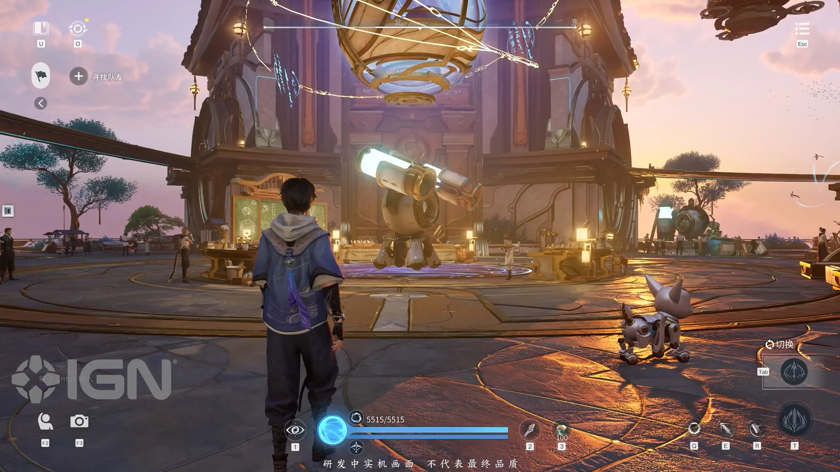
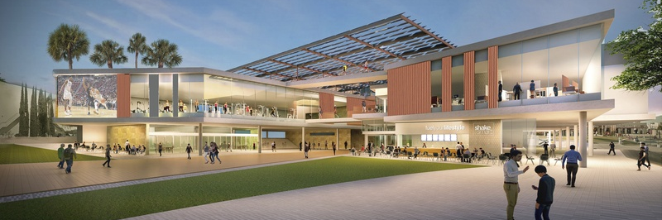

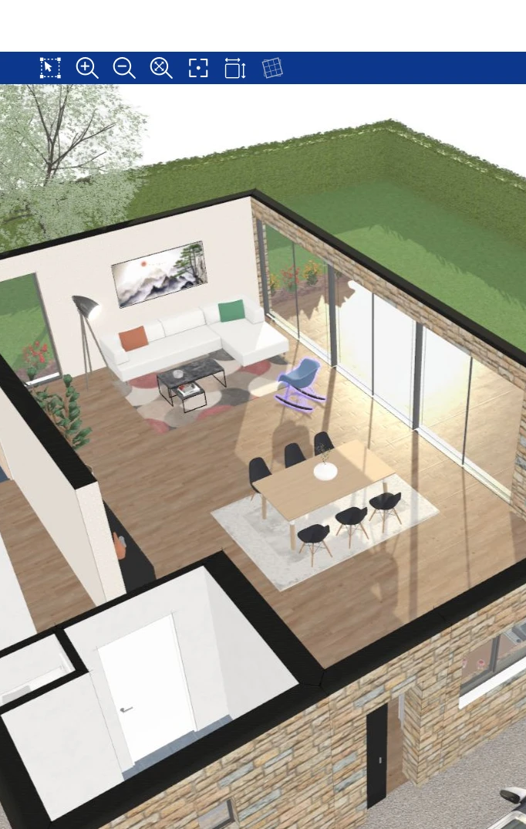
How could you integrate your findings and what you have learned into practice?
GAMES DESIGNERS, SPATIAL/ENVIROMENTAL DESIGNERS, or ARCHETECTS?

Slide 26

Revealing your secret message

Slide 27
What did you imagine?
Did the secret message affect your experience in VR? How?

Slide 28
Task: Write one sentence in response to each of these questions:
Did the space feel familiar or unfamiliar? Why?
How did you perceive time in the space?
How did the space make you feel, can you pinpoint something specific that made you feel that way?
Did you imagine a figure or though you saw a figure momentarily?
(be specific)
What did you imagine was in the space with you? (be specific in your description)
Did the experience link to a memory? If so, what memory?

Slide 29
Look at the words, phrases or themes in the text.
Record frequency of words, phrases, or treatment of themes.
Once this is done look for patterns.
Task Data Analysis:
You will use content analysis to review and explore the written reflection (your data).
You will look for patterns or repeated ideas that emerge in the text.

Slide 30
How does your experience connect with one of these ideas, does it support, conflict or expand upon the idea presented below? How?
Aristotle: “phantasia”: “imagination [phantasia] is different from both perception [aisthêsis] and reason [nous]…in [imagination], the affection is up to us, whenever we wish (for it is possible to produce something before one’s eyes)”
Jean Paul Sartre: “The act of imagination…is a magical act. It is an incantation to make the object of one’s thought, the thing one desires, appear…[The] object as imaged is an irreality”
Thomas Hobbes: For after the object is removed, or the eye shut, we still see an image of the thing seen…And this is it, the Latines call Imagination, from the image made in seeing…But the Greeks call it Fancy, which signifies appearance…IMAGINATION therefore is nothing but decaying sense.
(Cited in Matherne, 2024)
Matherne, S. (2024). Seeing More: Kant’s Theory of Imagination. Oxford University Press.

Slide 31

It’s important to note that the way you carry out your phenomenological research should not lead your participants toward a particular outcome. For example, surveys and questionnaires shouldn’t include any questions that lead participants to a particular answer or idea.
To get the best results from your research, try building a good rapport with your participants. It may be difficult to get people to share their honest experiences and you may have to consider how you can approach and work with your participants to make them feel comfortable.

Slide 32

Ethical Considerations
Because it’s such a people-focused methodology, ethics plays a big role in phenomenological research. Researchers must consider the impact the study will have on the participants and how it will affect them as researchers.

Slide 33
Pros and Cons of Phenomenological Research
Pros
● It’s a versatile it can be used across a wide range of subjects.
● It can remove a researcher’s preconceived ideas.
● It can help researchers get a much greater understanding of the phenomenon.
● It can help create new and more accurate theories.
● It can spread awareness about the phenomenon.
Cons
● It can be challenging to interpret the data.
● Studies can be dismissed as unreliable because it’s hard to validate people’s experiences.
● It can be easy for phenomenological studies to become biased by the researcher.
● Participants might struggle to get their points across because of issues like literacy, language barriers, and even age.
● Presenting findings can be challenging.

Slide 34

How could you apply phenomenology in your project?
Think about how you could use it.

Slide 35
Action research
Action research is a way of researching by actively trying to improve a real situation while studying it at the same time
Plan > act > observe > reflect

