Slide 1
Electrical and
Electronic Principles
(ACDA4006)
Lecture - 4

Slide 2
Content
Circuit Diagram
Circuit Element
Symbols
Active and Passive Devices

Slide 3
Learning Outcome
The student upon completion of the lecture will be able to:
Define a Circuit Diagram, Circuit Element, active and passive devices
Differentiate active and Passive Devices.
List out the symbols of various electronic devices

Slide 4
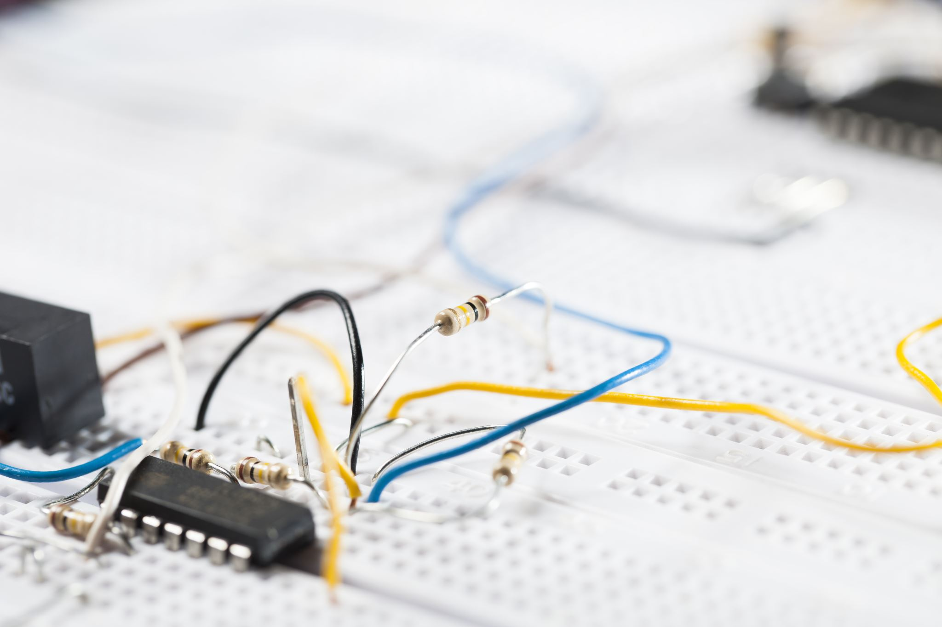
What is a circuit diagram?
A circuit diagram is a visual display of an electrical circuit using either basic images of components or industry standard symbols.
Symbol usage depends on the audience viewing the diagram.
WSJ lecture

Slide 5

Types of circuit diagram
There are two different types of circuit diagrams
  Schematic circuit diagram (using industry standard symbols).
  Pictorial circuit diagram (using basic images)
WSJ lecture

Slide 6
Steps to design a circuit diagram
Gather the details of the application for which the circuit is to be designed.
Draw the symbols or pictures of the electrical components in the appropriate place.
Connect the electrical components by wire accordingly (Series and parallel)
Connect with the appropriate power supply.
Check the phase (+) and neutral (-) connection.
Connect to the Ground /Earth the circuit.

Slide 7
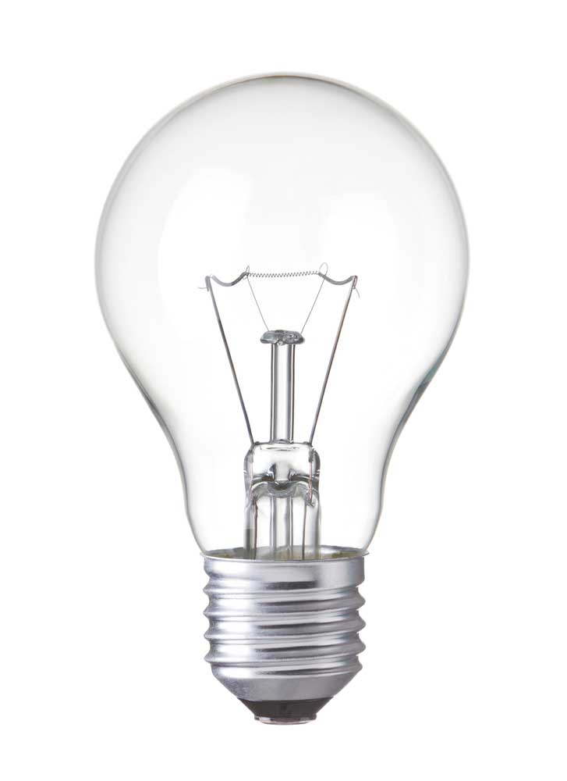

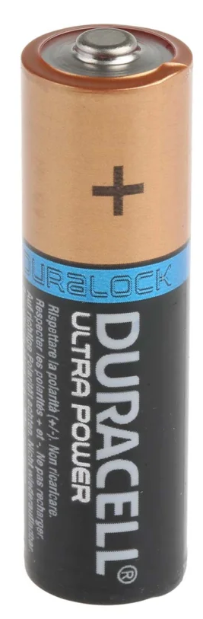

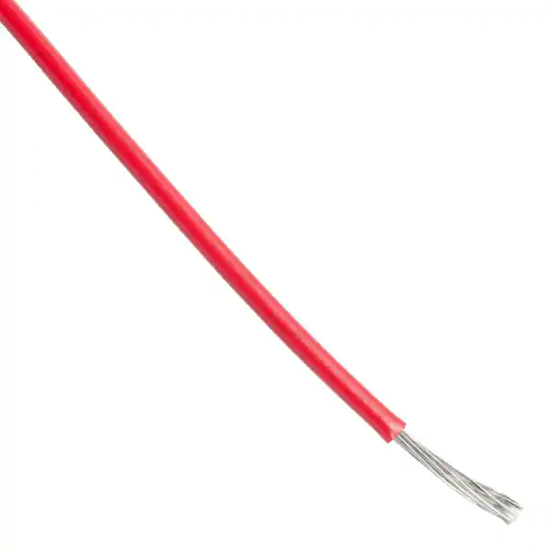



Connecting a Battery to lamp
Images of Electrical Equipments | Symbol | Name
 |  | Bulb
 |  | Battery
 |  | Wire
 |  | Switch

Slide 8
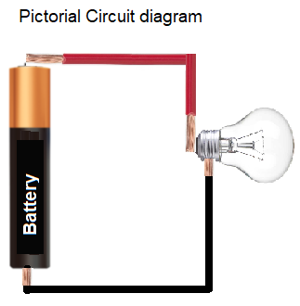
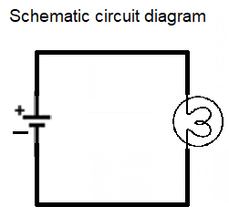
Connecting a Battery to a lamp

Slide 9
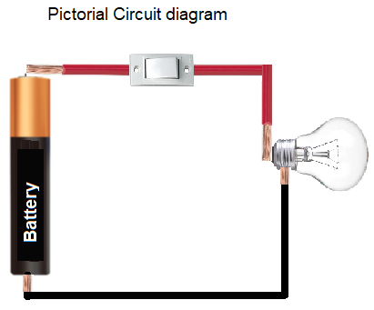
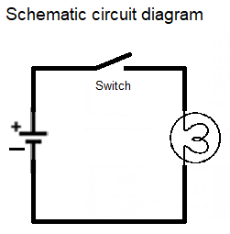
Connecting a battery to a lamp through a switch
Connecting a Battery to a lamp

Slide 10
Uses of Electrical circuit
Circuit diagrams are used in constructing circuits in PCB (Printed Circuit Board) or Bread Board.
It is used by engineers to get an idea about the physical electrical circuit.

Slide 11
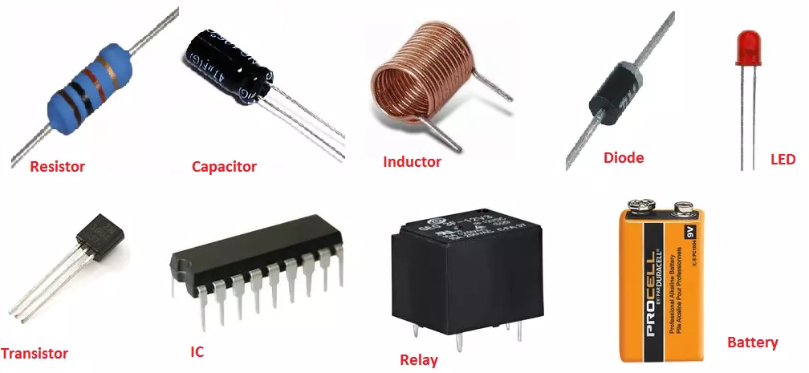
What is a Circuit element?
Each Component in a circuit is called a Circuit Element.
Resistor, capacitors, Inductors, Capacitors, Battery, Ammeter, etc

Slide 12
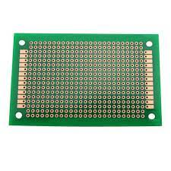
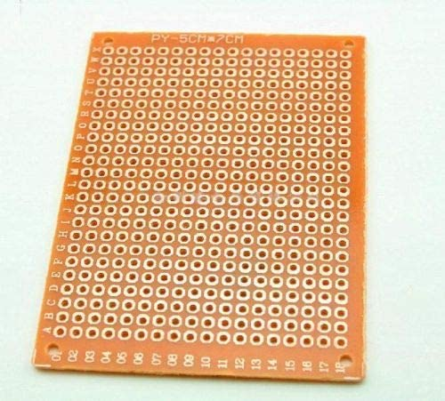
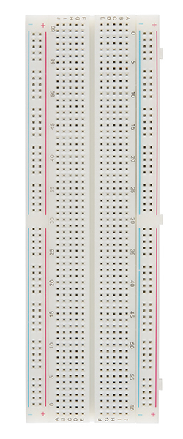
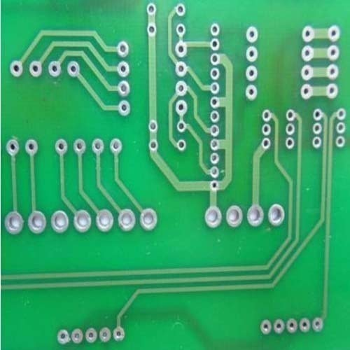
Where do you design circuits?

Slide 13
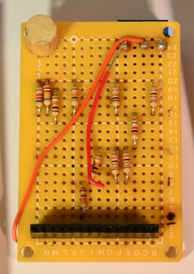
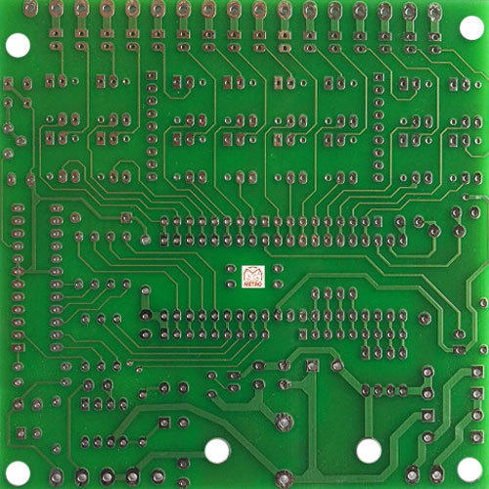
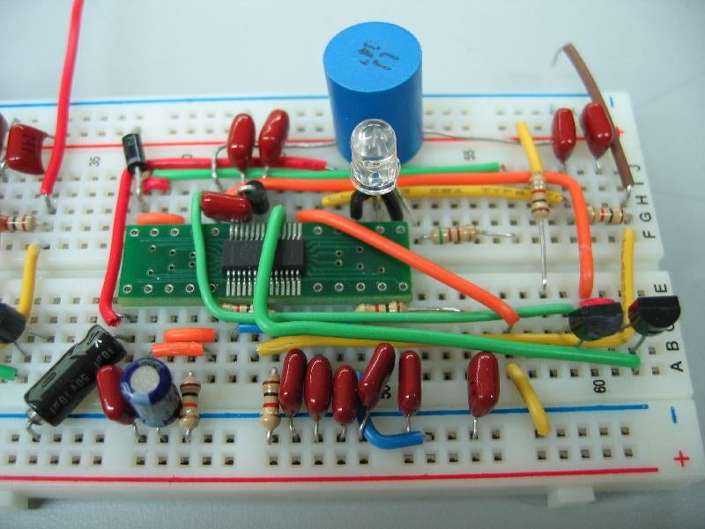
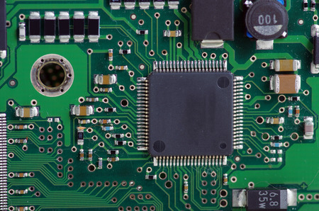
Where do you design circuits?

Slide 14
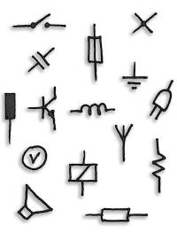
Symbols
To design electrical and Electronic circuit, it is necessary to know the symbol of all electrical and electronic components.
The symbol of Electrical and Electronic components are listed below.

Slide 15
Symbols

Slide 16
Symbols

Slide 17
Symbols

Slide 18
Symbols

Slide 19
Symbols

Slide 20
Symbols

Slide 21
Symbols

Slide 22
Symbols

Slide 23
Symbols

Slide 24
Symbols

Slide 25
Symbols

Slide 26
Symbols
Description | Notations
Voltage across a circuit is 5 | 5V
Current across a circuit is 2.5 | 2.5A
Value of the resistor is 100 | 100Ω
Value of inductance is 20 | 20H
Value of Capacitor is 300 | 300F
Power of the machine is 1000 | 1000W

Slide 27
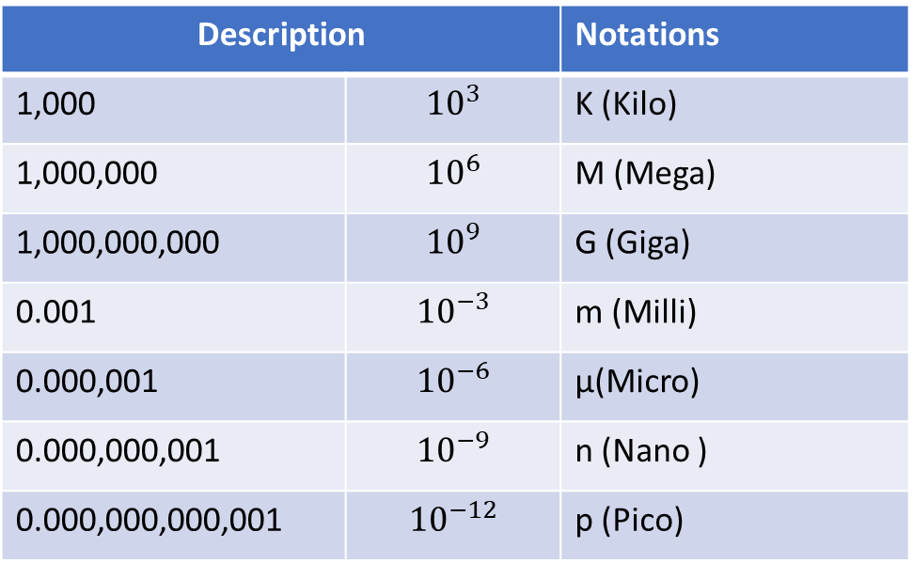
Symbols
Description |  | Notations
1,000 | $${10}^{3}$$ | K (Kilo)
1,000,000 | $${10}^{6}$$ | M (Mega)
1,000,000,000 | $${10}^{9}$$ | G (Giga)
0.001 | $${10}^{−3}$$ | m (Milli)
0.000,001 | $${10}^{−6}$$ | µ(Micro)
0.000,000,001 | $${10}^{−9}$$ | n (Nano )
0.000,000,000,001 | $${10}^{−12}$$ | p (Pico)

Slide 28
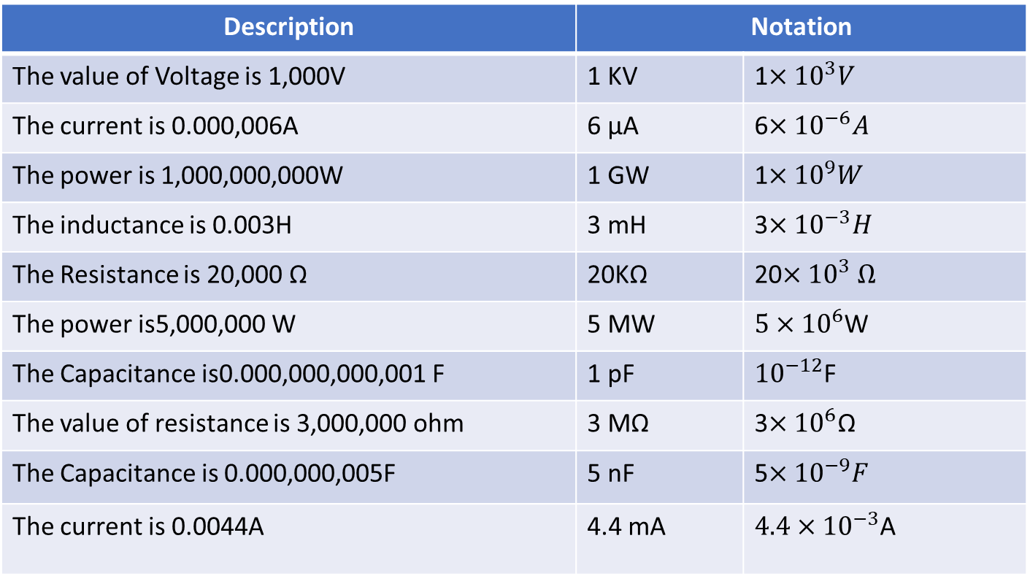
Symbols
Description | Notation
The value of Voltage is 1,000V | 1 KV | 1$×{10}^{3}V$
The current is 0.000,006A | 6 µA | 6$×{10}^{−6}A$
The power is 1,000,000,000W | 1 GW | 1$×{10}^{9}W$
The inductance is 0.003H | 3 mH | 3$×{10}^{−3}H$
The Resistance is 20,000 Ω | 20KΩ | 20$×{10}^{3} Ω$
The power is5,000,000 W | 5 MW | ${5×10}^{6}$W
The Capacitance is0.000,000,000,001 F | 1 pF | ${10}^{−12}$F
The value of resistance is 3,000,000 ohm | 3 MΩ | 3$×{10}^{6}\text{Ω}$
The Capacitance is 0.000,000,005F | 5 nF | 5$×{10}^{−9}F$
The current is 0.0044A | 4.4 mA | ${4.4×10}^{−3}$A

Slide 29
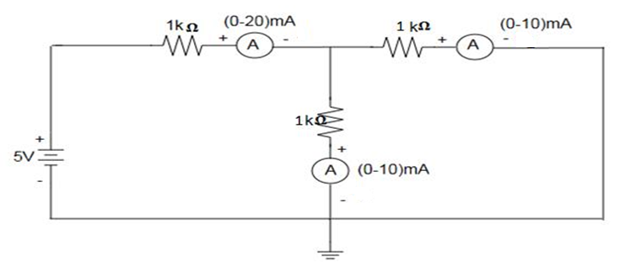
Circuits
Ammeter to be connected in series

Slide 30
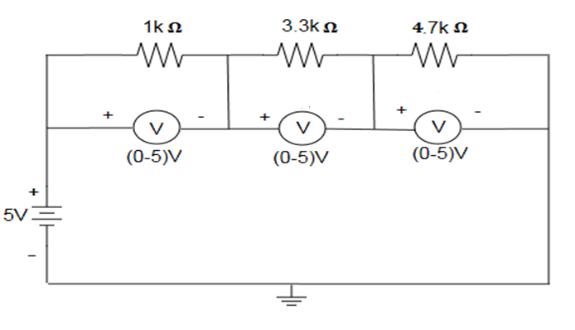
Circuits
Voltmeter to be connected in parallel.

Slide 31
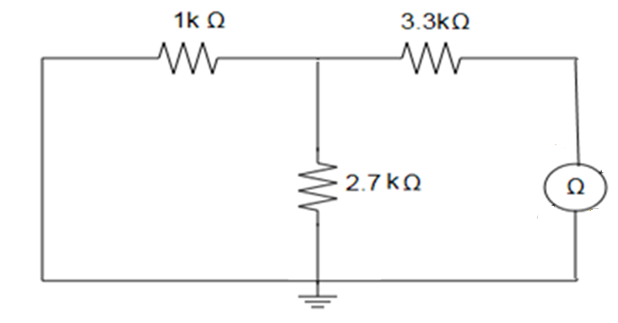
Circuits

Slide 32
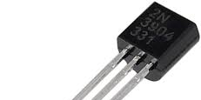
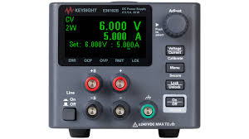
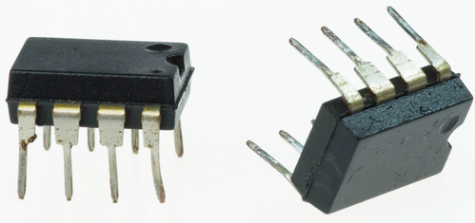
Active devices
An active device is a circuit elements with the ability to electrically control the flow of electricity. They can amplify, switch, or generate electrical signals.
In order for a circuit to be called active circuit, it must contain at least one active device
Eg: Power supplies, transistors, amplifiers and transmitters

Slide 33
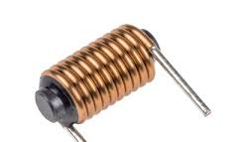
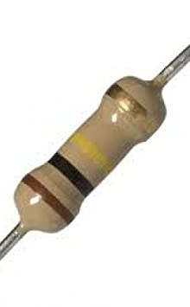
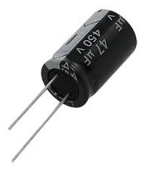
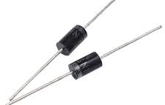
Passive devices
Components which does not require electricity to control the flow of current are called passive devices.
Eg: Resistors, capacitors, inductors, transformers, etc..

Slide 34
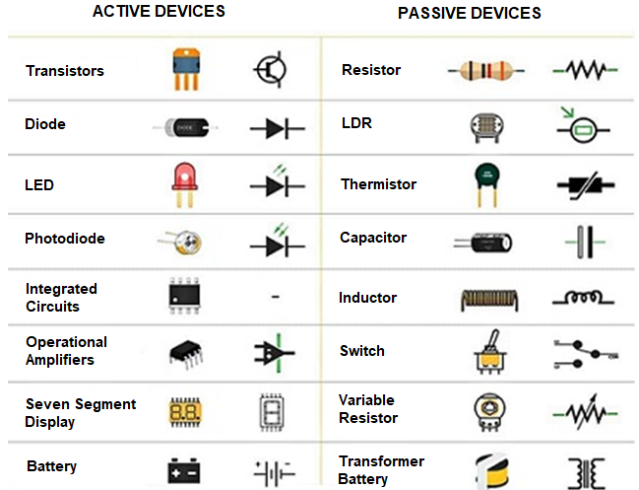
Differentiate Active and Passive devices

Slide 35
Thank You

