Slide 1
Coaching Models

Slide 2
Coaching:
Coaching is an enabling process aimed at enhancing learning and development with the intention of improving performance in a specific practice.
Renshaw 2008:p11.

Slide 3
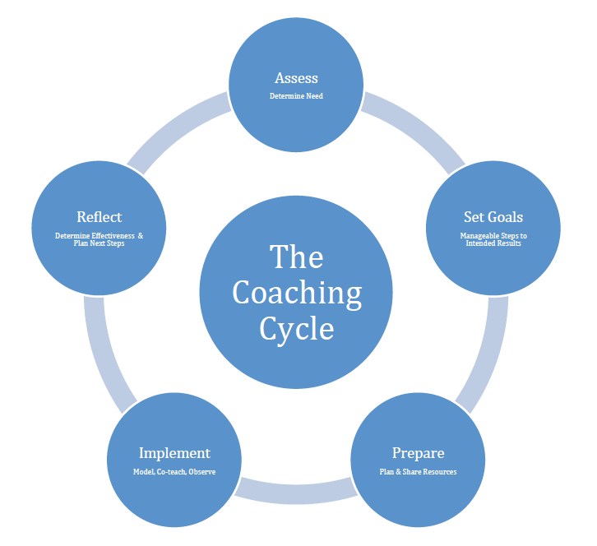
Stages in Coaching
accessed from http://empoweringeducators.wikispaces.com/The+Coaching+Cycle

Slide 4
Stages in coaching
What stages have you incorporated in your own coaching practice and why?

Slide 5
Why models?
Using tried and tested frameworks and models is one way of ensuring quality…
Connor and Pokora (2012:138)
Prevents the coaching conversations from deteriorating into an aimless chat

Slide 6
Popular Models
GROW
STRIDE
OSCAR
KOLB
GoMAD

Slide 7

GOAL
REALITY
OPTIONS
WILL/WAY FORWARD
(Model by John Whitmore based on Graham Alexander)

Slide 8
Advantages | Disadvantages
Popular, provides a logical flow and structure to the coaching relationship | Some consider the goal view as dismal reductionist, mechanical perspective that potentially corrupts behaviour Gray et al 2004:153
Some people view the setting of a goal as the true purpose of coaching | Arguments over whose goals are given priority and whose reality is acted upon
It is not too descriptive and therefore open for use in a variety of settings | Rigid adherence to goal pursuance might miss the purpose of the relationship

Slide 9

STRIDE MODEL
STRENGTH
TARGET
REALITY
IDEAS/
COMMIT
EVALUATE

Slide 10
Advantages | Weaknesses
Recognition of a client’s strengths maintains them in a resourceful mind-set | Some people find it hard to verbalise their perceived strengths.
Examination of the current reality gives coach the chance to address any limiting beliefs | On the other hand some individuals once aware of their strengths underestimate the need for change
Commits to an evaluation of purpose and process

Slide 11
OSCAR
OUTCOME (your destination)
SITUATION (your starting point)
CHOICES AND CONSEQUENCES (your route options)
ACTIONS (your detailed plan)
REVIEW (making sure you are on track)
Worth consulting

Slide 12
Advantages | Disadvantages
Provides a logical flow and structure to the coaching relationship | Risk that coach may focus too much on process rather than the outcome
Widely recognised, and easy to use | May not be suitable for more complex coaching situations
Can be used in a variety of settings | Approach not suited to all coachees

Slide 13
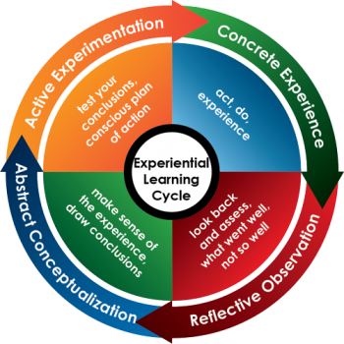
Kolb’s experiential learning

Slide 14
Advantages | Weakness
Beginning with a concrete experience provides a coachee with a reference point and vocabulary with which to address their situation. The coach helps to transform the experience into knowledge | The assumption that reflection on activity leads to experimentation
Places value on reflection
Individuals filter their world view through experience

Slide 15
GoMAD

Slide 16
Possible disadvantages of models
Focus on skill and process rather than tuning into the client
Might affect relationship
Client might not fit or like model chosen
Your style as a coach might be inhibited by the model
Coach may overlook valuable hunch in pursuance of model
Adapted from Connor and Pokora (2012)

Slide 17
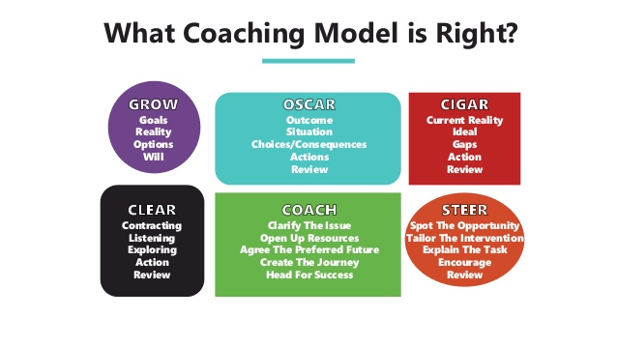
Choose the model that will fit comfortably with your organisation’s culture and that will also help your coachee achieve their learning goals

