Slide 1
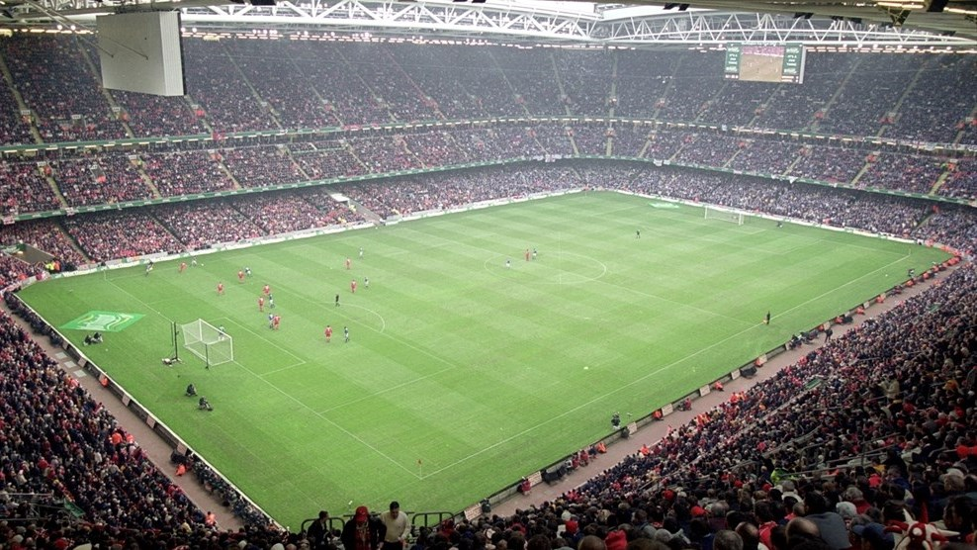

Live Events Project
Week One
Introduction

Slide 2
Session Outcomes
By the end of the session, you will have
An overview of the module and assessment
Event team skills assessment
Decide and Start planning your event

Slide 3

Expectations
Attendance and teamwork – This module will not work, and you will not pass if you don’t commit to your team and to your event.
Lectures Meetings and planning will happen on Mondays , so you need to be here with your team

Slide 4
The Assignments

Slide 5
Structure
Assignment 1:
Event Document 1000 words EACH
Planning and Managing an Event - Completion March 2026
Assignment 2: TEAMS presentation 29th April 2026 1000 words
Organizing an event requires careful planning and collaboration. In your group , you will generate a suitable idea for the event type as discussed with your lecturer. The event will run to meet the needs and requirements of a specific community or target market.
As part of the event planning the team members will meet regularly and plan all aspects of the event developing a clear planning document. This event should be a one-off event and can be either during the day or at night. Each team member can use their role-specific details to contribute to the overall planning process.
Event document/ portfolio can serve as a guide throughout the planning and execution of the event to support this process. Students must apply the theories and models taught in class to the specific details of the ‘who, what, when, where and how’ of event project management.

Slide 6
Using either EMBOK or any digital event planning platform.
This document should include (but is not limited to) the following elements:
A clear description of the event including concept - Timing, location and event programme
Aim and objectives
Evidence of project planning techniques used e.g. WBS, Gantt chart and running order
Market research identifying the event consumers/market segments the event is designed to appeal to
An event marketing plan (how, when and where the marketing and communication of the event will occur)
A clear outline of expected expenditure and income to include consideration of the resources required to stage the event, staff the event and create the event venue, to include external event suppliers.
A risk management plan and consideration of Health and Safety and legal arrangements. Evidence should include public liability insurance document, any required licences, risk assessment and emergency plans
Contingency planning - Evaluation strategy - Evidence of the division of work and responsibilities e.g. minutes of meetings, email correspondence.

Slide 7
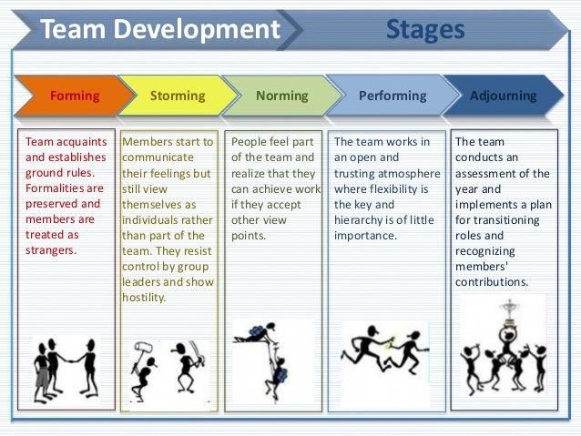
Forming an event team

Slide 8

Teamwork: What Is Behind Greatness. Leadership Insight #6

Slide 9
Team role and type
Each team member (including the leader) will have a positive or negative influence on the team
It is important to understand not only your preferred team role but also your leadership style and preferred type to have a positive impact on your team

Slide 10
Belbin’s team roles
Complete the questionnaire in Moodle by dividing 10 points between the ‘most likely’ responses
The excel format will calculate the scores for you
What does it mean?

Slide 11
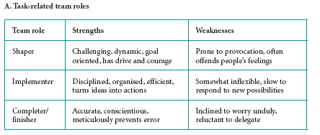
Belbin’s team roles (1)
Source: adapted from Belbin (2006, 2007); reproduced by kind permission of Belbin Associates.

Slide 12
Belbin’s team roles (2)
Source: adapted from Belbin (2006, 2007); reproduced by kind permission of Belbin Associates.

Slide 13
Belbin’s team roles (3)
Source: adapted from Belbin (2006, 2007); reproduced by kind permission of Belbin Associates.

Slide 14
Identifying an individual’s team role enables us to ...
improve self-awareness and personal effectiveness
foster mutual trust and understanding between work colleagues
engage in team selection and team-building
match people to jobs more effectively
Complete the task…. !
Belbin (1996, 2007)

Slide 15
The classification of team roles
Source: adapted from Belbin (2006, 2007); reproduced by kind permission of Belbin Associates.

Slide 16
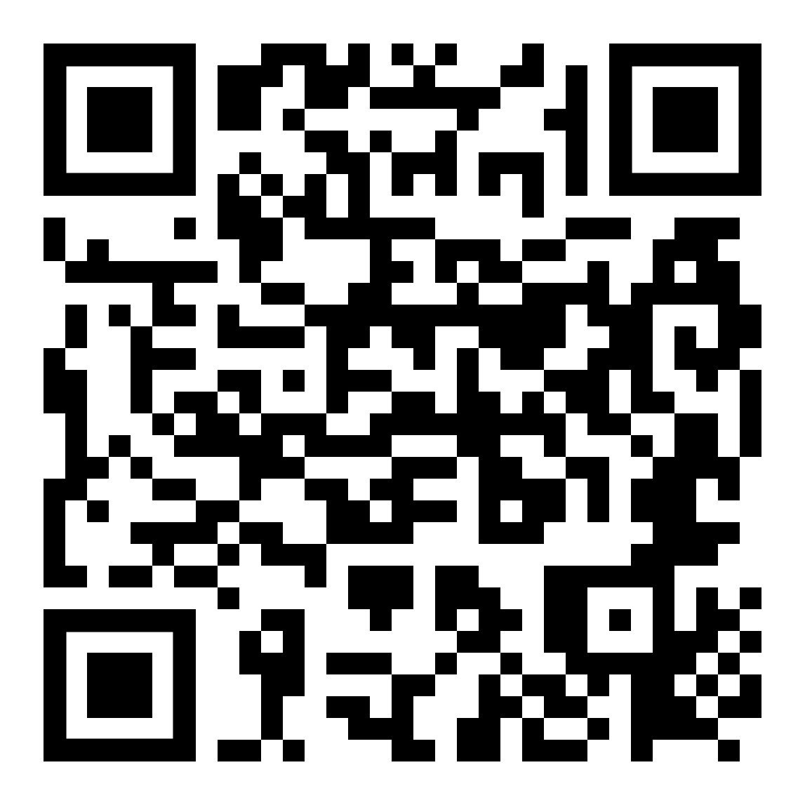

Team Roles
40 mins to complete your Team Roles questionnaire
And post your role(s) in the chatbox
Team Roles Test (psychologytoday.com)
Although you may have a preferred role, you should be developing other roles to increase your flexibility. You may need to adopt another role if you discover that there is too much overlap of roles in your group.
This will help with your group coordination and management and identify roles in your business plan.
Notes:
Team Roles Test (psychologytoday.com)

Slide 17

YOUR EVENT
Pre-planning and feasibility studies
Concept initiation
Who, what, when, where and why of events planning models
Aim and objectives

Slide 18
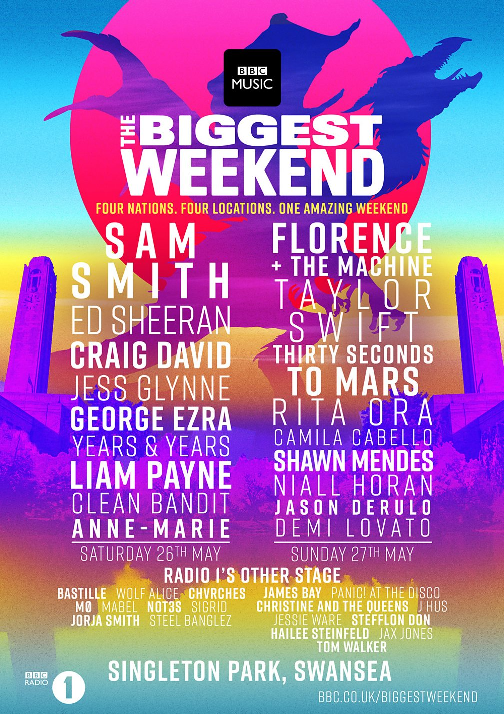
Planning Events
What is planning?
“The planning process is concerned with the ends and the means to achieve those ends.” (Bowdin, G. et al, 2001)
Why do events need to be planned?
“Without planning it is possible that the finished product will disappoint not only the intended audience, but also the organising bodies themselves.”
Notes:
18

Slide 19
The event planning process
Aims & Objectives
Concept
Feasibility
Proceed
Bidding
Implementation planning
Implement the event
Handover
Evaluation
Feedback

Slide 20
The event team
What is the event
What roles do you need?
Tasks involved
Who is best suited to each and why?

Slide 21
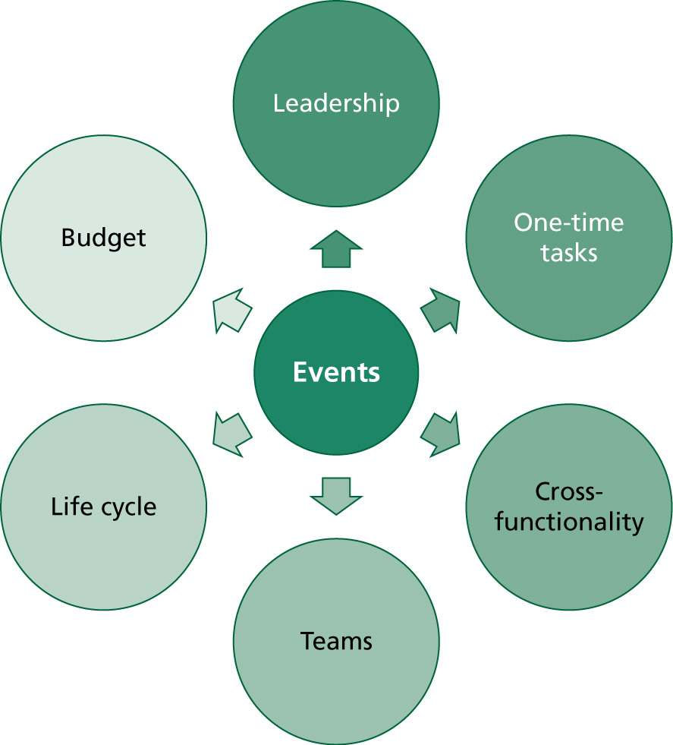
Figure 2.1 The characteristics of events
as projects

Slide 22
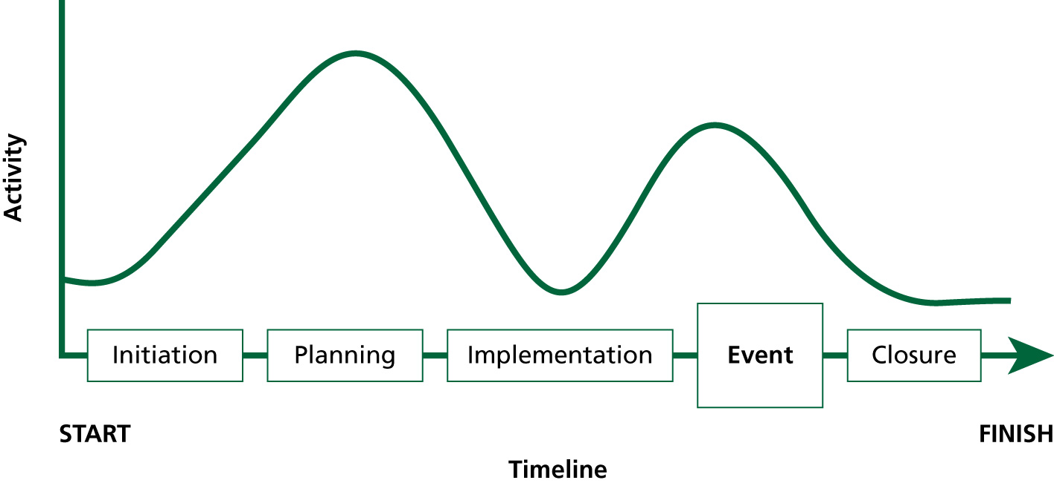
Figure 2.2 The event project life cycle
Source: Silvers 2007: 159

Slide 23
Objectives
Handover
Concept
Evaluation
Feasibility
No
Feedback
Proceed?
Implementation
Planning
The Planning Process
Adapted from
Masterman (2009)
Implement event

Slide 24

How to Create an Event Planning Checklist

Slide 25
Contextual Factors/Environmental Scanning - reminder
Current trends and fashions
Is there media interest in the theme/location?
Identify competing events from Tourist Information,
websites, local newspapers and trade press
Are there other events with similar themes or concepts?
A list of existing events serves a number of purposes:
identifies dates to avoid
provides a feel for what goes on and what the local
market likes
may identify gaps in the market
Notes:
25

Slide 26
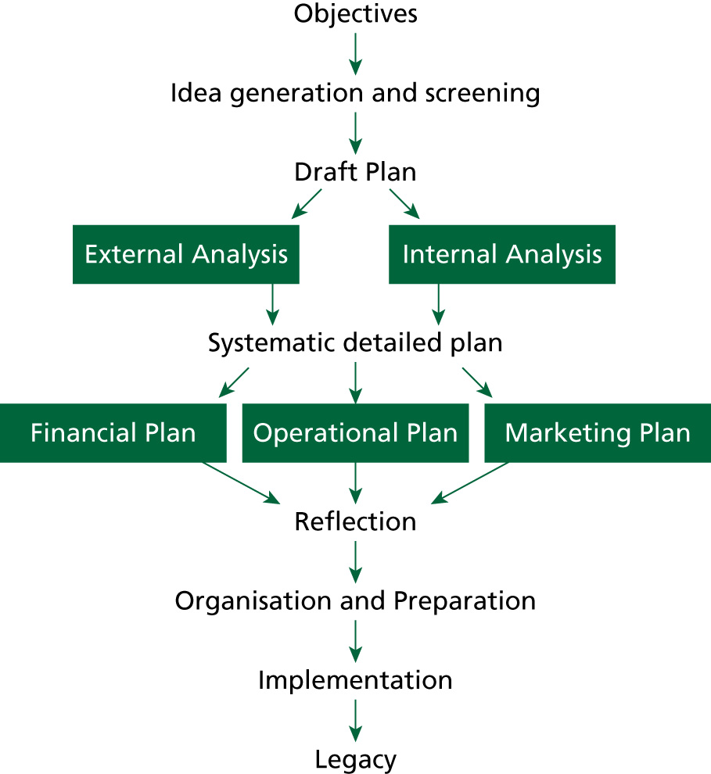

Figure 2.7
Event
planning
process
Source: Shone
and Parry 2010

Slide 27
Screening
“…An evaluation of the event concept in order to determine the extent to which the event concept matches the needs of the event and the resources available to the Event Manager to implement it.”
Bowdin et al (2006, p.108)

Slide 28
Concept Screening
Many concepts or ideas
1st screen: marketing (who will attend)
2nd screen: operations
3rd screen: financial
Remaining concept(s) and choices
Notes:
28

Slide 29
The marketing screen
Knowledge of target market: demographics, age group, past events experience – how do we find this out?
How many tickets are we likely to sell/how many will attend?
How do we know? – Opinions of organising committee, or pilot questionnaires
Need to consider competing events
Notes:
29

Slide 30
The Operations Screen
Level of expertise available – volunteer or professional
What locations / venues are available (with capacity and dates)?
What technology / equipment is required?
What is the timescale?
Legalities – licenses / insurance / permits required?
Is there a proforma from previous events?
Notes:
30

Slide 31

The Financial Screen
Is there an event budget?
Is the event cost only or is there another financial purpose?
Which of the events on the shortlist will
achieve the financial objective?
Outline budget – assess revenue (underestimate)
and costs (overestimate)
Other sources of financial support available
£
£
Notes:
31

Slide 32


EXPERIENCE MAKERS
Consider how to give your event a USP (unique selling point) or ‘wow’ factor
A special feature which attracts attention to your event and makes it both unique and memorable
What can I bring to my event that will make it ‘stand out’?
Any element of your event has the potential to become a ‘wow’ factor
Notes:
32

Slide 33
Task
Now focus on the assignment task. What are the requirements?
Brainstorm a list of possible events which would satisfy the above
Consider the needs of key stakeholders
Choose the best one – justify with reference to the screening methods

Slide 34
Getting started – the Objectives
What is the event intended to do?
Is it intended to celebrate, entertain or fund-raise?
Financial objective? Social objective?
Vision/Mission
Aim/Objectives (SMART)
https://www.carmarthenshire.gov.wales/home/business/organising-events/community-toolkit/establishing-aims-and-objectives/#.YffNGvvP1yw

Slide 35

Task
what is the purpose of your event? How can you translate this into an aim? Given the stakeholder and environmental screening/analyses,
How will your event conceptualise the aim?
How can this be measured – objectives!
Analyse your objectives using the SMART criteria

Slide 36
SMART Objectives
Specific – carefully focused on the mission of the event
Measurable – expressed in a concise and quantifiable form
Achievable – objectives can be realised given the human, financial and physical resources available
Realistic/Relevant – applicable to current environment
Timebound – achieved by a designated time

Slide 37
Examples of measurable objectives
Van der Wagen and White (2010)
Number of people attending
Number of participants
Contributions of sponsors
Value of grants and donations
Break-even or amount of profit
Goals for charitable contributions
Level of media exposure
Number of repeat visitors
Value of merchandise sold
Value of food and bev sold
Number of exhibitors or stall holders

Slide 38

Creating the Event Concept
Remember the ‘five W’s:
Why is the event being held?
Who will be the stakeholders/community in the event?
When will the event be held?
Where will the event be staged?
What is the event content / product?
Goldblatt (1997)
Notes:
38

Slide 39
Next session
Pre- planning for your event idea and its feasibility
Consider suitable venue options
Finalise your concept, theme and format
Event project planning techniques
Dates time etc
Group roles

Slide 40
References
Bowdin, G, et al (2001) ‘Events Management’ Oxford: Butterworth Heinemann
Goldblatt, J (2006) ‘Special Events: Event Leadership for a New World’ Wiley: New Jersey
Masterman, G. (2004) Strategic Sports Event Management: An International Approach, Oxford: Elsevier
Shone, A. and Parry, B. (2004) ‘Successful Event Management, a Practical Handbook’ London: Thomson
Tum, J, Norton, P, and Nevan-Wright, J. (2006) ‘Management of Event Operations’ Oxford: Butterworth-Heinemann
Wilson, R. (2006) The Economic Impact of Local Sport Events: significant, limited or otherwise. Managing Leisure 11:1, 57-70
Notes:
40

