Slide 1
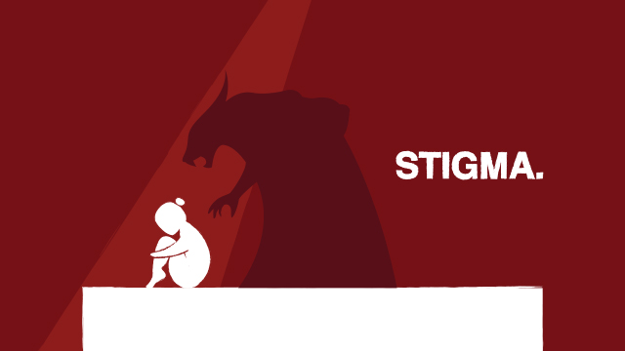
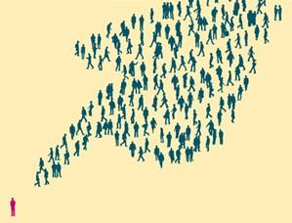
Stigma associated
with
eating disorders
Commonly diagnosed eating disorders
Anorexia nervosa
Bulimia nervosa
Binge eating disorder
Eating disorders are commonly comorbid with other psychological issues such as anxiety, depression and personality disorders
(Hudson,2007)
Stigmatization from society creates risk factors for those suffering with eating disorders.
It interferes with help seeking behaviour
It has been linked to substance abuse
It causes isolation and alienation
It can worsen the symptoms of an eating disorder
(Paxton,1999) (Holderness,1994) (Douglas et al,2016)
(Crisp et al,2000)
Research has suggested that society has more sympathy for people with other mental illnesses in comparison to those with eating disorders.
A study conducted by Roehrig and Mclean (2010) investigated the stigma associated with eating disorders and depression. The findings were that society had increased negative feelings towards those with eating disorders in comparison to those who suffered with depression.
Self-stigmatization can occur when a person with an eating disorder internalises the negative beliefs held by society.
(Heckler et al,2010) Corrigan et al,2006)
Research suggests that stereotypes of people with eating disorders has contributed to the level of stigmatization.
A study conducted by Gordan, Perez and Joiner (2002) discussed stereotypes and how society expects a person suffering with an eating disorder to typically be a young white thin female. The findings highlighted the risks of males not being recognised as having an eating disorder as easily as females and also that unless a person is severely thin they can be overlooked as having an eating disorder by people that are close to them and also this stigma has also been displayed by health professionals.
Research has suggested that stigma has been created in society due to false beliefs of people with eating disorders.
It is attention seeking behaviour
It is wilful behaviour
It can be controlled
The sufferers are to blame
The sufferers should take responsibility
(Crisp et al, 2000) (Stewart,2006)

Slide 2
References
Crisp, A. H., Gelder, M. G., Rix, S., Meltzer, H. I., & Rowlands, O. J. (2000). Stigmatisation of people with mental illnesses. The British journal of psychiatry, 177(1), 4-7.
Corrigan, P. W., Watson, A. C., & Barr, L. (2006). The self–stigma of mental illness: Implications for self–esteem and self–efficacy. Journal of social and clinical psychology, 25(8), 875-884.
Douglas, V., & Varnado-Sullivan, P. (2016). Weight stigmatization, internalization, and eating disorder symptoms: The role of emotion dysregulation. Stigma and Health, 1(3), 166.
Gordon, K. H., Perez, M., & Joiner Jr, T. E. (2002). The impact of racial stereotypes on eating disorder recognition. International Journal of Eating Disorders, 32(2), 219-224.
Hackler, A. H., Vogel, D. L., & Wade, N. G. (2010). Attitudes toward seeking professional help for an eating disorder: The role of stigma and anticipated outcomes. Journal of Counseling & Development, 88(4), 424-431.
Holderness, C. C., Brooks‐Gunn, J., & Warren, M. P. (1994). Co‐morbidity of eating disorders and substance abuse review of the literature. International Journal of Eating Disorders, 16(1), 1-34.
Hudson, J. I., Hiripi, E., Pope Jr, H. G., & Kessler, R. C. (2007). The prevalence and correlates of eating disorders in the National Comorbidity Survey Replication. Biological psychiatry, 61(3), 348-358.
Paxton, S. J., Schutz, H. K., Wertheim, E. H., & Muir, S. L. (1999). Friendship clique and peer influences on body image concerns, dietary restraint, extreme weight-loss behaviors, and binge eating in adolescent girls. Journal of abnormal psychology, 108(2), 255.
Roehrig, J. P., & McLean, C. P. (2010). A comparison of stigma toward eating disorders versus depression. International Journal of Eating Disorders, 43(7), 671-674.
Stewart, M. C., Keel, P. K., & Schiavo, R. S. (2006). Stigmatization of anorexia nervosa. International Journal of Eating Disorders, 39(4), 320-325.

