Slide 1
Student Name: Ligia Ramos
Student ID: 2535726
Lecturer’s Name: Sharin McDowall-Emefiele
Module Code: LCLM4004
Module Name: Problem Solving and Decision Making
Component 1: Basil’s Bakery

Slide 2
Presentation Overview
Basil’s Bakery business background and sales problem
Internal and external issues
PESTEL critique and explanation
Cause and Effect model
Key findings and summary

Slide 3
Basil’s Bakery business overview and decrease in sales
Basil’s Bakery is a small independent shop located in a retail park in Coventry, UK. Running since 2015
They specialise in baking cakes, pastries and bread using high quality of organic ingredients.
Their main consumers are local shoppers and people who visit the retail park for shopping.
Sales growth have not been recovered since Covid restriction were lifted and not returning to pre 2020 levels. Many business at the retail park are closing down and some of Basil’s most loyal customer have moved to the new model of working from home.

Slide 4
Business problems insights
Sales growth have not been recovered since Covid restriction were lifted.
They remain flat and not returning to pre 2020 levels.
Many business at the retail park are closing down. Additionally, some of Basil’s most loyal customer have moved to the new model of working from home.

Slide 5
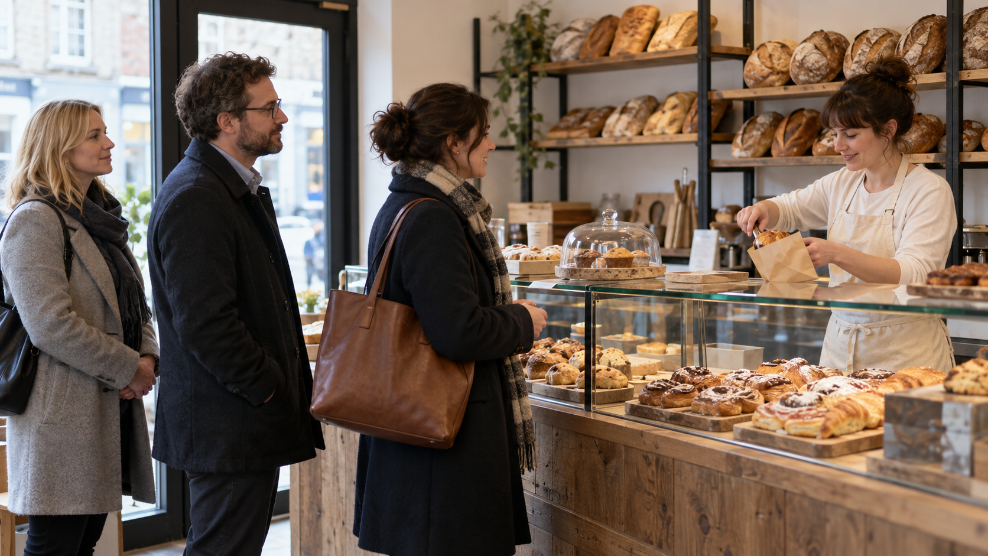
The sales problem and its contributors
Main problem: sales remain below the 2019 level.
External: Fewer visitors, shop closures, hybrid working, increase in utilities and crop failures.
Internal: Long waits, no delivery alternative. short staffing and missed pre order calls.
.
Problem-solving: Sproull (2018).

Slide 6
PESTEL critique
Purpose: Understand the group of external business influences.
  Use: Will help to examine and understand different root causes.
  Benefit: It will help to know the outside influences that help breakdown the categories of a business case to give context.
  Limitations: It is not a definite statement that sales reduced because of these reasons

Slide 7
PESTEL application to Basil’s Bakery
Political | Economic | Social | Technological | Legal | Environmental
2020 lockdown reduced sales. (Case study, 2026) | Local job losses reduce the customer visits to the retail park. Increase in utility bills, reduce margins. Srivastava, R. and Kirche, E. (2024) ‘The effect of manufacturing overhead on policies for allocating production capacity’, International Journal of Production Research, 62(24), pp. 8818–8834. doi: https://doi.org/10.1080/00207543.2024.2351954.) | Hybrid working reduces local office visits. Hybrid working patterns. Small independent retailers face unprecedented pressure to adapt. Nkiko, C.M. (2024) ‘Sustaining retail behaviour: Small business adaptation to hybrid working and urban decline’ International Journal of Production Research, | Online ordering will provide a more accessible way of placing orders. Basil’s phone pre orders are unreliable. | Allergies information to be available to customers. Allergens appear effective in curtailing retail triggered severe food allergy reaction,. MJ Walker, M H Gowland, J Points, Managing Food Allergens in the U.K. Retail Supply Chain, Journal of AOAC INTERNATIONAL, Volume 101, Issue 1, 1 January 2018, Pages 45–55, https://doi.org/10.5740/jaoacint.17-0385 | Organic materials are subject to have a shorter shelf life and add material availability pressures. Delayed agricultural activity, reduced yields, reducing quality, increased costs Benton, T., Gallani, B., Jones, C., Lewis, K. and Tiffin, R. (2012) Severe weather and UK food chain resilience: Food Research Partnership, Resilience of the UK Food System Subgroup..

Slide 8
Cause and effect critique
A fishbone diagram categorises the possible causes around an effect.
  Benefits: Provide a structure and make different causes visible and clear for understanding. This leads to further discussion and helps to organize root causes around a central effect.
  Limitations: Depends on the information used.
  It does not prove causes, just helps measuring them.
  Possible causes need checking against evidence.

Slide 9
Fishbone application to Basil’s Bakery
Methods
Machines
People
Long waits at busy times
Phone access unreliable
Basil must bake onsite
No delivery service
Digital ordering unconfirmed
Fewer office-worker visits
2023–2025 average
sales 25% below 2019
Organic ingredients only
Missed-call totals unknown
Retail park shop closures
Uncertain ingredient costs
Queue times not quantified
Local customers lose jobs
Materials
Measurement
Environment

Slide 10
Key findings
Sales remained around 25% below 2019 on average in 2023–2025.
    Shop closures and hybrid work reduce opportunities for local purchases.
    Waiting times and limited alternative ordering options leave demand unmet.
    Higher costs add pressure on costs and reduce margin, sales remain lower.
Source: Case study (2026)

Slide 11
Reference list 1
Nkiko, C.M. (2024) ‘Sustaining retail behaviour: Small business adaptation to hybrid working and urban decline’ International Journal of Production Research,
Walker MJ, MH Gowland, (2023) Managing Food Allergens in the U.K. Retail Supply Chain, Journal of AOAC INTERNATIONAL
Srivastava, R. and Kirche, E. (2024) ‘The effect of manufacturing overhead on policies for allocating production capacity’, International Journal of Production Research, 62(24), pp. 8818–8834. doi: https://doi.org/10.1080/00207543.2024.2351954.
Hingley, M. K. (2005). Power Imbalance in UK Agri-Food Supply Channels: Learning to Live with the Supermarkets? Journal of Marketing Management, 21(1–2), 63–88. https://doi.org/10.1362/0267257053166758

Slide 12
Reference list 2
Michael J Walker, M Hazel Gowland, John Points, Managing Food Allergens in the U.K. Retail Supply Chain, Journal of AOAC INTERNATIONAL, Volume 101, Issue 1, 1 January 2018, Pages 45–55, https://doi.org/10.5740/jaoacint.17-0385
Sproull, B. (2018). The Problem-Solving, Problem-Prevention, and Decision-Making Guide: Organized and Systematic Roadmaps for Managers (1st ed.). Productivity Press. https://doi.org/10.4324/9781351116268

