Slide 1
Lifelong learning in the digital era
Assignment 1
Ellie Kelman

Slide 2
contents
Element 1: Blog- what is time management. (Slide 3)
Reference list for Blog. (Slide 8)
Element 2: Poster- what is critical thinking and how can it be developed? (Slide 9)
Element 2: reference page (Slide 10)
Biography (Slide 11)

Slide 3

Positive thinking and preparation is a start
We all know about Dweck's theory on growth mindset (Dweck, C. S. (2019). p21), and if it wasn’t for this then I wouldn’t have applied for the course, or applied for the new job I started last term or bought a house! Believing in yourself is a huge part of time management as well as having a good routine.
What's hard is not getting so overwhelmed by it all and falling apart, or then procrastinating so then nothing happens and it all falls apart.
Working out a good plan, such as packing in the morning before the kids get up when I have more energy, then reading and course work in the evenings. While trying not to fall asleep.
Notes:
Dweck, C. S. (2019). The Choice to Make a Difference. Perspectives on Psychological Science, 14(1), 21–25. https://doi.org/10.1177/1745691618804180

Slide 4



Good Time management... what is that??
Yes!! I can do this!
Swm less
kickboxing
rounders
Swm less
uni
LBTs
So, what idiot with kids and no partner in the week, decides to start a new job in May, start university in September and then throw in a house move 2 weeks into starting university? That would be me! Then time management is my first assignment, how do I lesson plan, pack boxes, read material for university and start assignment work all without the use of pixie dust and a magic wand...
Any ideas?
get keys
Swm less
kickboxing
uni
rounders
LBTs
Move home
Swm less
kickboxing
uni
rounders
LBTs
kickboxing
rounders
This was a BAD idea...
I will never fit all this in...
Especially with kids and no peace. They don’t even sleep quietly!
Hand over
uni

Slide 5
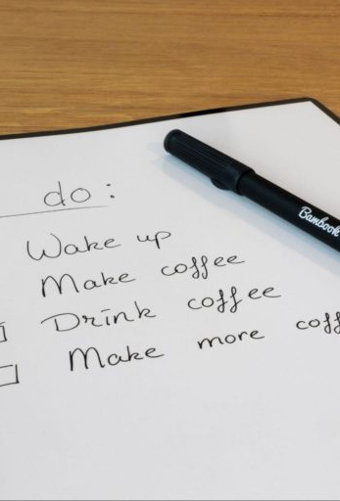
Time management, what is that??
How do I do this...
According to the Cambridge Dictionary (online addition 2022) it states " the practice of using the time that you have available in a useful and effective way" This is a great idea when you know how to prioritize things and not play games on your phone or get distracted by your kids fighting!
Which basically means, not moving house, and starting university at the same time, while having no help with the kids, where you can't fit everything in! So, I have produced a plan, either never sleep again or work out how an earth to fit everything in.
The first thing I need to do is create a list, and the top of my list is making a list! This way I know I can at least tick one thing off there! Next is Coffee.
Notes:
The Ultimate Guide To To-Do Lists (& 7 Ways To Improve Them) (acuitytraining.co.uk)
to do list

Slide 6
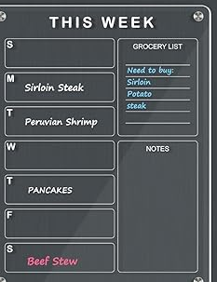


Time management... how to make it work
So, it turns out, that taking a day off work to move, sleeping only 4 hours a night for a week, takeaways and a lot of coffee, this can be done!
Beliveing in yourself but not being too hard on yourself when it doesn't work out. Sitting crying because I haven't packed as much as I wanted or even produce an idea for this blog yet was getting me anywhere. Realizing that I can hold my coffee in one hand and pack a box with another made a difference. Getting up and extra hour early with ho kids about, meant I could work twice as fast. Slow cooker and timer was a god send to help with after school routine. My weekly planner and to do list were on my fridge, and as I always like to eat a lot, I could see what I needed to do every time I went into the fridge!
MY ONE RULE...
IF I SNACK I MUST TICK SOMETHING OFF THE LIST!!
Notes:
4 THOUGHT Acrylic Dry Erase Board Calendar for Fridge, 30 x 40 cm Magnetic Clear Acrylic Whiteboard Veritical Weekly Planner Board for Refrigerator with 3 Markers for Menu Memo Home Kitchen : Amazon.co.uk: Stationery & Office Supplies
Coffee

Slide 7
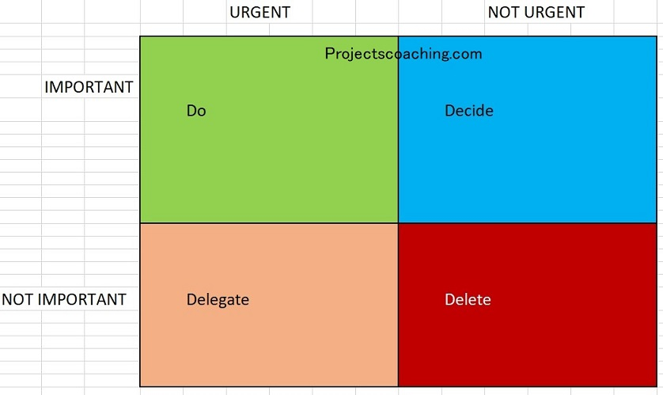
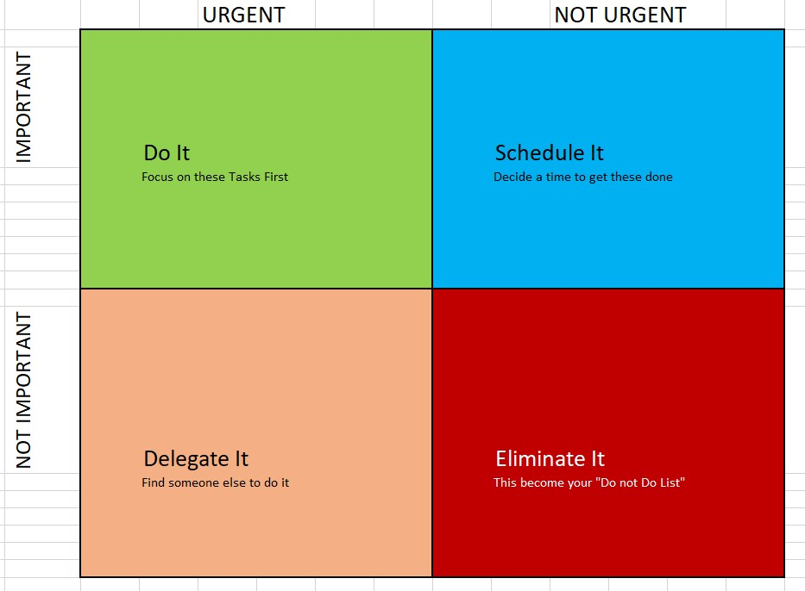
Matrix of time
We all have the same number of hours in a day, yet some of us can be more proactive than others. A simple way to help time management is to use a matrix like these. But who’s to choose...
Eisenhower Matrix vs Covey Matrix (Flours d. project coaching 2023)
As Flours explains in his article these are both similar, how every Eisenhour believes that everything with a date is urgent, while Covey priories those more do it now and schedule it for later.
I Personally, I favor of Covey's Matrix purely because I solve everything into the boxes easily. Working on important not urgent tasks will help eliminate the urgent important ones.
Notes:
Eisenhower Matrix vs Covey Matrix: Which Is Right For You? (projectscoaching.com)

Slide 8
references
Cambridge Dictionary online addition - TIME MANAGEMENT | English meaning - Cambridge Dictionary
Dweck, C. S. (2019). The Choice to Make a Difference. Perspectives on Psychological Science, 14(1), 21–25. https://doi.org/10.1177/1745691618804180
Flours P. Eisenhower Matrix vs Covey Matrix: Which Is Right For You? 25th June 2023
Eisenhower Matrix vs Covey Matrix: Which Is Right For You? (projectscoaching.com)
Moving Day Disasters And How To Avoid Them | lifespaceblog

Slide 9


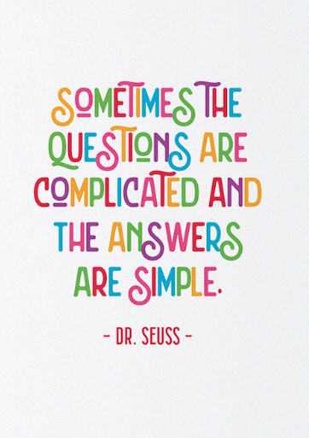
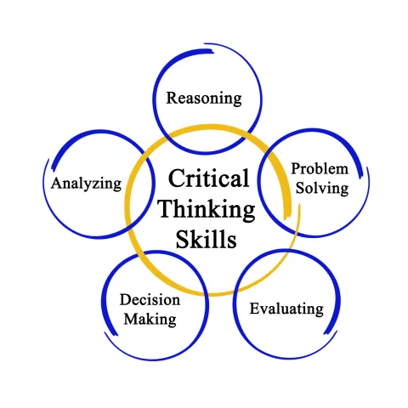


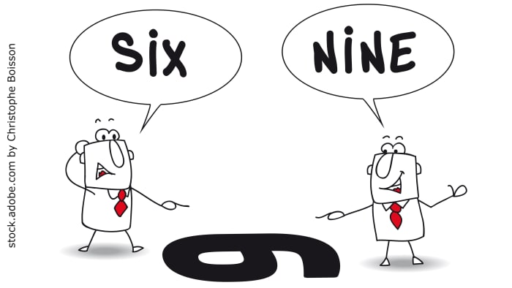
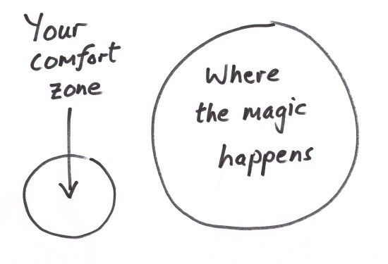
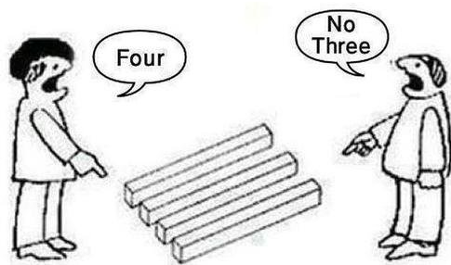
Critical thinking...
What is it?
In the Cambridge Dictionary (2023)it states "The process of thinking carefully about a subject or idea, without allowing feelings or opinions to affects you."
Critical consciouseness
(Freire P. 2016 p20)
Identify the problem
Find the original way to present the problem
See the problem though the learners eyes
Analyse the cause of the problem
Take action to solve the problem
DIfferent ways of thinking...
(Metivire A. 2023 the 7 main types of thinking)
Pull the idea apart, can you put it back a different way?
Look at the details, do they add up?
Think outside the box!
Work on the facts not opinions!
Looking back on what we have done, learning form this, i like to use, WWW. (What went well) EBI! (Even better if!) List 3 of each. @Team penyrheol
?!?!
Look at both sides of the story
Is it possible for both to be right?
"My father
used to say 'don't raise your voice, improve your argument.' "
—Desmond Tutu
Sky's the limit!
The only thing is your way is you!
Believe in yourself!
If it was easy everyone would do it!
Get out of your comfort zone, you can not solve the problem with the same thought that created it
Don't beleive everything you see. Make your own decisions

Slide 10
references
12 Inspiring Critical Thinking Quotes For Students - Number Dyslexia
Background picture, Microsoft/PowerPoint/insert/stock images/search sky
Bui H 2021, The 6/9 perspective image Toolbox (interculturaltoolbox.org)
CRITICAL THINKING | English meaning - Cambridge Dictionary
Center picture https://i0.wp.com/literacypathway.com/wp-content/uploads/2020/01/AdobeStock_185961949.jpeg?resize=480%2C480&ssl=1
Frieie P, 2016, Bob Bates book on Learning theories simplified page 20 critical consciousness
Holdo, M. (2023). Critical Reflection: John Dewey’s Relational View of Transformative Learning. Journal of Transformative Education, 21(1), 9-25. https://doi.org/10.1177/15413446221086727
Leanne, Trainee Counsellor at The DMC Clinic 23rd April 2020 the comfort zone - The Comfort Zone Blog - The DMC Clinic - Counselling Wexford
Metivire A. September 2023 the 7 main types of thinking The 7 Main Types Of Thinking (And How To Use Them Better) (magneticmemorymethod.com)
SandersH. 2023- Dr Seuss quote ""Sometimes the questions are complicated and the answers are simple." What does this quote mean?" eNotes Editorial, 6 Feb. 2019, https://www.enotes.com/homework-help/sometimes-questions-complicated-answers-sample-267175. Accessed 3 Oct. 2023.
12 Inspiring Critical Thinking Quotes For Students

Slide 11
Biography
Critical Reflection: John Dewey’s Relational View of Transformative Learning - Markus Holdo, 2023 (sagepub.com)
Edward graser created critical thinking! An Experiment in Development of Critical Thinking - Edward M. Glaser, 1942 (sagepub.com)

