Slide 1
Module Name : Electronics II
Module Code : ACDA6001
Topic : VHDL – Full Adder & Half Adder
– Test bench
Lecture : 7
Lecture By,
Mrs. Jenifer Prince Devaraj,
Lecturer - Embedded Electronics,
Faculty of Applied Computing,
UWTSD
Email:j.prince-devaraj@uwtsd.ac.uk

Slide 2
Introduction to VHDL
VHDL - Entity and Architecture : Exercise
3. Write a VHDL Program to implement a half adder.
UWTSD Lectures / ACDA6001 – Electronics 2

Slide 3
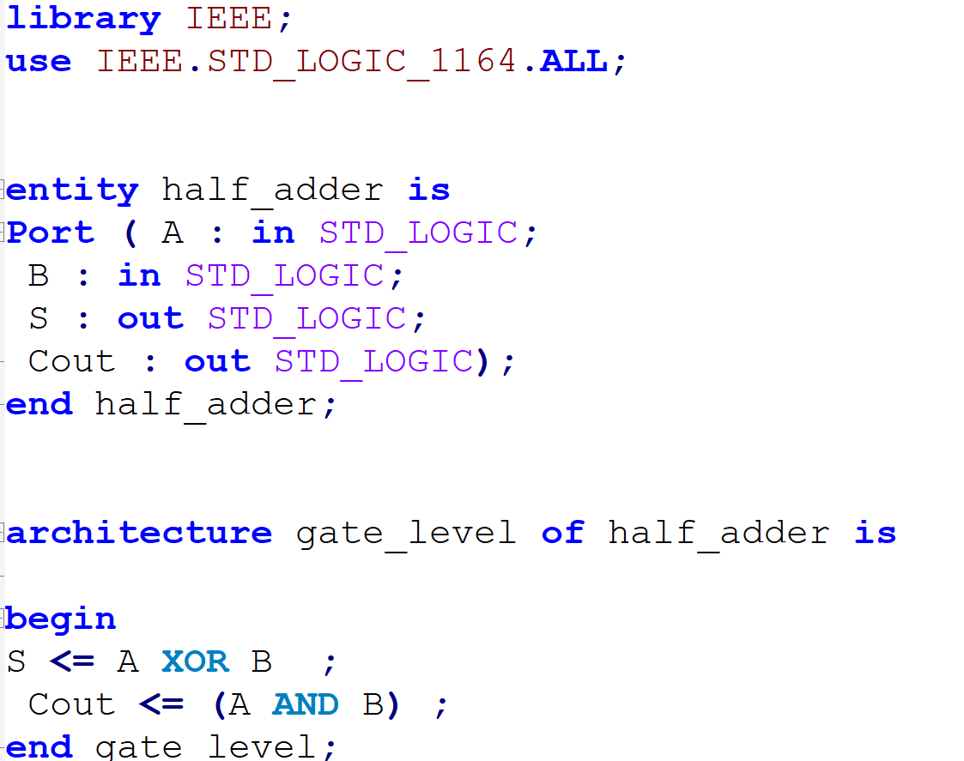
Introduction to VHDL
3. Write a VHDL Program to implement a half adder.
UWTSD Lectures / ACDA6001 – Electronics 2

Slide 4
Introduction to VHDL
VHDL - Entity and Architecture : Exercise
4. Write a VHDL Program to implement a Full adder.
UWTSD Lectures / ACDA6001 – Electronics 2

Slide 5
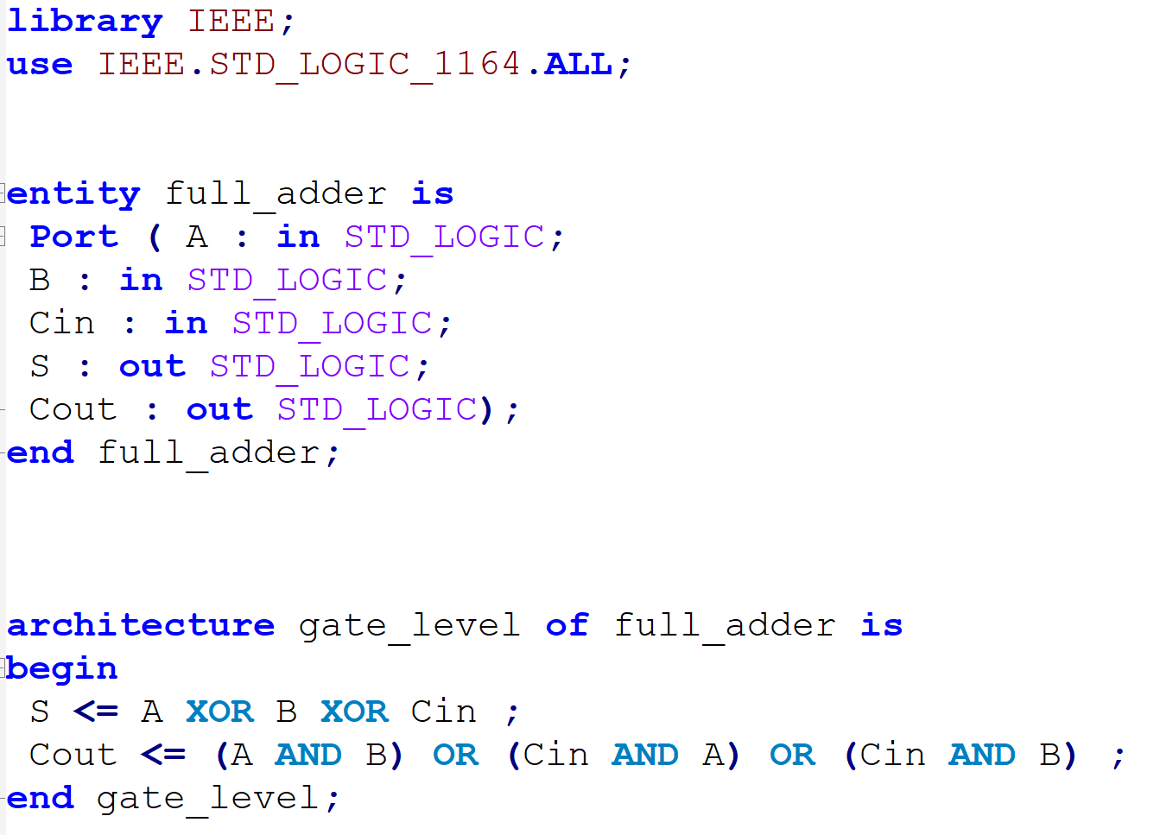
Introduction to VHDL
4. Write a VHDL Program to implement a Full adder.
UWTSD Lectures / ACDA6001 – Electronics 2

Slide 6
Introduction to VHDL
VHDL Basics - Signals
Signals are essential for defining the interconnections and data flow within an entity's internal behaviour, contributing to its overall functionality.
They serve as internal communication pathways, allowing various parts of the entity to exchange data without directly exposing this interaction to the outside world.
They exists between ‘architecture’ and ‘begin’.
UWTSD Lectures / ACDA6001 – Electronics 2

Slide 7
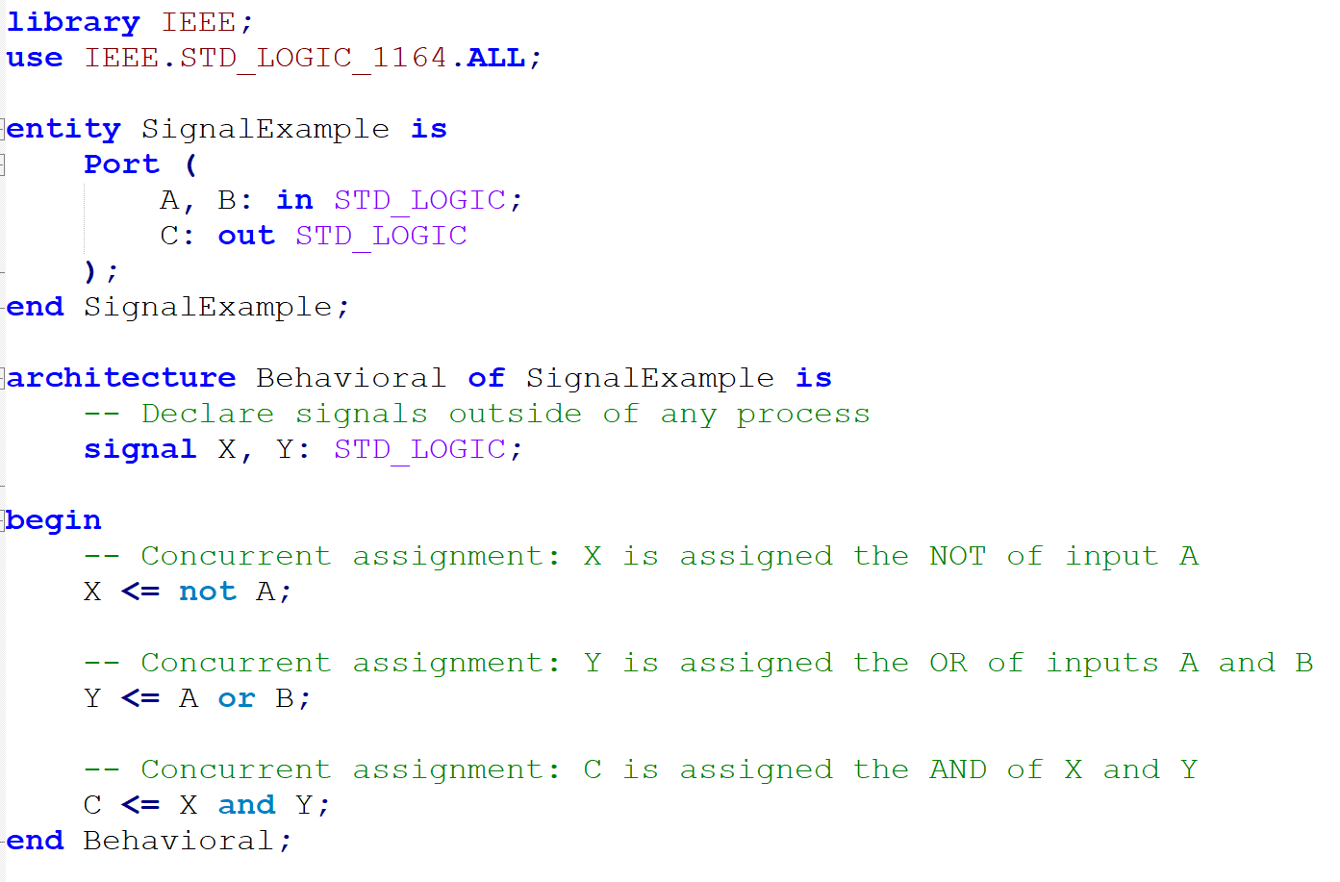
Introduction to VHDL
VHDL Basics - Signals
UWTSD Lectures / ACDA6001 – Electronics 2

Slide 8
Introduction to VHDL
VHDL Basics - Signals
In this example, the signals "X" and "Y" serve as intermediate variables for storing the results of the individual logical operations, making the code more readable and modular.
These signals are continuously updated based on the inputs and, in turn, influence the final result in output signal "C."
UWTSD Lectures / ACDA6001 – Electronics 2

Slide 9
Introduction to VHDL
VHDL Instantiation
In VHDL, instantiation refers to the process of creating and using components (previously defined modules) within your design.
It allows you to reuse existing modules in your design hierarchy.
It consists of the following
  Component Declaration
  Instance
  Port Mapping
UWTSD Lectures / ACDA6001 – Electronics 2

Slide 10
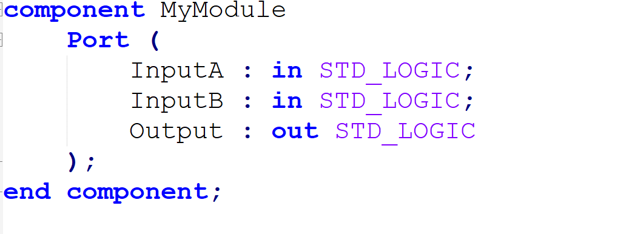
Introduction to VHDL
VHDL Instantiation -Component Declaration
Before instantiate a module, it is important to declare its component.
A component declaration describes the interface of the module, specifying its inputs and outputs.
UWTSD Lectures / ACDA6001 – Electronics 2

Slide 11
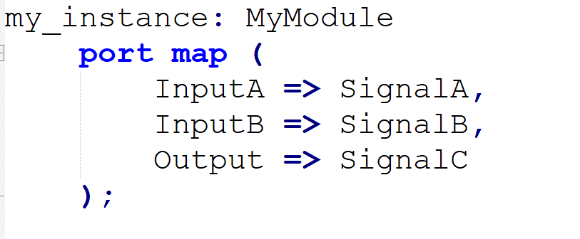
Introduction to VHDL
VHDL Instantiation –Instance and Port Map
Instance
After declaring the component, you can instantiate it within the architecture.
An instance of the module can be created and can be connected to signals or other instances.
Port Mapping
In the instantiation, the signals in current architecture should be specified are connected to the module's inputs and outputs. This is called port mapping.
UWTSD Lectures / ACDA6001 – Electronics 2

Slide 12
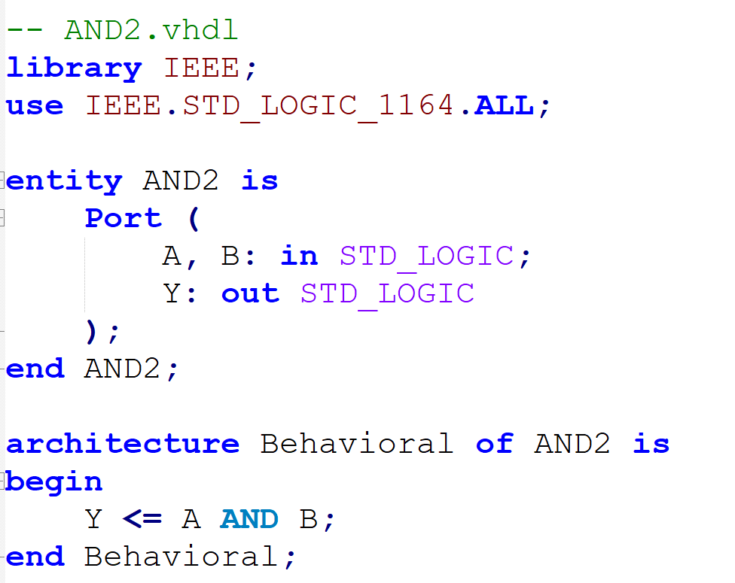
Introduction to VHDL
VHDL Instantiation –Example
Consider a 2-input AND gate module called "AND2" with the following VHDL code:
UWTSD Lectures / ACDA6001 – Electronics 2

Slide 13
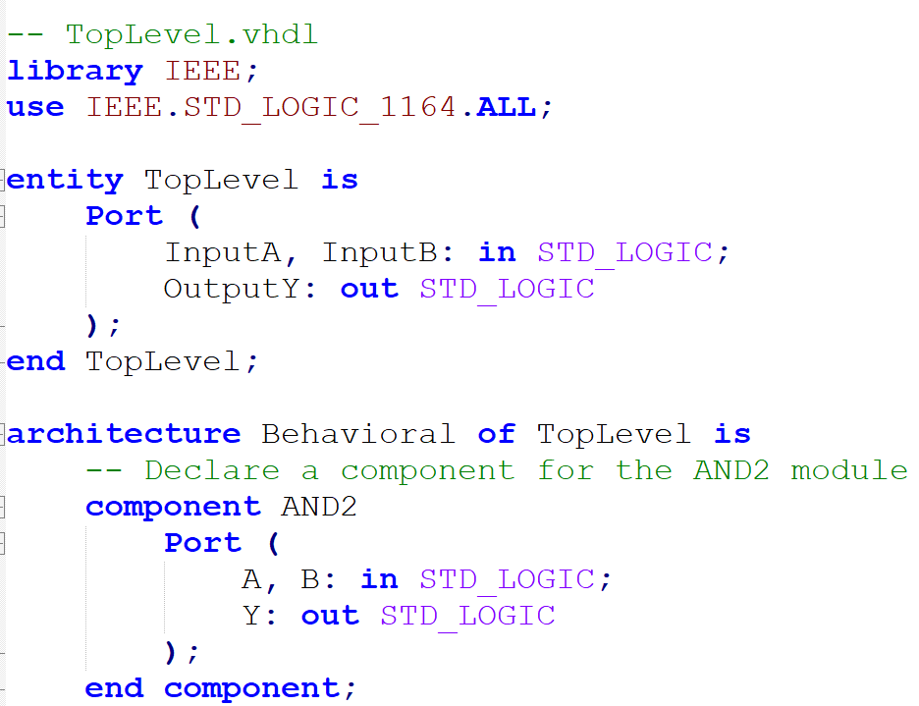
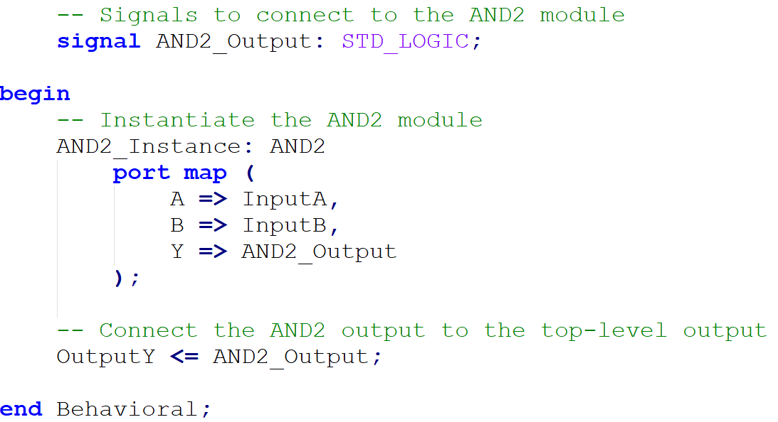
Introduction to VHDL
VHDL Instantiation –Example
To use this AND gate within a top-level module.
UWTSD Lectures / ACDA6001 – Electronics 2

Slide 14
Introduction to VHDL
VHDL – Creating Test Bench
Test benches helps to evaluate the behavioural aspects of your design.
The design responds to various input conditions and scenarios, which gives idea on its behaviour under different conditions.
The test bench ensures whether the design functions correctly, meets its requirements, and operates reliably in real-world scenarios.
UWTSD Lectures / ACDA6001 – Electronics 2

Slide 15
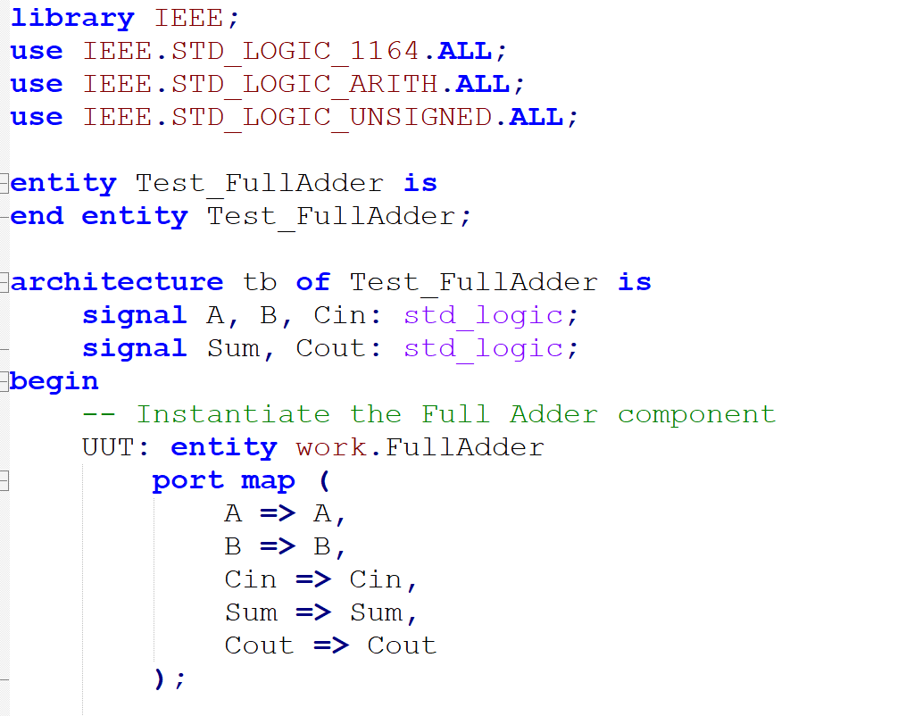
Introduction to VHDL
Test Bench
- Example- Full Adder
UWTSD Lectures / ACDA6001 – Electronics 2

Slide 16
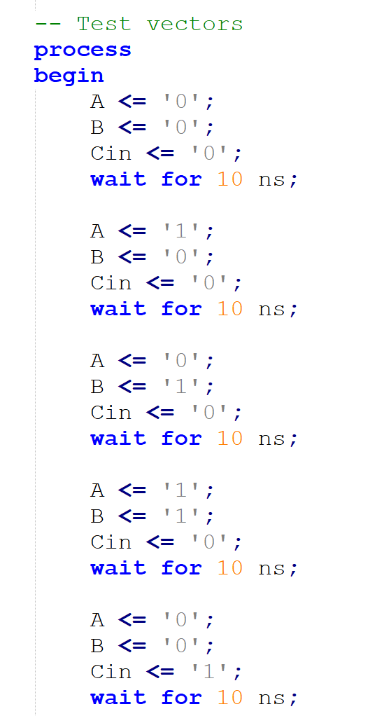
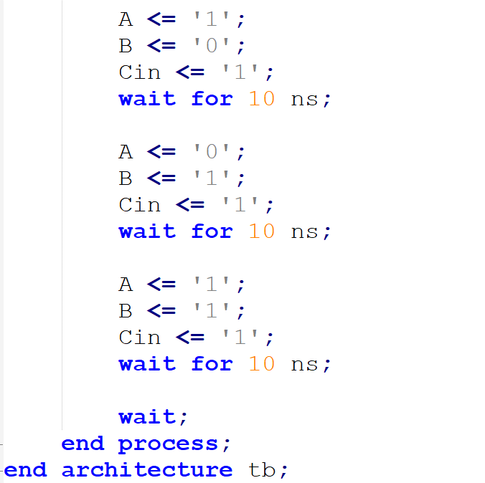
Introduction to VHDL
Test Bench
- Example- Full Adder
UWTSD Lectures / ACDA6001 – Electronics 2

Slide 17
Thank you

