Slide 1
Social work
Name: Adela Jaimes Flores
Student ID:2443012
Module Code:lCHS4001
Module:Academic and Employability skills

Slide 2

Introduction
Social workers make a difference to individuals and families by helping them live their lives more successfully.
Social work is a practice-based profession and an academic discipline that promotes social change and development, social cohesion, and the empowerment of people.
Social workers make a difference to individuals and families by helping them live their lives more successfully.

Slide 3
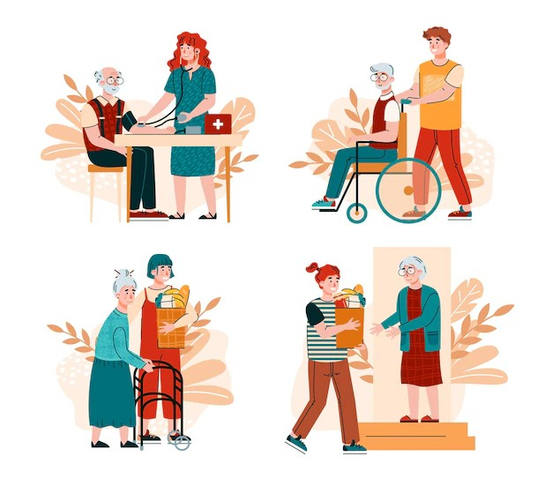
Reason
There are many job options
A degree in Social Work will provide me with the ability to undertake a variety of different professional roles. Some of the roles you can do include:
The world needs social workers
There will always be people in need, so there will always be a demand for those who are educated in the subject area, meaning jobs shouldn’t be too difficult to find and you will always be able to make a positive

Slide 4

Research
Key word:role social work,objetive of social work.
I’ve been looking at many websites, but I chose the ones that had the clearest and most precise concepts to understand.

Slide 5

Evaluation
Acurrancy up to data
Relevance.skill social work
Authority:Trust information
Porpose: To inform ,provide support people

Slide 6
Challenges
Difficult to manage digital
Difficult to understand academic word
Confusion a lot of information

Slide 7

Next step
Research: I need improve more my research
Planning: try to explain and more slide.
Writing: Describe more detail, understandably using formal academic language.

Slide 8
References
https://www.ifsw.org/what-is-social-work/global-definition-of-social-work/
https://basw.co.uk/about-social-work/what-social-workers-do
https://www.ifsw.org/what-is-social-work/global-definition-of-social-wor
Google indexó www.healthcareers.nhs.uk octubre of 2015

