Slide 1
Sustainable Construction Management
ACBA5010
Lara Hopkinson

Slide 2
Outline for today
The linear vs circular economy
  What do both mean?
  Discussion on merits & demerits of both models of economy
  Current situation
  Case studies

Slide 3

What do you already know?
This Photo by Unknown Author is licensed under CC BY-NC-ND

Slide 4
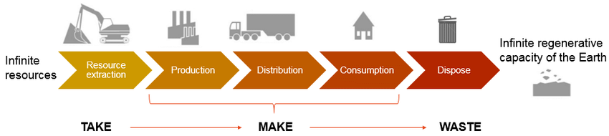
The linear economy
Source: Wautelet T (2018)

Slide 5
What are the risks in this model?
This Photo by Unknown Author is licensed under CC BY-NC-ND

Slide 6
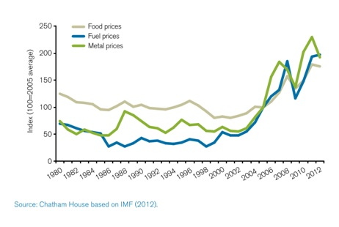
Risks include:
Supply risks
  Price volatility
  Critical materials and demand
  Interconnectedness
Increase of externalities
  Degradation of ecosystems
  Decreasing lifetime of products
  Accountability

Slide 7
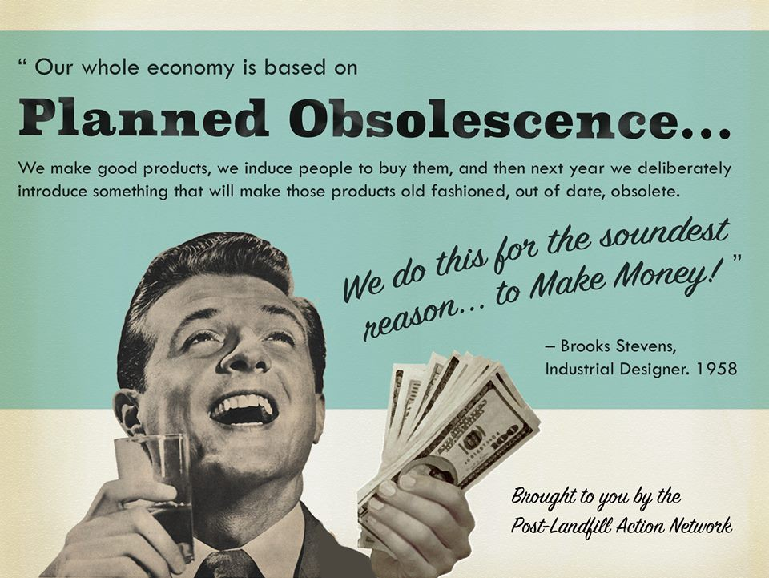

Slide 8
What is the Circular Economy?
This Photo by Unknown Author is licensed under CC BY-NC-ND

Slide 9
Circular economy
“decouples economic growth from the consumption of finite resources and designing out waste from the system to keep products and materials in use and regenerate natural systems” (Ellen MacArthur Foundation)
“keeps resources in use for as long as possible, extract the maximum value from them in use, to then recover and regenerate products and materials at the end of each service life” (WRAP)
“an economic system aimed at eliminating waste and encouraging the continued use of resources” (Geissdorfer et al, 2017)
There are at least 114 definitions!

Slide 10

Short video
https://www.youtube.com/watch?time_continue=228&v=zCRKvDyyHmI

Slide 11
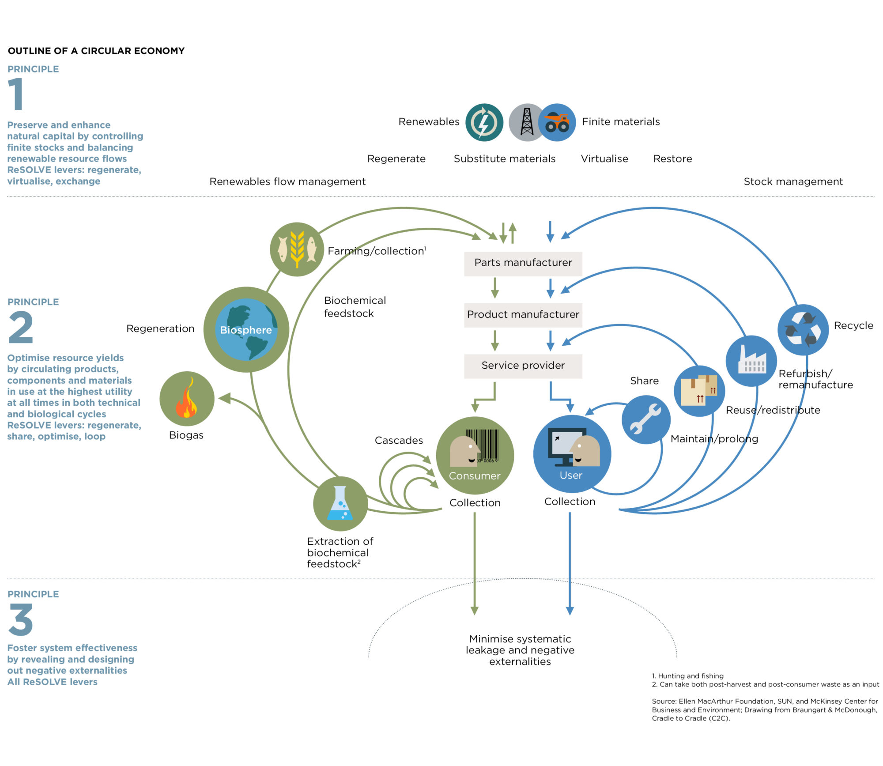

Slide 12
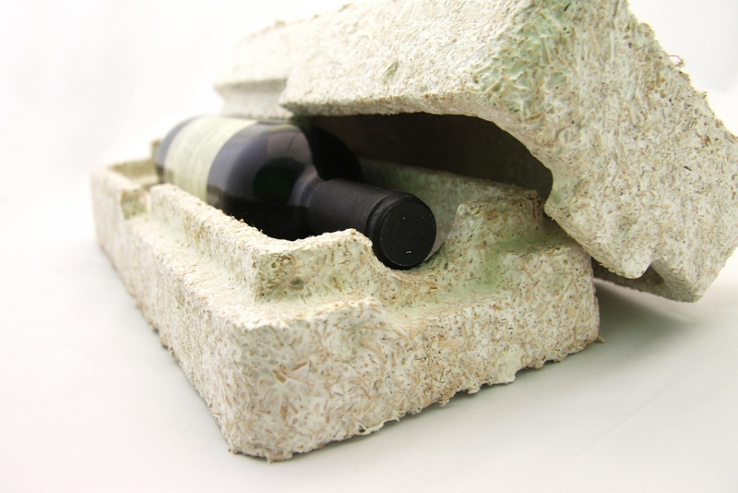

Case study: Ecovative
Source: Ellen MacArthur Foundation

Slide 13
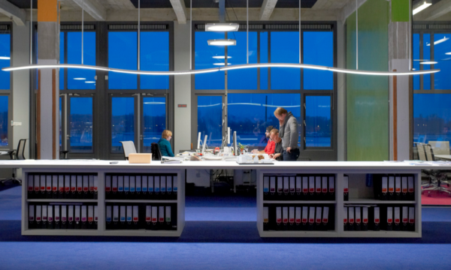
Case study: Phillips
“Pay-per-lux”
Source: Ellen MacArthur Foundation

Slide 14
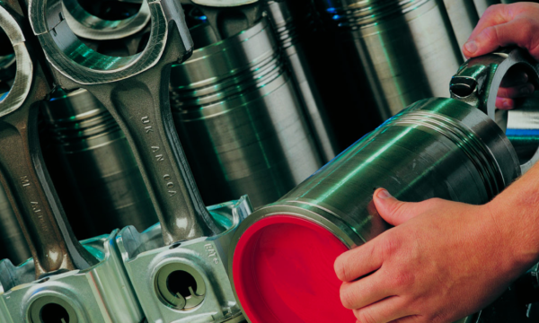
Case study: Caterpillar
Heavy machinery remanufacture
Source: Ellen MacArthur Foundation

Slide 15
In the built environment…
The ReSOLVE Framework:
  Regenerate
  Share
  Optimise
  Loop
  Virtualise
  Exchange

Slide 16
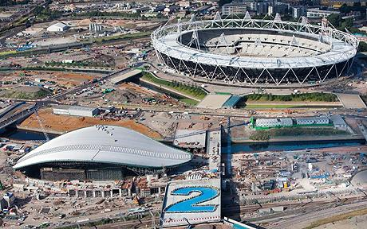
Case study:
London 2012 Olympics
https://www.theguardian.com/sport/interactive/2012/jul/27/olympic-regeneration-legacy-stratford
Source: The Telegraph

Slide 17
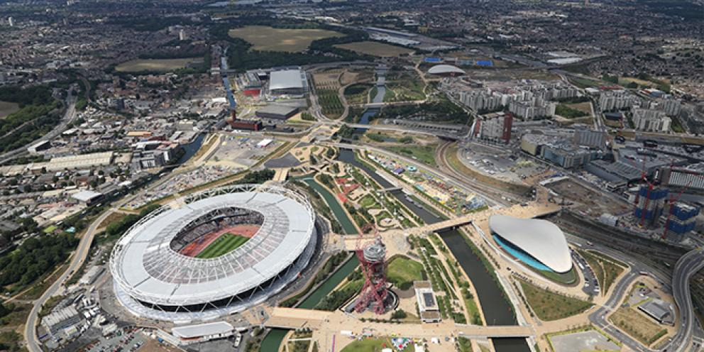
Sustainability
Source: The Mayor of London

Slide 18
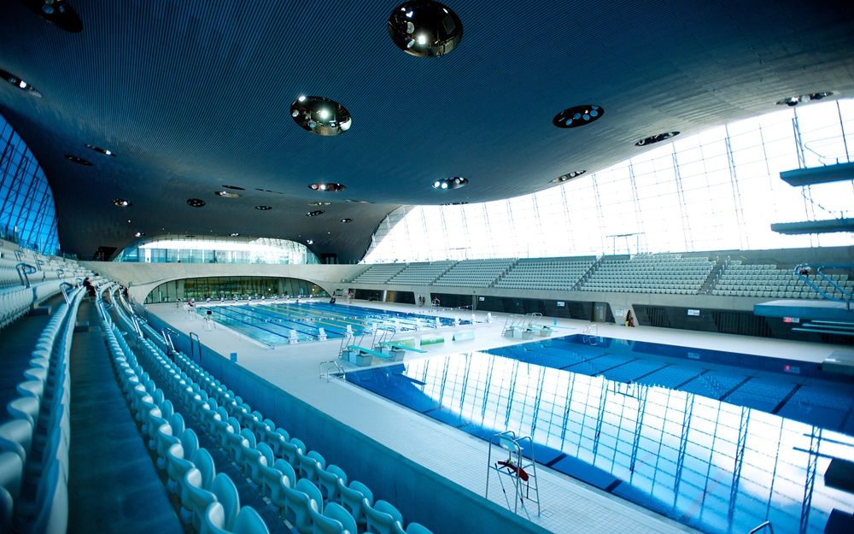
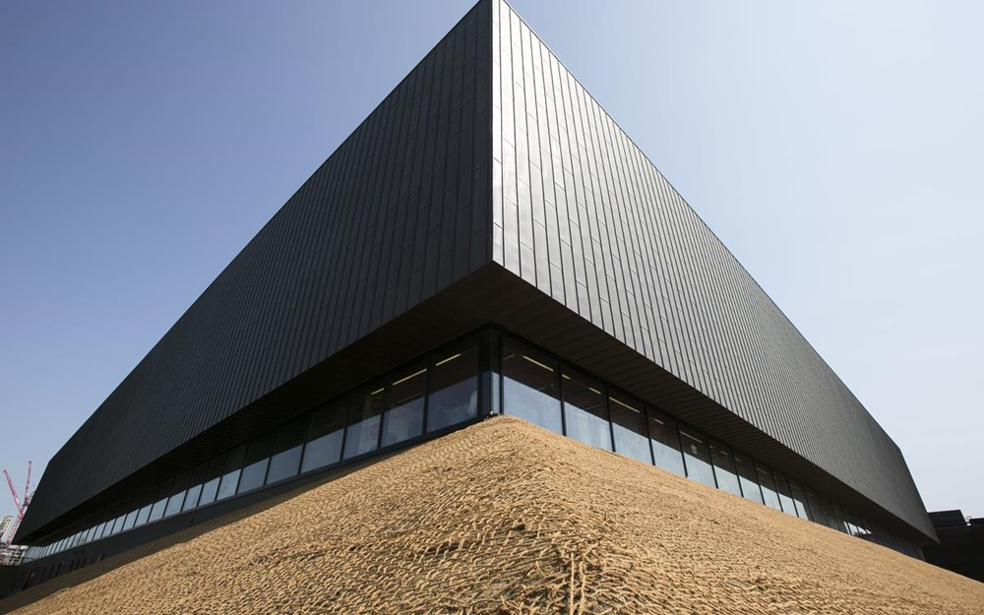
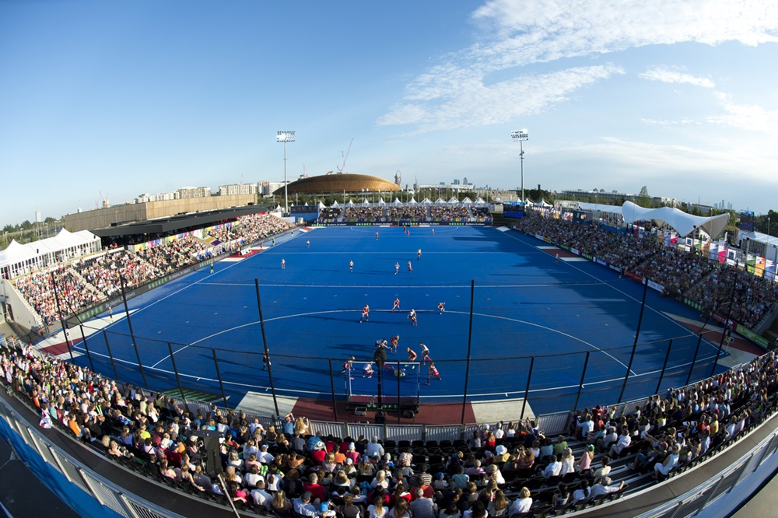
Legacy
Source: London Corporation

Slide 19
Useful information
Ellen MacArthur Foundation (www.ellenmacarthurfoundation.org)
Circularity in the Built Environment: case studies (https://www.ellenmacarthurfoundation.org/assets/downloads/Built-Env-Co.Project.pdf)
WRAP (www.wrap.org.uk)
Mayor of London (www.london.gov.uk)
Olympic Park (www.queenelizabetholympicpark.co.uk)

