Slide 1
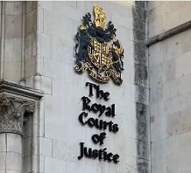
Criminological Theories and Cause of Criminal Behaviour
By Megan Goodier
Understanding Crime, Justice and Punishment
BMCP5009
Laura Knight
(Watts, 2024).

Slide 2
The purpose of this PowerPoint presentation is to compare and contrast the following theories while considering how they explain the cause of criminal behaviour and assumptions they make about human nature.
Rational Choice Theory
Brain Structure and Function
Bandura Theory
Right Realist Biosocial Theory

Slide 3
Rational Choice Theory
Social scientist employ the rational choice theory as a method to comprehend human conduct.
How behaviour is influenced by incentives and restrictions.
Several presumptions form the foundation of rational choice theory:
1) Individualism; it emphasises personal conduct.
2) People must maximise their objectives
3) People are self- interested.
The criminal weighs that cost and the benefits (Piquero and Hickman 2002). The rational choice perspective begins with the idea that people choose crime because it is advantageous.
Crime will happen if there are many advantages to it and few disadvantages. But the crime will not happen if the advantages of crime outweigh the disadvantages.
According to this hypothesis,
Rational offenders will stop or be discouraged from committing crime if the costs of the crime are made high (Paternoster and Bachman 2001:1).

Slide 4
-
Criminal and delinquent offenders are goal oriented and attempt to demonstrate some degree of rationality
Rationality is the central idea in the rational choice theory (Cornish and Clark 1986)(Kenan,2024).
Rationality describes how reasoning influences human conduct and sees crime as the result of a person weighing the potential benefits and the drawbacks / costs of committing a crime.
According to rational choice theory, a potential crime is based on a set of choices:
whether to (or not) conduct a crime
to choose a specific target
how often to commit an offence
whether to (or not) refrain from committing crimes. (Verbora,2023).

Slide 5
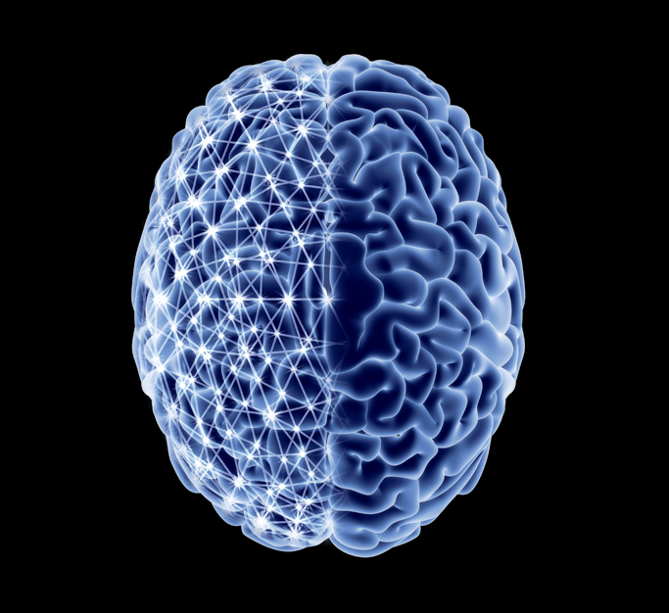
Brain structure and function
Analysis of functional MRI brain scans of 40 people.
Results found distinctive brain activity.
Machine learning analysis of the data was able to correctly predict whether the individual displayed criminal intent or was just taking a risk between 71 and 80% of the time (Straiton and Lake,2021).
Modern criminologists, on the other hand, argue that crime is the consequence of intricate interplay between genetic, social, and environmental factors, criticising this viewpoint as being unduly simplistic and scientifically inaccurate.
Lombroso's investigations:
Lacked scientific rigour in their methodology, frequently depending on anecdotal findings without control groups or standardised procedures, which rendered his results untrustworthy.
Ethical issues since it may result in negative stereotyping and physical appearance-based discrimination.
Biological factors alone cannot account for criminality and point out that empirical research has repeatedly failed to find a meaningful connection between criminal behaviour and physical traits (Goring, 1913).
As a result, modern criminology takes a multidimensional approach that considers both biological and societal elements in order to comprehend criminality, making Lombroso's theory mostly obsolete (Goring, 1913).
(Columbia magazine,2024).

Slide 6
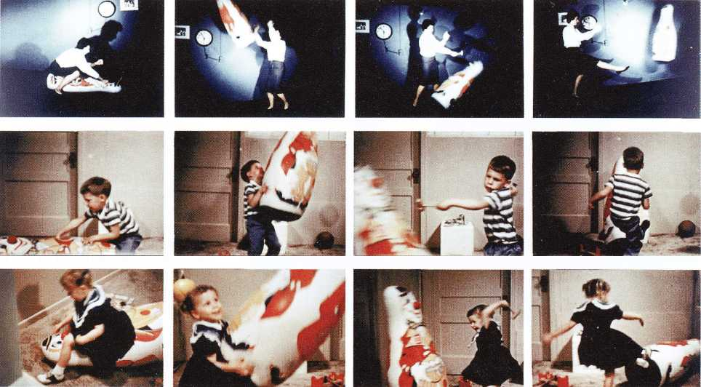
Bandura Theory
Albert Bandura in 1962
Explain why learning frequently takes place in the absence of explicit reinforcement.
Bandura’s theory he split two groups of children
Results
Case study Example
Explanation of Banduras Bobo doll
(Ambika,2024).

Slide 7
Right Realist Biosocial Theory
Majority of people believed that crime should virtually never be committed, some believed there were numerous benefits to engaging in criminal activity.
Some persons exhibited unrestrained behaviour and appeared to be more likely to commit crimes. The majority of people had internalised anxieties and concerns about committing crimes and facing consequences from the criminal justice system.
Some people had short attention spans and needed nearly instant gratification of their desires, whereas many others were able to postpone gratification and so maintain and finish tasks with distant payoffs. While the mere possibility of criminal prosecution was sufficient to restrain OR stop many persons from committing crimes, others appeared to learn little or nothing from punishment experiences.
Wilson and Herrnstein questioned which processes—biological, developmental, environmental, and adaptive—led to the emergence of personal traits that predict criminal behaviour.
Additionally, the papers they selected to analyse focused on studies from a variety of fields that typically demonstrated individual-level variance in crime and risk factors for criminal activity (Wilson and Herrnstein,2010).
First, Wilson and Herrnstein present their own theories of crime “person will do that thing whose consequences he or she perceives to be preferable to the consequences of doing something else," according to their perspective (p.43). People and societies continue to associate certain crimes with both positive and bad reinforcements. The reason that "individuals differ in the value they assign to such reinforcements and the degree to which they discount them over time" (p.56) can be explained by a combination of biological, psychological, and environmental factors. What matters, though, is that people decide which values to ascribe to different reinforcement of criminal activity. They specifically enquire as to why young guys are especially affected by this phenomenon (Manfredi,1985).

Slide 8
Conclusion
Overall, these four theories contradict each other as they have similarities and differences.
They have more differences than similarities they are:
The rational choice theory looks at method to comprehend human conduct whereas Bandura’s theory is learning though social learning and imitating behaviour.
The Brain structure and function looks at the brain and comparing the MRI scans to criminal activities whereas Right realist biosocial theory can be explained by a combination of biological, psychological, and environmental factors.

Slide 9

Research Timeline
WC 7/10/2024 - Learned about Classicism and Positivism in lecture and started to read around the topic to help me start planning my PowerPoint.
WC 14/10/2024 – After reading a lot of research around the topics, picked the best research for each topics. Classicism and Positivism continued learning via lecture.
WC 21/10/2024 – Started to put power point together and started to structure the slides together and add information on the slides. Learned about Critical and realist criminological theories in lecture.
23/10/2024/ 25/10/2024 - Read more information on the additional information that was already on the power point and upon doing more research gathered more information for each of the theories.
WC 28/10/2024 – Learned about Integrated theories. Faced some challenges when it came to the research as it was difficult to find appropriate websites. Finalised research and power point slides.

Slide 10
References
Ambika, (2024), Available at: https://thelearningchapter.com/2016/01/15/bobo-dolls-and-learning/ (Accessed 2nd November 2024)
Columbia magazine,(2024), Available at: https://magazine.columbia.edu/article/your-beautiful-brain (Accessed 2nd November 2024)
Flanagan. C, Liddle. R (2019). Applied Psychology Book 1, Cheltenham, Gloucestershire, Illuminate Publishing.
Goring, C. (1913). The English Convict: A Statistical Study. London: H.M. Stationery Office.
Kenan. S, (2024), An evaluation of the rational choice theory in criminology, Available at: https://citeseerx.ist.psu.edu/document?repid=rep1&type=pdf&doi=8d1b66b6d20c54e1f38be1c6e79bf0c32c4ab331 (Accessed 25 October 2024)
Kincheloe. J and Horn. R (2006), The Praeger Handbook of Education and Psychology, Volume 4, Published: Bloomsbury Publishing, Available at: https://www.google.co.uk/books/edition/The_Praeger_Handbook_of_Education_and_Ps/C7HOEAAAQBAJ?hl=en&gbpv=1&dq=bandura+theory+&pg=PA49&printsec=frontcover (Accessed 24 October 2024)
Manfredi. C, (1985), A review of crime and human nature by James. Q and Richards Herrnstein, Available at: https://claremontreviewofbooks.com/crime-and-human-nature/ (Accessed 31 October 2024)
Straiton. J and Lake. F (2021), Inside the Brain of a Killer: The ethics of neuroimaging in a criminal conviction, Volume 70, Issue 2, Available at: https://www.tandfonline.com/doi/full/10.2144/btn-2020-0171#:~:text=The%20orbitofrontal%20cortex%20is%20one,located%20in%20the%20frontal%20lobe. (Accessed: 14 October 2024)
Verbora.R, (2023), 16.6 Rational Choice Theory, Available at: https://kpu.pressbooks.pub/introcrim/chapter/16-6-rational-choice-theory/ (Accessed 25 October 2024)
Watts. D, (2024), Available at: https://ministryofinjustice.co.uk/royal-courts-of-justice/ (Accessed 2nd November 2024)
Wilson, and Herrnstein: Crime and Human Nature (2010), Encyclopedia of criminological theory, Available at: https://study.sagepub.com/system/files/Wilson%2C_James_Q.%2C_and_Richard_J._Herrnstein_-_Crime_and_Human_Nature.pdf (Accessed 31 October 2024)

