Slide 1
The Holistic Nature of Learning

Slide 2
This session
Theories related to the nature of development and learning
Consideration of the influences on development
The role of the educator in development

Slide 3
Development and learning
What do we mean by:
  Child development
  The holistic nature of learning
What is the purpose of a school?
Notes:
In groups (whatever works in your group), give students a chance to discuss and consider each of these, ask for feedback on them – feedback shouldn’t be wrong really, but ask others to build upon any defintions
One example is: Child development is usually subdivided: prenatal → infancy & toddlerhood → early childhood → later childhood→adolescence
Get to consider the different aspects of development e.g. physical, mental, emotional etc
Holistic nature of learning: An approach that seeks to fully activate all aspects of the learner's personality (intellect, emotions, imagination, body) for more effective and comprehensive learning. (UNESCO)
Based on the second point, HOPEFULLY, there should be a realisation that school’s should provide more than “chalk and talk” but should consider all aspects of a child and their development

Slide 4
How have these notions been realized in the new Curriculum for Wales
The four purposes
The four purposes are the shared vision and aspiration for every child and young person. In fulfilling these, we set high expectations for all, promote individual and national well-being, tackle ignorance and misinformation, and encourage critical and civic engagement.
A school’s curriculum is everything a learner experiences in pursuit of the four purposes.
(Gov.wales, 2015)
Notes:
Introduce the notion of successful futures – mainly the need for the review, Graham Donaldson, and that the core purposes set out were not around learning specifically, but around the four purposes
Gov.wales. (2015). Introduction - Hwb. [online] Available at: https://hwb.gov.wales/curriculum-for-wales/introduction
‌

Slide 5
The Four Purposes
The Four Purposes are that all children and young people will be:
  Ambitious, capable learners who are ready to learn throughout their lives.
  Enterprising, creative contributors who are ready to play a full part in life and work.
  Ethical, informed citizens who are ready to be citizens of Wales and the world.
  Healthy, confident individuals who are ready to lead fulfilling lives as valued members of society.
Notes:
Give students a chance to consider these – did they align in any way with their idea of what schools should do?

Slide 6
How our idea of learning has changed
How we used to think learning happened
ABILITY
TIME
Notes:
Ask learners what the problems are with this notion, particularly across a number of subjects in a school curriculum
They should pick up the obvious:
We develop at different rates
Some people will develop faster than others in specific subjects

Slide 7
How our idea of learning has changed
How we now know learning happens
ABILITY
TIME
Notes:
Introduce the notion of progression as being nonlinear – and get them to seriously consider the idea of the education they have received, one of age related expectations – all learners, in all subject should be at the exact same point

Slide 8
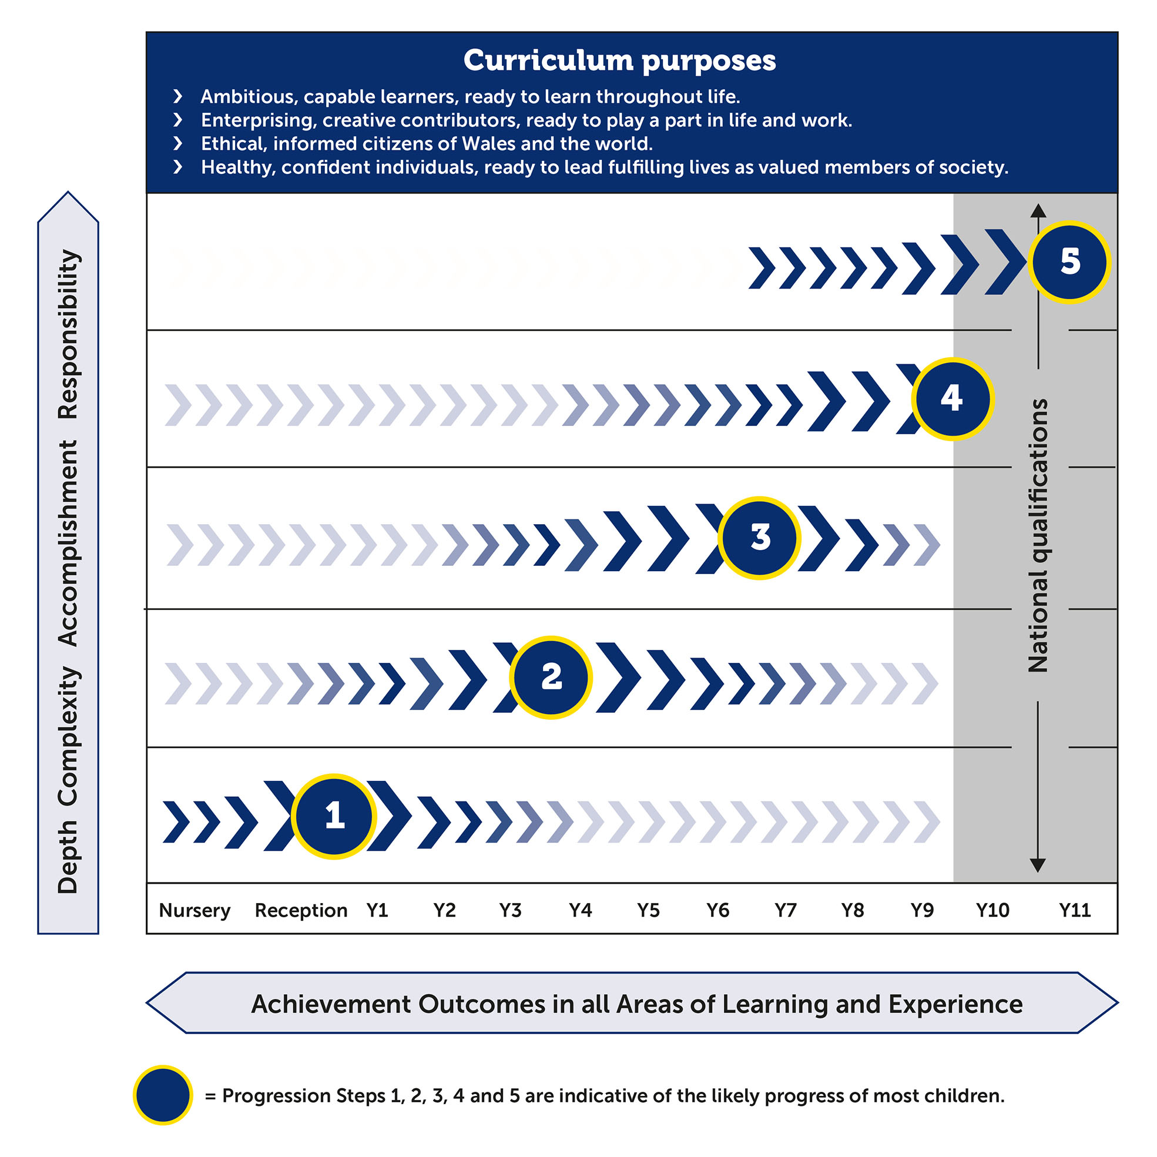
How the curriculum for Wales accounts for this
Removal of age-related expectations
Move towards the idea of ‘progression steps’ in areas
Notes:
Introduce progression steps very lightly – make sure they know that this will be covered in detail as part of their 6008 module, the important take away is that learners can be anywhere on the progression steps (though progression is expected) the diagram demonstrates nicely how these steps can overlap
get them to consider their own school experience, can they relate to this notion – feel free to use your own phase/subject area experience to provide anecdote for discussion
It is also worth pointing out that this is a reason we mix our pri and secondary – the idea that someone in primary has no idea about how a 12 yo learns (and vice versa) is silly – and we have lots to leanr form eachother
Senedd.wales. (2022). Donaldson Review: An end to Key Stages and a change to the way we structure pupils’ progression? [online] Available at: https://research.senedd.wales/research-articles/donaldson-review-an-end-to-key-stages-and-a-change-to-the-way-we-structure-pupils-progression/ [Accessed 25 Aug. 2022].
‌

Slide 9

Key Questions?
How does our understanding of a child development theory influence how we teach and how does this impact the learning in the classroom
How does this new knowledge of child development underpin their individual classroom practice

Slide 10

Activity
In groups, make a list of the different things that can affect a child’s development from 0-19
Notes:
Ask for some responses
unique nature of each individual / what each takes from others / how this differs with culture (and the vast array of this).
There is some opportunity here to explore the context of development – where we live, the people we know, , our families, how these are different for all of our learners

Slide 11
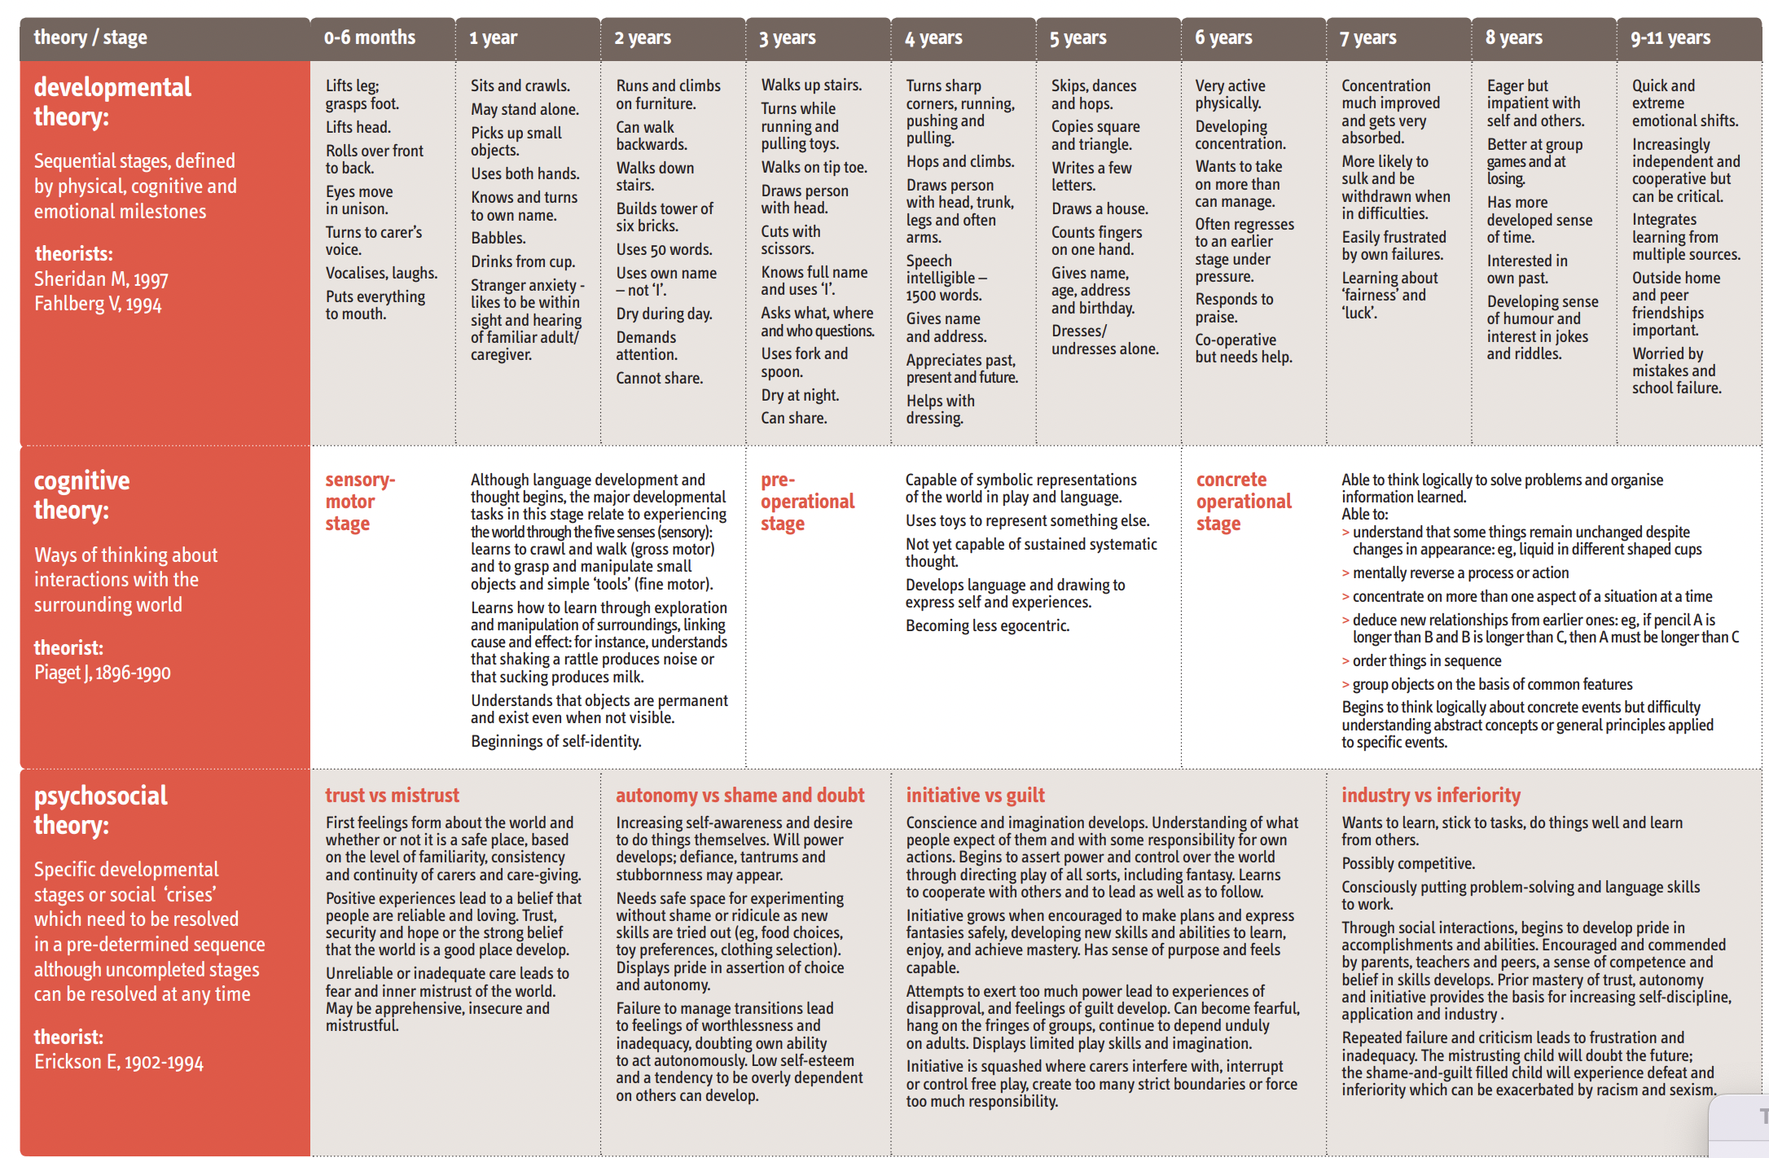

Slide 12
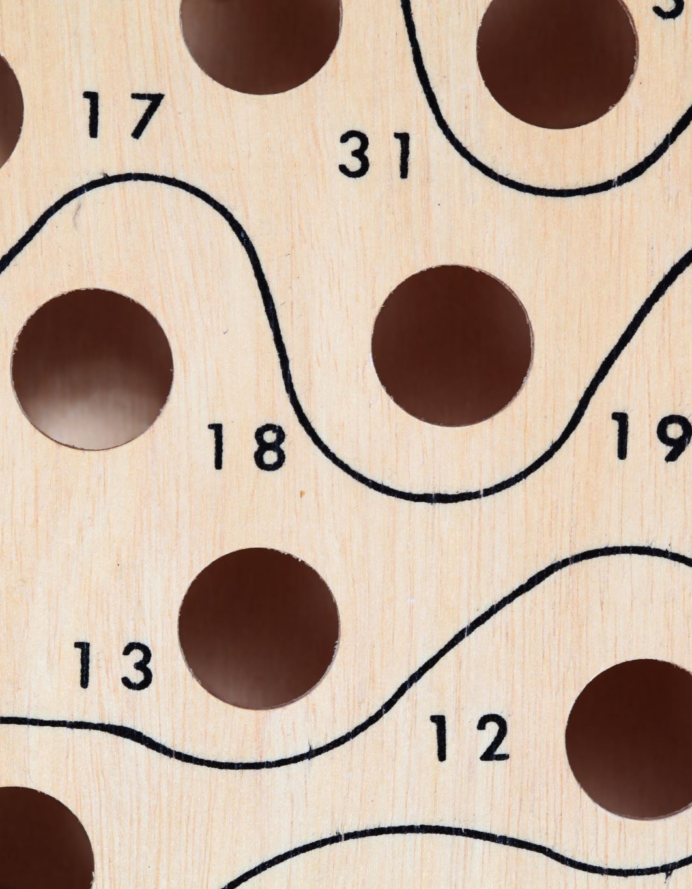
Key Theories
Piaget- Cognitive Development Theory
Vygotsky- Socio-Cultural Theory
Bruner-
Bronfenbrenner- Biological Model of Development
Skinner- Operant Conditioning
Bandura – Social Learning Theory

Slide 13
Activity – major child development theorists
Jean Piaget
Lev Vygostky
Erik Erikson
B.F. Skinner
Albert Bandura
Urie Bronfenbrenner
Arnold Gesell
In groups, use the template on Moodle to create a one-page profile for your assigned theorist
Will have: their details
Major contributions/what they say about development
Discuss the merits or possible issues with their theories, and be ready to discuss with the class
Save the file with your theorist's name plus your group name HERE
Notes:
In smaller groups (3/4 ish) get to complete the task – once saved this could be a point of reference for them later on – they will get lots of extra theory in Who’s who
The general overview is on the next slide for you, but it wont play on the screen ☺_

Slide 14
Y tîm o gwmpas y plentyn
The team around the child
Crëwch ddiagram o’r tîm a’r byd o gwmpas y plentyn gan grwpio’r dylanwadau gwahanol i gategorïau.
Pa ddylanwadau a allai fod y rhai mwyaf?
Create a diagram of the team and the world surrounding the child. Group and categorise the various influences.
Which influences might be the greatest?
Notes:
Allow students 5 minutes to engage with this task
Lecturer invite shared responses illustrating the complex nature of the possibilities. Positives and negatives.
Before introducing the next slide.
This will have nuances according to secondary / primary phase.

Slide 15
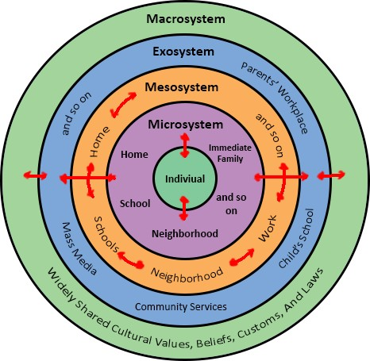
Bronfenbrenner’s Ecological Systems Theory (1979)
Microsystem: the child’s own close family & friends
Mesosystem: extended family, friends & teachers
Exosystem: cultural system outside the family (church, employer etc)
Macrosystem: larger society
Notes:
Discuss Bronfenbrenner’s ecological systems – does any of this bear resemblance to any diagrams or influences identified by the learners?
Looks at a child’s development within the context of the system of relationships that form his or her environment. Bronfenbrenner’s theory defines complex “layers” of environment, each having an effect on a child’s development.
The interaction between factors in the child’s maturing biology, their immediate family/community environment, and the societal landscape fuels and steers his development. Changes or conflict in any one layer will ripple throughout other layers. To study a child’s development then, we must look not only at the child and her immediate environment, but also at the interaction of the larger environment as well.

Slide 16
Beirniadaeth o’r model
Criticism of the model
Mae rhai beirniad yn meddwl bod angen ychwanegu cronosystem (newidiadau dros amser).
Gwêl eraill yr angen i gynnwys haenen tu allan i’r macro i gwmpasu’r modd y gall unigolion ddylanwadu ar eu hunain.
Some critics consider a chronosystem to be a necessary addition (changes over time).
Others see the need to include an ex-macro layer to account for the way individuals may influence themselves.
Notes:
Bronfennbrenner (and Evans) later revised elements of the theory to include time –
As pointed out by Ashiabi and O’Neil (2015) ‘more concern was given’ to related concepts including time in later versions.
Christensen J. (2016) includes the point on an ‘entrepreneurial’ ex-macro layer provided by the individual – Malmo University Sweden.
Worth mentioning that the chronosystem theory also relates to events of great import to young people in their development, and that the timing of the event can have a different impact – think covid for EYFS, compared to a year 6 to year 7 transition compared to GCSEs

Slide 17
Prif Ddamcaniaethwyr Datblygiad Plant
Jean Piaget - Rhaid gosod tasgau dysgu sy’n cyd-fynd â lefel datblygu plentyn.
Lev Vygotsky – Dylid sicrhau cyfleoedd cyson ar gyfer rhyngweithio cymdeithasol. Mae cyswllt cymdeithasol yn angenrheidiol ar gyfer datblygiad deallusol.
Erik Erikson - Rhaid i rieni a gofalwyr eraill fod yn ymwybodol o anghenion plant ym mhob cyfnod datblygu ac yn sensitif iddynt, a’u cefnogi trwy gyfnodau o argyfwng.
B.F. Skinner - Gall rhieni a gofalwyr ddylanwadu ar ymddygiad plant trwy ddefnyddio adborth cadarnhaol a negyddol.
Albert Bandura - Mae angen i ofalwyr gynnig esiamplau da i blant allu eu dilyn.
Urie Bronfenbrenner - Pwysigrwydd perthynas sefydlog, gariadus a pharhaus gyda’r gofalwr agosaf. Mae’r amgylchedd yn effeithio ar ddatblygiad.
Arnol Gesell - Pennir datblygiad yn enetig gan “batrymau aeddfedu” cyffredinol sy’n digwydd mewn dilyniant rhagweladwy.

Slide 18
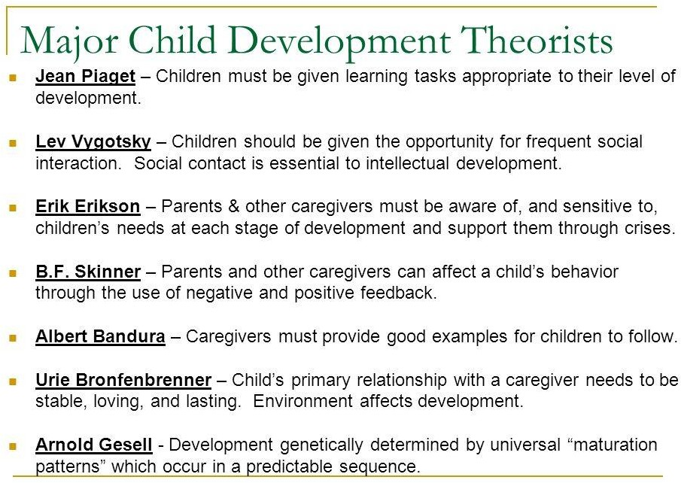
Notes:
The briefest overview here - more detail will come in Who’s Who 1 and 2

Slide 19
Tasks
In a group of 4 read a section of an academic paper relating to a theory of child development, explain your understanding of this theoretical framework to the group.
Group to plan four activities according to four different theoretical frameworks. Share with whole group
Reflect on a theory of learning and how this impacts their own philosophy of education
Reflect on theoretical knowledge of child development and theory of learning and plan a task with progressions for an area of specialism (secondary) an AoLE (primary)
Consider what are the key perspectives that are going to influence your DAP (developmentally appropriate practice)

Slide 20

Linked Videos to watch
Piaget Conservation Task
A typical child on Piaget's conservation tasks - YouTube
Vygotsky- PD
Charlie demonstrates Vygotsky 0001 - YouTube
Bandura- Social Learning
Bandura's Bobo Doll Experiment - YouTube

Slide 21
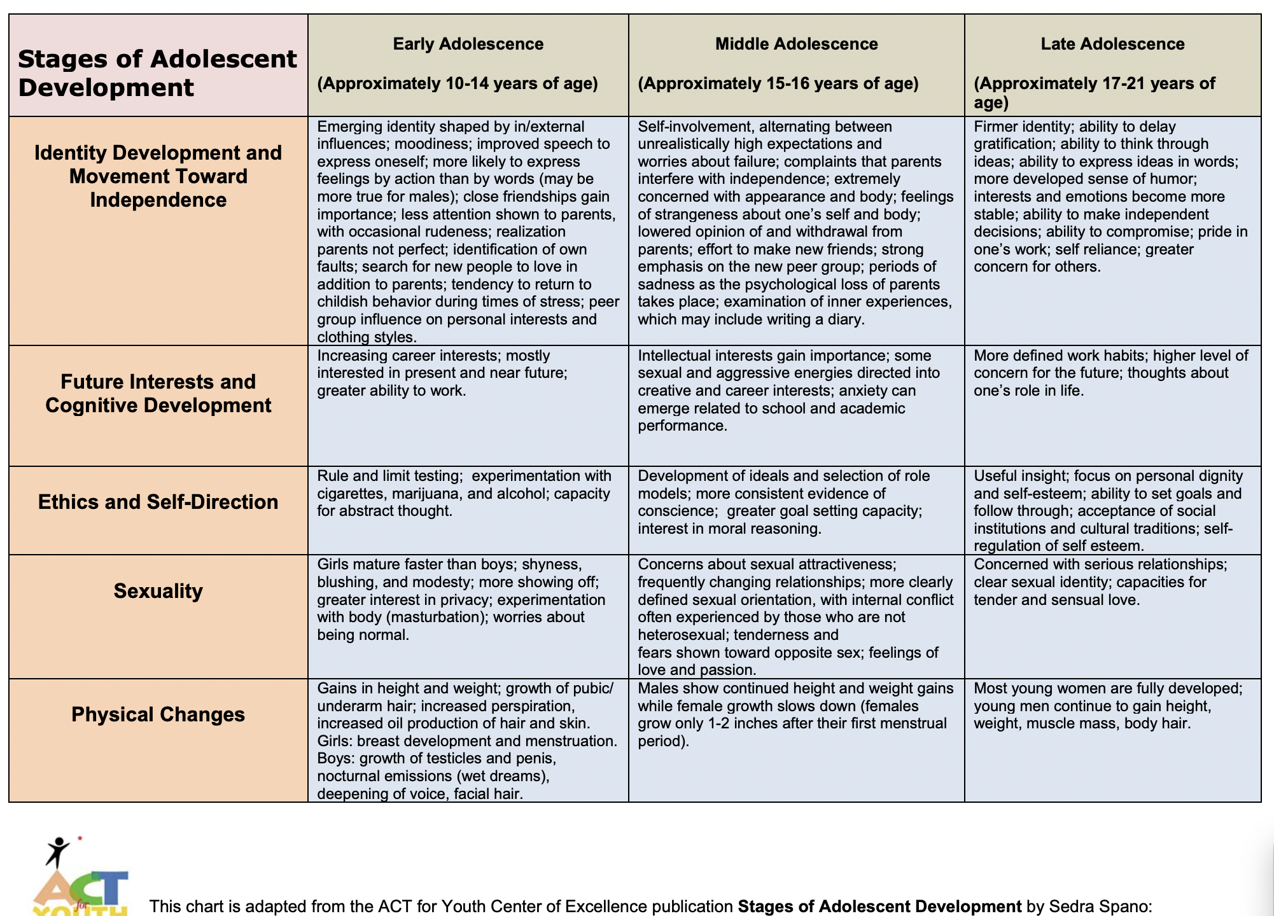

Slide 22
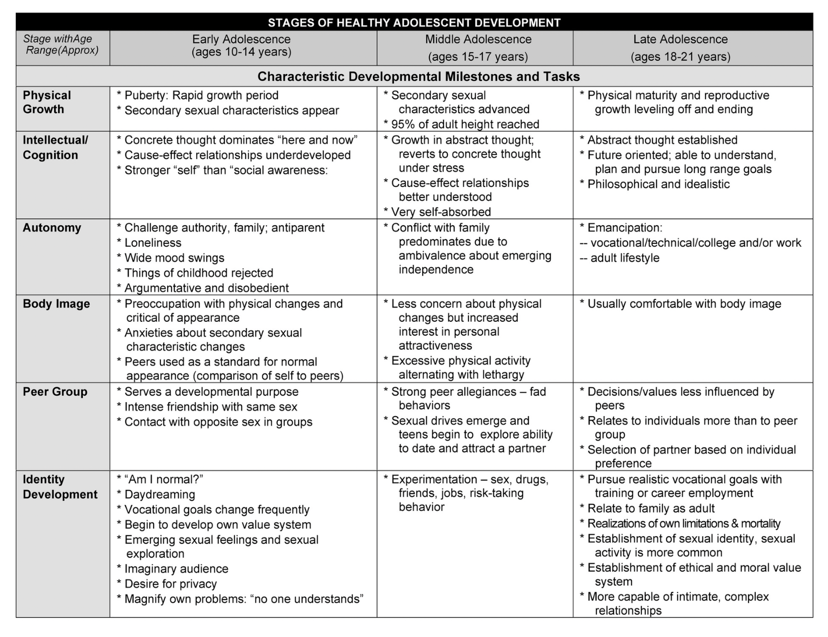

Slide 23
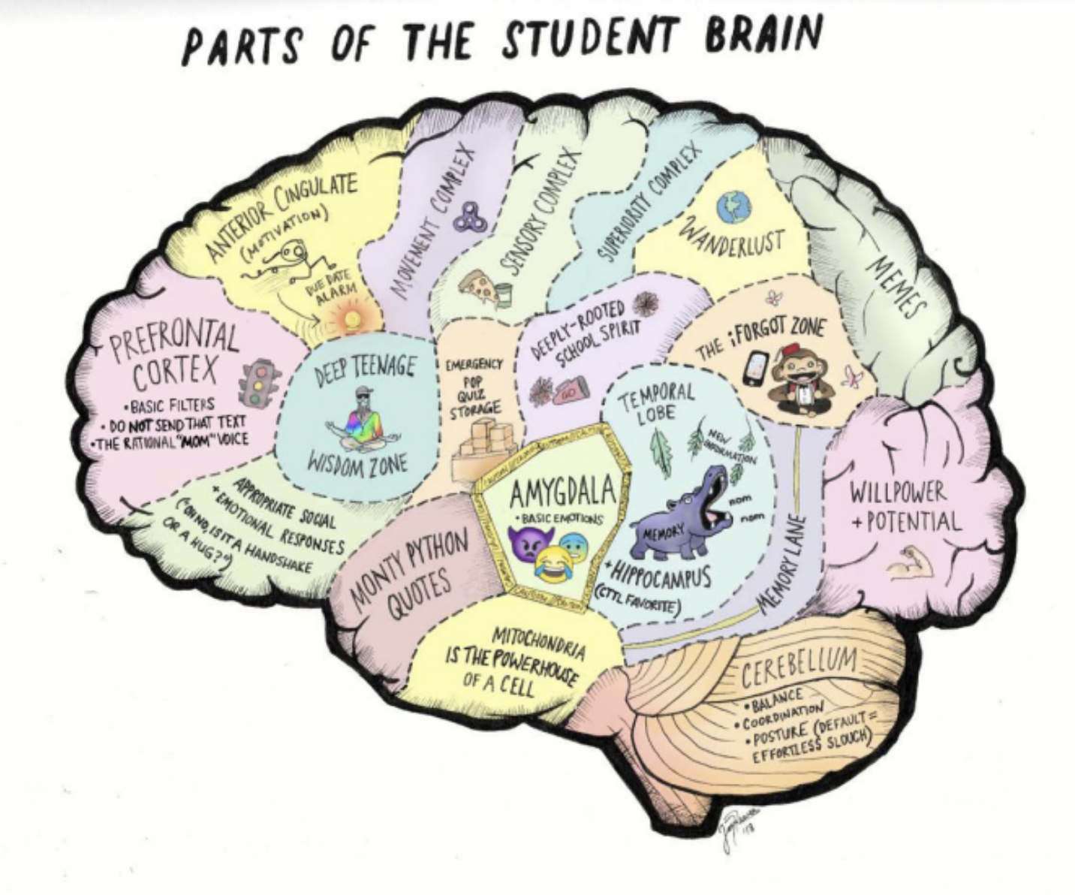

Slide 24
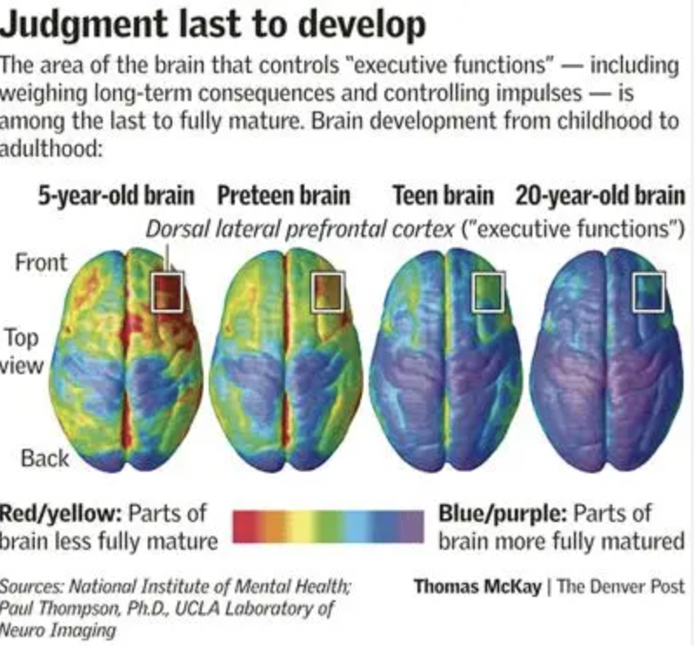

Slide 25
Y plentyn The child
Tynnwch lun o ‘blentyn’ a dewis ei oedran.
Ar un ochr nodwch ei holl anghenion mewn perthynas ag agweddau datblygiad cyfannol.
Ar yr ochr arall, meddyliwch sut gallech chi fel athro ddatblygu’r agweddau hynny?
Draw a ‘child’ and choose his/her age.
Write down on one side all of the needs related to the aspects of holistic development
On the other side, think about how you as a teacher might develop those aspects.
Notes:
According to phase – primary / Secondary
Activity take 10/15 mins – ask for feedback on these aspects – remind that not all of teaching is content

Slide 26
Poverty, progression and development
There were 3.9 million children living in poverty in the UK in 2020-21.That's 27 per cent of children, or eight in a classroom of 30
49 per cent of children living in lone-parent families are in poverty. Children from Black and minority ethnic groups are more likely to be in poverty: 46 per cent are now in poverty, compared with 26 per cent of children in white British families.
Work does not provide a guaranteed route out of poverty in the UK. 75 per cent of children growing up in poverty live in a household where at least one person works.
Children in larger families are at a far greater risk of living in poverty – 47 per cent of children living in families with 3 or more children live in poverty.(CPAG, 2022)
Notes:
Ask students in groups to consider these points – what impact do these figure have on a child development – how do they impact what we do in the classroom
Definitely consider the energy crisis as we see it – how does this, as well as poverty impact learners – the impact will be immense – worth noting back that this will impact on every aspect of bronfenbrenners model
CPAG. (2022). Child poverty facts and figures. [online] Available at: https://cpag.org.uk/child-poverty/child-poverty-facts-and-figures

Slide 27
Final reflection
How does what you have learned today about progression and development impact how you think about working in education?

Slide 28

References
Book- Doherty, & Hughes, M. (2014). Child development : theory and practice 0-11 (Second edition.). Pearson.
Hayes, N., O'Toole, L. and Halpenny, A.M., 2022. Introducing Bronfenbrenner: A guide for practitioners and students in early years education. Taylor & Francis. (Chapter 2)
Stephen Newman & Ashkan Latifi (2021) Vygotsky, education, and teacher education, Journal of Education for Teaching, 47:1, 4-17, DOI: 10.1080/02607476.2020.1831375

