Slide 1



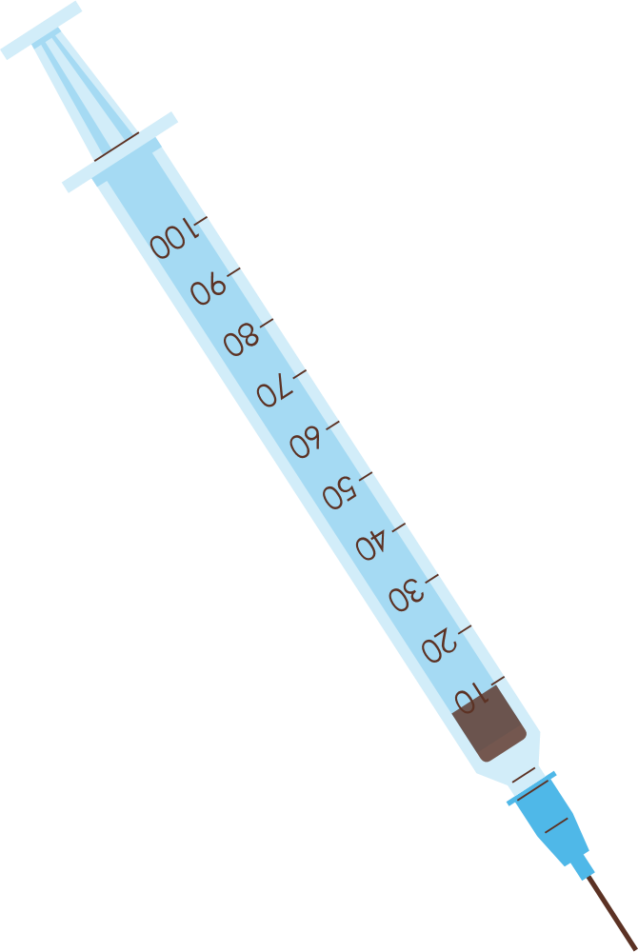

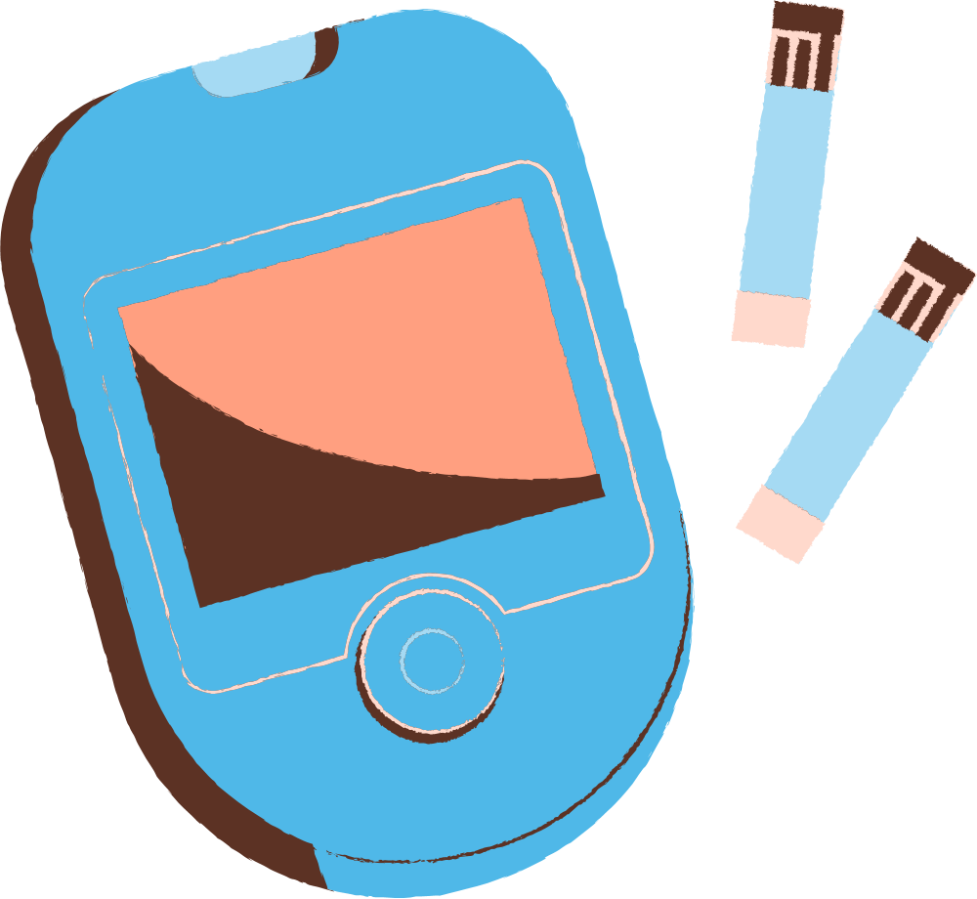

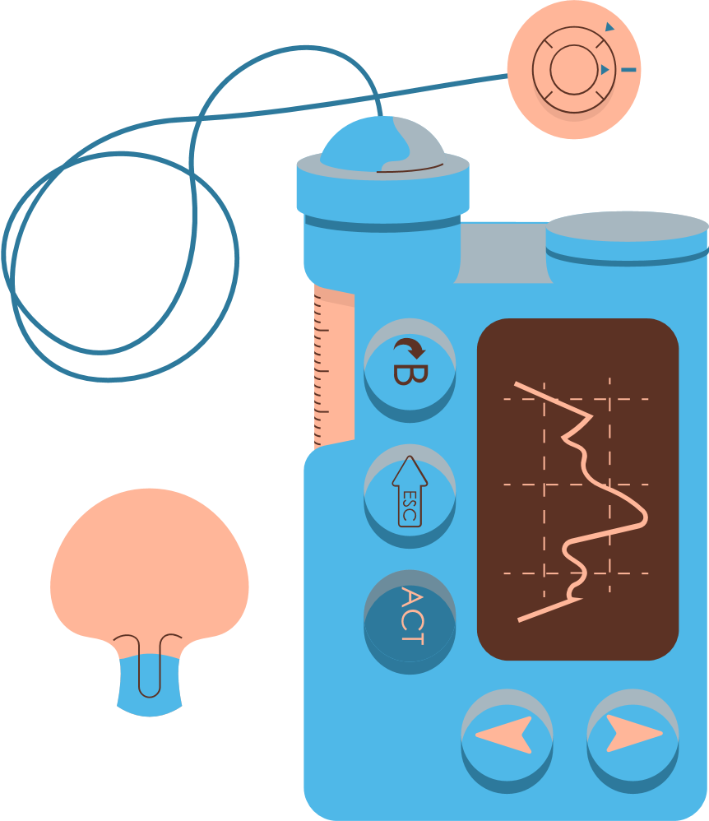
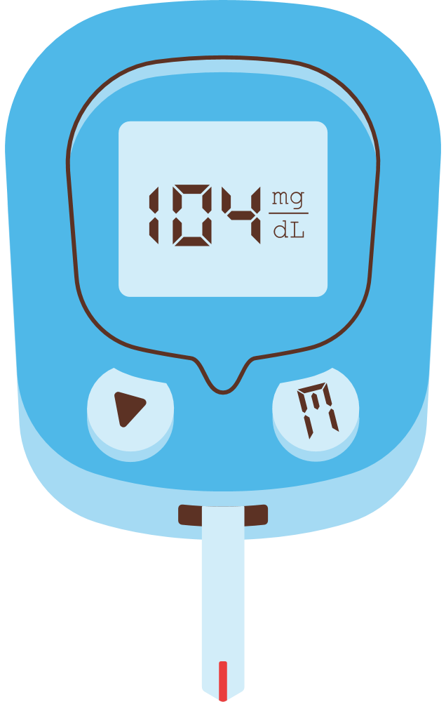

Programme: MSc Public Health and Social Care in Practice
Module code: LCHS7003
Module: Community Care and Management of Longer-term Conditions
Assignment Title: Component 2
Individual Presentation
Student ID:2214807
Student Name:Afshan Mirza

Slide 2

Introduction
The presentation aims to analyse the contribution of primary care nurses in dealing with the Type 2 Diabetes health condition.
Primary care nurses play a significant role in the diagnosis, treatment and assessment of long-term health conditions.
Notes:
Care and management are comprehensive patient-oriented care to coordinate and maintain the health and support services, which assist them in dealing with long-lasting circumstances (Martin et al., 2021). The presentation will deliver an overview of Type 2 Diabetes and illuminate the incidence of Type 2 Diabetes. Along with this, the social and economic pressure of Type 2 Diabetes will be discussed. In the meantime, the diagnosis and primary assessment approach, along with the management of this long-lasting disease in the UK, will be showcased. Afterwards, the treatment options and comorbidities related to the disease will be presented. In the meantime, the anticipation of Type 2 Diabetes will be showcased. Furthermore, the skills and behaviour that are required to be followed by the primary care nurses to deal with the diabetic patients will be discussed with showcasing the Comprehensive Model of Personalised Care to deal with the diseases.

Slide 3

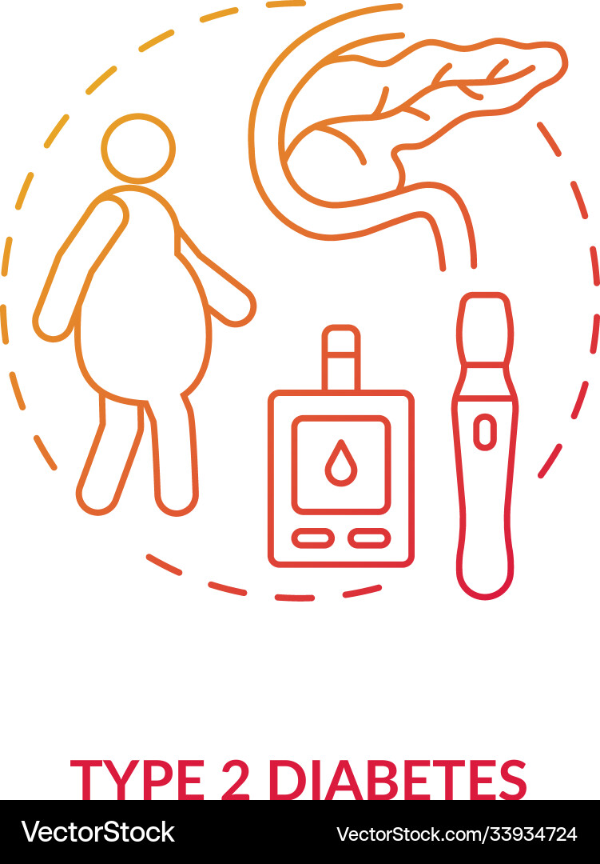
Type 2 Diabetes Overview
Type 2 Diabetes Mellitus, or T2DM, is a long-lasting condition where the human body does not produce enough insulin, which increases blood glucose.
The symptoms of Type 2 Diabetes are blurred vision, fatigue, polyuria, and persistent infections.
Notes:
As per Pienaar and Reid (2020), T2DM is caused by insulin resistance in the body, where cells cannot react to insulin, and the body cannot produce proper insulin. Mostly, the avoidance of physical activities, an overweight situation and genetic tendency are recognised as the aetiology of Type 2 Diabetes Mellitus (Chiauzzi, Rodarte and DasMahapatra, 2015). Along with this, the family history, increasing age, cholesterol issues and high blood pressure are considered for the Type 2 Diabetes Mellitus reason.

Slide 4

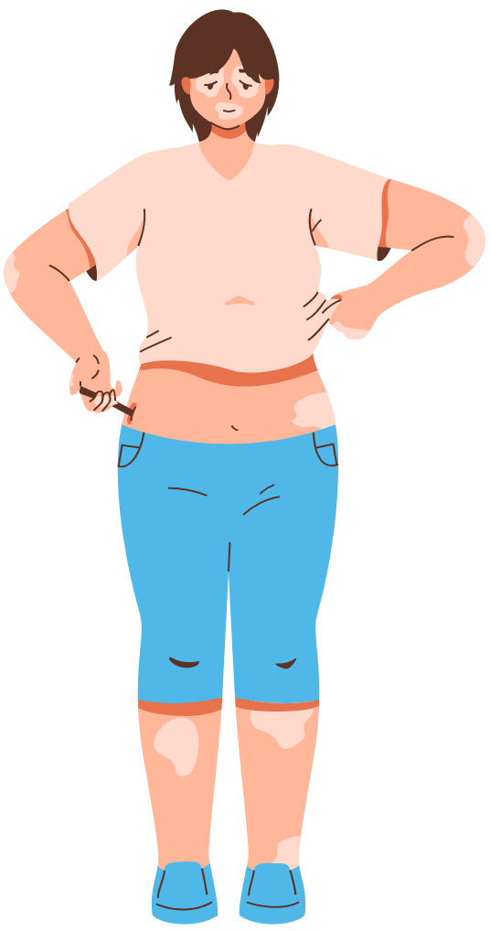
Type 2 Diabetes Prevalence in the UK and worldwide
Around 4.6 million people are dealing with Type 2 Diabetes in the UK (Davis et al., 2021).
Globally, the Type 2 Diabetes cases surpassed the 590 million mark (Knowles et al., 2023).
Notes:
The report of Ahmad et al. (2022), showcases that 4.6 million people are dealing with diabetes, where 90% of them are Type 2 diabetes cases, pointing out its severity in the UK. The prevalence of long-lasting diseases is 7.8% in the UK, which was recognised in 2021, where more than 16 years and older are mostly relevant to the discussion (American Diabetes Association, 2021). Along with this, diabetes is increasing around the world noticeably, where sedentary lifestyles and obesity contribute the most.

Slide 5



Type 2 Diabetes Effects on the Economy and Social
Just in the UK, 14 billion pounds are spent on diabetic care yearly (Davis et al., 2021).
Type 2 Diabetes noticeably affects the emotional well-being of individual, their quality of life and social participation.
Notes:
The figure that is spent yearly on diabetic care in the UK is 10% of the NHS budget. Such amount of expenses is caused by dealing with eyesight loss, kidney failure, cardiac disease and amputations (Knowles et al., 2023). Moreover, the global economic burden for the selected disease was 1.3 trillion pounds in 2015, which is expected to increase to 2.5 trillion in 2030 (Martin et al., 2021). In the meantime, the disease can noticeably affect quality of life and emotional health and social life. Most of the patients who are dealing with this, facing anxiety and depression. Such conditions in the ethnic minorities are also fatal as they lead to health inequalities. For instance, the people who are dealing with the situation cannot deliver their best in their work, and it can increase the absenteeism numbers (Eaton, Roberts and Turner, 2015).

Slide 6

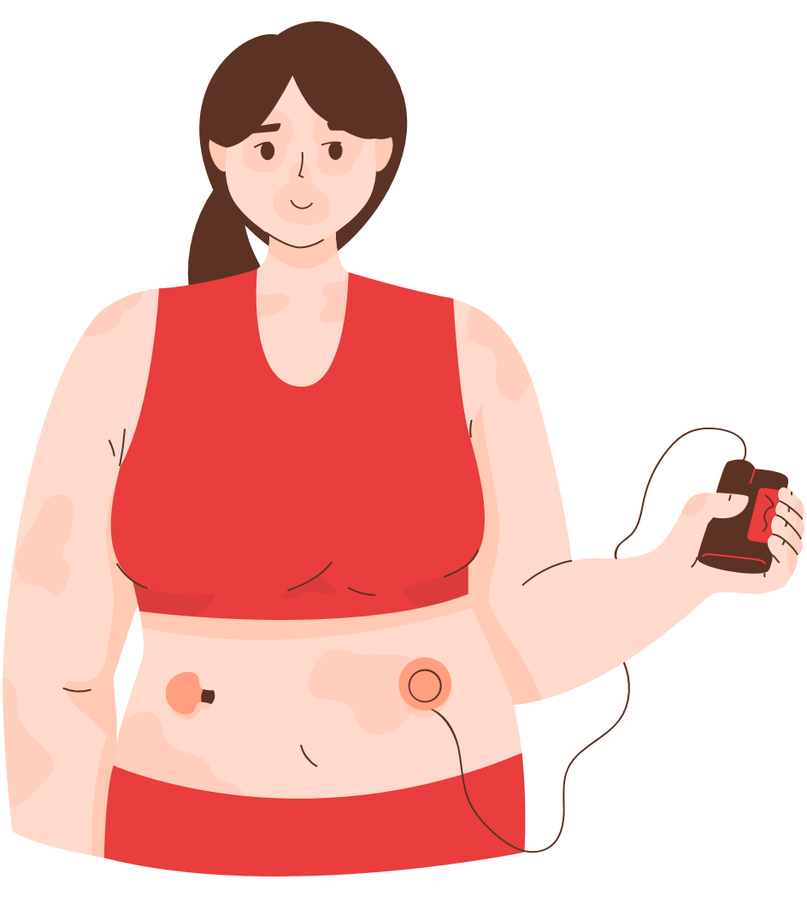
Diagnosis and Initial Assessment
  The diagnosis of Type 2 Diabetes Mellitus is followed by NICE guidance in England.
  The glycated haemoglobin test is performed for the diabetic test.
  The test result of more than 48 mmol or 6.5% is considered diabetic, whereas 42 to 47 mmol is considered non-diabetic (Patel, 2020).
Notes:
Primary care nurses are compelled to perform initial assessments such as BMI, blood pressure, fasting lipids, and HbA1c laboratory tests. After testing blood in the A1C test, if the result shows equal to 6.5% or more and 126 or more in the fasting plasma glucose test, then it will be determined as type 2 diabetes (Pienaar and Reid, 2020). Furthermore, the random plasma glucose test, where a 200 mg/dL level needs to be performed among people who have symptoms (Strain et al., 2021). The initial assessment must involve analysing symptoms, determining the risk factors and dealing with possible challenges. That will assist in preparing a proper management plan for the patients. Primary care nurses need to be focused on measuring the blood pressure, weight and smoking habits of individuals. Moreover, the initial assessment consists of laboratory tests such as fasting lipids, HbA1c, and kidney function (Friis et al., 2016). Moreover, the physical examination involves checking for ulceration in the foot. The social status, medical history and mental situation are required to be reviewed by primary care nurses.

Slide 7

Managing Type 2 Diabetes in the UK
The NICE guideline is followed for diabetes management in the UK (Davis et al., 2021).
The NHS DPP program is supportive in dealing with diabetic patients, who are at high risk and facing weight loss situations.
Notes:
As per the guidelines, proper diabetes management requires a comprehensive approach by primary care nurses under the NICE guidelines. Specifically, the NICE guideline NG28 showcases that a patient-centric and stepwise approach is needed to be taken for the management plan of a diabetic patient (Ahmad et al., 2022). Therefore, the guideline indicates a step-by-step process to maintain the blood glucose, cardiovascular risks and complications. The NHS DPP, or NHS Diabetes Prevention Programme, is supportive in assisting personnel who are on the verge of high risk and their behaviours are centred on healthy eating and proper physical activity (Health Foundation, 2025). NHS England introduced the Comprehensive Model of Personalised Care in this context, which indicates the tailored care and support with different features such as shared decision-making, personalised care and support planning, empowering determination, social recommending, supporting self-management and personalising health funds (Martin et al., 2021). Following these actions can assist in ensuring effective patient-oriented care.

Slide 8

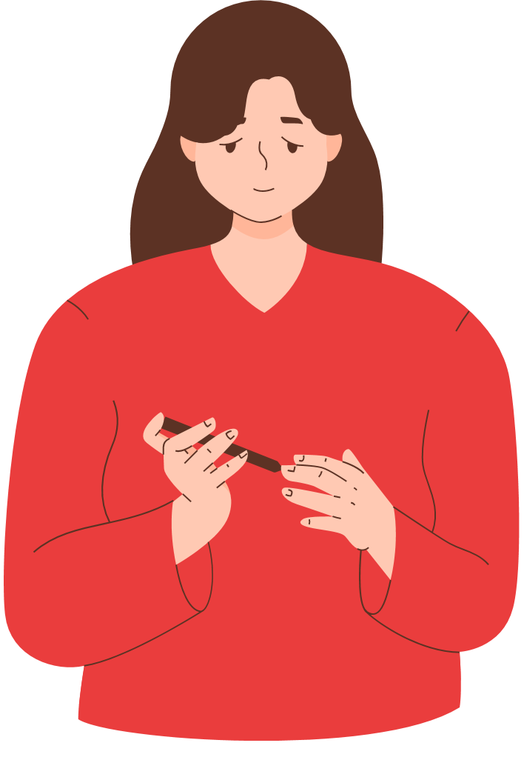
Treatments in the UK
The treatment of Type 2 Diabetes Mellitus follows an evidence-based order.
The first-line treatment includes lifestyle alteration and metformin.
Notes:
Patients are suggested by healthcare professionals, like primary care nurses, to improve their lifestyles by achieving a healthy weight, maintaining calorie control and participating in regular physical activity. At least more than 150 minutes of exercise are suggested to be performed along with maintaining a balanced diet plan (American Diabetes Association, 2021). They are also advised to consume rich fibre and improve their carbohydrate. Moreover, the suggestions of using dual and triple therapy is delivered to provide, while the HbA1c goals are not attained. Moreover, the patients are suggested to use DPP-4 inhibitors to lower the hypoglycaemia and control glucose. Again, the SGLT2 inhibitors like dapagliflozin are recommended for renal and cardiovascular advantages (Davis et al., 2021). In the meantime, the insulin is mostly used for meeting the glycaemic targets. Along with this, statin therapy to control lipid levels and blood pressure management actions with the antihypertensives are required to be suggested (Lloyd and Heller, 2012).

Slide 9

Comorbidity Accompanied by Type 2 Diabetes
Only in a few isolated cases, Type 2 diabetes can be seen, whereas it relies on coexisting conditions.
In most cases, obesity, hypertension, and dyslipidaemia increase the cardiovascular risk.
.
Notes:
As per Knowles et al. (2023), fatty liver disease, kidney disease and extreme depression lead to diabetic situations. Diabetes problems are formed slowly, where the peripheral vascular and neuropathy complications can lead to confiscation and blindness. The report of Pienaar and Reid (2020), showcases more than 1000 amputations yearly, where many of those could be avoidable with early detection and proper care of patients' feet.

Slide 10


Type 2 Diabetes Prevention Measures
Type 2 Diabetes needs to be prevented with an adjusted approach to the risk issues.
Notes:
Now, healthier environments and declining obesity are promoted around the world. Therefore, actions such as salt and sugar, high-fat limits in food and adding a sugar tax within the Soft Drinks Industry are given (NHS England, 2021). However, the primary care nurses are responsible at the personal level to recognise and maintain the high-risk. Moreover, diabetic patients can be referred to the NHS DPP, which can assist in maintaining weight and improving lifestyle (Knowles et al., 2023).

Slide 11

Skills, Values and Behaviours for Co-productive Care
Offering co-productive care to the Type 2 diabetic patient requires skills in communication, motivational questioning, and digital tools usage capabilities.
Notes:
Primary care nurses must have respect, showcase empathy and commitment towards the diabetic patients. Furthermore, they need to use their active listening skills while communicating with them and try to gain their trust in the treatment process (Davis et al., 2021).

Slide 12


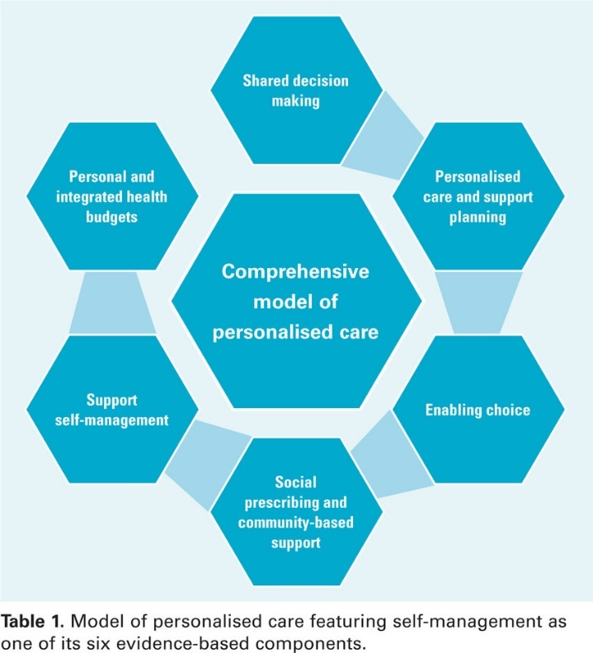
Comprehensive Model of Personalised Care and Self-Management Support
The comprehensive model is useful for Type 2 Diabetes management, employing shared decision-making, personalised care, allowing choice, social prescribing, supported self-management, and a personal health budget.
Source: (Knowles et al., 2023).
Notes:
Determining the model, the primary care nurses need to participate with the patients and discuss with them about the treatment procedures to align with the shared decision-making (Smith and Roberts, 2007). Moreover, they are compelled to deliver personalised caring and support planning for developing personalised caring plans at the yearly review and incorporate the patient's aims and choices (Martin et al., 2021). Along with this, the health professionals must suggest that the patients be part of local community support groups. In the meantime, directing about the community exercise classes can be dealt with that resonate with the social prescribing. For supported self-management plans, patients will be offered glucose meters and digital apps so that they can measure their diabetes levels. However, only in the complicated cases, personal health budgets required, determining the involvement of offering coordinated and personalised offerings.

Slide 13

Conclusion
The analysis indicated that T2DM is a long-term health condition that affects the UK’s health system.
Notes:
The preventive measures, such as considering health, avoiding sugar in Soft Drinks, and improving the lifestyle of the patient, were suggested. Personalised caring plans were required to be delivered for the patients, and they can join the local community support groups.

Slide 14
References
Chiauzzi, E., Rodarte, C. and DasMahapatra, P. (2015). Patient-centered activity monitoring in the self-management of chronic health conditions. BMC Medicine, 13(1).
Eaton, S., Roberts, S. and Turner, B. (2015). Delivering person centred care in long term conditions. British Medical Journal, [online] 350(feb10 14), pp.h181–h181.
Friis, K., Lasgaard, M., Osborne, R.H. and Maindal, H.T. (2016). Gaps in understanding health and engagement with healthcare providers across common long-term conditions: a population survey of health literacy in 29 473 Danish citizens. BMJ Open, 6(1), p.e009627.
Health Foundation (2025). A practical guide to self-management support. [online] The Health Foundation. Available at: https://www.health.org.uk/.
Lloyd, C.E. and Heller, T. (2012). Long-term conditions: challenges in health and social care. 1st ed. Los Angeles, Calif.: Sage.
NHS England (2021). Comprehensive model of personalised care. [online] NHS England. Available at: https://www.england.nhs.uk/personalisedcare/comprehensive-model-of-personalised-care/.
Smith, J. and Roberts, A. (2007). Self-management for long-term conditions. BMJ,335(7627), pp.968–970.
World Health Organisation (WHO) (2024). Self-care interventions for health. [online] www.who.int. Available at: https://www.who.int/health-topics/self-care
Ahmad, E., Lim, S., Lamptey, R., Webb, D.R. and Davies, M.J. (2022). Type 2 Diabetes. The Lancet, 400(10365), pp.1803–1820.
American Diabetes Association (2021). 3. Prevention or Delay of Type 2 Diabetes and Associated Comorbidities: Standards of Medical Care in Diabetes—2022. Diabetes Care, [online] 45(Supplement_1), pp.S39–S45.
Davis, T.M.E., Drinkwater, J.J., Fegan, P.G., Chikkaveerappa, K., Sillars, B. and Davis, W.A. (2021). Community‐based management of complex type 2 diabetes: adaptation of an integrated model of care in a general practice setting. Internal Medicine Journal, 51(1), pp.62–68.
Knowles, M., Crowley, A.P., Vasan, A. and Kangovi, S. (2023). Community Health Worker Integration with and Effectiveness in Health Care and Public Health in the UK. Annual Review of Public Health.
44(1), pp.363–381. Martin, S., Longo, F., Lomas, J. and Claxton, K. (2021). Causal impact of social care, public health and healthcare expenditure on mortality in England: cross-sectional evidence for 2013/2014. BMJ Open, 11(10), p.e046417.
Miller-Rosales, C. and Rodriguez, H.P. (2021). Interdisciplinary primary care team expertise and diabetes care management. The Journal of the American Board of Family Medicine, 34(1), pp.151–161.
Patel, M.R. (2020). Social Determinants of Poor Management of Type 2 Diabetes Among the Insured. Current Diabetes Reports, 20(11).
Pienaar, M. and Reid, M. (2020). Self-management in face-to-face peer support for adults with type 2 diabetes living in low- or middle-income countries: a systematic review. BMC Public Health, 20(1).
Strain, W.D., Down, S., Brown, P., Puttanna, A. and Sinclair, A. (2021). Diabetes and Frailty: An Expert Consensus Statement on the Management of Older Adults with Type 2 Diabetes. Diabetes Therapy, 12(5).

