Slide 1
BA GAMES – DISSERTATION – Viva
By James Doward 2307692

Slide 2
What I’ve done so far

Slide 3
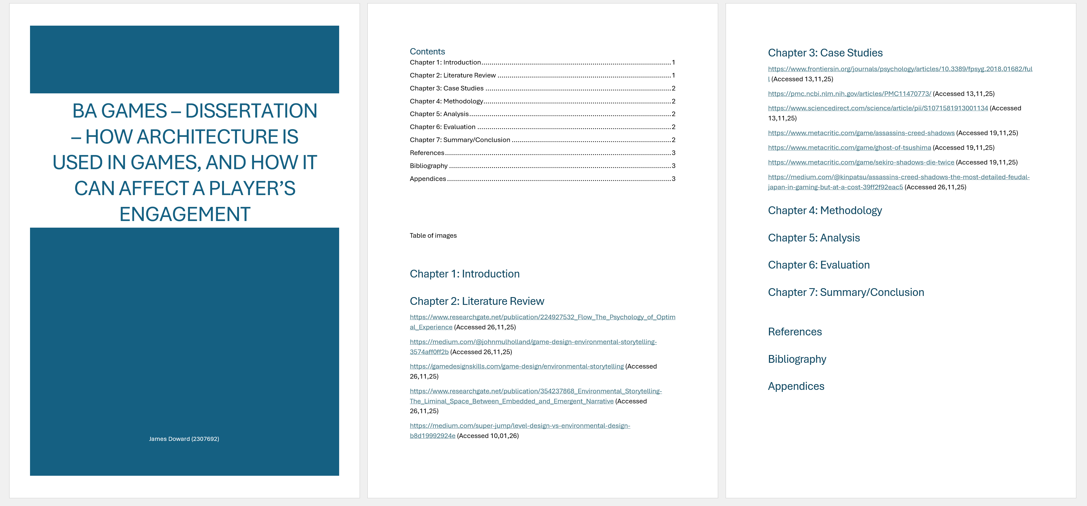
Research I’ve done
I've looked at research for the literature review
I’ve looked at research for the case study’s
I’ve looked at some review’s for my selected games for the case study’s

Slide 4
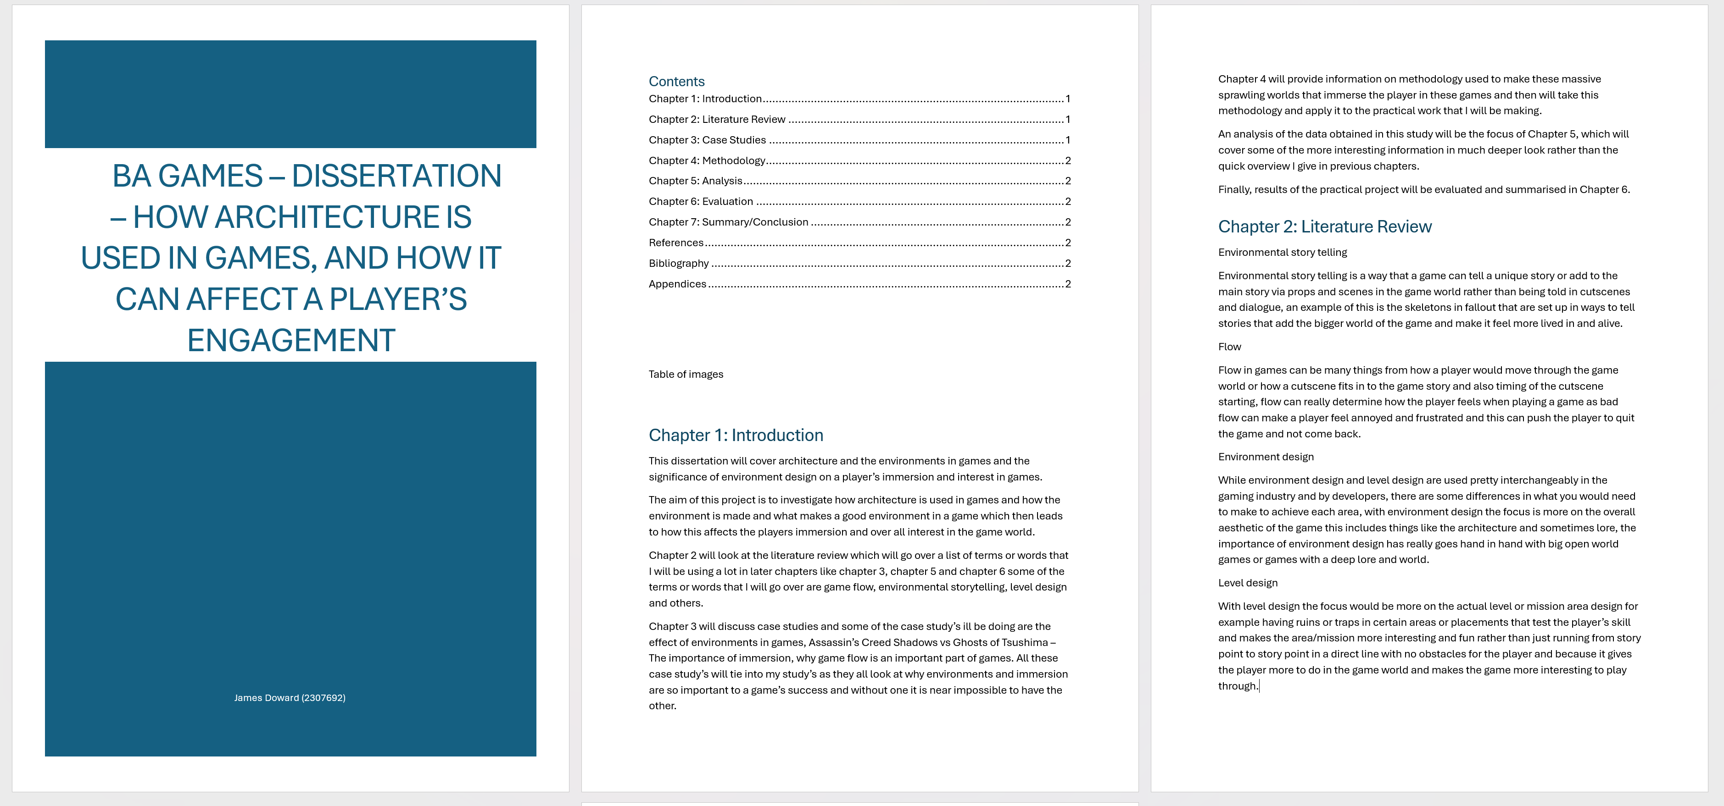
What I’ve written
I’ve written my introduction for the dissertation
I’ve started writing my literature review
I’ve started writing the base ideas for my case study’s

Slide 5
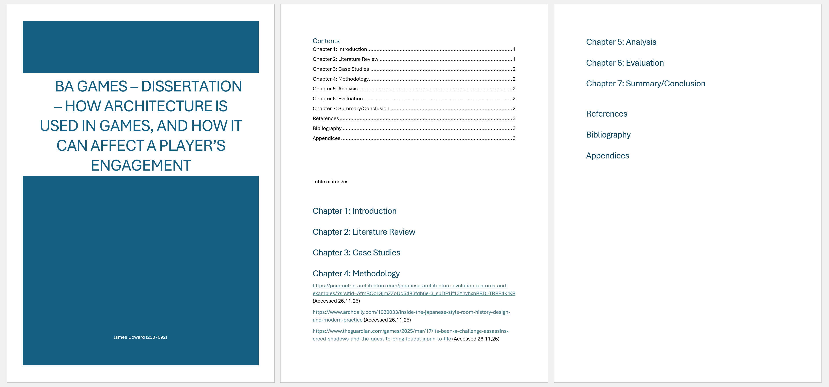
What I’ve looked at for the asset pack
I’ve looked at research for environment design
I’ve looked at research about feudal Japan architecture
I’ve looked at research about Japanese culture around their architecture

Slide 6
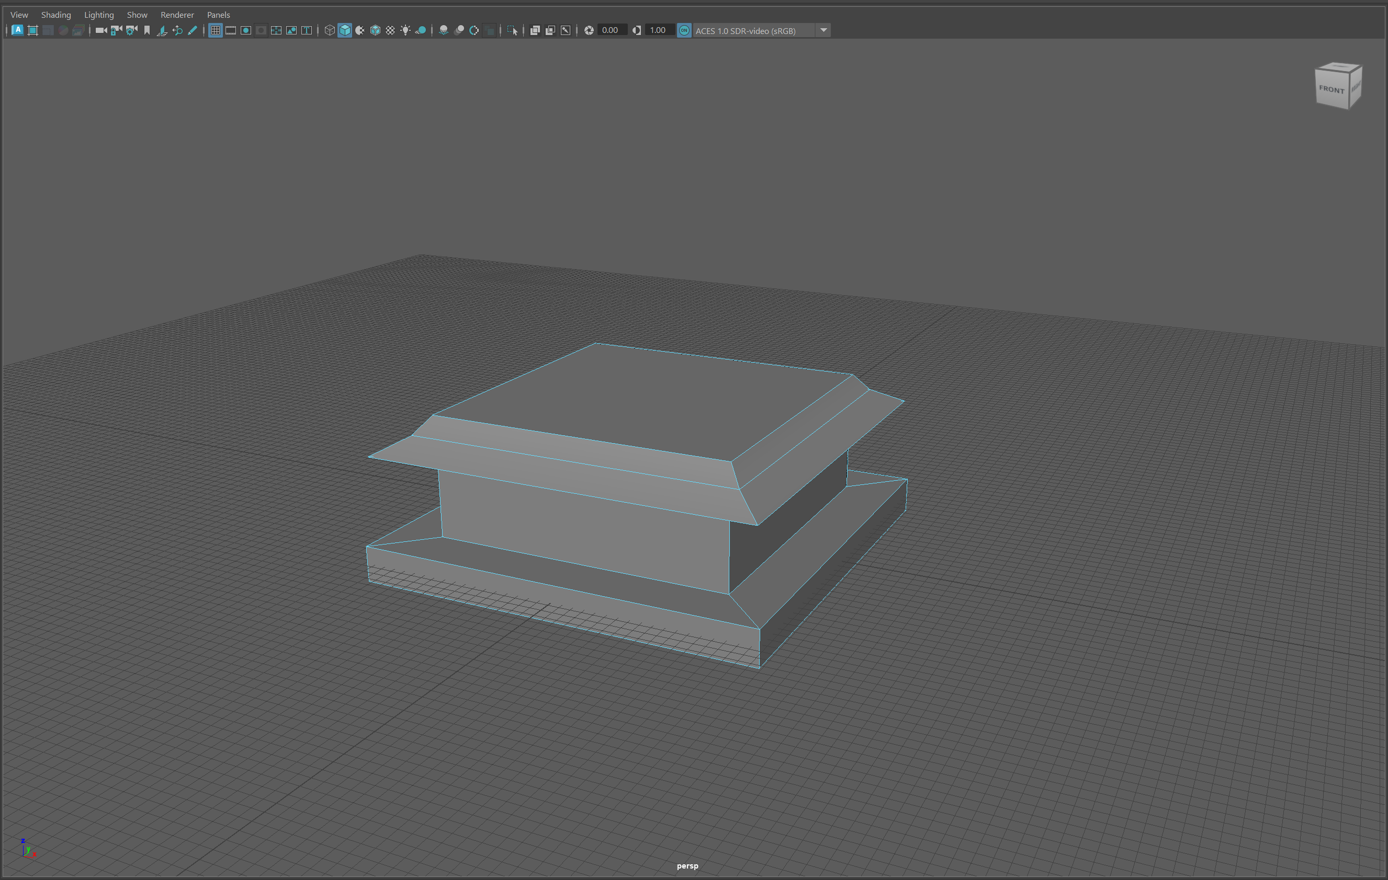
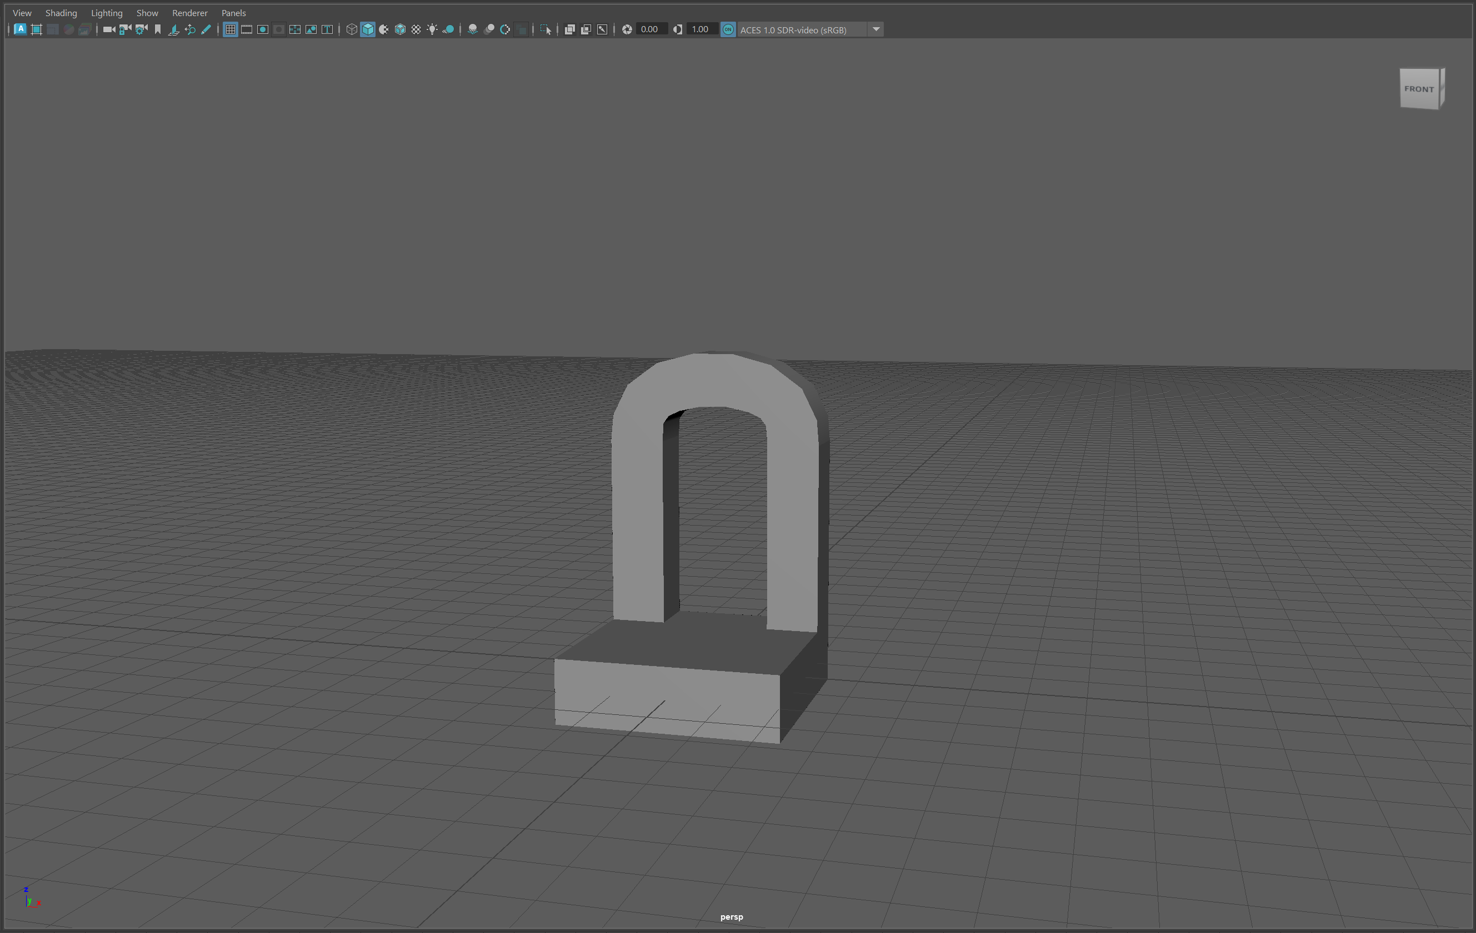
What I’ve done for the asset pack
I’ve made some basic block outs of buildings
I’ve made some block outs of smaller objects (e.g. shrines)

Slide 7
What I’m going to do

Slide 8
What research I’m going to do
I’m going to do some more research on game immersion
I’m going to do some more research on my selected games
I’m going to do some more research on what gets a player immersed

Slide 9
What I’m going to write
I’m going to finish writing my case study’s
I’m going to start writing my methodology
I’m going to start writing my analysis and evaluation

Slide 10
More research I want to do for the asset pack
I’m going to do some research on modularity
I’m going to do some more research on different Japanese architecture
I’m going to do some research on Japanese culture

Slide 11
What I want to do for the asset pack
Finish the models I’ve started blocking out
Start any models that I haven’t blocked out yet
Texture all models when they have been finished

