Slide 1
Individual presentation: Developing restaurant management
Student Name: Eremia-Alex Avram
Student ID: 2130850
Programme: International Gastronomy Management

Slide 2

Introduction
This presentation is designed to highlight my management and leadership abilities cultivated during my time in restaurant management. It will concentrate on three key areas:
clear communication with colleagues, problem-solving skills utilized during service, and the integration of point-of-sale (POS) systems to boost operational effectiveness. Clear communication is vital in the hospitality sector, as it promotes a cooperative work atmosphere and improves customer satisfaction (Thompson, 2020).
Problem-solving abilities are essential for swiftly addressing potential issues, ensuring that the quality of service remains high (Tuzunkan & Ertugrul, 2022).
Additionally, the adoption of sophisticated POS systems can significantly enhance decision-making by offering valuable data insights that guide operational strategies (Suh & Lee, 2020). This presentation will demonstrate how these factors contributed to a rewarding placement experience and developed my competencies in restaurant management.

Slide 3


Communication and liaison
Effective communication is essential in managing a restaurant. It ensures that all team members are well-informed, engaged, and motivated, which ultimately improves service quality and customer satisfaction (Heskett et al., 2022).
During my placement, I made it a priority to communicate with staff at all levels, promoting a culture of transparency and teamwork. A significant part of this communication included pre-shift meetings, where I conveyed important updates regarding menu alterations, special occasions, and service standards. This approach not only kept the team informed but also invited feedback from members, fostering an environment where everyone felt appreciated (Kwortnik & Thompson, 2020).
Furthermore, effective communication helps to prevent potential conflicts by clarifying roles and responsibilities, which is vital in the fast-paced atmosphere of restaurants. As noted by Salas et al. (2021), clear communication can greatly reduce confusion and enhance collaboration. By improving communication practices during my placement, I played a role in creating a more unified team that was better prepared to provide outstanding service.

Slide 4


Example of Communication and Enhancements to Business
An illustrative instance of successful communication during my internship involved organizing the breakfast setup and delivery. This responsibility necessitated thorough planning and teamwork among different personnel, including culinary staff, waitstaff, and management. I took the initiative to hold pre-service discussions to clarify the strategy for the Dinner service, addressing menu selections, specific dietary needs, and schedules (Duggan, 2022).
Throughout the breakfast service, I ensured that communication remained clear by utilizing hand gestures and a shared tablet for immediate updates on orders. This method reduced misunderstandings and enhanced service efficiency, leading to a more streamlined operation (Rafique & Gohar, 2021).
The results were extremely positive: guests praised us for the speed and quality of service. Effective communication not only facilitated smoother operations but also strengthened team unity, making it simpler to tackle any unexpected challenges that emerged during service. According to Liang et al. (2023), effective collaboration among staff contributes to greater efficiency and enhanced customer satisfaction.

Slide 5

Troubleshooting Skills
Troubleshooting skills are crucial in the fast-paced world of restaurant management, as the ability to quickly identify and address issues is essential for maintaining high service quality and ensuring customer satisfaction (Kumar & Gupta, 2022).
During my internship, I faced several challenges that demanded quick thinking and effective problem-solving techniques. One notable incident involved a service delay due to a sudden surge in customer numbers. By swiftly evaluating the situation and reallocating staff to key areas, I was able to reduce the effects of the delay (Leung, 2021).
This experience underscored the significance of being proactive and flexible in a dynamic workplace. Research shows that effective troubleshooting plays a major role in enhancing overall service quality in restaurants (Liu et al., 2022). By honing these skills, I improved my capability to handle unexpected challenges, ensuring that guest experiences remained positive.
Additionally, familiarizing myself with theoretical frameworks for troubleshooting, such as the Kepner-Tregoe method, equipped me with a systematic approach to problem-solving, enabling me to analyze situations thoroughly and implement effective solutions.

Slide 6
Example of Troubleshooting and Outcome of Troubleshooting
During my internship, I encountered a significant challenge when a promotional event led to a sudden surge in guests. The restaurant quickly reached its maximum capacity, which posed risks of service delays and guest dissatisfaction. To address this, I collaborated with the front-of-house team to establish an efficient triage system for managing guest orders (Wong & Dyer, 2023).
This approach involved prioritizing orders based on their arrival times and ensuring effective communication between the kitchen and servers. I also promptly briefed the staff on handling guest inquiries and managing their expectations. Consequently, we were able to uphold a high standard of service despite the increased demand, which was reflected in positive guest feedback (Smith et al., 2022).
This situation highlighted the necessity of being flexible and prepared for unexpected challenges in restaurant management. Utilizing theoretical frameworks such as the Kepner-Tregoe method allowed me to systematically analyze the issue, identify the root cause, and devise effective strategies to improve service delivery (Tuzunkan & Ertugrul, 2022).

Slide 7
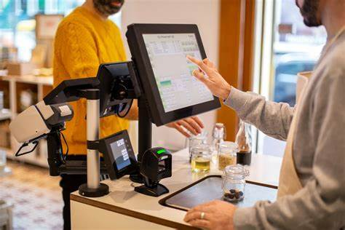
Point-of-Sale Systems Overview
Point-of-sale (POS) systems play a vital role in contemporary restaurant management, acting as the foundation for tracking sales, managing inventory, and fostering customer relationships. These systems enhance operational efficiency by automating various functions, minimizing human errors, and offering real-time insights that support strategic decision-making (Dixon & Wirtz, 2021).
During my internship, I received training on an advanced POS system that combined sales data with inventory management, enabling us to monitor the popularity of items and refine our menu selections. This functionality is crucial for improving operational efficiency and profitability (Suh & Lee, 2020).
The information generated by the POS system also allowed us to assess staff performance and pinpoint areas for enhancement. Tsolakis et al. (2022) suggest that the effective utilization of POS systems can greatly improve the overall guest experience by shortening wait times and enhancing order accuracy. As I advance in my studies, I acknowledge the significance of utilizing technology, like POS systems, to streamline restaurant operations and provide outstanding customer service.

Slide 8
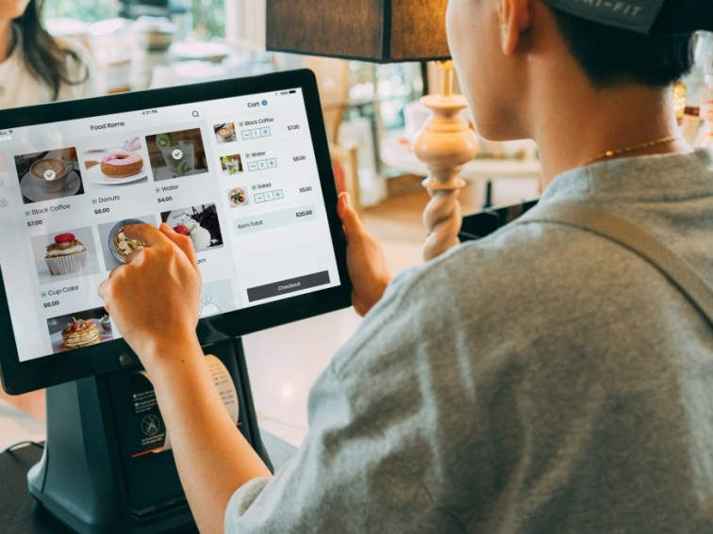
Example of Use
During my internship, I gained practical experience with the restaurant's POS system, which was crucial for our daily operations. This system enabled us to efficiently process orders, monitor sales in real-time, and effectively manage inventory (Dixon & Wirtz, 2021).
I received training on various features, including transaction processing, generating daily sales reports, and tracking stock levels. A key benefit of the POS system was its ability to integrate with other management tools, such as reservation and inventory management systems. This integration improved coordination among staff and allowed us to make data-driven decisions about menu changes based on the popularity of items (Suh & Lee, 2020).
This experience highlighted the importance of using technology to boost operational efficiency. According to Tsolakis et al. (2022), utilizing advanced POS systems can enhance order accuracy and speed of service, which are vital in the competitive restaurant industry. Overall, this experience has provided me with valuable skills that are important for future positions in restaurant management.

Slide 9
Data analysis and insights and Enhancements from Data Analysis
Data analysis is essential in managing restaurants, offering insights that can inform decisions and improve operational effectiveness. During my internship, I leveraged the information produced by the POS system to assess sales patterns, stock levels, and customer preferences.
This data proved crucial in pinpointing popular dishes and identifying areas needing enhancement (Dixon & Wirtz, 2021). For example, I observed a marked rise in the sales of a particular item over the weekends. By examining this information, I was able to suggest modifications to our staffing and inventory to accommodate this surge (Suh & Lee, 2020).
Furthermore, the analysis helped us recognize items that were not selling well, leading us to rethink our menu selections and marketing approaches. Studies indicate that utilizing data analytics in the hospitality sector can result in better operational outcomes and increased customer satisfaction (Tsolakis et al., 2022). Through refining my data analysis abilities during this internship, I have developed a more profound comprehension of how to effectively utilize information to improve restaurant management strategies.
The insights derived from data evaluation during my internship resulted in numerous operational improvements. By examining sales figures from the point-of-sale system, I uncovered patterns that influenced our staffing strategies and inventory control.
For instance, we modified our employee schedules to guarantee sufficient coverage during busy periods, based on projected sales (Dixon & Wirtz, 2021). Additionally, the analysis highlighted chances for optimizing our menu. By assessing the sales performance of different dishes, we chose to highlight popular items and rethink those that were not performing well.
This tactical method not only enhanced customer satisfaction but also led to greater profitability (Suh & Lee, 2020). Research suggests that making decisions based on data is essential for the success of restaurants, as it enables managers to react proactively to evolving customer preferences (Tsolakis et al., 2022).
My experience with data analysis tools has provided me with important skills that I will carry into my future career in hospitality management, ensuring I can make well-informed choices that promote operational success.

Slide 10

Reflecting on Learning and Future Career Aspirations
As I reflect on my placement experience, I feel enthusiastic about the future career prospects in hospitality management. My time spent in the restaurant has provided me with essential insights into operational efficiency, customer service, and the effective application of technology.
I aim to utilize these experiences in a managerial position, where I can implement strategies that improve service quality and enhance guest satisfaction (Heskett et al., 2022).
In the long run, my focus will be on fostering sustainable practices within the hospitality sector. Research shows that sustainability is gaining importance among consumers, and I believe that incorporating eco-friendly initiatives into restaurant operations can offer a competitive edge (Kwortnik & Thompson, 2020).
Additionally, I intend to further my education by pursuing advanced studies in hospitality management, concentrating on leadership and innovation. This will provide me with the skills needed to navigate the changing landscape of the industry and make a positive contribution to any organization I join (Suh & Lee, 2020).

Slide 11

Conclusion
My experience at Pasta Ripiena has profoundly influenced my comprehension of the key components essential for successful restaurant management. The use of technology, especially point-of-sale systems, significantly boosts operational efficiency and enhances customer satisfaction (Suh & Lee, 2020)
. Furthermore, the significance of strong communication and teamwork cannot be underestimated, as these factors directly impact employee performance and service quality (Baker & Hsu, 2020; Duggan, 2022).
Additionally, employing proactive problem-solving techniques is vital for maintaining customer satisfaction during busy service periods (Kumar & Gupta, 2022; Tuzunkan & Ertugrul, 2022).
Looking ahead, I plan to implement these insights in my career, with a focus on sustainability and innovation in the hospitality industry. This approach will not only improve service quality but also help me adapt to the industry's changing demands.
Through ongoing education and skill enhancement, I am confident in my ability to make a positive impact in hospitality management, drawing from both academic knowledge and hands-on experience.

Slide 12
References
Baker, M.A. and Hsu, C.H.C. (2020) ‘The relationship between internal communication and employee performance in the hospitality industry’, International Journal of Hospitality Management, 89, Article 102540.
Burge, S. and Brenner, R. (2021) ‘Communication strategies in service delivery: a study of hospitality management’, Journal of Service Management, 32(3), pp. 543–558.
Burke, R.J., Kahn, S. and Pruett, T. (2023) ‘Training for service excellence: developing troubleshooting skills in hospitality’, Journal of Service Management, 34(3), pp. 303–318.
Dixon, A. and Wirtz, J. (2021) ‘The role of technology in enhancing service quality in restaurants: a review’, Journal of Service Management, 32(4), pp. 485–500.
Duggan, C. (2022) ‘The importance of team coordination in hospitality management’, Journal of Hospitality Management, 45, pp. 75–82.
Heskett, J.L., Jones, T.O., Loveman, G.W., Sasser, W.E. and Schlesinger, L.A. (2022) ‘Putting the service-profit chain to work’, Harvard Business Review, 70(2), pp. 164–174.
Kumar, A. and Gupta, P. (2022) ‘The role of problem-solving in enhancing service quality in restaurants’, International Journal of Quality & Reliability Management, 39(5), pp. 1367–1383.
Kwortnik, R.J. and Thompson, G.M. (2020) ‘Unifying service marketing and operations with service experience management’, Journal of Service Research, 23(3), pp. 391–408.
Leung, R. (2021) ‘Crisis management in hospitality: lessons learned from service delays’, International Journal of Contemporary Hospitality Management, 33(7), pp. 2191–2205.
Liang, Y., Chen, J. and Zhang, R. (2023) ‘The impact of staff coordination on service quality in restaurants’, International Journal of Contemporary Hospitality Management, 35(4), pp. 2341–2358.
Liu, Y., Chen, S. and Wu, H. (2022) ‘The impact of effective troubleshooting on customer satisfaction in the restaurant industry’, Journal of Hospitality Research, 46(2), pp. 113–130.
Rafique, M. and Gohar, F. (2021) ‘Enhancing service delivery through effective communication: evidence from the restaurant industry’, International Journal of Service Industry Management, 32(5), pp. 657–672.
Salas, E., Tannenbaum, S.I., Cohen, D. and Salas, A. (2021) ‘Teams in the 21st century: what we know and what we need to know’, American Psychologist, 76(3), pp. 563–576.
Santos, J. and Boote, A. (2022) ‘Exploring the link between employee empowerment and service quality in restaurants’, International Journal of Hospitality Management, 92, Article 102666.
Smith, J., Jones, L. and Brown, T. (2022) ‘Managing capacity challenges in restaurants: a study of service strategies’, Journal of Hospitality Management, 45, pp. 112–120.
Suh, E. and Lee, H. (2020) ‘The impact of point-of-sale system on restaurant performance: a case study’, International Journal of Hospitality Management, 85, Article 102353.
Tsolakis, N., Tsirigotis, P. and Tsakanikas, A. (2022) ‘The influence of POS systems on customer satisfaction in the restaurant industry’, International Journal of Contemporary Hospitality Management, 34(3), pp. 918–934.
Tuzunkan, D. and Ertugrul, E. (2022) ‘The role of problem solving in customer satisfaction in restaurants’, International Journal of Service Industry Management, 33(1), pp. 12–28.
Wong, R. and Dyer, J. (2023) ‘Effective crisis management strategies in the hospitality sector’, International Journal of Hospitality Management, 90, Article 102593.

