Slide 1

Integration of Health, Wellbeing and Sustainable Development in Health and Social Care
Mohi Tuki Student ID-2216172

Slide 2
Introduction
The aim of this presentation is –
The overview of the importance of health, wellbeing, and sustainability in healthcare
Describe sustainable development, well-being, and health.
Examine the ways in which health and social care incorporate these ideas.

Slide 3


What is Health ?
According to the World Health Organization (WHO):"Health is a state of complete physical, mental and social wellbeing and not merely the absence of disease.“(World Health Organization, 2024)
Physical, mental, and social well-being
Beyond absence of disease
Influenced by lifestyle, environment, and social determinants

Slide 4

What is wellbeing?
Wellbeing is a holistic concept that includes:
Physical wellbeing
Mental wellbeing
Emotional wellbeing
Social wellbeing
Financial and environmental wellbeing
Why it Matters
Improves life satisfaction
Enhances resilience
Reduces risk of illness
Supports positive health outcomes (Dodge et al., 2012)

Slide 5

Sustainable development
Meeting present needs without compromising future generations
Encompasses environmental, social, and economic sustainability
Relevance to healthcare systems and policies (World Commission on Environment and Development, 1987)

Slide 6

WHO Sustainable Development Goals
17 goals for SDGs
• No Poverty - End poverty everywhere.
• Zero Hunger - End hunger and promote sustainable food systems.
• Good Health and Well-being - Ensure healthy lives for all.
• Quality Education - Provide inclusive, quality education for everyone.
• Gender Equality - Achieve equality and empower women and girls.
• Clean Water and Sanitation - Ensure safe water and sanitation for all.
• Affordable and Clean Energy - Provide affordable, sustainable energy for everyone.
• Decent Work and Economic Growth - Promote decent jobs and inclusive economic growth.
• Industry, Innovation, and Infrastructure - Build resilient infrastructure and foster innovation.
• Reduced Inequality - Reduce inequality within and between countries.
• Sustainable Cities and Communities - Make cities safe, inclusive, and sustainable.
• Responsible Consumption and Production - Promote sustainable use of resources.
• Climate Action - Act urgently to fight climate change.
• Life Below Water - Protect oceans and marine life.
• Life on Land - Protect ecosystems, forests, and biodiversity.
• Peace, Justice, and Strong Institutions - Promote peace, justice, and accountable institutions.
• Partnerships for the Goals - Strengthen global cooperation for sustainable development.
Health outcomes are influenced by social, economic and environmental factors. (United Nations, 2024)

Slide 7
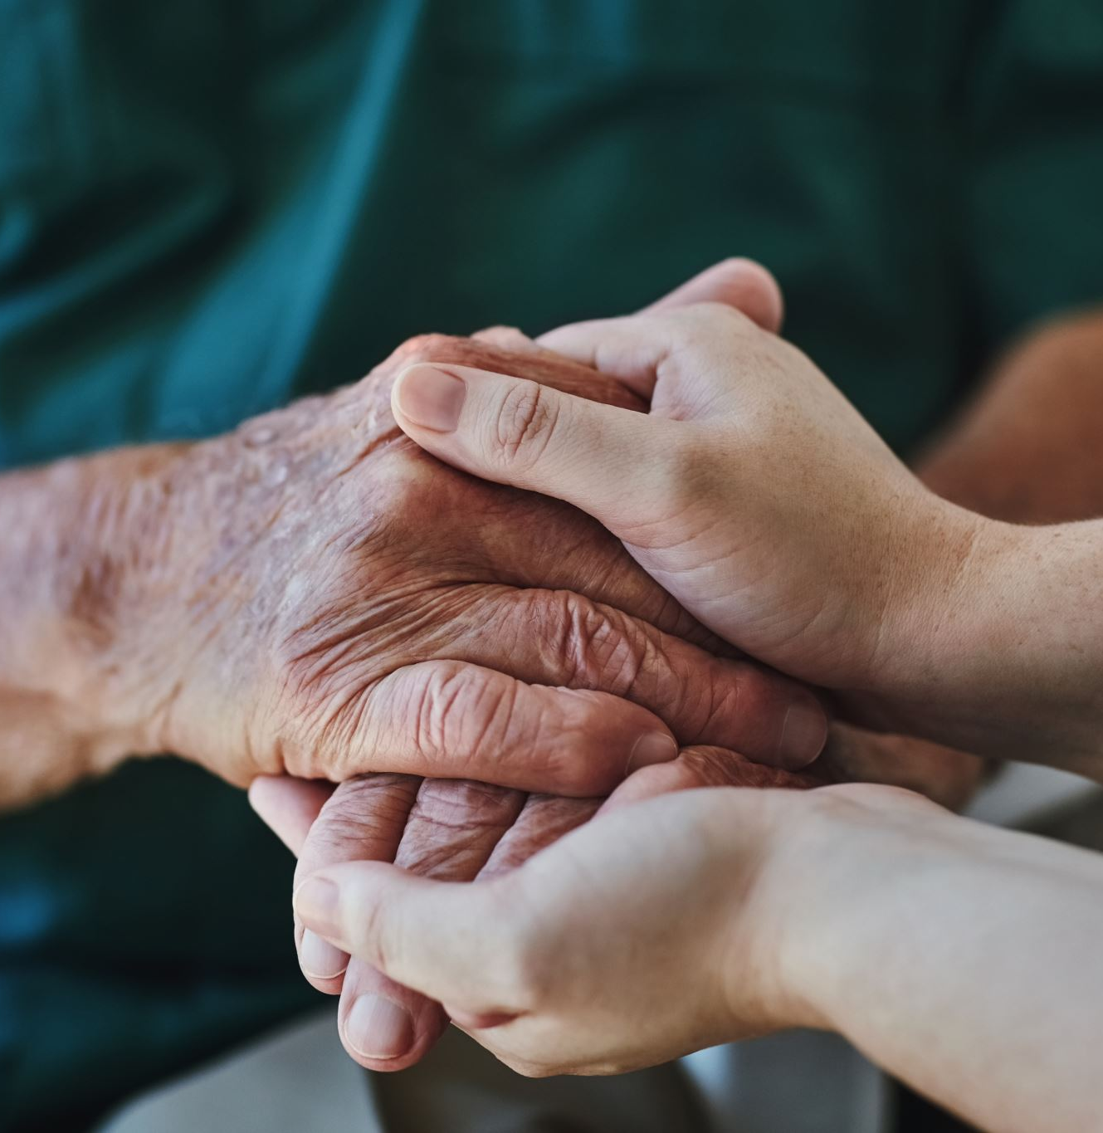
Integration of Approaches
Healthcare increasingly focuses on:
Physical health
Mental health
Emotional support
Social needs
Examples: Mental health services within primary care
Social prescribing
Multidisciplinary teams
Person-centred care (World Health Organization, 2023)

Slide 8

UK Models of Health
Biomedical Model: Focus on biological factors
Psychological Model: Mental and emotional health
Social Model: Social determinants and community context
The Biopsychosocial Model: An integrated comprehensive approach by George Engel (Engel, 1977) Biological Factors include Genetics
Disease
Physical condition
Importance it provides a comprehensive understanding of health and wellbeing.

Slide 9
Policies Supporting Holistic Health
Preventive care initiatives Mental health promotion programs Examples: National mental health strategies, vaccination programs
Challenges in Policy and Governance
Regulatory barriers
Funding limitations
Fragmentation of services
Need for integrated policy frameworks
Government Role
Regulation
Funding
Quality assurance
Workforce planning. (Department of Health and Social Care, 2022)

Slide 10
Innovative Service Delivery Models
Holistic Hospital Care
A patient-centred approach includes:
Medical treatment
Mental health support
Nutritional advice
Social care planning
Outcomes
Better recovery rates
Improved patient experience
Reduced readmissions
Example
Integrated care teams working together to support patients with long-term conditions. (NHS England, 2024)

Slide 11
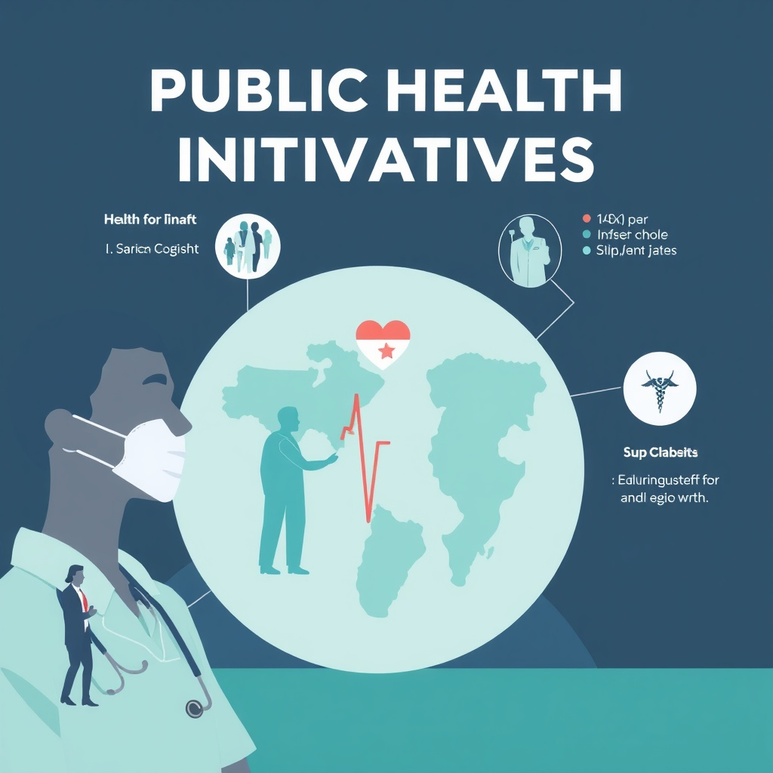
Public Health Initiatives
Promoting Healthy Lifestyles
Campaigns on nutrition, exercise, smoking cessation
Creating supportive environments
Impact of Public Health
Campaigns
Improved societal wellbeing
Reduction in preventable diseases
Enhanced health equity. (Office for Health Improvement and Disparities, 2024)

Slide 12
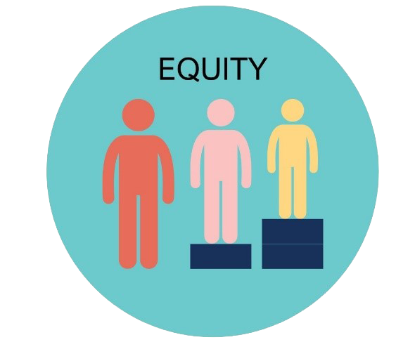
Equity and Access
Disparities in Healthcare
Socioeconomic, geographical, and cultural barriers
Impact on health outcomes(Marmot et al., 2020)
Initiatives to Reduce Inequalities
Universal healthcare systems.
Targeted health interventions for vulnerable groups(NHS England, 2024)
Policy measures promoting equity

Slide 13

Recommendation Slide
1. Increase Investment in Preventive Healthcare
Governments and healthcare organisations should prioritise prevention programmes such as health education, vaccinations and lifestyle interventions.
This can reduce long-term healthcare costs and improve population health.
2. Expand Digital Health Services
Further development of telehealth and digital healthcare services can improve access for rural and underserved populations.
Support should be provided for individuals who lack digital skills or internet access.
3. Strengthen Cross-Sector Collaboration
Healthcare providers should work closely with education, housing and environmental sectors through a "Health in All Policies" approach.
This would address wider determinants of health and promote sustainable development.

Slide 14

Conclusion
Key Findings
Health, wellbeing and sustainable development are interconnected.
Holistic approaches improve patient care and outcomes.
Policies and governance play a vital role in implementation.
Public health initiatives promote healthier communities.
Equity and access remain major challenges. (WHO, 2024; United Nations, 2024)
Final Thought
Integrating health, wellbeing and sustainable development creates more effective, equitable and resilient health and social care systems.

Slide 15
References
Department of Health and Social Care (2022) Health and social care integration: joining up care for people, places and populations. London: DHSC.
Dodge, R., Daly, A., Huyton, J. and Sanders, L. (2012) 'The challenge of defining wellbeing', International Journal of Wellbeing, 2(3), pp. 222–235.
Engel, G.L. (1977) 'The need for a new medical model: A challenge for biomedicine', Science, 196(4286), pp. 129–136.
Marmot, M., Allen, J., Boyce, T., Goldblatt, P. and Morrison, J. (2020) Health Equity in England: The Marmot Review 10 Years On. London: Institute of Health Equity.
NHS England (2024) The NHS Long Term Plan. London: NHS England.
Office for Health Improvement and Disparities (2024) Public Health Outcomes Framework. London: OHID.
United Nations (2024) Sustainable Development Goals. Available at: https://sdgs.un.org (Accessed: 4 June 2026).
World Commission on Environment and Development (1987) Our Common Future. Oxford: Oxford University Press.
World Health Organization (2014) Health in All Policies Framework for Country Action. Geneva: WHO.
World Health Organization (2023) Integrated people-centred health services. Geneva: WHO.
World Health Organization (2024) Constitution of the World Health Organization. Geneva: WHO.

