Slide 1
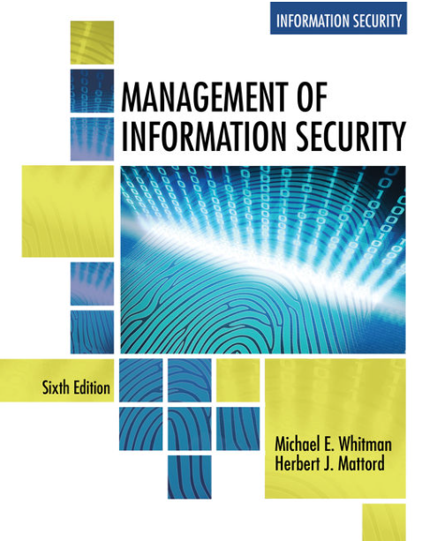
Introduction
Data Security Governance & Compliance
Lecture 1
Lecturer: Assoc. Prof. Carlene Campbell
Email: carlene.campbell@uwtsd.ac.uk
Website: https://www.knowledgewithprofit.com/
Adapted Text

Slide 2
Learning Outcome
Upon completion of this material, you should be able to:
  Upon completion of this material, you should be able to:
  List and discuss the key characteristics of information security
  List and describe the dominant categories of threats to information security
  Discuss the key characteristics of leadership and management
  Describe the importance of the manager’s role in securing an organization’s information assets
  Differentiate information security management from general business management
Notes:
Committee on National Security Systems (CNSS), formerly known as the National Security Telecommunications and Information Systems Security Committee (NSTISSC), chaired by the U.S. Secretary of Defense.
“National Training Standard for Information Systems Security (InfoSec) Professionals,” presents a comprehensive model of InfoSec known as the McCumber Cube, which is named after its developer, John McCumber. Shown in Figure 1-2, which is an adaptation of the NSTISSI model, the McCumber Cube serves as the standard for understanding many aspects of InfoSec, and shows the three dimensions that are central to the discussion of InfoSec: information characteristics, information location, and security control categories. If you extend the relationship among the three dimensions that are represented by the axes in the figure, you end up with a 3 × 3 × 3 cube with 27 cells. Each cell represents an area of intersection among these three dimensions, which must be addressed to secure information. When using this model to design or review any InfoSec program, you must make sure that each of the 27 cells is properly addressed by each of the three communities of interest.
It’s the role of management to ensure that each strategy is properly planned, organised, staffed, directed, and controlled.
Specialised areas include:
Physical security—The protection of physical items, objects, or areas from unauthorized access and misuse.
Operations security—The protection of the details of an organization’s operations and activities.
Communications security—The protection of all communications media, technology, and content.
Cyber (or computer) security—The protection of computerized information processing systems and the data they contain and process. The term cybersecurity is relatively new, so its use might be slightly ambiguous in coming years as the definition gets sorted out.
Network security—A subset of communications security and cybersecurity; the protection of voice and data networking components, connections, and content.

Slide 3
What Is Security?
In general, security means being free from danger. To be secure is to be protected from the risk of loss, damage, unwanted modification, or other hazards
Achieving an appropriate level of security for an organization also depends on the implementation of a multilayered system
Security is often achieved by means of several strategies undertaken simultaneously or used in combination with one another
It is the role of management to ensure that each strategy is properly planned, organized, staffed, directed, and controlled
Modern organizational dependencies:
  cloud computing
  remote work
  AI systems
  digital transformation
Can organizations still rely on traditional perimeter security?
Notes:
NO:
cloud dissolves perimeter
hybrid work expands attack surface
identity now more important than location

Slide 4
Specialized Areas of Security
Specialized areas of security include:
  IoT
  cloud security
  AI governance
  Zero Trust
  Physical security
  Operations security
  Communications security
  Cyber (or computer) security
  Network security
Notes:
Physical security—The protection of physical items, objects, or areas from unauthorized access and misuse.
Operations security—The protection of the details of an organization’s operations and activities.
Communications security—The protection of all communications media, technology, and content.
Cyber (or computer) security—The protection of computerized information processing systems and the data they contain and process. The term cybersecurity is relatively new, so its use might be slightly ambiguous in coming years as the definition gets sorted out.
Network security—A subset of communications security and cybersecurity; the protection of voice and data networking components, connections, and content.

Slide 5
Information Security
Information security (InfoSec) focuses on the protection of information and the characteristics that give it value, such as:
  confidentiality, integrity, and availability,
  includes the technology that houses and transfers that information through a variety of protection mechanisms such as:
    policy,
    training and
    awareness programs, and technology
Modern InfoSec is broader than CIA alone:
resilience
governance
Privacy
trust
modern InfoSec challenges:
  AI-driven attacks
  ransomware
  cloud breaches
Is cybersecurity now more about organizational resilience than prevention?
Notes:
Modern InfoSec is broader than CIA alone:
resilience
governance
Privacy
trust
Committee on National Security Systems (CNSS), formerly known as the National Security Telecommunications and Information Systems Security Committee (NSTISSC), chaired by the U.S. Secretary of Defense.
“National Training Standard for Information Systems Security (InfoSec) Professionals,” presents a comprehensive model of InfoSec known as the McCumber Cube, which is named after its developer, John McCumber. Shown in Figure 1-2, which is an adaptation of the NSTISSI model, the McCumber Cube serves as the standard for understanding many aspects of InfoSec, and shows the three dimensions that are central to the discussion of InfoSec: information characteristics, information location, and security control categories. If you extend the relationship among the three dimensions that are represented by the axes in the figure, you end up with a 3 × 3 × 3 cube with 27 cells. Each cell represents an area of intersection among these three dimensions, which must be addressed to secure information. When using this model to design or review any InfoSec program, you must make sure that each of the 27 cells is properly addressed by each of the three communities of interest.

Slide 6
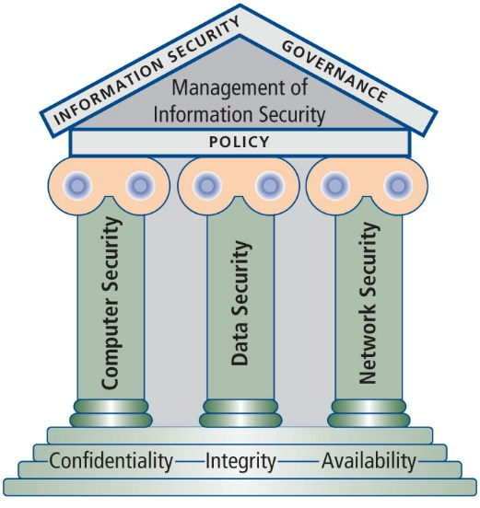
Components of Information Security
Notes:
The Figure shows that InfoSec includes the broad areas of InfoSec management (the topic of this module): computer security, data security, and network security. The figure also shows that policy is the space where these components overlap.

Slide 7
The CIA Triad and the CNSS Model
The NSTISSI (or CNSS) Security Model (also known as the McCumber Cube) provides a more detailed perspective on security
While the NSTISSC model covers the three dimensions of information security, it omits discussion of detailed guidelines and policies that direct the implementation of controls
Another weakness of using this model with too limited an approach is to view it from a single perspective
Does the CIA Triad fully address modern cyber threats?
Notes:
Committee on National Security Systems (CNSS), formerly known as the National Security Telecommunications and Information Systems Security Committee (NSTISSC), chaired by the U.S. Secretary of Defense.
Does the CIA Triad fully address modern cyber threats?
Partially:
resilience
privacy
trust
governance
safety
have become equally important.

Slide 8
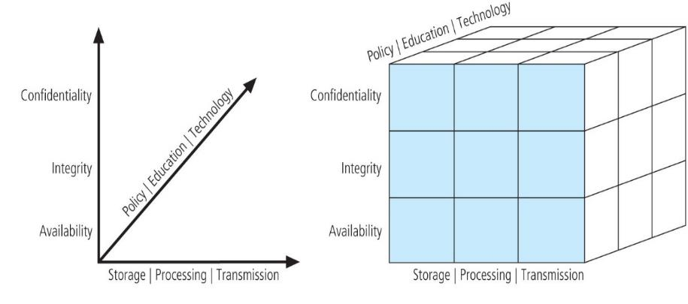
Committee on National Security Systems (CNSS) model
Notes:
modern environments now include:
cloud
AI
SaaS
mobile ecosystems
Committee on National Security Systems (CNSS), formerly known as the National Security Telecommunications and Information Systems Security Committee (NSTISSC), chaired by the U.S. Secretary of Defense.
“National Training Standard for Information Systems Security (InfoSec) Professionals,” presents a comprehensive model of InfoSec known as the McCumber Cube, which is named after its developer, John McCumber. Shown in Figure 1-2, which is an adaptation of the NSTISSI model, the McCumber Cube serves as the standard for understanding many aspects of InfoSec, and shows the three dimensions that are central to the discussion of InfoSec: information characteristics, information location, and security control categories. If you extend the relationship among the three dimensions that are represented by the axes in the figure, you end up with a 3 × 3 × 3 cube with 27 cells. Each cell represents an area of intersection among these three dimensions, which must be addressed to secure information. When using this model to design or review any InfoSec program, you must make sure that each of the 27 cells is properly addressed by each of the three communities of interest.
The Committee on National Security Systems (CNSS) model is often referred to as the "McCumber Cube" due to its association with the McCumber Cube framework developed by William (Bill) McCumber in the late 1990s. This framework visually represents the relationship between three key dimensions of information security:
Confidentiality, Integrity, Availability (CIA Triad): These three core principles of information security ensure that data is protected from unauthorized access (confidentiality), remains accurate and trustworthy (integrity), and is accessible to authorized users when needed (availability).
Information States: The cube considers different states of information, including stored, processed, and transmitted data. Each state has unique security requirements and vulnerabilities.
Security Measures: The third dimension represents various security measures that can be applied, including physical, administrative, and technical controls.
Significance of the McCumber Cube:
Holistic View: The McCumber Cube provides a comprehensive approach to understanding and implementing information security, emphasizing the interrelationship between the dimensions.
Framework for Assessment: It serves as a tool for assessing security measures and ensuring that all aspects of information security are considered.
By incorporating these elements, the CNSS model helps organizations enhance their cybersecurity posture while addressing the complexities of protecting national security systems.

Slide 9
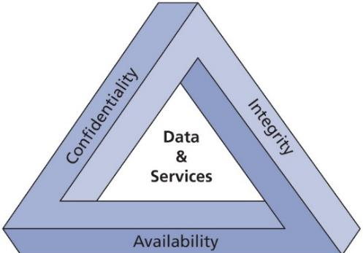
The C.I.A. Triad
The C.I.A. triad—confidentiality, integrity, and availability—has expanded into a more comprehensive list of critical characteristics of information
The C.I.A. triad
Notes:
Confidentiality is “an attribute of information that describes how data is protected from disclosure or exposure to unauthorized individuals or systems”
Confidentiality means limiting access to information only to those who need it, and preventing access by those who do not
To protect the confidentiality of information, a number of measures are used:
Information classification
Secure document (and data) storage
Application of general security policies
Education of information custodians and end users
Cryptography (encryption)
Integrity is “an attribute of information that describes how data is whole, complete, and uncorrupted”
The integrity of information is threatened when it is exposed to corruption, damage, destruction, or other disruption of its authentic state
Corruption can occur while information is being entered, stored, or transmitted
Availability is “an attribute of information that describes how data is accessible and correctly formatted for use without interference or obstruction”
Availability of information means that users, either people or other systems, have access to it in a usable format
Availability does not imply that the information is accessible to any user; rather, it means it can be accessed when needed by authorized users
Privacy is, “in the context of information security, the right of individuals or groups to protect themselves and their information from unauthorized access, providing confidentiality”
Information that is collected, used, and stored by an organization is to be used only for the purposes stated by the data owner at the time it was collected
In this context, privacy does not mean freedom from observation (the meaning usually associated with the word); it means that the information will be used only in ways approved by the person who provided it

Slide 10
Authentication & Accountability
MFA
Biometrics
Passwordless authentication
behavioural authentication
Zero Trust
Adaptive access control
Are passwords becoming obsolete?
Notes:
Are passwords becoming obsolete?
Increasingly YES:
phishing resistant MFA
biometrics
passkeys
adaptive authentication
are replacing traditional password reliance.
Information Aggregation
Many organizations collect, swap, and sell personal information as a commodity
Today, it is possible to collect and combine personal information from several different sources (known as information aggregation) that has resulted in databases that could be used in ways the original data owner has not agreed to or even knows about
Identification is “the access control mechanism whereby unverified entities who seek access to a resource provide a label by which they are known to the system”
An information system possesses the characteristic of identification when it is able to recognize individual users
Identification and authentication are essential to establishing the level of access or authorization that an individual is granted
Identification is typically performed by means of a user name or other ID
Authentication is “the access control mechanism that requires the validation and verification of an unauthenticated entity’s purported identity”
It is the process by which a control establishes whether a user (or system) has the identity it claims to have
Individual users may disclose a personal identification number (PIN), a password, or a passphrase to authenticate their identities to a computer system
Authorization is “the access control mechanism that represents the matching of an authenticated entity to a list of information assets and corresponding access levels”
After the identity of a user is authenticated, authorization defines what the user (whether a person or a computer) has been specifically and explicitly permitted by the proper authority to do, such as access, modify, or delete the contents of an information asset
Accountability is “the access control mechanism that ensures all actions on a system—authorized or unauthorized—can be attributed to an authenticated identity. Also known as auditability”
Accountability of information occurs when a control provides assurance that every activity undertaken can be attributed to a named person or automated process
Accountability is most commonly associated with system audit logs

Slide 11
Modern Cybersecurity Threat Landscape
Include:
  ransomware-as-a-service
  AI-driven attacks
  deepfake phishing
  cloud breaches
  insider threats
  supply-chain attacks
Why are attacks increasing despite cybersecurity investment?
https://www.youtube.com/watch?v=lc7scxvKQOo
Which threat do you believe organizations underestimate most?
Notes:
🔷 Ransomware-as-a-Service (RaaS)
A criminal business model where ransomware developers sell or lease ransomware tools to attackers, allowing even low-skilled criminals to launch ransomware attacks for profit.
🔷 AI-driven attacks
Cyber attacks that use Artificial Intelligence (AI) to automate, enhance, or personalise attacks such as phishing, malware creation, password cracking, and evasion techniques.
🔷 Deepfake phishing
A social engineering attack using AI-generated fake voices, videos, or images to impersonate trusted individuals and trick victims into revealing sensitive information or transferring money.
🔷 Insider threats
Security risks caused by individuals within an organisation, such as employees, contractors, or partners, who intentionally or accidentally misuse access to systems or data.
🔷 Supply-chain attacks
Attacks targeting third-party suppliers, vendors, or software providers to gain indirect access to a larger target organisation’s systems or data.
🔷 Cloud breaches
Unauthorised access, exposure, or theft of data stored in cloud environments due to misconfigurations, weak access controls, stolen credentials, or vulnerabilities.

Slide 12
Key Concepts of Information Security: Threats and Attacks

Slide 13
Sun Tzu Wu’s The Art of War
Therefore I say: One who knows the enemy and knows himself will not be in danger in a hundred battles
One who does not know the enemy but knows himself will sometimes win, sometimes lose. One who does not know the enemy and does not know himself will be in danger in every battle (Sun Tzu, 500 BC)
To protect your organization’s information, you must:
  know yourself; that is, be familiar with the information assets to be protected and the systems, mechanisms, and methods used to store, transport, process, and protect them; and
  know your enemy; that is the threats your organization faces
Are cybercriminal organizations becoming more sophisticated than some legitimate organizations?
Notes:
modern cyber warfare
ransomware groups
nation-state attacks
AI-driven threats
Modern attackers now operate like:
businesses
criminal ecosystems
organised groups
Are cybercriminal organisations becoming more sophisticated than some legitimate organisations?
YES:
ransomware business models
affiliate programs
AI automation
professionalisation of cybercrime
A threat represents a potential risk to an information asset, whereas an attack (or threat event) represents an ongoing act against the asset that could result in a loss
Threat agents damage or steal an organization’s information or physical assets by using exploits to take advantage of a vulnerability where controls are not present or no longer effective
Attack: “an intentional or unintentional act that can damage or otherwise compromise information and the systems that support it”
Exploit: “a technique used to compromise a system… Threat agents may attempt to exploit a system or other information asset by using it illegally for their personal gain”
Vulnerability: “a potential weakness in an asset or its defensive control system(s)”

Slide 14
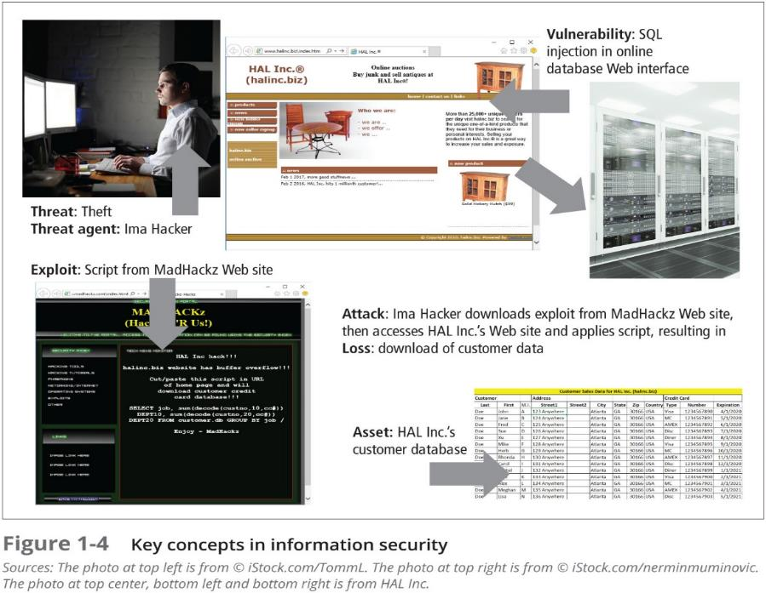
Notes:
Can organisations ever fully eliminate vulnerabilities?
NO:
technology complexity
human error
legacy systems
zero-days
cloud misconfigurations
As illustrated in Figure, a threat represents a potential risk to an information asset, whereas an attack, sometimes called a threat event, represents an ongoing act against the asset that could result in a loss. Threat agents damage or steal an organization’s information or physical assets by using exploits to take advantage of a vulnerability where controls are not present or no longer effective. Unlike threats, which are always present, attacks exist only when a specific act may cause a loss. For example, the threat of damage from a thunderstorm is present throughout the summer in many places, but an attack and its associated risk of loss exist only for the duration of an actual thunderstorm.
To investigate the wide range of threats that pervade the interconnected world, many researchers have collected information on threats and attacks from practicing information security personnel and their organizations. While the categorizations may vary, threats are relatively well researched and fairly well understood. There is wide agreement that the threat from external sources increases when an organization connects to the Internet. The number of Internet users continues to grow; almost exactly half (49.7 percent) of the world’s 7.52 billion people had some form of Internet access as of mid-2017.4 Therefore, a typical organization with an online connection to its systems and information faces more than 3.7 billion potential hackers.

Slide 15
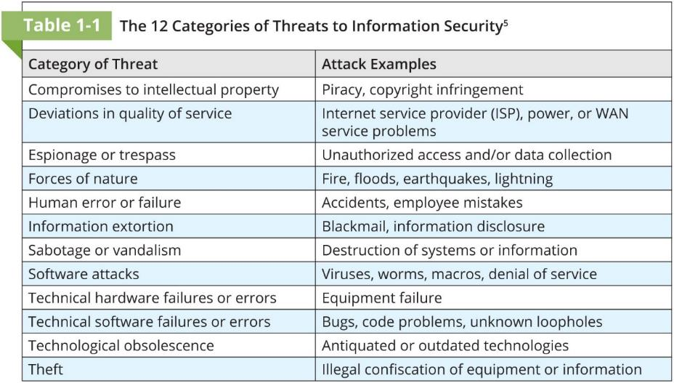
Notes:
The Table shows the 12 general categories of threats that represent a clear and present danger to an organization’s people, information, and systems. Each organization must prioritize the threats it faces based on the particular security situation in which it operates, its organizational strategy regarding risk, and the exposure levels of its assets. You may notice that many of the attack examples in the table could be listed in more than one category. For example, theft performed by a hacker falls into the category of “theft,” but it can also be preceded by “espionage or trespass” as the hacker illegally accesses the information. The theft may also be accompanied by defacement actions to delay discovery, qualifying it for the category of “sabotage or vandalism.”
NEW MODERN THREATS
Include:
ransomware-as-a-service
AI-driven attacks
deepfake phishing
cloud attacks
supply-chain attacks
modern examples:
Zero-day vulnerabilities
cloud misconfiguration
API exploitation
AI-generated phishing
Intellectual property (IP) can be trade secrets, copyrights, trademarks, and patents
IP is protected by U.S. Copyright and other laws, carries the expectation of proper attribution or credit to its source, and potentially requires the acquisition of permission for its use, as specified in those laws
The unauthorized appropriation of IP constitutes a threat to information security
This category includes two primary areas:
Software piracy
Copyright protection and user registration
Deviations in Quality of Service:
An organization’s information system depends on the successful operation of many interdependent support systems, including power grids, data and telecommunications networks, parts suppliers, service vendors, and even janitorial staff and garbage haulers, any of which can be interrupted by severe weather, employee illnesses, or other unforeseen events
Irregularities in Internet service, communications, and power supplies can dramatically affect the availability of information and systems
Subcategories of this threat include the following:
Internet service issues
Communications and other service provider issues
Power irregularities
Espionage or Trespass:
When an unauthorized person gains access to information an organization is trying to protect, the act is categorized as espionage or trespass
When information gatherers employ techniques that cross a legal or ethical threshold, they are conducting industrial espionage
In the real world, a hacker frequently spends long hours examining the types and structures of targeted systems and uses skill, guile, and/or fraud to attempt to bypass controls placed on information owned by someone else
Once an attacker gains access to a system, the next step is to increase privileges (privilege escalation) to gain administrator- (or root-) level control
Password attacks fall under the category of espionage or trespass just as lock-picking falls under breaking and entering
Attempting to guess or reverse-calculate a password is often called cracking
There are alternative approaches to password cracking:
Brute force attack
Dictionary password attack
Rainbow tables
Social engineering password attack
Forces of Nature:
Forces of nature can present some of the most dangerous threats because they usually occur with little warning and are beyond the control of people
Because it is not possible to avoid these threats, organizations must implement controls to limit damage and prepare contingency plans for continued operations
Force majeure, or “superior force,” includes forces of nature as well as civil disorder and acts of war
Most forces of nature can only be mitigated through insurance, although careful facilities design and placement can reduce the likelihood of damage
Some typical force of nature attacks include the following:
Fire
Flood
Earthquake
Lightning
Landslide or mudslide
Tornados or severe windstorms
Hurricanes, typhoons, and tropical depressions
Tsunami
Electrostatic discharge (ESD)
Dust contamination
Human Error or Failure:
This category includes acts performed without intent or malicious purpose or in ignorance by an authorized user
When people use information systems, mistakes happen; similar errors happen when people fail to follow established policy
Inexperience, improper training, and incorrect assumptions are just a few things that can cause human error or failure
One of the greatest threats to an organization’s information security is its own employees, as they are the threat agents closest to the information
Human error or failure often can be prevented with training, ongoing awareness activities, and controls
Some typical human error or failure attacks include the following:
Social engineering
Advance-fee fraud
Phishing
URL manipulation
Web site forgery
Spear phishing
Pretexting

Slide 16
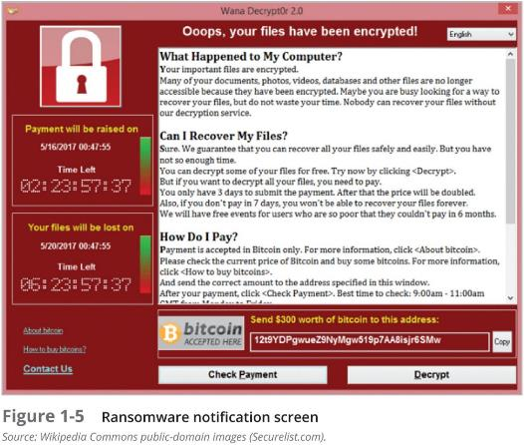
Information Extortion
Information extortion, also known as cyberextortion, is common in the theft of credit card numbers
Recent information extortion attacks have involved specialized forms of malware known as ransomware that encrypt the user’s data and offer to unlock it if the user pays the attacker
Notes:
Sabotage or Vandalism
This category of threat involves the deliberate sabotage of a computer system or business, or acts of vandalism to destroy an asset or damage the image of an organization
These acts can range from petty vandalism by employees to organized sabotage against an organization
Vandalism to a Web site can erode consumer confidence, diminishing an organization’s sales, net worth, and reputation
Activism in the digital age:
Online activism
Cyberterrorism and cyberwarfare
Positive online activism
Software Attacks
Deliberate software attacks occur when an individual or a group designs and deploys software to attack a system
This software can be used to overwhelm the processing capabilities of online systems or to gain access to protected systems by hidden means
Malware—viruses, worms, Trojan horses, polymorphic threats and hoaxes
Back doors, trap doors, and maintenance hooks
Denial-of-service (DoS) and distributed denial-of-service attacks (DDoS)
E-mail attacks—spam, mail bombs, and social engineering attacks
Communications interception attacks—packet sniffers, spoofing, pharming, and man-in-the-middle attacks
Technical Hardware Failures
Technical hardware failures or errors occur when a manufacturer distributes equipment containing a known or an unknown flaw, which can cause the system to perform outside of expected parameters, resulting in unreliable service or lack of availability
In hardware terms, failures are measured in mean time between failure (MTBF) and mean time to failure (MTTF)
MTBF presumes that the item can be repaired or returned to service, MTTF presumes the item must be replaced
From a repair standpoint, MTBF = MTTF + MTTD + MTTR, where mean time to diagnose (MTTD) examines diagnosis time and mean time to repair (MTTR) calculates repair time
Technical Software Failures
Large quantities of computer code are written, debugged, published, and sold before all their bugs are detected and resolved
Sometimes, combinations of certain software and hardware reveal new failures that range from bugs to untested failure conditions
Sometimes these bugs are not errors, but purposeful shortcuts left by programmers for benign or malign reasons, bypassing security checks to speed up software testing—known as trap doors
Among the most popular bug documentation Web site is Bugtraq, hosted by Security Focus, which provides up-to-the-minute information on the latest security vulnerabilities as well as a thorough archive of past bugs
The Open Web Application Security Project (OWASP) list of “The Ten Most Critical Web Application Security Risks” for 2017:
Injection
Broken authentication and session management
Cross-site scripting (XSS)
Broken access control
Security misconfiguration
Sensitive data exposure
Insufficient attack protection
Cross-site request forgery (CSRF)
Using components with known vulnerabilities
Underprotected APIs
Deadly Sins of Software Security
Web Application Sins
SQL injection
Web server-related vulnerabilities
Web client-related vulnerabilities (XSS)
Use of magic URLs, predictable cookies, and hidden form fields
Implementation Sins
Buffer overflow
Format string problems
Integer overflows
C++ catastrophes
Catching exceptions
Command injection
Failure to handle errors correctly
Information leakage
Race conditions
Poor usability
Not updating easily
Executing code with too much privilege
Failure to protect stored data
The sins of mobile code
Cryptographic Sins
Use of weak password-based systems
Weak random numbers
Using the wrong cryptography
Networking Sins
Failure to protect network traffic
Improper use of PKI, especially SSL
Trusting network name resolution

Slide 17
Technological Obsolescence
Antiquated or outdated infrastructure can lead to unreliable and untrustworthy systems
Management must recognize that when technology becomes outdated, there is a risk of losing data integrity from attacks
Ideally, proper planning by management should prevent technology from becoming obsolete, but when obsolescence is clear, management must take immediate action
Perhaps the most significant case of technology obsolescence in recent years is Microsoft’s Windows XP
Why do organizations continue using unsupported systems?
Notes:
unsupported cloud systems
outdated IoT devices
legacy infrastructure
unsupported software
Windows 10 end-of-support discussion
Why do organisations continue using unsupported systems?
cost
operational dependency
legacy applications
migration complexity
recent phishing/credential breach headline.

Slide 18
Theft
The value of information is diminished when it is copied without the owner’s knowledge
Physical theft can be controlled easily using a wide variety of measures, from locked doors to trained security personnel and the installation of alarm systems
Electronic theft, however, is a more complex problem to manage and control
Theft is often an overlapping category with software attacks, espionage or trespass, information extortion, and compromises to intellectual property

Slide 19
Management and Leadership

Slide 20
Management and Leadership
Management is the process of achieving objectives using a given set of resources
A manager is a member of the organization assigned to marshal and administer resources, coordinate the completion of tasks, and handle the many roles necessary to complete the desired objectives
Management roles:
  Informational
  Interpersonal
  Decisional
Notes:
CISO role
board responsibility
executive accountability

Slide 21
The Difference Between Leadership and Management
A leader influences employees so that they are willing to accomplish objectives, and is expected to lead by example and demonstrate personal traits that instill a desire in others to follow
By comparison, a manager administers the resources of the organization—creates budgets, authorizes expenditures, and recruits, hires, evaluates, and terminates employees
Leaders do not always perform a managerial function, and managers are often assigned roles in which they are not responsible for personnel
Effective managers can be effective leaders
Should CISOs be technical experts or strategic leaders?
Notes:
Should CISOs be technical experts or strategic leaders?
Technical perspective
understands threats deeply
operational credibility
Strategic perspective
governance
communication
board engagement
risk management

Slide 22
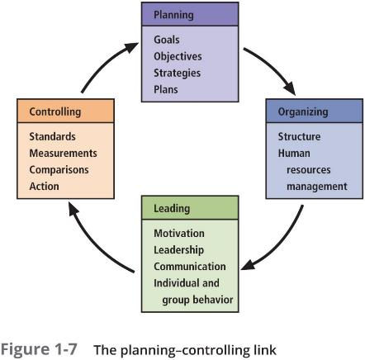
Management Characteristics
Two basic approaches to management are:
  Traditional management theory uses the core principles of planning, organizing, staffing, directing, and controlling (POSDC)
  Popular management theory categorizes the principles of management into planning, organizing, leading, and controlling (POLC)
Notes:
Planning: the process of developing, creating, and implementing strategies for the accomplishment of objectives. Three levels of planning are strategic, tactical, and operational
Organizing: the management function dedicated to the structuring of resources to support the accomplishment of objectives
Leading: encourages the implementation of the planning and organizing functions, and includes supervising employee behavior, performance, attendance, and attitude while ensuring completion of the assigned tasks, goals, and objectives
Controlling: ensures the validity of the organization’s plan—that sufficient progress is made, that impediments to the completion of the task are resolved, and that no additional resources are

Slide 23
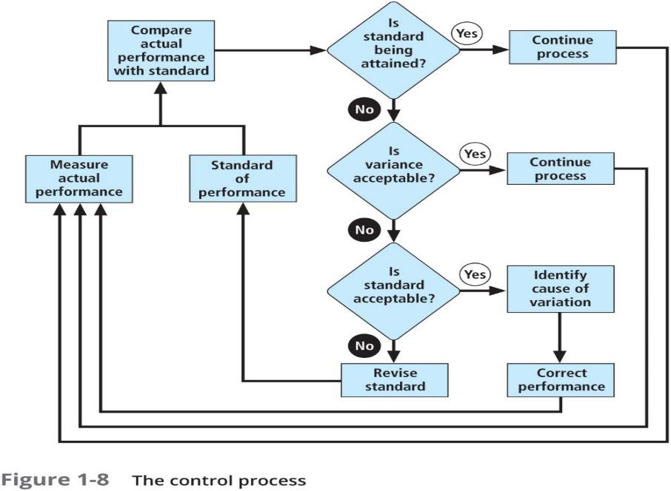

Slide 24
Governance
Governance is “the set of responsibilities and practices exercised by the board and executive management with the goal of providing strategic direction, ensuring that objectives are achieved, ascertaining that risks are managed appropriately, and verifying that the enterprise’s resources are used responsibly”
Governance emphasizes escalating the importance of InfoSec to the uppermost levels of the organization and providing it with an appropriate level of management
Can organizations delegate cyber risk entirely to the IT department?
Notes:
cyber governance
NIST CSF
ISO 27001
board accountability
NIS2
governance frameworks
Can organisations delegate cyber risk entirely to the IT department?
NO:
Cyber risk is:
organisational
strategic
governance-related
NOT purely technical.

Slide 25
Solving Problems
Step 1: Recognize and Define the Problem
Step 2: Gather Facts and Make Assumptions
Step 3: Develop Possible Solutions
Step 4: Analyze and Compare Possible Solutions (Feasibility Analyses)
Step 5: Select, Implement, and Evaluate a Solution
Notes:
Cyber incident decision-making.
ransomware decisions
breach disclosure
crisis communication
business continuity

Slide 26
Modern Cyber Governance Challenges
AI governance
cloud governance
remote workforce
third-party risk
supply-chain attacks
regulatory pressure
What is the biggest governance challenge organizations face today?

Slide 27
Principles of Information Security Management

Slide 28
Principles of Information Security Management
The unique functions of information security management are known as the six Ps:
  Planning
  Policy
  Programs
  Protection
  People
  Project management
Notes:
InfoSec Planning:
Planning as part of InfoSec management is an extension of the basic planning model discussed earlier in this chapter
Included in the InfoSec planning model are activities necessary to support the design, creation, and implementation of information security strategies
Because the InfoSec strategic plans must support not only the IT use and protection of information assets, but those of the entire organization, it is imperative that the CISO work closely with all senior managers in developing InfoSec strategy
Several types of InfoSec plans exist:
Incident response planning
Business continuity planning
Disaster recovery planning
Policy planning
Personnel planning
Technology rollout planning
Risk management planning
Security program planning including education, training and awareness

Slide 29
Policy
Policy is “a set of organizational guidelines that dictate certain behavior within the organization”
In InfoSec, there are three general categories of policy:
  Enterprise information security policy (EISP)
  Issue-specific security policy (ISSP)
  System-specific policies (SysSPs)

Slide 30
Programs
InfoSec operations are specifically managed as separate entities
A security education training and awareness (SETA) program is one such entity
Other programs that may emerge include a physical security program, complete with fire, physical access, gates, guards, and so on

Slide 31
Protection
The protection function is executed via a set of risk management activities, including risk assessment and control, as well as protection mechanisms, technologies, and tools
Each of these mechanisms represents some aspect of the management of specific controls in the overall information security plan

Slide 32
People
People are the most critical link in the information security program
This area of InfoSec includes security personnel and the security of personnel, as well as aspects of the SETA program mentioned earlier

Slide 33
Projects
The final component is the application of thorough project management discipline to all elements of the information security program
Project management involves identifying and controlling the resources applied to the project, as well as measuring progress and adjusting the process as progress is made toward the goal

Slide 34
Project Management
Information security is a process, not a project, however, each element of an information security program must be managed as a project, even if the overall program is perpetually ongoing
How can information security be both a process and a project? It is, in fact, a continuous series, or chain, of projects
Some aspects of information security are not project based; rather, they are managed processes (operations) and are ongoing

Slide 35
Summary
Because businesses and technology have become more fluid, the narrower concept of computer security has been replaced by the broader concept of InfoSec
From an InfoSec perspective, organizations often have three communities of interest: InfoSec managers and professionals, IT managers and professionals, and nontechnical managers and professionals
The C.I.A. triad is based on three desirable characteristics of information: confidentiality, integrity, and availability
To make sound decisions about information security, management must be informed about threats to its people, applications, data, and information systems

Slide 36
Summary (Continued)
Threats or dangers facing an organization’s people, information, and systems fall into the following general categories:
  Compromises to intellectual property
  Deviations in quality of service
  Espionage or trespass
  Forces of nature
  Human error or failure
  Information extortion
  Sabotage or vandalism
  Software attacks
  Technical hardware failures or errors
  Technical software failures or errors
  Technological obsolescence
  Theft

Slide 37
Summary (Continued)
An attack is a deliberate act that takes advantage of a vulnerability to compromise a controlled system. It is accomplished by a threat agent that damages or steals an organization’s information or physical assets. A vulnerability is an identified weakness in a controlled system, where controls are not present or are no longer effective
Poor software development practices can introduce significant risk, but by developing sound development practices, change control, and quality assurance into the process, overall software quality and the security performance of software can be greatly enhanced
In its simplest form, management is the process of achieving objectives by using resources
The important distinction between a leader and a manager is that a leader influences employees so that they are willing to accomplish objectives, whereas a manager creates budgets, authorizes expenditures, and hires employees

Slide 38
Summary (Continued)
The traditional approach to management theory uses the core principles of planning, organizing, staffing, directing, and controlling (POSDC). Another approach to management theory categorizes the principles of management into planning, organizing, leading, and controlling (POLC)
The process that develops, creates, and implements strategies for the accomplishment of objectives is called “planning.” There are three levels of planning: strategic, tactical, and operational
InfoSec management operates like all other management units, but the goals and objectives of the InfoSec management team are different in that they focus on the secure operation of the organization

Slide 39
Questions

Slide 40
References
M. E Whitman, H. J. Mattford, Management of Information Security, Cengage Learning, 6th ed 2019.
NIST Cybersecurity Framework 2.0
  National Institute of Standards and Technology (NIST). Cybersecurity Framework (CSF) 2.0. Gaithersburg, MD: NIST, 2024. Available:
  NIST Cybersecurity Framework 2.0
NIST Zero Trust Architecture
  National Institute of Standards and Technology (NIST). Zero Trust Architecture (SP 800-207), 2020. Available:
  NIST SP 800-207 Zero Trust Architecture
ISO/IEC 27001:2022
  International Organization for Standardization (ISO). ISO/IEC 27001:2022 Information Security Management Systems. Available:
  ISO 27001 Information Security Management

