Slide 1
Check Today, Thrive Tomorrow
A Campaign to Promote Breast Cancer Screening Among Women Aged 50–70
2542085 : Dhruvisha Vinaybhai Prajapati
2518470 : Vishalbhai Mukeshbhai Khristi
2530748 : Shivangi Bharatbhai Tank

Slide 2
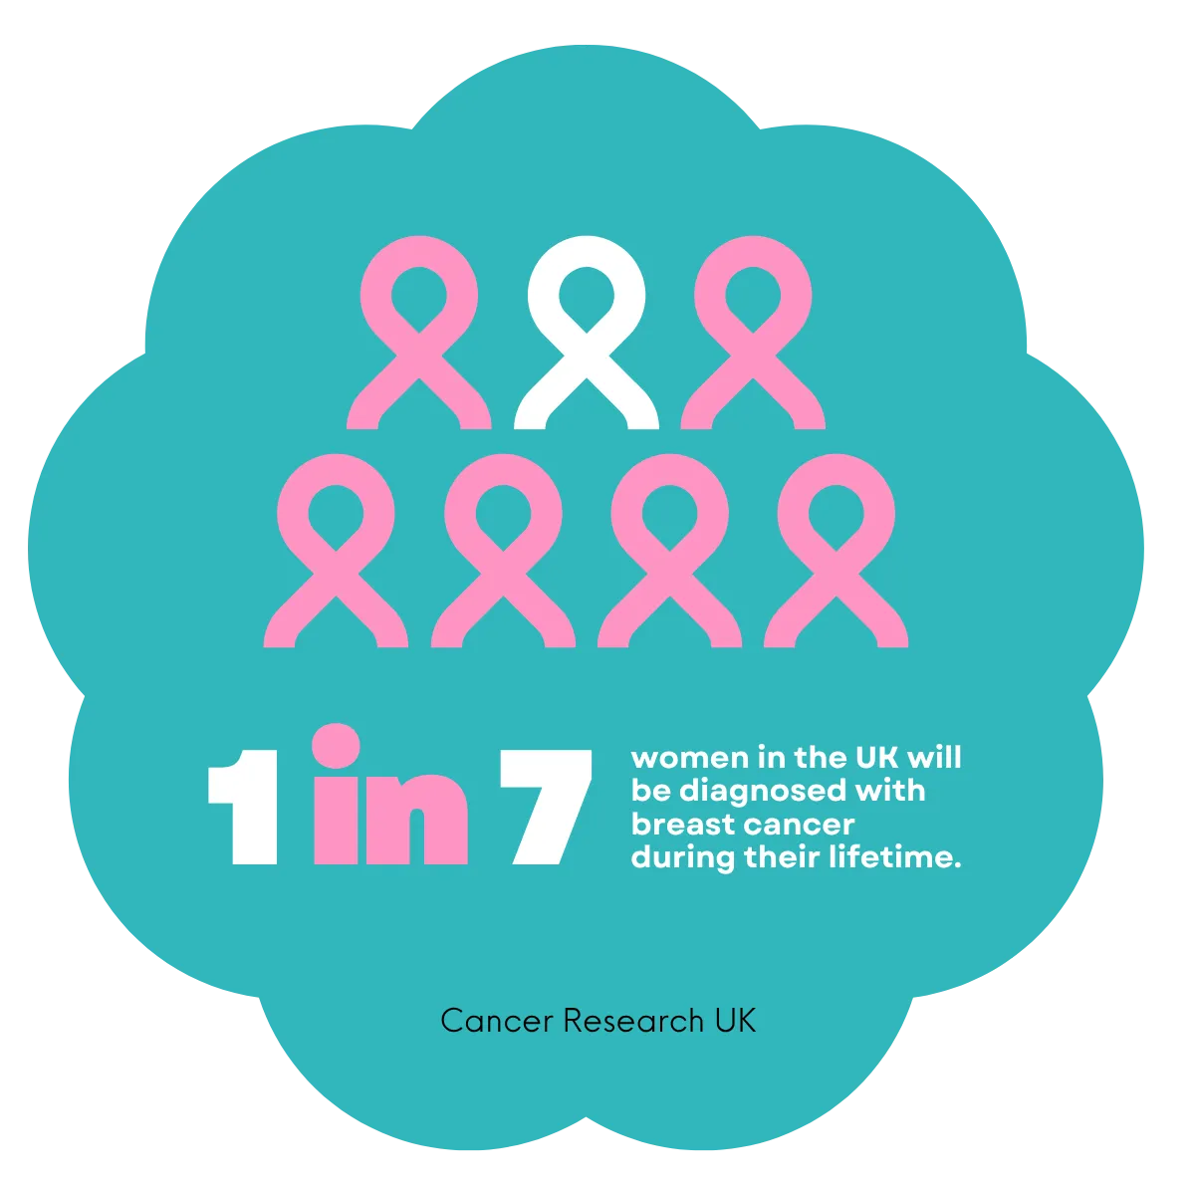
"Check Today, Thrive Tomorrow" – A Campaign to Promote Breast Cancer Screening Among Women Aged 50–70
Our campaign will focus on women aged 50-70 years who have the right to NHS mammography screening within three years.
Breast cancer is the widespread one among women in the UK, as it is manifested in about 1 in 7 women in their lives (Well One, 2026).
The title of the campaign will motivate proactive screening behaviour with empowering health messages that are positive.
Figure 1: Incidence of Breast Cancer in UK
(Source: Well One, 2026)
Notes:
The campaign is particularly aimed at 50-70-year-old women due to NHS statistics showing that women between 50 and 70 have the highest incidence of breast cancer with the highest incidence rate recorded in 60-69 year olds. The 1 in 7 lifetime risk statistic, often quoted, should be taken with care since it is a cumulative population level risk, but not an individual probability (Well One, 2026). Most importantly, this number conceals great ethnic, deprivation and family history variability. Our six-week framework is reflective of evidence-based models of community intervention that reported long-term behavioural change including the Wolverhampton PCN programme that reported measurable re-engagement with previously disengaged women through a structured weekly contact.

Slide 3
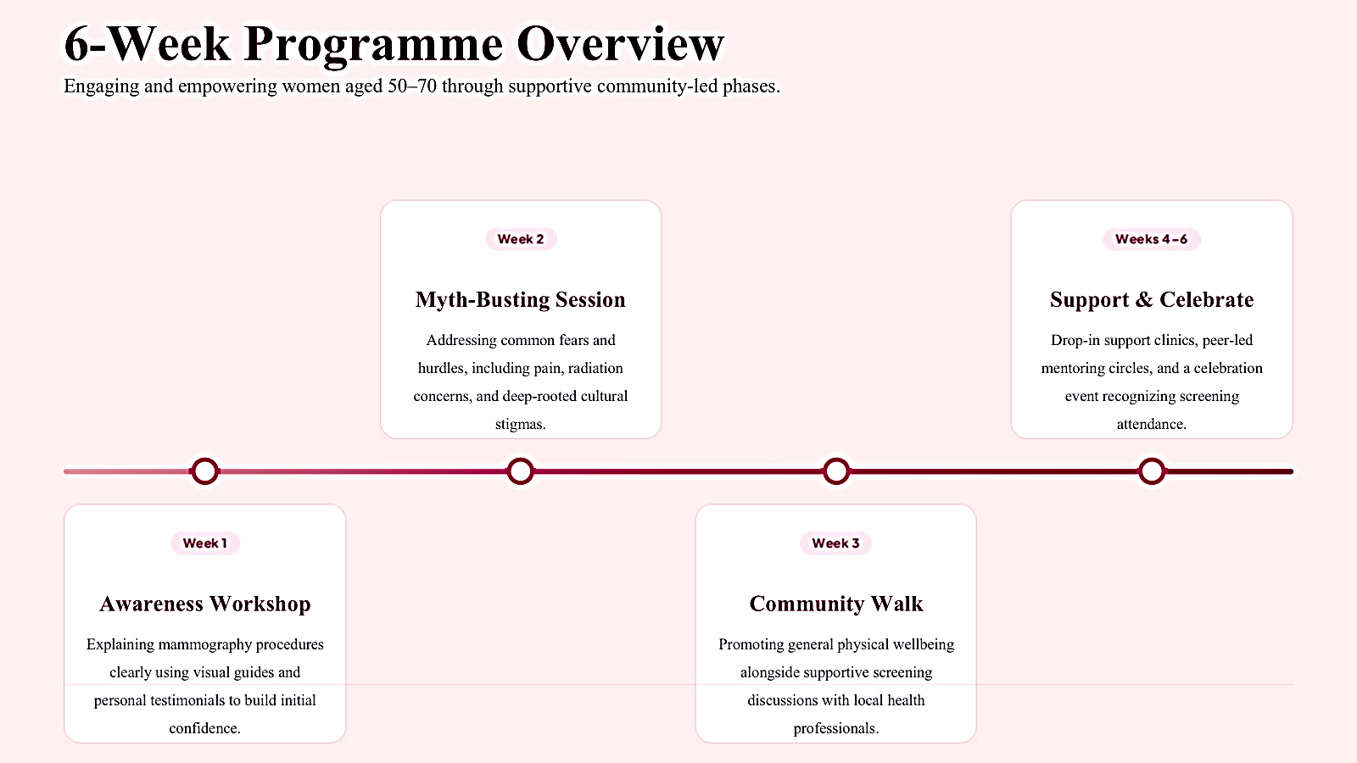
Campaign Activity Plan – 6-Week Programme Overview

Slide 4
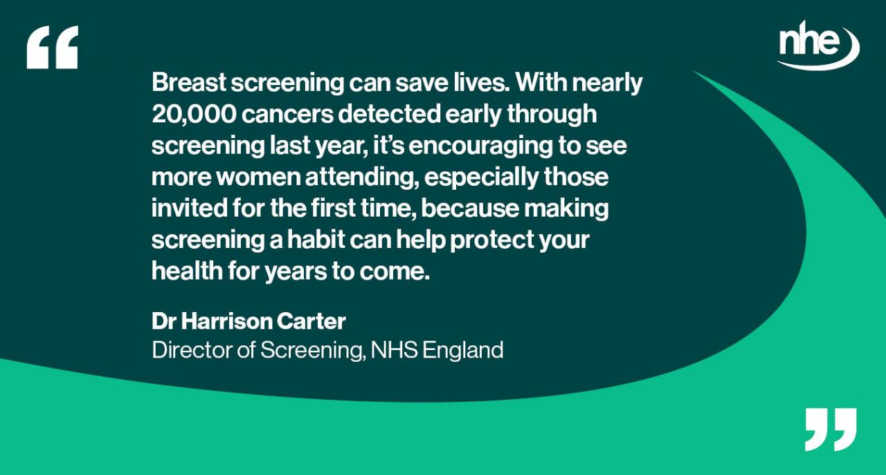
Rationale: Why Breast Cancer Screening Matters
Screening of the NHS averts an estimated 1300 deaths due to breast cancer per annum throughout England due to the early identification.
In 2024/25, the cancer cases were diagnosed at 19,291 cases, which is 16% higher than the 16,677 cancer cases diagnosed in the previous year (NHS England, 2026).
The five-year survival rate is much higher (above 99) when detected in stage one, and only 31 in stage four (Stump-Sutliff, 2025).
Figure 2: Breast Cancer Screening in UK
(Source: National Health Executive, 2026)
Notes:
The 1,300 deaths it would protect per year is modelled as opposed to actually observed, providing some uncertainty to the methodology. But the 2024/25 figures of 19 291 cancers are tangible, quantifiable programme outputs and the figure of 16% annual increase is actual attendance enhancement and not rising cancer statistics (NHS England, 2026). Survival difference between stage 1 at 99% and stage 4 at 31 powerfully illustrates the clinical value of screening but critics have indicated that these numbers are due to lead-time bias, in which screening changes the date of diagnosis, but may not increase the lifespan (Stump-Sutliff, 2025). Although this is true, clinics have overwhelmingly agreed on the advantage of screening in terms of mortality (National Health Executive, 2026).

Slide 5
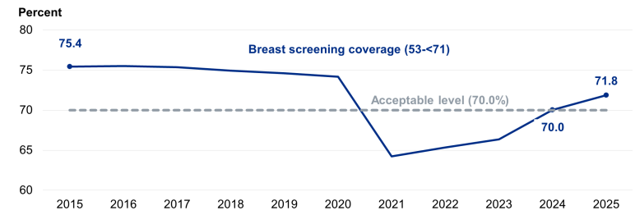
National Guidelines and Current Screening Uptake Statistics
NHS guidelines recommend three-yearly mammography testing among women of between 50 and 70 years with an uptake level of 80% achievable (NHS Cancer Screening Programmes, 2025).
Overall uptake in 2024/25 was 70.6%, slightly above 70% (minimum standard) and just short of 80% target (NHS England, 2026a).
Initial invitee uptake stood at just 63.6% which does not meet the 70% minimum standard in all of England.
Figure 3: Screening Services in UK
(Source: NHS England, 2026a)
Notes:
The figure of 70.6% uptake, although necessary to the minimum standard of 70%, is a terrible failure when compared to the possible 80%. This loophole is not just numerical but translates to a direct loss in diagnoses. Now, Breast Cancer estimates that, with 80% uptake, 259,519 more women would have been screened and about 2,228 more cancers would have been identified in 2024/25 alone (NHS Cancer Screening Programmes, 2025). The initial invitee rate of 63.6%, although a decade high, is still below the minimum standard in all English regions, presenting a systemic inability to attract younger viable women joining the programme in the first instance (NHS England, 2026a).

Slide 6
Short-Term and Long-Term Consequences of Low Screening Utilisation
Short-term
Long-term
Diminished day-to-day functioning due to an unexplained development of tumours that bring fatigue, soreness and emotional pain.
More anxiety at a time when there are symptoms, lost early diagnosis and postponed medical appointments.
Late-onset diagnosis with treatment that involves aggressive therapy with chemotherapy and mastectomy and extended hospitalization.
The UK economy spends up to £2.8 billion on breast cancer every year, with an estimate of a preponderance to £3.6 billion in 2034 (Moloney, 2024).
Notes:
Short-term outcomes are not that commonly considered in the community health discourse. Women who have undetected tumours will report and feel the unknown fatigue and breast alterations that bring them daily anxiety without being researched without screening indicators. The cost-benefit analysis is interesting especially in the long term where the cost to the UK economy is estimated to be up to 2.8 billion in 2024 and it is estimated to be up to £3.6 billion in 2034 (Moloney, 2024). Importantly, Demos and Breast Cancer Now modelling have shown that with uptake rates of 80% and above enhancing the net economic savings are between £96 and £111 million year one with the investment in screening campaigns becoming financially self-justifying (Bush and Misak, 2025).

Slide 7
Three Key Campaign Aims and Measurable Outcomes
Aim 1
Aim 2
Aim 3
By 6 months, the target population consists of local women aged 5053 years increasing first time screening attendance by 15% of the target group.
Increase the knowledge scores on breast cancer screening by 25% with pre-and post session questionnaires.
Decrease known obstacles to screening by one-fifth of baseline evaluated by survey of participants at campaign end.
Notes:
All goals are clearly formulated along SMART lines that allow them to be carefully evaluated. The first-time attendance target of 15% is a stretch but it is evidence-based because the Wolverhampton telephone interaction resulted in 22% re-engagement of non-attenders. The 25% knowledge improvement pre- and post-questionnaires are validated and give a quantitative measure. Importantly, aim three is concerned not exclusively with knowledge but with the barriers, and it is understandable that awareness does not necessarily lead to the behaviour change (Hendel et al., 2024). This objective ensures that perceived barriers require reduction to exemplify the predicted attendance of screening more effectively compared to an isolated increase in knowledge, thus validating the Health Belief Model.

Slide 8
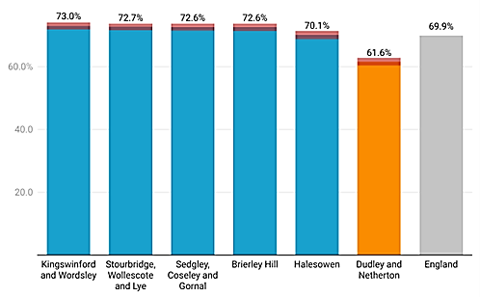
Campaign Evaluation: Methods and Measuring Success
Process evaluation: Monitoring weekly attendance at the sessions, numbers and the levels of participation in resources spending.
Outcome evaluation: Comparison of the pre- and post-campaign screening uptake data of the local NHS screening units (Obinna Onyedum et al., 2025).
Impact evaluation: Assessing changes in health knowledge, attitudes and self-reported intentions to screen using validated questionnaires.
Formative assessment: Gathering feedback of the participants on a weekly basis in the form of a survey, to reshape the course of the sessions and methods of delivery.
Figure 4: Breast cancer screening coverage by primary care network
(Source: Local Government Association, 2025)
Notes:
The presence of four types of evaluation makes the campaign have a strong evidence base. Process evaluation reflects implementation fidelity, that is, sessions were conducted as planned. Nonetheless, attendance tracking will not be an adequate quality measure because the women can attend without really engaging. Top-tier evidence On outcome evaluation refers to the comparison of local screening data and again, attribution is difficult as there could be some external conditions affecting uptake like the national NHS campaign at the same time. Weekly feedback (formative) allows the programme to be responsive, a vital part since inflexible programme delivery usually fails to respond to emergent issues mentioned in the implementation of the programme (Local Government Association, 2025).

Slide 9
Campaign Poster
Check Today, Thrive Tomorrow

Slide 10









NHS BREAST SCREENING CAMPAIGN
HEALTH PROMOTION • 2026
Early detection saves lives.
Book your free NHS mammogram today.
99%
1 in 7
19,291
5-year survival at Stage 1
UK women affected in lifetime
cancers found via screening 2024/25
WHY IT MATTERS
Early detection
Finds tumours before symptoms appear.
Don't wait — book your screening today.
Free NHS service
Quick, safe, confidential and fully covered.
Community support
Peer mentors and multilingual guidance.
Check Today,
Thrive Tomorrow.
6-WEEK COMMUNITY PROGRAMME
A community campaign for women aged 50–70
Week 1
Awareness
Week 2
Myth-busting
Week 3
Community walk
Weeks 4–6
Support
PARTNERS
NHS England • Breast Cancer Now • Cancer Research UK
15 minutes
Local clinics
Every 3 years
Scan
to book

Slide 11
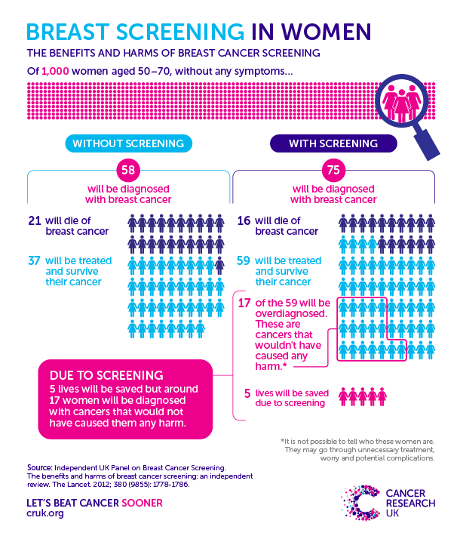
Local and National Partner Organisations
Breast Cancer Now: UK based charity that advocates on getting more people to take the breast cancer screening and also funds breast cancer research.
Cancer Research UK: Offers education, awareness of screening campaigns and offers funding to early detection research programmes.
NHS England Breast screening Programme: Provides mammography services throughout the country and implements specific awareness campaigns, locally (Hull Joint Strategic Needs Assessment, 2026).
Figure 5: Importance of Breast Cancer Screening
(Source: Hull Joint Strategic Needs Assessment, 2026)
Notes:
Collaborating at an organisational level creates a sense of legitimacy, materials and distribution which a lone campaign would not have. The participation of Breast Cancer Now is also instrumental as it passed lobbying to introduce the first national campaign to raise awareness about screening in February 2025. But a more detailed study shows that working in partnership may have certain drawbacks. National organisations might focus on more generalised messages than locally oriented methods, and local GP surgeries have a major time and resource burden that restrain their reach (Hull Joint Strategic Needs Assessment, 2026). GOV.UK 2026 review advises that Primary Care Networks are supposed to establish text messaging reminders and the ability to make appointments more flexible although there is a significant difference between different areas of application (NHS England, 2026b).

Slide 12
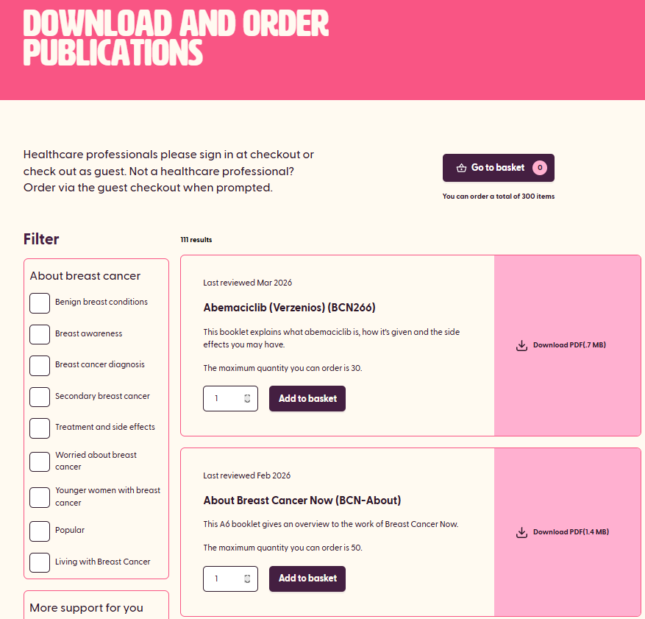
Existing Campaign Resources and How We Will Use Them
The national breast screening campaign by the NHS initiated in February 2025 as a result of the efforts achieved 32,000 webpage visits per week, which is 145% higher (NHS England, 2026a).
Breast Cancer Now offers the possibility of free download of leaflets, social media toolkits, and community engagement guidelines to be replicated (Breast Cancer Now, 2026).
Re-engagement with former non-attended cases and outreach replicability were observed.
Figure 6: Breast Cancer Now Website
(Source: Breast Cancer Now, 2026)
Notes:
The 32,000 visits to webpages and 145% growth in webpage traffic during the NHS campaign show promise of strong participation by the population. But critically, higher information-seeking is not necessarily reflected into screening attendance. The Wolverhampton PCN model recorded a tangible 22% re-engagement rate by means of direct telephone contact, which implies that an individualised outreach is more valuable in direct information provision than standalone information provision (NHS England, 2026a). The multilingual resources provided by Cancer Research UK fill key areas of access gaps, but are not very accessible in all languages spoken in the community. Our campaign will be a blend of digital awareness and face-to-face engagement of the individual as we know that neither of the two methods will help the behaviour to change in the long-term (Breast Cancer Now, 2026).

Slide 13
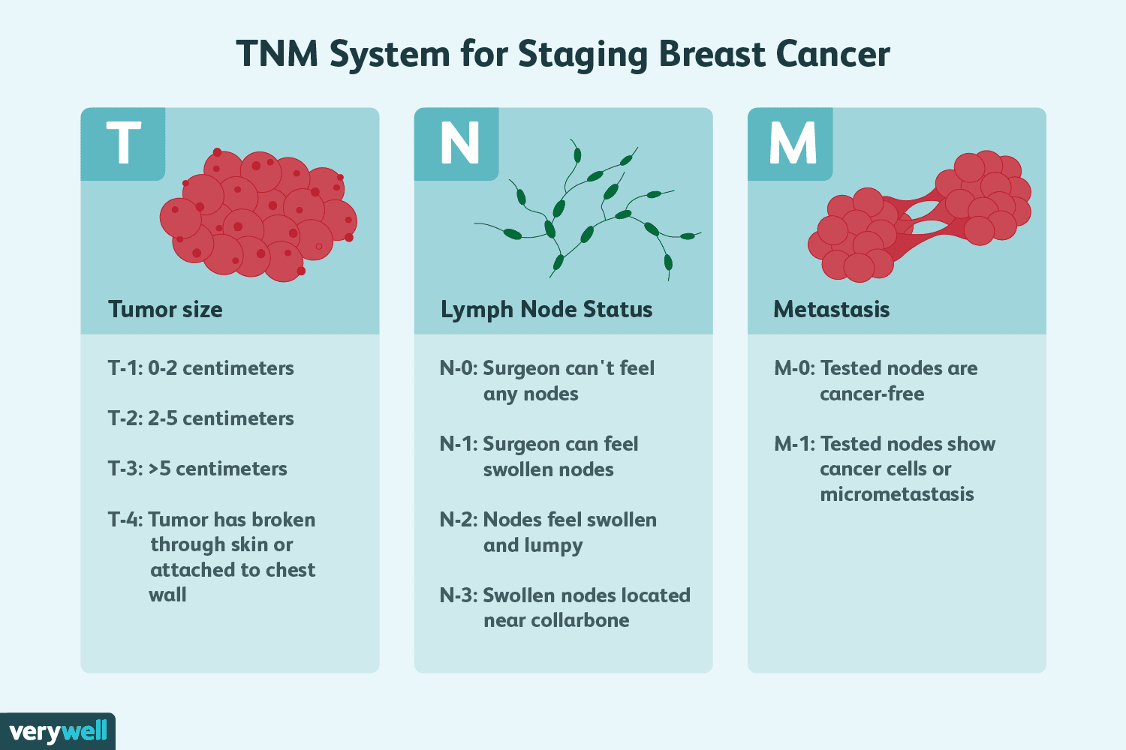
Physiological Benefits of Regular Breast Screening
Allows diagnosis of tumours smaller than 15mm where 63% of cancers detected during screening have been, enhancing treatment choices (Davis, 2026).
Early diagnosis prevents aggressive chemotherapy which decreases the physical side effects such as nausea, loss of hair and immunosuppression.
Regular every three year screening with mammography ensures continuous surveillance, lowering chances of interval cancers when round-to-round screening.
Figure 7: TNM System for Staging Breast Cancer
(Source: Davis, 2026)
Notes:
The fact that 63% of the detected tumours on the screen are under 15mm is of clinical significance as the smaller the tumour, the greater the likelihood that it can be removed with breast-conserving surgery as opposed to a mastectomy. This also has a direct effect on body image outcomes and physical recovery of women (Davis, 2026). But screening also does have physiological risks and these need to be honestly admitted. Mammography radiation levels are low (albeit) related, but the rate of false-positives can be observed at about 5.2% (referrals), resulting in unnecessary biopsies and discomfort. More importantly, the three-year screening interval trades off the sensitivity to detect against the risk of overdiagnosis although other authors argue that more frequent screening would identify a faster-growing interval cancer (American Cancer Society, 2022).

Slide 14
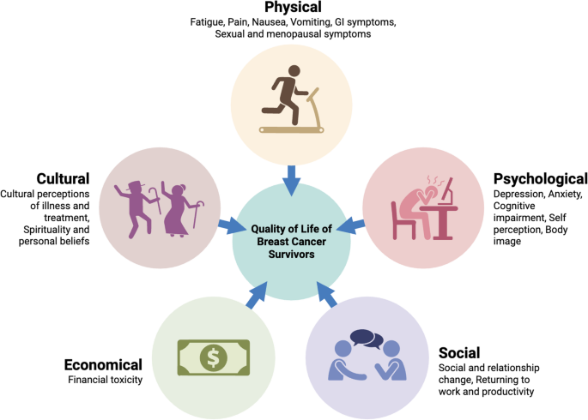
Sociological and Psychological Benefits of Screening Behaviour Change
Lessens anxiety in cancer by offering relief and definite knowledge of the breast health status with every 3-year cycle (Savitri et al., 2025).
Gives women the information they need to enhance their health, making them feel more confident in their ability to take positive steps towards their own health.
Saves money on families, since it avoids expensive late-stage care and protracted unemployment (CDC, 2024).
Figure 8: Influence of Breast cancer on Quality of Life
(Source: Savitri et al., 2025)
Notes:
The psychological advantage of anxiety reduction is well-established yet has a two-way action. Although a clear screening outcome is reassuring, the screening procedure can cause high levels of anticipatory anxiety amongst many women. Importantly, the sociological advantage of screening being made normal in communities is especially applicable in the case of women of ethnic minority who have a significantly lowered rate of breast cancer screening uptake (CDC, 2024). Data published by NHS England in 2026 shows that deprivation is closely related to a lower level of screening, which indicates that normalisation of the community level needs to effectively address underserved communities and not focus on supporting the current state of health behaviour of already-interested population groups (Savitri et al., 2025).

Slide 15
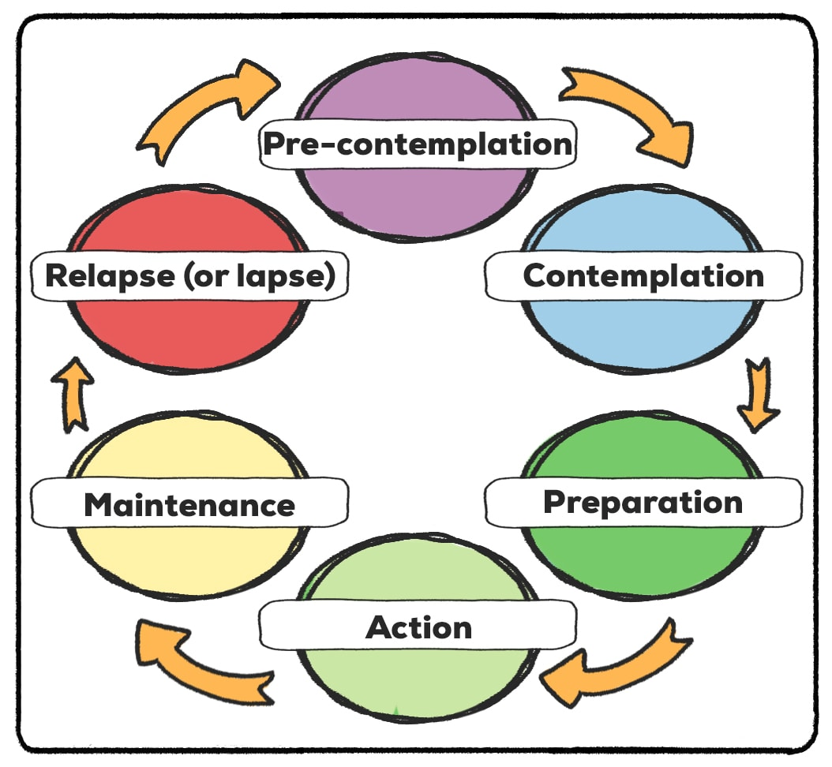
Health Behaviour Theories: Understanding Barriers to Screening
Health Belief Model
Transtheoretical Model
Planned Behaviour Theory
The perceived barriers such as pain, embarrassment and fear of diagnosis are what do not see women accessing mammography (Alyafei and Carr, 2024).
A significant proportion of non-attenders are still on pre-contemplation level and do not know the importance of the screening or their own risk level (de Freitas et al., 2020).
The intentions to attend screening are affected by the subjective norms and perceived ability to control the behaviour in women (Brookes, 2023).
Figure 9: Transtheoretical Model
(Source: Practical Psychology, 2023)
Notes:
The Health Belief Model is very effective in predicting non-attendance as the perceived barriers are the most powerful predictor of non-attendance even more so than the perceived susceptibility or severity (Alyafei and Carr, 2024). Studies have established that women who are at action and maintenance levels of the Transtheoretical Model indicate a large number of fewer perceived barriers as compared to those who are at pre-contemplation. There are however limitations to these models (de Freitas et al., 2020). The Health Belief Model pays much attention to personal thoughts, but ignores structural factors, including access to appointments and transport (Brookes, 2023). The Theory of Planned Behaviour introduces the norms of subjectiveness, recognition of social influence, but none of the three models sufficiently takes into consideration the systemic inequalities.

Slide 16
Overcoming Individual Challenges – Solutions Within Our Campaign
Myth busting about fear by conducting workshops about the mammography procedure is fast, safe and in most cases painless (Anderson Diagnostics, 2025).
Addressing cultural barriers through multilingual resources and health champions of various ethnic groups in the community at the local level.
Breaking logistical hurdles with marketing of NHS text messages, flexible evening appointments and mobile screening units location.
Notes:
Each solution directly corresponds to a theoretically identified barrier. Myth-busting workshops are developed to deal with perceived barriers addressed in the Health Belief Model to rectify the misconception about the anguish and danger of mammography. The use of multilingual content will overcome cultural and language barriers that NHS data points out as a factor in low uptake in ethnic minority women (Anderson Diagnostics, 2025). Flexible appointments are being promoted in response to the GOV.UK discovery that personal logistics has become the foremost barrier to attendance in the country. Importantly, peer mentoring strategy taps into the social learning theory because 89.1% of women with prior screenings returned proves that the beneficial personal experience is the most effective motivational factor to continue attendance.

Slide 17
References
Alyafei, A. and Carr, R.E. (2024). The Health Belief Model of Behavior Change. [online] National Library of Medicine. Available at: https://www.ncbi.nlm.nih.gov/books/NBK606120/.
American Cancer Society (2022). Breast Cancer Mammogram | How Does a Mammogram Work? [online] www.cancer.org. Available at: https://www.cancer.org/cancer/types/breast-cancer/screening-tests-and-early-detection/mammograms/mammogram-basics.html.
Anderson Diagnostics. (2025). The Vital Truth: Mammogram Myths And Facts. [online] Available at: https://www.andersondiagnostics.com/mammogram-myths-facts/%
Breast Cancer Now. (2026). Download and order publications. [online] Available at: https://breastcancernow.org/download-and-order-publications.
Brookes, E. (2023). The Theory of Planned Behavior - Simply Psychology. [online] www.simplypsychology.org. Available at: https://www.simplypsychology.org/theory-of-planned-behavior.html.
Bush, L. and Misak, J. (2025). SEPTEMBER 2025. [online] Available at: https://demos.co.uk/wp-content/uploads/2025/09/The-cost-of-breast-cancer-2025-update_Report_Sept.pdf.
CDC (2024). Health and Economic Benefits of Breast Cancer Interventions. [online] National Center for Chronic Disease Prevention and Health Promotion (NCCDPHP). Available at: https://www.cdc.gov/nccdphp/priorities/breast-cancer.html.
Davis, L.E. (2026). Understanding Your Breast Tumor Size and Stage. [online] Verywell Health. Available at: https://www.verywellhealth.com/know-your-breast-tumor-size-4114640.
de Freitas, P.P., de Menezes, M.C., dos Santos, L.C., Pimenta, A.M., Ferreira, A.V.M. and Lopes, A.C.S. (2020). The transtheoretical model is an effective weight management intervention: a randomized controlled trial. BMC Public Health, [online] 20(1). doi:https://doi.org/10.1186/s12889-020-08796-1.

Slide 18
References
Hendel, K.R., Vaughan, E., Kirschmann, J.M. and Johnston, C.A. (2024). Moving Beyond Raising Awareness: Addressing Barriers. American Journal of Lifestyle Medicine, 18(6). doi:https://doi.org/10.1177/15598276241274114.
Hull Joint Strategic Needs Assessment (2026). Screening Among Adults and the NHS Health Check. [online] www.hulljsna.com. Available at: https://www.hulljsna.com/adults/prevention-adults/screening-and-nhs-health-check/.
Kelly, C.J., Wilson, M., Warren, L.M., Sidebottom, R., Halling-Brown, M., Yang, L., Morigami, M., Venton, J., Chopra, R., Chang, J., Dixon, J., Gilbert, F.J., Golden, D.I., Gruzewska, E., Honeyfield, L., Hujan, A., Khodabakhshi, D., Lewis, E., Malhotra, N. and Mallya, R. (2026). Diagnostic accuracy, fairness and clinical implementation of AI for breast cancer screening: results of multicenter retrospective and prospective technical feasibility studies. Nature Cancer. [online] doi:https://doi.org/10.1038/s43018-026-01127-0.
Local Government Association (2025). Health inequalities - Breast cancer screening rates in Dudley and Netherton PCN. [online] Local.gov.uk. Available at: https://www.local.gov.uk/case-studies/health-inequalities-breast-cancer-screening-rates-dudley-and-netherton-pcn.
Moloney, C. (2024). Cost of breast cancer to UK economy could reach £3.6bn by 2034, study shows. The Guardian. [online] 22 Jan. Available at: https://www.theguardian.com/society/2024/jan/22/cost-of-breast-cancer-uk-economy-study.
National Health Executive. (2026). Breast screening uptake rises as thousands more cancers detected early | National Health Executive. [online] Available at: https://www.nationalhealthexecutive.com/articles/breast-screening-uptake-rises-thousands-more-cancers-detected-early.
NHS Cancer Screening Programmes (2025). NHS Breast Screening Programme (NHSBSP). [online] Cancerscreening.org.uk. Available at: https://cancerscreening.org.uk/breastscreen/index.html.

Slide 19
References
NHS England (2026a). Breast cancer screening. [online] Available at: https://assets.publishing.service.gov.uk/media/67acc2e937726e9056af60b6/An_easy_guide_to_breast_screening_Feb25.pdf.
NHS England (2026b). Breast Screening Programme, England, 2024-25. [online] Available at: https://digital.nhs.uk/data-and-information/publications/statistical/breast-screening-programme/england-2024-2025.
NHS England (2026c). NHS England» Primary Care Networks: Network Contract Directed Enhanced Service from April 2026. [online] England.nhs.uk. Available at: https://www.england.nhs.uk/long-read/primary-care-networks-network-contract-directed-enhanced-service-from-april-2026/.
NHS England (2026d). NHS England» Women attending first NHS mammogram hits 10-year high as thousands more cancers found. [online] England.nhs.uk. Available at: https://www.england.nhs.uk/2026/02/women-attending-first-nhs-mammogram-hits-10-year-high-as-thousands-more-cancers-found/.
Obinna Onyedum, Singh, P., Tan, T.K., Kannan, A.K., Salma Reehana, Rajnish Mohindroo and Mittal, R. (2025). Enhancing Breast Cancer Screening Uptake: A Community-based Intervention in Southeast Wolverhampton, UK. Cureus. doi:https://doi.org/10.7759/cureus.87788.
Practical Psychology (2023). Transtheoretical Model and Stages of Change (Examples) | Practical Pie. [online] Practical Psychology. Available at: https://practicalpie.com/transtheoretical-model-stages-of-change-examples/.
Savitri, M., Sutanto, H., Romadhon, P.Z., Diansyah, M.N., Amrita, P.N.A., Hendarsih, E., Bintoro, S.U.Y. and Ashariati, A. (2025). Quality of Life Following Breast Cancer Chemotherapy: A Narrative Review of Patient-Reported Outcomes and Supportive Care. SN Comprehensive Clinical Medicine, 7(1). doi:https://doi.org/10.1007/s42399-025-02195-6.
Stump-Sutliff, K.A. (2025). Breast Cancer Survival Rates. [online] WebMD. Available at: https://www.webmd.com/breast-cancer/breast-cancer-survival-rates.
Well One. (2026). Breast self-checks | How to stay breast aware. [online] Available at: https://wellone.co.uk/campaigns/check-for-changes-breast-cancer-awareness/%

