Slide 1
BA in Leadership and Management Skills for the Workplace
Workplace culture and its impact on organisational efficiency
(BMSW 5005)
BUSINESS ETHICS

Slide 2

Ethical Dilemmas

Slide 3
Structure of Ethical Dilemmas
Doing what is morally wrong
Doing what is morally right
VS
Good Effects / Results
Bad Effects / Results

Slide 4
Effects of Business Ethics
Shareholders
Employees
Society
Image of Business
Customers

Slide 5
Effects of Business Ethics
Shareholders
Employees
Society

Slide 6
Sources of Ethical Issues
Ethical dilemmas can be caused by changes in:
Law
Economic System
Ideologies
New Technologies
Religion
Cultural and Social Beliefs

Slide 7
Some Ethical Challenges
Activity 1
Your supervisor enters the office and asks for a cheque of £1500 for expenses incurred entertaining a client last night. He submits receipts of restaurants and lounge. At lunch, your supervisor’s girlfriend stops by to pick him up for lunch and you overhear her telling the receptionist what a great time she had at dinner and dancing with your supervisor the night before.
What do you do?

Slide 8
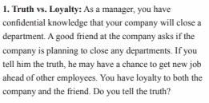
Some Ethical Challenges

Slide 9
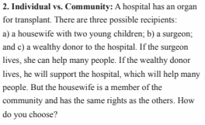
Some Ethical Challenges

Slide 10

11.10AM

Slide 11

Some Ethical Challenges

Slide 12
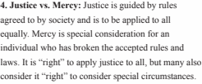
Some Ethical Challenges

Slide 13
Safeguarding Ethical Challenges
Fear of commission
Ostracising the corrupt
Healthy activism against corruption
Personal integrity
Reject unethical ethics
Conscience of and equality before the law
Protecting whistle blowers
Target unethical conduct at the top

Slide 14

ANY QUESTIONS?

Slide 15

In this session…..
We will;
Discuss the implications of operating globally for an organisation.

Slide 16
Understanding cultures
Culture and its impact on organisations and people has been an area of research for many scholars for a long period of time.
Geert Hofstede is one such scholar who’s work is considered to be the most prominent in understanding the impacts of culture.

Slide 17
Hofstede’s Dimensions of Culture
Power Distance
  Small - trusting, less formal organizations
  Large - mistrusting, hierarchical organizations
Uncertainty Avoidance
  Weak - risk is non-threatening; diversity is appreciated
  Strong - risk averse, diversity is threatening
Individualism
  Collectivist - belonging to groups ideal; group decision making
  Individualist - individual initiative and achievement; leadership is the ideal
Masculinity
  Feminine - quality of life; people and relationships come first
  Masculine - performance; money and transactions come first
Long-term orientation
  Long-term – Focused on the future
  Short-term – Focus on the present

Slide 18
Approaches to management
Kase et al. (2011) are convinced that there is a difference between the way Western and Eastern managers approach strategic problems and reach conclusions about outcomes.
Western managers use a deductive, top-down, thinking approach, i.e. draw logical consequences (outcomes) from premises (assumptions)
Eastern managers use an inductive, bottom-up, thinking approach, i.e. start with a generalisation and conclude with a particular.
BROWAEYS, M.-J., & PRICE, R. (2011). Understanding cross-cultural management. Harlow, England, Financial Times Prentice Hall.

Slide 19
Concept of Asian cultures
Two Asian clusters:
  Confucian Asia: countries that have undergone influence of Confucian ideology
  Southern Asia: countries with different religions and ethnic groups living in peaceful co-existence.
  Both clusters share similarities regarding the way relationships are managed: concern for respect and harmony.
  Doing business therefore involves establishing a good relationship.
BROWAEYS, M.-J., & PRICE, R. (2011). Understanding cross-cultural management. Harlow, England, Financial Times Prentice Hall.

Slide 20
Confucian Asia: China
  Guanxi:
  Build a strong network of relationships
  Provides information, expertise, enables new business partners and new deals
  Mianzi:
  Maintain their own dignity and with others
  Helping friends within a network with a moral and social obligation.
BROWAEYS, M.-J., & PRICE, R. (2011). Understanding cross-cultural management. Harlow, England, Financial Times Prentice Hall.

Slide 21
Confucian Asia: Japan
  Wa
  It is the spirit of harmony, applied to all relationships
  It is seen in a collaborative behaviour and concord-building in an organisation
  Reflected in mutual commitment and loyalty between company and employee
  Loyalty: individual > group > company > country.
BROWAEYS, M.-J., & PRICE, R. (2011). Understanding cross-cultural management. Harlow, England, Financial Times Prentice Hall.

Slide 22
Confucian Asia: Korea
  Chaebols
  The role of the extended family in developing a network of conglomerates
  It focus on family life and enhancement of its fortunes has influenced the rapid development of the economy
BROWAEYS, M.-J., & PRICE, R. (2011). Understanding cross-cultural management. Harlow, England, Financial Times Prentice Hall.

Slide 23
Southern Asia: India
The Indians and family
Every company employee works for the family to maintain and enhance its fortunes
Loyalty to the (extended) family takes priority over loyalty to the company
Success in your profession will give your family added status.
Being successful involves not just working long hours but also being creative
Manager has to contend with both collectivist and individualist values within a formal system of management
BROWAEYS, M.-J., & PRICE, R. (2011). Understanding cross-cultural management. Harlow, England, Financial Times Prentice Hall.

Slide 24
Southern Asia: Thailand
Thailand and karma
Thai Buddhist economic model
  Avoidance of extremes
  Create sustainable profit.
Buddhism plays dominant role: Buddhists assert personal and social responsibilities to ensure peace and serenity.
The leader is considered to have accumulated good rather than bad karma.
Leadership requires exercising personal responsibility towards the community, being its leader and servant.
Thai Buddhist economic model: creating sustainable profit.
BROWAEYS, M.-J., & PRICE, R. (2011). Understanding cross-cultural management. Harlow, England, Financial Times Prentice Hall.

Slide 25
Concept of
African and Middle East cultures
Sub-Saharan Africa
According to Shepherd Shonhiwa, the fundamental African personality traits are:
  Being non-discriminatory, not promoting prejudice,
  seeking reconciliation in politics and business.
  Having inherent trust and belief in human fairness.
  Having high standards of basic morality, based on historical precedent and bolstered by extended family system.
  Believing in a hierarchical political ideology, but based on an inclusive system of consultation.
  Perpetual optimism, mainly due to strong religious beliefs.
BROWAEYS, M.-J., & PRICE, R. (2011). Understanding cross-cultural management. Harlow, England, Financial Times Prentice Hall.

Slide 26
European cultures
Europe’s identity never clearly established culturally, politically or geographically.
Most recent development: creation of the European union (EU): common economic, socio-cultural and political bodies.
Council of Europe aims to promote fundamental values, e.g. human rights.
BROWAEYS, M.-J., & PRICE, R. (2011). Understanding cross-cultural management. Harlow, England, Financial Times Prentice Hall.

Slide 27
Western Europe
Latin Europe
Influence of Roman Empire
Highly developed bureaucracies
‘Rule-bending’ through family and personal relationships
BROWAEYS, M.-J., & PRICE, R. (2011). Understanding cross-cultural management. Harlow, England, Financial Times Prentice Hall.

Slide 28
Western Europe (Continued)
  France:
  Viking heritage: self-sufficiency, fairness, egalitarianism and democracy
  Face up to authority, question it and expect to be consulted
  Upholder of universal cultural values.
German:
  Longer term perspective when managing uncertainty
  Assertive behaviour, explicit communication
  Emphasis on results rather than relationships
BROWAEYS, M.-J., & PRICE, R. (2011). Understanding cross-cultural management. Harlow, England, Financial Times Prentice Hall.

Slide 29
American and Australasian cultures
We move from the ‘European Old World’ to the ‘New World’.
Areas where immigrants from European peoples set up home and business.
Concept examines:
  Anglo-Saxon approach to business
  The strong values of the Latin Europe as reflected in Latin America.
BROWAEYS, M.-J., & PRICE, R. (2011). Understanding cross-cultural management. Harlow, England, Financial Times Prentice Hall.

Slide 30
United States of America
  Originally 13 British colonies which would become the USA
  Constitution based on the principle of equality
  Many immigrants adopted the Protestant work ethic
  Indicator of success for US businesses is the ‘bottom-line’
  Difference between British and American businesses: the way they look at the future
The ‘new’ immigrants
  Latin American and Asian immigrants
  Recent immigrants (Mexican) are still undergoing the process of assimilation.
BROWAEYS, M.-J., & PRICE, R. (2011). Understanding cross-cultural management. Harlow, England, Financial Times Prentice Hall.

Slide 31
Canada, Australia and New Zealand
Canadians
  More a ‘mosaic’ than a ‘melting-pot’ society
  Respect for cultural diversity and cultural pluralism
  Canadian style of management contrasts to that of the USA: less formalised, less driven by individual goals, more aware of society as a whole.
Australians and New Zealanders
  Increasing cultural diversity, despite Anglo-Saxon foundations
  Business culture remains Anglo-Saxon in nature,
  but more collaborative, distrust of authority.
BROWAEYS, M.-J., & PRICE, R. (2011). Understanding cross-cultural management. Harlow, England, Financial Times Prentice Hall.

Slide 32
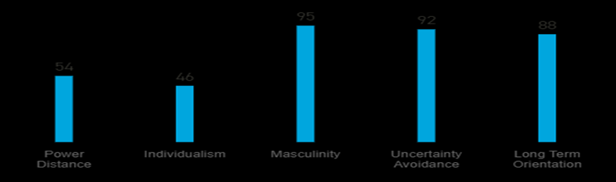
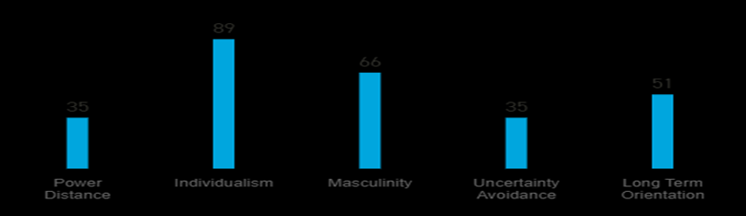
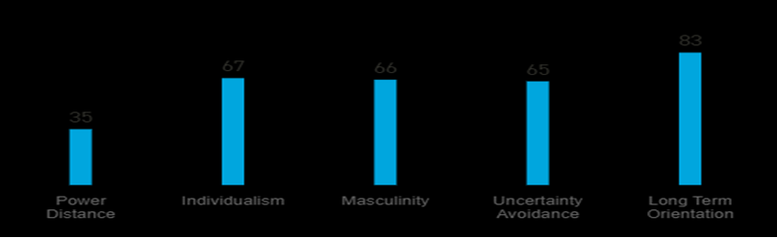
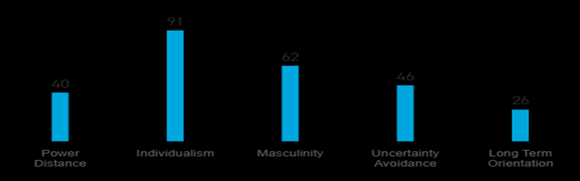
Japan
UK
Germany
USA

Slide 33
Activity
You are going to work in:
- Japan
- Germany
- USA
Predict some of the deeper and less visible cultural differences which you might encounter in the workplace

Slide 34
The impact of culture
Organisations needs to ensure there is a fit between organisational culture and the individuals. This will impact many decisions in an organisation such as;
Recruitment
Socialisation / Orientation
Training
Motivation (Rewards and remuneration)etc

Slide 35


Summary
Can you explain how international culture has an impact on an organisation?

Slide 36

Next session
Oral performance

