Slide 1
TRRS4010
Judaism & Christianity

Slide 2
Dr Angus M Slater
Lecturer in Theology & Religious Studies
Office:
Email:
Office Hours:

Slide 3
Week 10i: Christianity or Christianities?
Plurality and variety in Christian belief

Slide 4
Christianity or Christianities?
Plurality and variety in Christian belief
Christian variety
Christian conceptions of variety

Slide 5
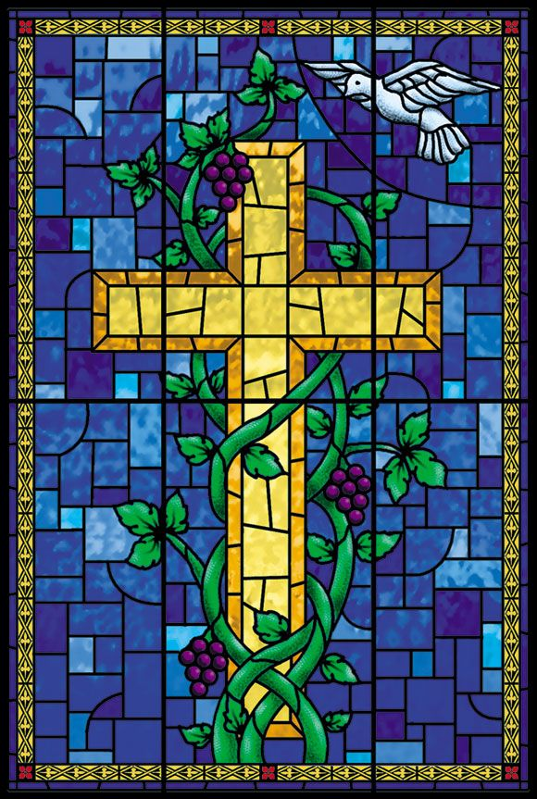
Christianity or Christianities?
Can we speak of a single Christian faith?
What varieties of Christianity exist?
Why does this matter?

Slide 6
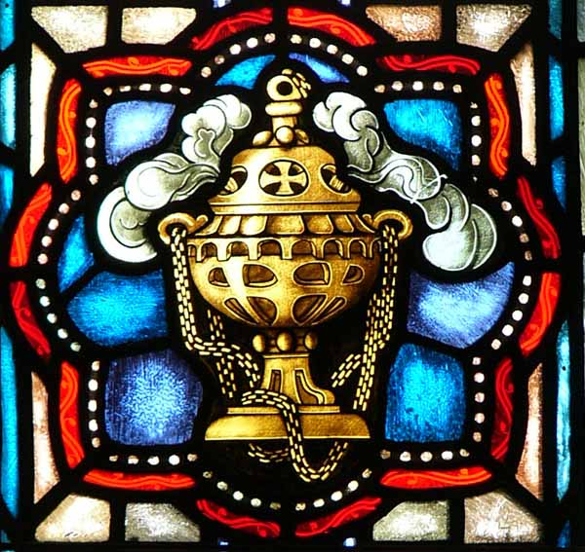
Christianity or Christianities?
What binds all of these “Christianities” together?
How do Christians conceptualise / understand this variety?

Slide 7
Christian Paradigms
Academic responses

Slide 8
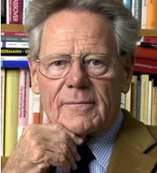
Hans Küng
‘Can one talk about “Christianity” in the singular at all? Aren’t there different Christianities - Eastern Orthodox, Roman Catholic, Reformation Protestant Christianity, not to mention the various Free Church Christianities and all the countless Christian sects and groups?’

Slide 9
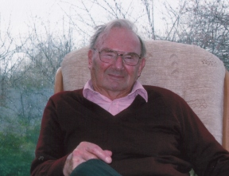
John Hick
‘the Christian tradition’rather than‘Christianity’

Slide 10
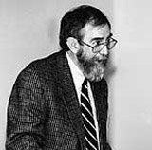
John de Gruchy
‘there are, in fact, different Christianities, and different ways in which the gospel is understood and related to the world’

Slide 11
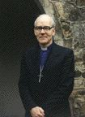
Stephen Sykes
‘is Christianity one thing, even one highly complex thing? Does not the very use of a single term, Christianity, cast an aura of spurious unity over its irreducible diachronic, and hence synchronic, pluralism?’

Slide 12
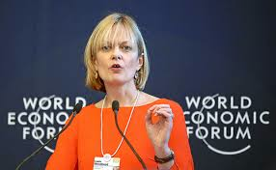
Linda Woodhead
‘The picture that emerges is of a religion with its origins in an explosion of spiritual energy … In the first centuries of Christian history it gave rise to a wide range of different spiritual groups, ideas and practices – to many different “Christianities”.’

Slide 13
Christian Paradigms
Orthodox, catholic, protestant

Slide 14
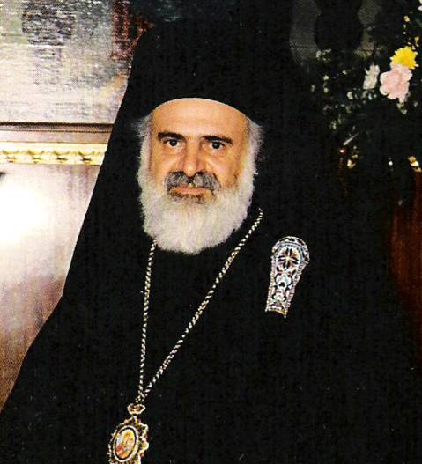
The Orthodox Paradigm
Historical continuity
Seven Ecumenical Councils
Holy Spirit proceeds from the Father
Iconology

Slide 15
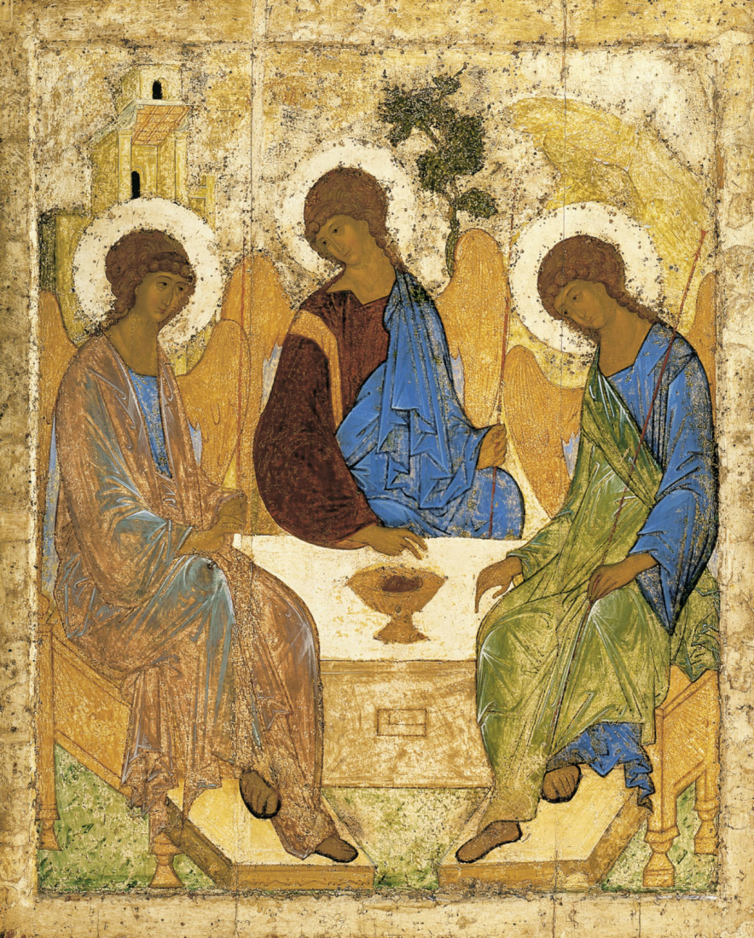
Rublev’s Trinity

Slide 16
2 basic forms
Eastern Orthodox
Russia, Eastern Europe and Greece
Basically independent in structure
‘Orthodox’ for maintaining the true faith
Oriental Orthodox
Egypt, Ethiopia, Syria, Iraq, Iran, Armenia, Kerala (India)
Only first three ecumenical councils
Monophysite – one divine nature, not two

Slide 17
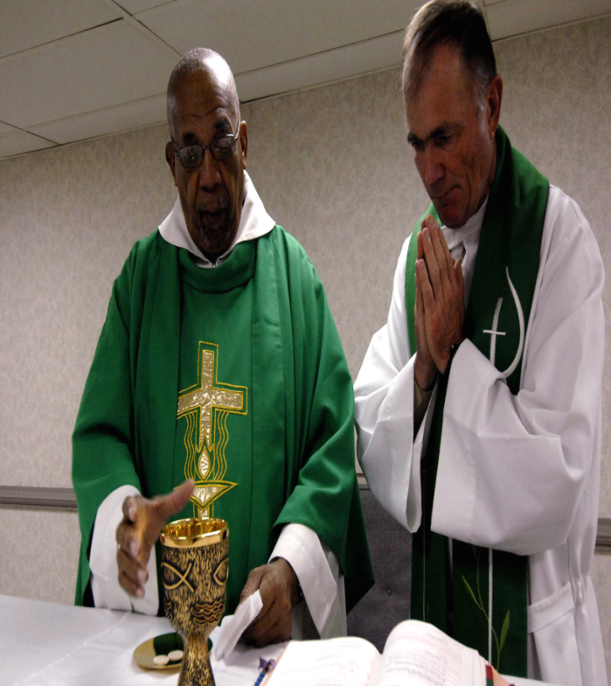
The Catholic Paradigm
Hierarchical and centralised
Teaching office of the church
Liturgy
‘Sacramental economy
’
Saints and the Virgin Mary

Slide 18
Orthodox / Catholic Differences
‘… and I tell you, you are Peter, and on this rock I will build my church, and the gates of Hades will not prevail against it’ (Matthew 16:18)
Play on words
Is it Peter, all the disciples, the confession?
1054 – Great Schism
Differences in ecclesiology, practice and theology
Place of Constantinople and the priority of Rome
Use of unleavened bread
The Spirit proceeding from the Father and the Son

Slide 19
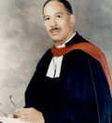
The Protestant Paradigm
Sola Scriptura
Sola Fide
Sola Gratia
Solus Christus

Slide 20
Lutheran
Reformed
Congregational
Presbyterian
Methodist
Pentecostal
Baptist
Anglican

Slide 21
Other paradigmatic distinctions

Slide 22
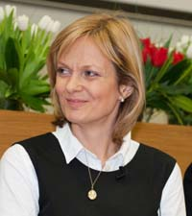
Linda Woodhead / Paul Heelas
Transcendent / Immanent distincti
Heelas and Woodhead identify three varieties of religion: Spiritualities of Life, Religions of Difference and Religions of Humanity

Slide 23
Linda Woodhead / Paul Heelas
This is an over simplification but:
• Within a Religion of Difference authority is attributed, first and foremost, not to human beings or nature but to the transcendent. Humanity is saved by a God outside rather than a god within.
• Within a Religion of Humanity great authority is attributed to humanity and the goodness of humans.
• Within a Spirituality of Life divinity is located within self and nature
Generally, Religions of Humanity are in decline whereas Spiritualities of Life and Religions of Difference are growing.
Christianity falls into both Religions of Difference and Religions of Humanity

Slide 24
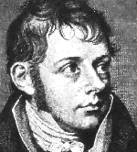
The Modernist Paradigm - Schleiermacher
On Religion: Speeches to its Cultured Despisers
Feeling rather than morality or reason
Feeling of Absolute Dependence
Religious Experience

Slide 25
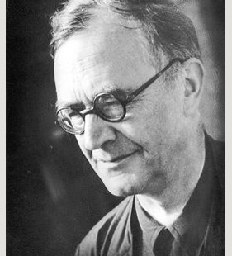
The neo-orthodox reaction - Barth
Revelation of God’s Word
Word of Scripture
Proclaimed Word

Slide 26

The Challenge of Postmodernity
No unified narrative – fragmentation
Ideological criticism – feminism
Globalization – distributive justice

Slide 27

New Paradigm / Emergent Churches
Experiential not dogmatic
Blend of ancient and contemporary
Non-denominational

Slide 28

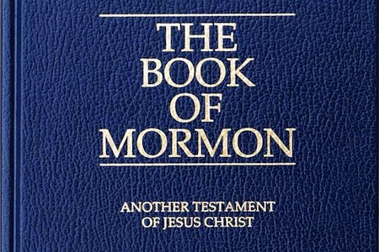

Alternatives?
Mormonism?
Scientology?
Jehovah’s Witnesses?

Slide 29
What binds it all together?
What does it take to be a Christian?
What makes someone not a Christian?
How might we draw the boundary of Christian belief?

Slide 30
Christianity or Christianities?
PLURALITY AND VARIETY IN CHRISTIAN BELIEF
Multiple Christianities

Slide 31
Next Lecture: Contemporary Christianity
Globalisation and Geographic variety in the Christian community

