Slide 1

Understanding and solving the problem of Staff shortage in Proper care
Name: Hristina Bufi
Student number:2121309
Module: BMSW Problem Solving and Decision Making
Lecturer: Chijioke D Uba

Slide 2

Introduction
1. Problem identification
2. Criteria definition
3. Causes and effects of the problem
4. Technical tools to resolve the problem.
5. Analysis

Slide 3
The nature and impact staff shortage on Proper care and its employees
Nature of the problem -staff shortages are a problem in the UK affecting the NHS and care homes. Which leads to a decrease in the quality of health services
Impact on employees and proper care- long working hours and more stress, delays in health care, long waiting lists for care homes and many other

Slide 4
Understanding the causes of staff shortage
To solve a problem, the main causes must be identified and addressed
To understand the causes of staff shortage proper, a Pestel analysis and Fishbone diagram have been used

Slide 5
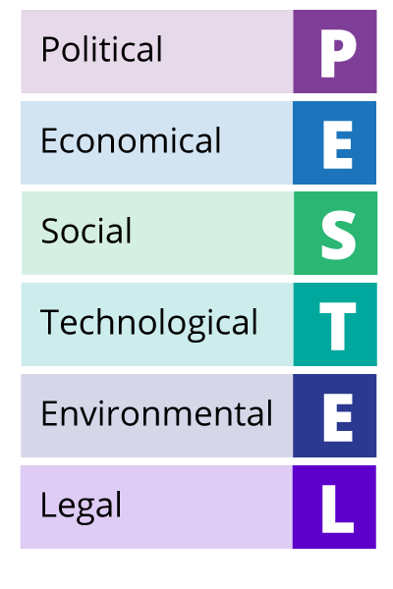
A Pestel analysis
PESTLE helps us identify the facts that led to the staff shortage.
1 political- Brexit is one of the main political factors that have led to the shortage of medical personnel
2 economical- the low pay of medical workers, which leads to disinterest in this branch
3 social-shortage of skilled workers
This Photo by Unknown Author is licensed under CC BY

Slide 6

Cause and effect analysis
After we have looked at the PESTLE analysis and determined some of the factors we will look at the FISHBONE diagram to supplement and look in more detail
This Photo by Unknown Author is licensed under CC BY

Slide 7
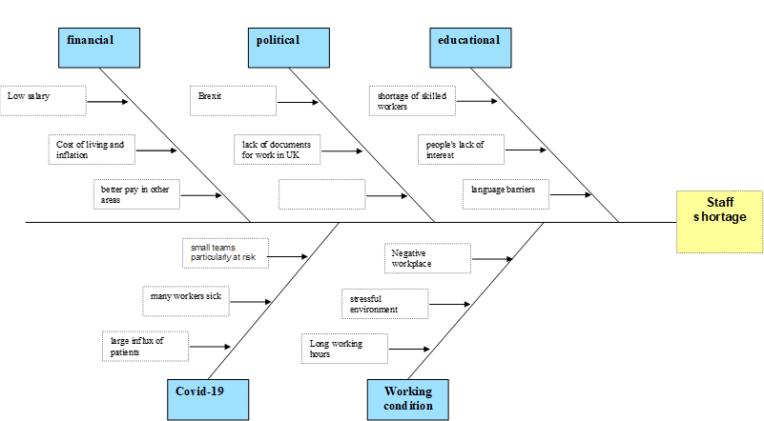
Fishbone diagram for staff shortage

Slide 8

Possible solution
Main causes identified from PESTEL and FISHBONE
LONG WORKING HOURS
SHORTAGE OF
QUALIFIED WORKERS
STRESS
LACK OF WORK
DOCUMENTS IN THE UNITED KINGDOM
LANGUAGE BARRIER
LOW WAGES
Solutions that address these cause
Motivation people to study medicine with high scholarships and various benefits
Hiring more workers by attracting their attention with higher pay
Giving qualified foreign nationals access to free language learning courses and document assistance for work

Slide 9
GRID analysis
factors | Less time | less funds | efficiency | quality | more staff | TOTAL
Value (0-5) | 5 | 3 | 2 | 3 | 5
Solution A | 1 5 | 1 3 | 3 6 | 3 9 | 1 5 | 28
Solution B | 3 15 | 1 3 | 2 4 | 1 3 | 3 15 | 40
Solution C | 2 10 | 3 9 | 2 4 | 1 3 | 1 5 | 25
The results of the evaluation using the Grid show that solution B is the most suitable to solve the problem quickly.

Slide 10

conclusion
Lack of proper care is a serious problem that affects everyone. Its results are not pleasant for any of us. Therefore, it is necessary to pay serious attention to the recruitment and retention of medical professionals. The most important thing is to value our health, and in order for someone to pay attention to us, the work of the medical staff must be well paid.

Slide 11

References
Buchan, J., Charlesworth, A., Gershlick, B. and Seccombe, I., 2017. Rising pressure: the NHS workforce challenge. Workforce Profile and Trends of the NHS in England. London: The Health Foundation.
Buchan, J., Charlesworth, A., Gershlick, B. and Seccombe, I., 2019. A critical moment: NHS staffing trends, retention and attrition. London: The Health Foundation.
Goetsch, D.L. and Davis, S.B., 1997. Introduction to total quality. Quality Function Deployment, pp.245-279.
Quirk, H., Crank, H., Carter, A., Leahy, H. and Copeland, R.J., 2018. Barriers and facilitators to implementing workplace health and wellbeing services in the NHS from the perspective of senior leaders and wellbeing practitioners: a qualitative study. BMC public health, 18(1), pp.1-14.
Yüksel, I., 2012. Developing a multi-criteria decision making model for PESTEL analysis. International Journal of Business and Management, 7(24), p.52.
This Photo by Unknown Author is licensed under CC BY

