Slide 1
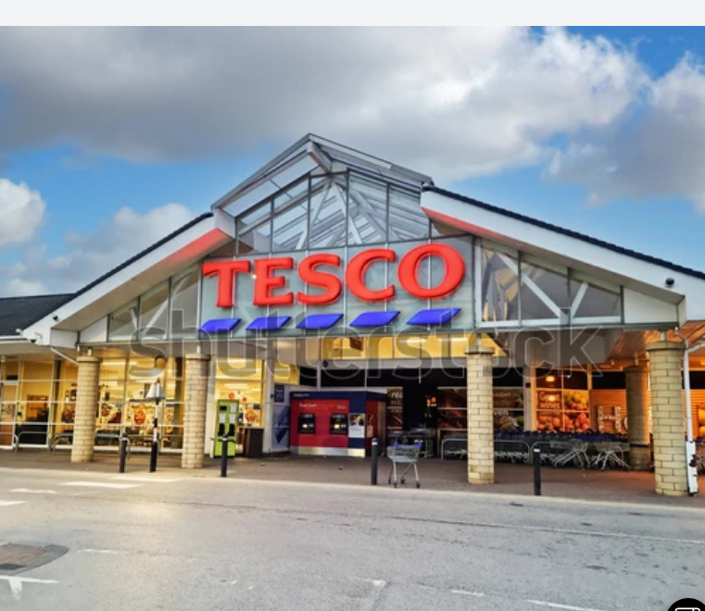
INTERNATIONAL BUSSINESS COMMUNICATIONS
Student Name: Gabriela Koleva
ID: 2115686
Lecturer name: Charles Nwaogwugwu

Slide 2
Introduction
This is a presentation to the board of directors of Tesco PLC
It aims at assessing the cultural differences between UK and German in support of Tesco PLC expansion to Germany .
Relevant intercultural communication theories will be applied to support the presentation.
Recommendations on successful opening of new management office in Germany for Tesco PLC will also be presented.
Notes:
The presentation is prepared for Tesco board of directors with an aim of ensuring the company makes a successful entry to the Germany market. To achieve this, the cultural differences between Germany and UK will be explored with the help of some intercultural communication theories.

Slide 3
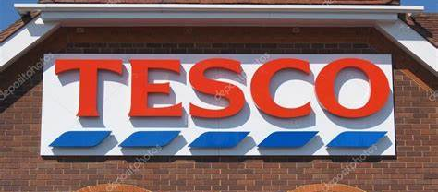
Overview of Tesco PLC
Tesco is a public limited company operating in the retail industry and founded by Jack Cohen.
Some of the regions that Tesco Plc operates in are Ireland, the United Kingdom, the Czech Republic, Hungary and Slovakia (Tesco, 2023).
Notes:
Tesco is a British multinational groceries and general merchandise retailer headquartered in Welwyn Garden City, England. In 2011, it was the third-largest retailer in the world measured by gross revenues and the ninth-largest in the world measured by revenues. It has shops in Ireland, the United Kingdom, the Czech Republic, Hungary, and Slovakia. It is the market leader of groceries in the UK (where it has a market share of around 28.4%).
Tesco has expanded globally since the early 1990s, with operations in 11 other countries in the world. The company pulled out of the US in 2013, but as of 2018 continues to see growth elsewhere.

Slide 4
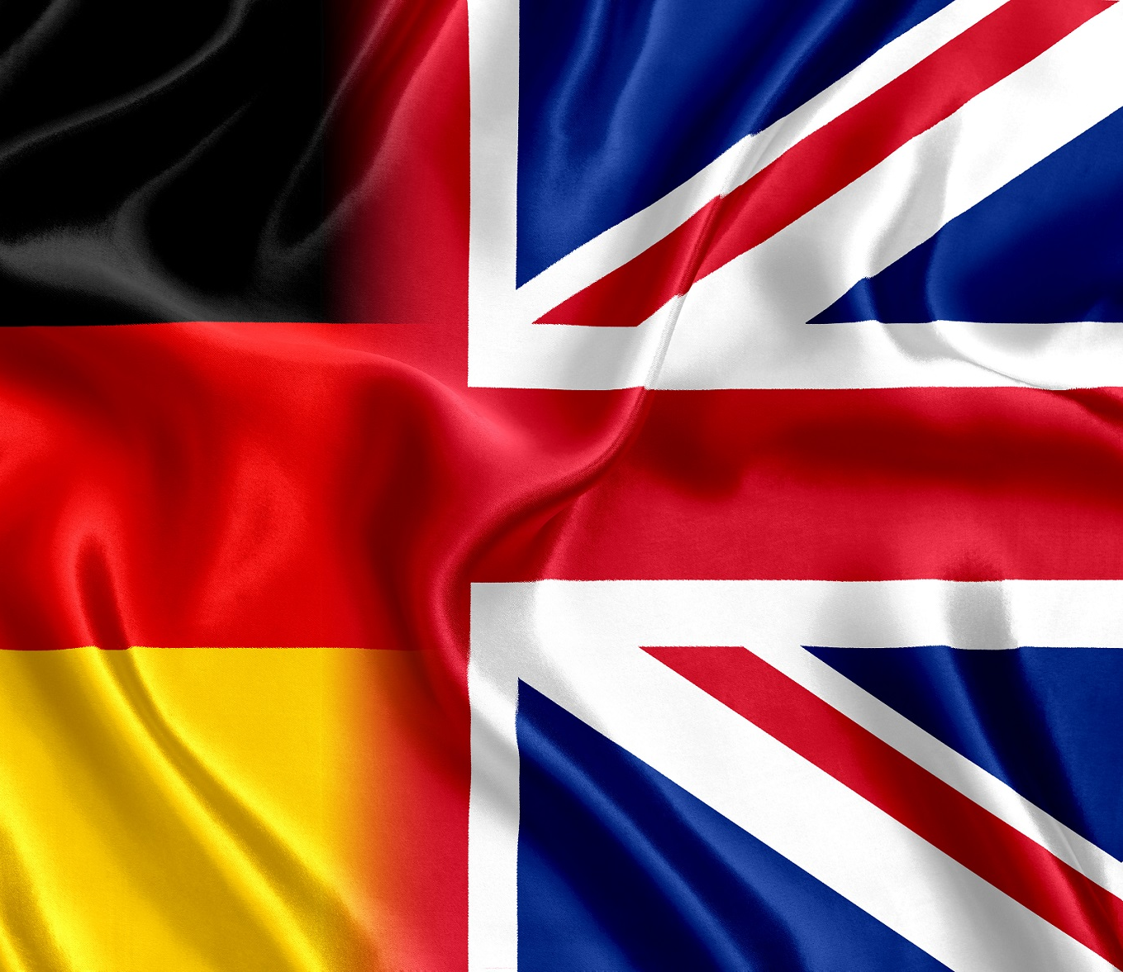
Cultural differences between the UK and Germany
For Tesco to successfully establish offices in Germany, it has to understand the cultural difference between UK and Germany.
While 98% of the people in Britain speak English, 95% of people in Germany speak deutsch and only the literate can speak English (Varul, 2019).
Language barrier may result to a misunderstanding between Tesco employees and the customers, frustrations , wasted efforts time and money.
Notes:
While in UK English is the main language, in Germany- Deutsch is the main language. There is a strong sense of national identity in Germany, built closely around the German language. Around 95% of the population speaks German, and 76% believe that this is very important for belonging. Other commonly-spoken languages include Turkish, Danish, Arabic, and Serbian. Tesco may therefore experience language barrier which may make it difficult in understanding customer needs where inaccurate information may be given hence customers not receiving the help they required.

Slide 5

Cultural differences between the UK and Germany
Ethnic make-up of the people
In UK, about 87.1% of the population is made up of White British people including the population in Northern Ireland (Schröter, 2017).
In Germany, the largest ethic group is Germans while others are Yanish people, Serbs, Romanian, and Bavarians among other ethnic groups who are small in numbers (McCarthy, 2015).
Notes:
The rest of the population in UK are made up of Black British and Afro-Caribbean, who make up for 3%, Indian who are 2.3%, and the rest are Pakistani, Bangladeshi, Chinese and others.
According to social science approach of intercultural communication, Tesco should focus on observing the different culture in both UK and Germany in order to adjust their communication and make sales (Varul, 2019).

Slide 6
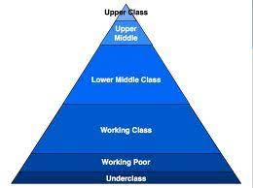
Cultural differences between the UK and Germany
Social structures.
The British system is a hierarchical structure that classify people into upper class, middle class and working class.
In Germany, the social classes also consists of the upper class who are the wealthy individuals and families holding significant influence and power in the society (Schröter, 2017).
This means that Tesco will not face a challenge in determining the type of goods to sell and the managerial and operational practices to establish in their new offices in Germany (Varul, 2019).
Both countries have the same social structures.
Notes:
The British system categorises people in regard to their education, occupation, income, and social status. The upper class consists of the elite members with high economic capital, high social capital and very high cultural capital.
They are about 6% of the British population (Schröter, 2017).
The middle class have standard living including owning a home, affording to pay for college education and have enough disposable income. They make about 25% of the UK population (Kirkcaldy, Furnham and Lynn, 2022). Working class are of basic low level unskilled or semi-skilled and live for pay-check to pay-check and very little savings.

Slide 7

Cultural differences between the UK and Germany
Religious values
About 46% of the people in UK are Christians, 37% have no religion, 6% are Muslim 2% are Hindus (McCarthy, 2015).
About 2% are either Jewish, Buddhist, Sikh or of other religions (Kirkcaldy, Furnham and Lynn, 2022).
In Germany, The south and west of the country are mostly catholic while protestants live in the north and east (Schröter, 2017).
Other religions like Islam, Judaism, Buddhism and Hinduism are not so popular in Germany.
Notes:
According to the cultural approach of intercultural communication, Tesco should consider the religious values and interactions to determine how they will relate with their customers in Germany (Schröter, 2017).

Slide 8
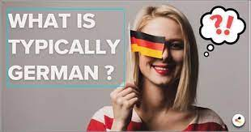
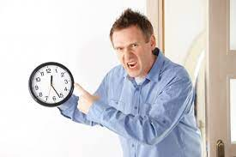
Cultural differences between the UK and Germany
Business and work related attitudes
Germans prefer more direct style of communication and do not entertain pleasantries as people do in UK.
They like to get on the point and have efficient discussion which can be confused by people from UK as being rude.
Germans are punctual unlike in UK and if one is late for work, this is considered as poor work ethics (Varul, 2019).
Businesses tend to operate under the German language unlike in UK where business is conducted in English.
Notes:
Germans also emphasis on contracts and agreements which act as the backbone of the business. In Germany, the working hours are between 36 to 40 hours a week, which is about 8 hours per day and 5 days in a week, which is similar to UK.

Slide 9
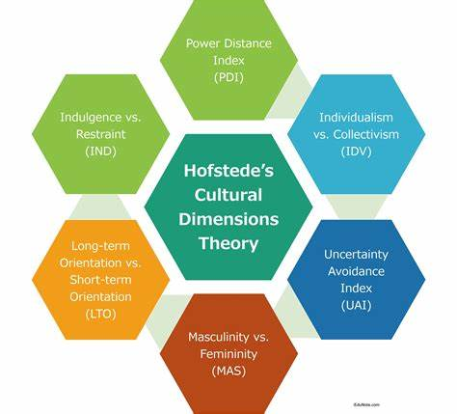
Hofstede cultural dimensions :
UK and Germany
Power distance:
Individualism
Masculinity vs. Femininity
Uncertainty avoidance index
Long-term orientation vs. short-term orientation
Indulgence vs. restraint

Slide 10
Hofstede cultural dimensions :
UK and Germany
Power distance is the first cultural dimension to consider. In the context of Tesco, power distance refers to the extent to which authority and decision-making are centralized or decentralized within the organization. In the United Kingdom, the power distance is relatively low, meaning there is a belief in equality and a preference for decentralized decision-making. Tesco UK, therefore, promotes a more participatory management style, where employees are encouraged to contribute ideas and suggestions. In contrast, Germany has a higher power distance, emphasizing hierarchical structures and centralized decision-making. As a result, Tesco Germany follows a more top-down approach, with decisions being made by senior management.
individualism, focuses on the degree to which individuals prioritize their personal goals over group goals. The United Kingdom is known for its individualistic culture, valuing independence and personal achievements. Tesco UK promotes individual initiative and performance-based rewards to motivate its employees. On the other hand, Germany tends to be more collectivist, emphasizing the importance of group harmony and cooperation. Tesco Germany, therefore, places greater emphasis on teamwork and collaborative decision-making, fostering a sense of community among its employees.
The cultural dimension of masculinity refers to the extent to which a society values competitiveness, assertiveness, and material success. In the United Kingdom, there is a higher emphasis on masculinity, with a focus on individual achievement and career progression. Tesco UK rewards employees based on their performance, encouraging a competitive environment. In contrast, Germany has a more feminine culture, emphasizing cooperation, modesty, and work-life balance. Tesco Germany promotes a more collaborative and supportive work environment, valuing team achievements over individual success.

Slide 11
Hofstede cultural dimensions :
UK and Germany
Uncertainty avoidance is another dimension that plays a significant role in shaping organizational cultures. It refers to the extent to which a society feels threatened by ambiguity and uncertainty. The United Kingdom has a relatively low uncertainty avoidance, allowing for flexibility, adaptability, and risk-taking. Tesco UK encourages innovation and experimentation, enabling the organization to quickly respond to changing market demands. Germany, on the other hand, has a higher uncertainty avoidance, valuing stability, rules, and regulations. Tesco Germany follows well-defined processes and procedures, prioritizing stability over risk-taking.
The dimension of long-term orientation focuses on a society's time horizon and its focus on either short-term or long-term goals. The United Kingdom leans towards a short-term orientation, emphasizing immediate results and profitability. Tesco UK employs strategies aimed at short-term gains, such as promotional offers and discounts. In contrast, Germany has a long-term orientation, valuing sustainability, quality, and long-term relationships. Tesco Germany focuses on building strong customer loyalty and maintaining high-quality standards to ensure long-term success.
The dimension of indulgence examines the extent to which a society allows for gratification of basic human desires. The United Kingdom is considered more indulgent, valuing leisure, enjoyment, and self-expression. Tesco UK caters to diverse customer preferences and promotes a wide range of products to satisfy individual desires. In contrast, Germany has a more restrained culture, prioritizing self-discipline, and strict adherence to rules. Tesco Germany focuses on providing reliable and consistent products, aligning with the cultural preference for discipline and moderation.

Slide 12

Recommendations
Tesco has to ensure that it has done a thorough planning and preparation before entering the German market.
This is because the German people do not appreciate sudden changes.
The senior executives that will be managing Tesco offices in Germany should have prior knowledge of German business culture .
Notes:
Tesco should consider their customer service approach as German consumers do not like to be guided intrusively when purchasing their products
Tesco should ensure it complies with the rules and regulations of the Germany’s highly regulated retail market.

Slide 13

Conclusion
When joining a new market, it is important to determine their culture for the company to have a successful entry.
Some of the factors to consider in international communication include the country’s ethics, social structures, religious values, and business and work related attitudes.
Notes:
Although there are some similarities between the UK and the German culture, some differences like the business language used in the country have to be considered.
It is important for Tesco to make the right preparation and planning to make a successful entry in German.

Slide 14

References
Brodbeck, F. C., and Frese, M. (2017). Societal culture and leaders
Deißinger, T. (2018). Cultural patterns underlying apprenticeship: Germany and the UK.
Kirkcaldy, B. D., Furnham, A. F., and Lynn, R. A. (2022). National differences in work attitudes between the UK and Germany. European Work and Organizational Psychologist, 2(2), 81-102.
McCarthy, G. (2015). Leadership practices in German and UK organisations. Journal of European Industrial Training, 29(3), 217-234.
Schröter, E. (2017). Chapter 12 Deconstructing Administrative Culture: Exploring the Relationship Between Cultural Patterns and Public Sector Change in the UK and Germany. In Cultural aspects of public management reform (pp. 299-322). Emerald Group Publishing Limited.
Tesco (2023). Tesco. Online. Available at: https://www.tescoplc.com/ Accessed by:[7th November 2023]
Varul, M. Z. (2019). Ethical selving in cultural contexts: Fairtrade consumption as an everyday ethical practice in the UK and Germany. International Journal of Consumer Studies, 33(2), 183-189.

Slide 15


