Slide 1
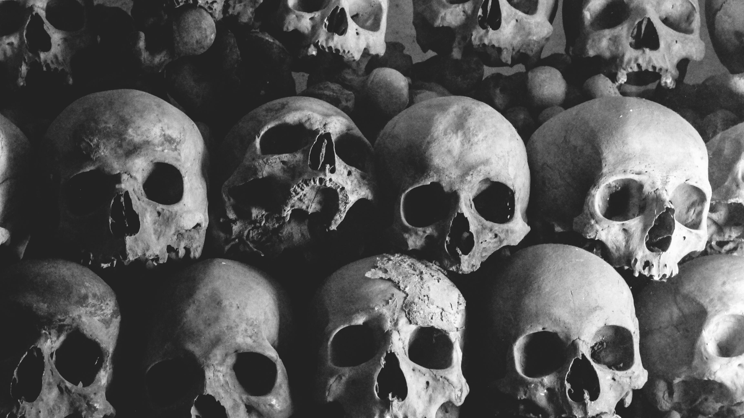
Sedlec Ossuary
A discussion on agency of the dead
Aria Anderson

Slide 2
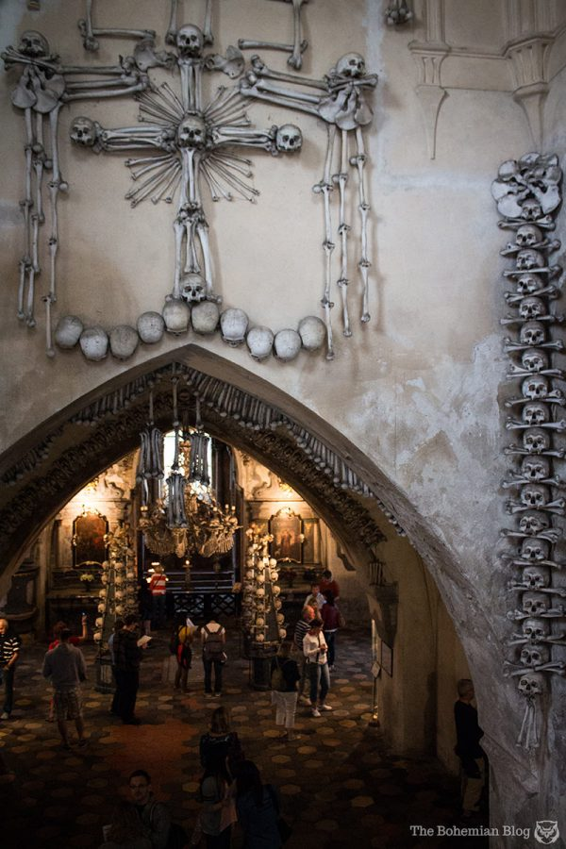
Dark Tourism
The act of travelling to sites associated with death, suffering and the macabre (Sharpley and Stone, 2009, p.10)
Whilst this area of study is new, the phenomenon itself is not (2009, p.4)
Academic focus on the ethics of presenting sites and objects related to death and suffering (2009, p.8)

Slide 3
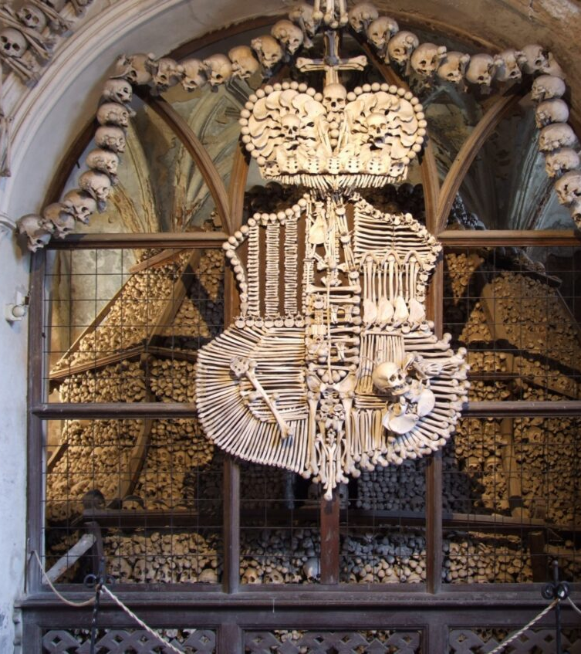
The Ossuary
The Ossuary is decorated from the bones of thousands of people (Horák et al., 2022, p.281)
Woodcarver František Rint is credited for displaying the bones in a decorative manner (p.282)
He famously recreated the Schwarzenberg family’s coat of arm using bones (p.283)

Slide 4
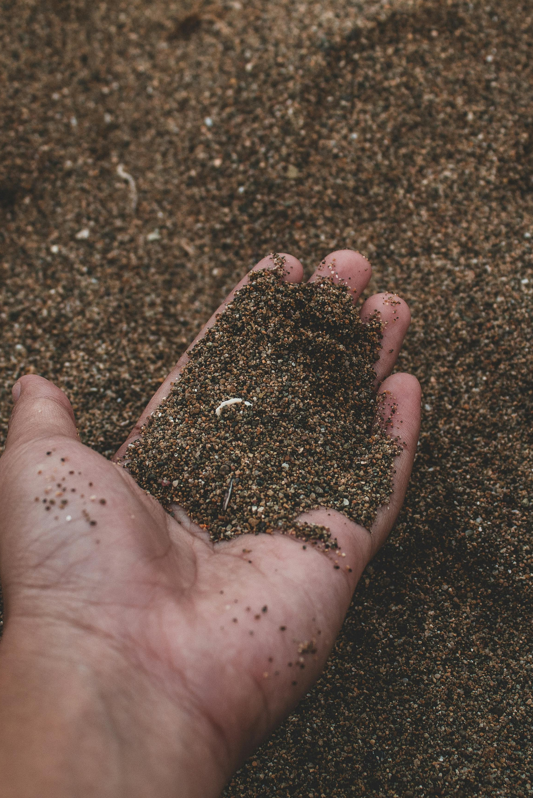
The Legend of the Holy Soil
Legend says soil was holy and could disintegrate fresh corpses within 24 hours (Horák et al., 2022, p.279)
Abbot Heidenreich brought back soil from Israel and combined it with the soil at Sedlec
Word got out and the cemetery became a popular burial site amongst outsiders

Slide 5
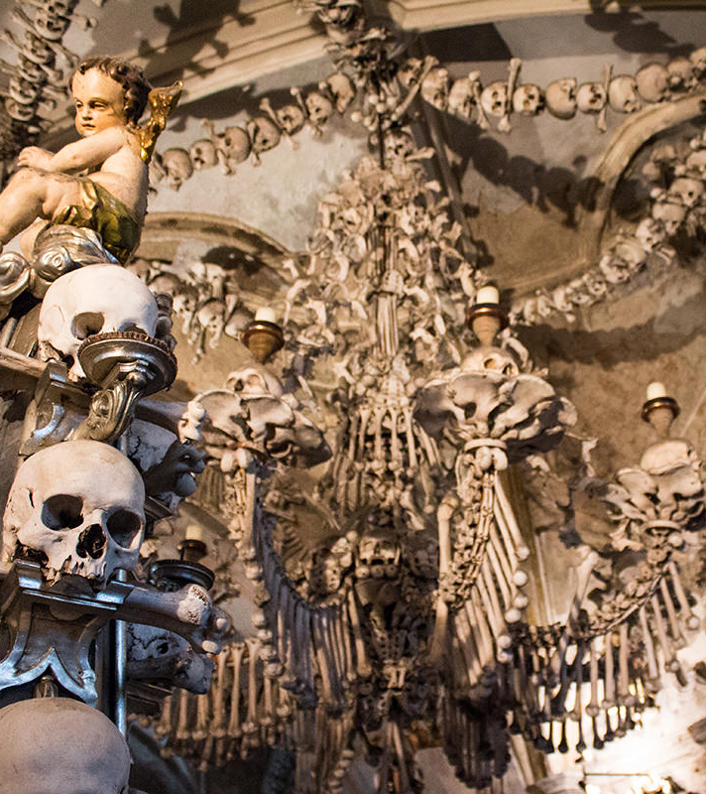
More Myths & Legends
Legend states the bones were first arranged in a decorative order by a blind monk (Horák et al., 2022, p.284)
All bones from the Holy Field were free of sin and could cast malevolent or benevolent acts
Such stories clearly attribute power and agency to the bones

Slide 6
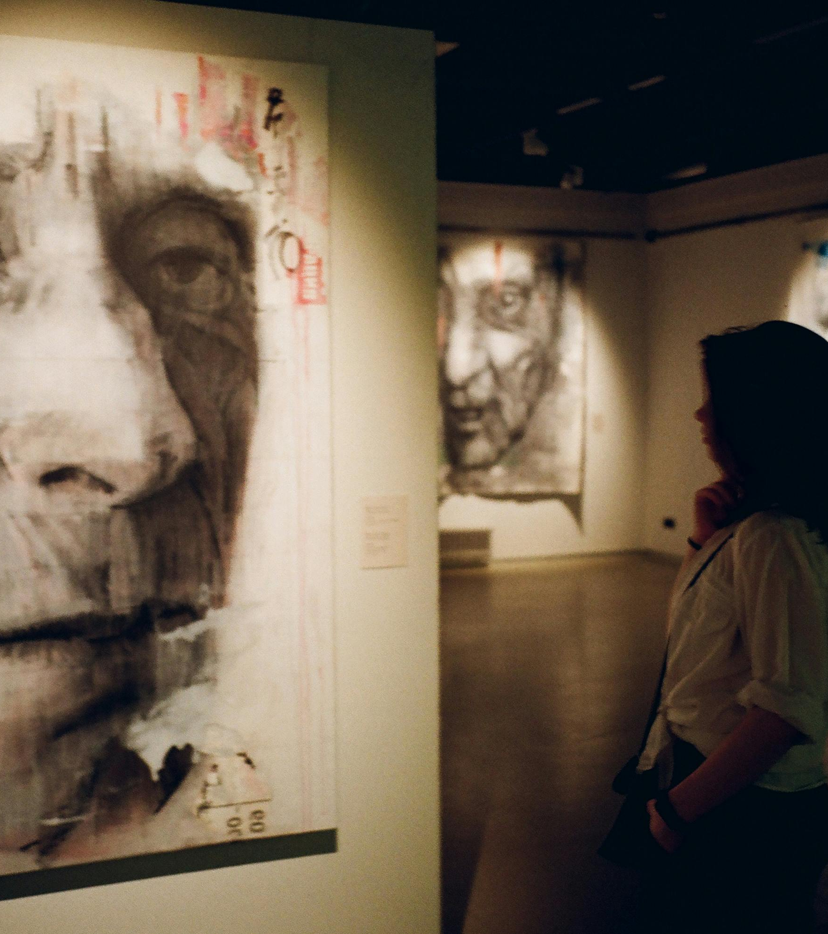
Object Agency
Object agency examines how objects influence us rather than presume that humans influence objects (Tung, 2014, p.441)
Art objects are social agents which mediate social relations (Gell, 1998, p.20)
Agency only becomes visible through its effects

Slide 7
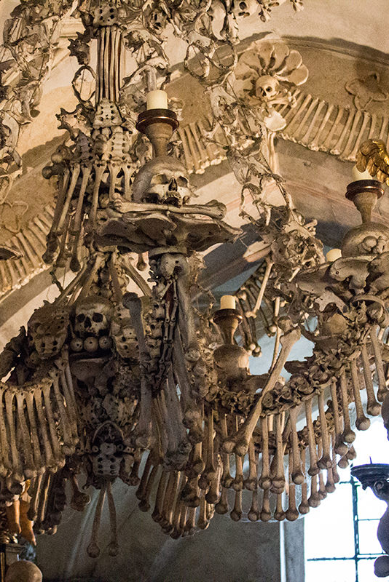
Primary & Secondary Agency
“Are dead-body-objects inherently different from other objects?” - Tung (2014, p.449)
Body parts differ from other inanimate objects in that they once were part of a living, sentient being
Acts of secondary agency are dependent on interaction (2014, p.442)

Slide 8
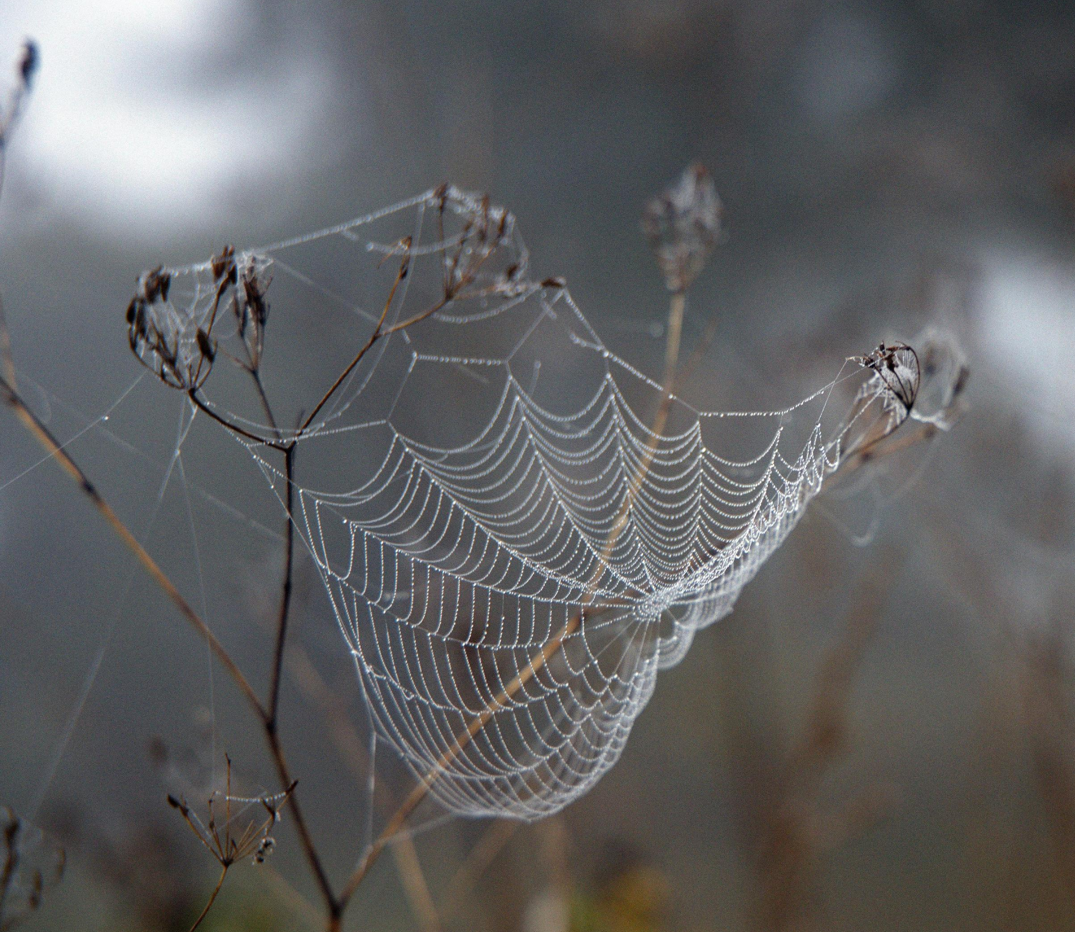
Actor Network Theory
Everything is connected through networks through which actors interact (Ren et al., 2023, p.1298)
Actors include human and non-human entities
No action is performed in isolation – thus all actors are given equal status

Slide 9
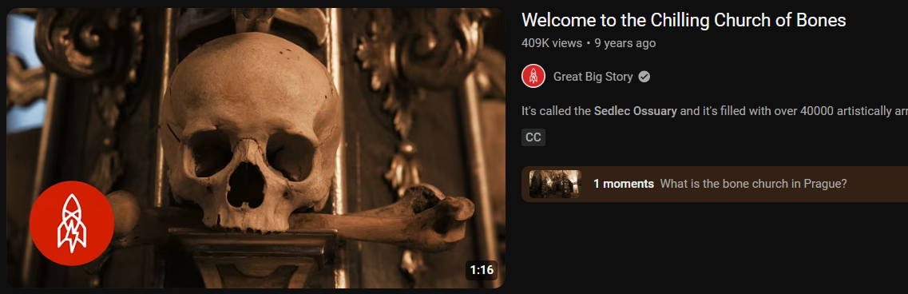

Slide 10
Myths and legends attribute agency to the bones
According to Gell, agency of the bones becomes visible through their effects and influence on the world around them
As beings of secondary agency, their agency is dependent on interaction
For Latour, all human and non-human beings are equal in terms of agency as they interact equally within a network
The bones mediate interaction between the living and the dead
Conclusion

Slide 11
Gell, A. (1998) Art and Agency: An Anthropological Theory. Oxford, UNITED KINGDOM: Oxford University Press, Incorporated. Available at: http://ebookcentral.proquest.com/lib/trinity/detail.action?docID=5746790 (Accessed: 11 March 2025).
Horák, J. et al. (2022) ‘The Cemetery and Ossuary at Sedlec near Kutná Hora: Refections on the Agency of the Dead’, in Interdisciplinary Explorations of Postmortem Interaction: Dead Bodies, Funerary Objects, and Burial Spaces Through Texts and Time. Springer.
Ren, C., Jóhannesson, G.T. and van der Duim, R. (2023) ‘Tracing tourism with Bruno Latour: actor-network theory, critical proximity and down to earth’, Tourism Geographies, 25(5), pp. 1297–1302. Available at: https://doi.org/10.1080/14616688.2023.2222696.
Sharpley, R. and Stone, P.R. (eds) (2009) The Darker Side of Travel: The Theory and Practice of Dark Tourism. Bristol: Channel View (Aspects of Tourism, v. 41).
Tung, T.A. (2014) ‘Agency, ‘Til Death Do Us Part? Inquiring about the Agency of Dead Bodies from the Ancient Andes’, Cambridge Archaeological Journal, 24(3), pp. 437–452. Available at: https://doi.org/10.1017/S0959774314000614.
Walter, T. (2009) ‘Dark Tourism: Mediating Between the Dead and the Living’, in R. Sharpley and P.R. Stone (eds) The Darker Side of Travel: The Theory and Practice of Dark Tourism. Channel View Publications, pp. 39–55. Available at: https://doi.org/10.21832/9781845411169-004.
Bibliography

Slide 12
Drozda, K. (2024) Spiderweb. Available at: https://www.pexels.com/photo/nastrazeno-28260188/
Ex Utopia. (2014) Selection of images of the Sedlec Ossuary. Available at: https://www.exutopia.com/bone-churches-of-bohemia-the-sedlec-ossuary-at-kutna-hora/
Hueb, F. (2014) Pile of human skulls. Available at: https://www.pexels.com/photo/pile-of-human-skulls-2747893/
Muffin Creatives. (2019) Close-up photo of person holding sand. Available at: https://www.pexels.com/photo/close-up-photo-of-person-holding-sand-2203683/
Sannikova, D. (2019) Woman standing in front of man’s painting. Available at: https://www.pexels.com/photo/woman-standing-in-front-of-man-s-painting-2121666/
Sedlec Ossuary. (2025) Schwarzenberg coat of arms. Available at: https://sedlecossuary.com/
Images

