Slide 1

GROUP PRESENTATION
CASE STUDY - POLIOMYELITIS
Assessment 1: Group Presentation: Group Number 2.
Module Name: Introduction to Public Health
Module Number: LCHS4008
Lecturer Name: Shepherd Ziko

Slide 2
Group2 Members
Student Name | Student Number
Gillian Gibbs | 2508019
Kausar Sultan | 2513140
Annette Dixon | 2511146
Oksana Tulba | 2513894

Slide 3
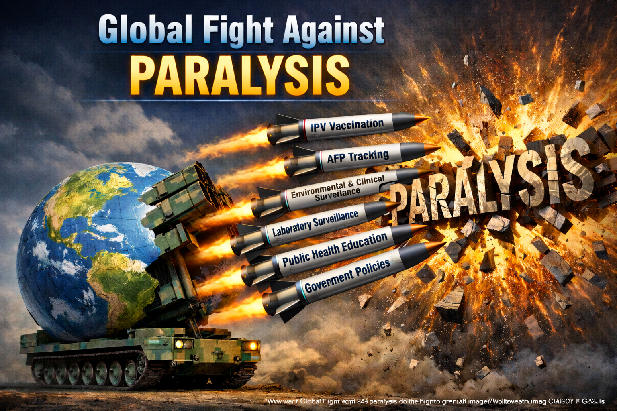
Figure 1: Global fight against paralysis (AI-generated image) (OpenAI, 2026).

Slide 4

CONTENTs
• The main approaches and strategies that could be used to measure the Poliomyelitis outbreak caused by the ‘circulating’ vaccine-derived type 2 poliovirus (VDPV2).
• The main approaches and strategies that could be used to monitor the Poliomyelitis outbreak caused by the ’circulating’ vaccine-derived type 2 poliovirus(VDPV2).
• The main approaches and strategies that could be used to control the Poliomyelitis outbreak caused by the ’circulating vaccine type 2 poliovirus (VDPV2).
• Policy and strategies are available to the UK government to maintain public health regarding Poliomyelitis
Health Education to be provided for the neighbourhood to prevent the outbreak of Poliomyelitis

Slide 5
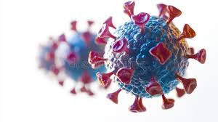
INTRODUCTION
As an integral aspect of the United Kingdom’s (UK) obligation to the World Health Organisation (WHO) universal elimination campaign, a routine environmental investigation was conducted by the National Institute for Biological Standards and Control(NIBSC) in February 2022 at the Northeast London, Beckton sewage plant. Vaccine-derived poliovirus type 2 (VDPV2) was identified. Subsequent analysis revealed new variant strains, indicating community transmission by individuals who received the oral vaccine (OPV), bringing the disease from overseas(carriers). Sequentially spreading the disease by means of faecal shedding (United Kingdom Health Security Agency(UKHSA),2023).

Slide 6
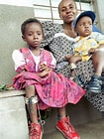
WHAT IS POLIOMYELITIS?
Poliomyelitis is an extremely contagious reportable viral disease.
Managed under strict international and national regulatory frameworks.
Non-age-specific. Predominantly affecting children under the age of five years.
Transmitted primarily orofecally, and through ingesting contaminated food and water, associated with unsanitary conditions, infrequently via air-droplets by coughing and sneezing.
Poliovirus can replicate in the gastrointestinal tract for 3-6 weeks following contact with an infectious person. Most infected individuals are asymptomatic, while others may present with fever, lethargy, sore throat, neck stiffness, vomiting, and muscle pain in extremities.
Potentially life-threatening, particularly if the brain and spinal cord are infected, progressing not only to permanent or temporary limb paralysis (Acute Flaccid Paralysis or AFP and Acute Flaccid Myelitis or AFM), exacerbating within 10days, resulting in neuromuscular respiratory failure.
(WHO, 2025)

Slide 7
POLIOMYELITIS (POLIO)
AETIOLOGY
The wild poliovirus (WPV) inherently causes polio.
Three known WPV species – WPV, WPV2 and WPV3.
WPV2 and WPV3 were confirmed eliminated, with the final virus identified in India in 1999 and 2019, respectively.
WPV remains endemic in Pakistan and Afghanistan.
Mutated species such as VDPV2 also cause polio.
VDPV2 is the species of the weakened poliovirus from the oral polio vaccine, often indistinguishable from WPV, with a great risk to partially vaccinated and unvaccinated individuals.
( Global Polio Eradication Initiative(GPEI), 2023).

Slide 8
POLIOMYELITIS BURDEN
Incidence, Prevalence and Severity Metrics.
During the 2022 London outbreak of vaccine-derived poliovirus strain 2, no human cases of AFP occurred despite positive faecal specimens during environmental testing (WHO, 2022).
The incidence of wild poliovirus has plummeted by more than 90% across more than 125 endemic countries globally since 1988, falling from approximately 350,000 to 2 endemic countries (WHO, 2025).
Prevalence Rate: From January 2023 to June 2024, 70 vaccine-derived poliovirus strain 2 outbreaks occurred in 38 countries, with 532 AFP cases confirmed in 26 countries (CDC, 2024).
Morbidity: 1in 200 infected cases progresses to permanent paralysis (WHO, 2025).
Fatality density: 5-10% of paralysed cases suffer respiratory failure(WHO, 2025).

Slide 9
The Strategies and Approaches that could be used to Measure Poliomyelitis caused by cVDPV2.
Measuring Poliomyelitis caused by cVDPV2 is carried out through an integrated surveillance system coordinated by the UKHSA in collaboration with the WHO Polio Global Specialised Laboratory at the Medicines and Healthcare products Regulatory Agency (MHRA), enabling early detection of the circulating poliovirus, assessing immunisation coverage, and expediting response to potential outbreaks.
Measurement strategies denote the procedures used to detect, diagnose and calculate the incidence and prevalence of the cVDPV2 poliovirus within a population and region over a specific timeframe.
1. AFP Tracking is the fundamental technique used to identify children under 15 years old. Susceptible to a sudden onset of neuromuscular incapacity.
2. Environmental Assessment and Analysis of Wastewater Systems is key to determining covert distribution of the virus in localities. Alerting the need for robust surveillance and vaccination efforts.
Involving the collection of raw sewage specimens from varied locations and analysis for enteroviruses, including the poliovirus. Tests are conducted over weeks and months to detect the
poliovirus (UKHSA, 2026).

Slide 10
Strategies and Approaches that could be used to Measure Poliomyelitis caused by cVDPV2.
3. CLINICAL SURVEILLANCE OF PARALYSIS CASES:-
As per Schedule 1 of the Health Protection(Reportable)Legislation 2010
All clinicians are mandated to notify the local Health Protection Team via telephone on the same day or the next business day.
Report all AFP/ AFM, alongside all unexplained AFP/ AFM non-contagious cases, enabling early detection of polio infection, rapid response to limit spread, transmission and inform outbreak management.
Moreover, doctors must report concerns to the local Virologist or Microbiologist. Forward them the stool specimens within the first forty -eight hours, along with nasopharyngeal exudate and CSF if gathered.
Furthermore, an enhanced survey form must be completed and emailed to the UKHSA’s designated email address.

Slide 11

Measurement Strategies and Approaches that could be used to Measure Poliomyelitis caused by cVDPV2.
4. LABORATORY SURVEILLANCE and GENETIC SEQUENCING
The National Health Service(NHS), local or regional Biolaboratories, private enterprises, and
UKHSA specialist laboratories are legally bound to report the recognition of all enteroviruses to the Enteric Virus Unit(EVU).
Biolaboratories must establish standards of operation for the secure collection of
faecal, throat or CSF specimens from suspected AFP/ AFM unexplained by non-communicable causative agents.
All specimens collected must be expeditiously transported to the UKHSA Virus Reference
Department for further analysis.
Advanced molecular techniques, including genetic sequencing, are used to isolate the specific strain
WPW or cVDPV2.
Genetic sequencing analysis helps health authorities trace the source, emergence and monitor potential transmission chains.
(UKHSA, 2022; WHO, 2023)

Slide 12
The Main Strategies and Approaches Used to Monitor Polio Caused by ‘circulating’ Vaccine Derived Strain 2 (VDPV2) .
Incorporates the ongoing, rigorous critical auditing of surveying data.
Spotting or pinpointing patterns or trajectories of the pathogen dissemination incrementally.
Identifying and measuring population immunisation uptake.
High-risk area mapping – tracking positive wastewater sites. Allowing identification of geographical hotspots and the extent of potential community transmission.
Localities are selected on specific criteria, for example, areas with low vaccine uptake for the childhood vaccination programme and areas known to be high risk of importation from endemic WPV1 or VDPV countries, where OPV is currently used.
Allowing government public health agencies to detect outbreaks early and establish the efficacy or ineffectiveness of interventions used in decreasing the spread of the poliovirus.
(Centre for Disease Control and Prevention (CDC), 2023).

Slide 13
Key Elements of the Monitoring
Strategies.
Monitoring or surveillance means continuously watching for the virus in the population to understand if it is:
Spreading, disappearing or changing(mutating) or safely controlled
Health agencies track this report to respond quickly if polio starts to recur, to stop outbreaks promptly
Methodology:-
After the poliovirus is detected, the UKHSA takes several steps:
1. Increase frequency of testing, for example, testing wastewater every two weeks instead of monthly.
2. Collect more samples in the affected areas.
3. Expand monitoring to the nearby or high-risk regions.

Slide 14
Key Elements of the Monitoring
Strategies.
4. Childhood Vaccination Evaluation
The UKHSA extracts data from NHS Childhood Immunisation Digital Records (NHS Digital Strategic Data Collection Service(SDCS).
Cover of Vaccination Evaluation Rapidly(COVER)Monitoring the number of eligible children vaccinated with polio-containing vaccines( 6-in-1, 4-in-1, and Teenage Boosters by certain ages (12monthths, 24months and 5years).
Targeted Surveillance: During the 2022 London incident, NHS England and UKHSA monitored the uptake of IPV among children aged 1-9 years in London General Practitioner (GP)practices.
Active Call-Recall: After the detection of vaccine-derived strain 2 in the sewage specimens in 2022, the UKHSA collaborated with NHS teams in conducting active call-recall measures for unimmunised or partially vaccinated children less than 5years old since June 2022 within the vulnerable London boroughs
(UKHSA, 2025).

Slide 15
The Main Strategies and Approaches Used to Control Poliomyelitis Caused by the ‘circulating’ VDPV2.
Control measures comprise the launch or roll-out of the functional system, or policies required to break the chain and spread and the elimination of the poliovirus following its detection.
The most preferred and paramount protection or solution is national and universal systematic inoculation drives targeting the priority populations or most susceptible groups of people.
Emergency response crusade or incident management. Involves tightening and enhancing scrutiny measures. Advertise, lobby and advocate for the worldwide annihilation of poliomyelitis.
(Global Polio Eradication Initiative (GPEI), 2023).

Slide 16
Key Elements of Control Strategies.
Public Health Measures developed to control the spread of poliomyelitis include:- ‘Mop Up and Catch -Up Crusades’.
Risk Assessment of the high-risk populations and regions to identify the demand and supply ratio strategies to be implemented.
Promote IPV as the ultimate control strategy and stop virus transmission. Reiterating that the most immediate priority is to ensure all eligible individuals are up to date with their vaccinations.
Given that the vaccination uptake for the 3-dose primary schedule in 1-year-olds in London, alongside the pre-school booster in 5-year-olds, is significantly less than the optimal target of the WHO(95% target) . The IPV Booster campaign should also be implemented, targeting resident children aged 1-9 years in London to prevent paralysis caused by poliovirus and suppress the transmission of VDPV2 in communities.
Mass immunisation campaigns: aim to vaccinate large numbers of children, especially those under 5 years old, in a short period. The goal is to achieve a Polio-Free world.
WHO and the GPEI collaborate with governments to expand vaccination coverage, reaching children in remote or hard-to-access areas.

Slide 17
Key Elements of Control Strategies
Additionally, evaluating disease surveillance: Health services track cases of acute paralysis in children as an early indicator of poliovirus infection.
Multiagency response focusing on expanded wastewater testing and analysis, targeted booster immunisations for children, and heightened clinical reporting to control disease spread.
National Incident Management involves all the aforementioned approaches, including measurement, monitoring and controlling. There is a collaboration of national, regional and international partners, including WHO and UKHSA, for resources and support.
Poliovirus is transmitted via the orofecal route. Therefore, improved sanitation and hygiene practices are crucial for reducing transmissions.
Access and availability of safe drinking water, effective waste disposal, and regular handwashing all help limit infection.
Public Health Education: Inform stakeholders, including healthcare providers, communities, and travellers, about risks and response measures.
(CDC, 2023; 2024;GPEI(2024);WHO, 2024).

Slide 18
POLICY AND STRATEGIES ARE AVAILABLE TO THE uk government to maintain public HEALTH
Health Protection & The NHS Long Term Plan
Health Promotion & Digital Innovation
Recommendations for Public Health Policy

Slide 19
Health Protection & The NHS Long Term Plan
Strategic Alignment and Surveillance Mandates
The NHS Long Term Plan (LTP): The NHS Long Term Plan (LTP) outlines a shift from a reactive "sick care" model to proactive prevention. This means prioritizing the 6-in-1 vaccine to maintain high immunity and close the gap in health inequalities across the country.
The ‘Gold Standard’ of Detection: Monitoring Acute Flaccid Paralysis (AFP) is our early warning system. Since 99% of polio infections show no symptoms, every AFP case is a critical signal that the virus could be circulating silently.
New Legal Requirements (April 2025): From April 2025, AFP becomes a statutory notifiable disease in England. This legally requires clinicians to report cases immediately to the UKHSA, ensuring no potential case is missed.
Better Local Action: Integrated Care Boards (ICBs) have been given the authority to run local vaccination campaigns. The ‘Every Contact Counts’ approach ensures that a child’s vaccination status is checked at every healthcare visit, especially in areas with low uptake.

Slide 20
Health Promotion & Digital Innovation
Environmental Monitoring and Tech-Driven Engagement
Environmental Monitoring: Expanding the sewage testing network to 26 key sites across England. This allows us to catch the virus in wastewater long before clinical symptoms appear, building on lessons from the 2022-2024 London incident.
Faster Lab Results: We are now using Nanopore Sequencing (DDNS), which can identify polio strains within a few days rather than weeks. Faster detection enables health teams to respond quickly and prevent further virus spread.
Community-Led Outreach: Public health messaging has shifted from "one-size-fits-all" to community-focused engagement. Local teams collaborate with communities to identify social and economic barriers, build trust, and improve equitable access to vaccines.
Smart Digital Health: Using Digital Child Health Records to automate ‘call and recall’ alerts, making sure no child misses their scheduled vaccinations. Updating the NHS App to provide parents with clear, evidence-based info to help reduce vaccine hesitancy.

Slide 21
Recommendations for Public Health Policy
Strategic Priorities for Sustaining Polio-Free Status
Mandatory Clinical Training: We must introduce mandatory training (CPD) on the new 2025 notification laws. This ensures every clinician knows exactly when and how to report AFP cases, meeting essential WHO safety standards.
Targeted Funding for ICBs: Policy makers should provide "ring-fenced" budgets for Integrated Care Boards. This allows local teams to tackle health inequalities by designing vaccination programs that work for their specific communities.
Stronger Early-Warning Systems: Turning sewage monitoring into a permanent partnership between UKHSA and water companies. This creates a reliable, long-term safety net for the entire country.
Closing the Vaccination Gap: Using smart data to find "immunization cold spots" early. This lets us move resources to the areas that need them most, stopping potential outbreaks before they start.

Slide 22
Health Education
Vaccination awareness
Hygiene and sanitation practices
Community awareness and communication
Encouraging early medical advice and cooperation with public health guidance

Slide 23
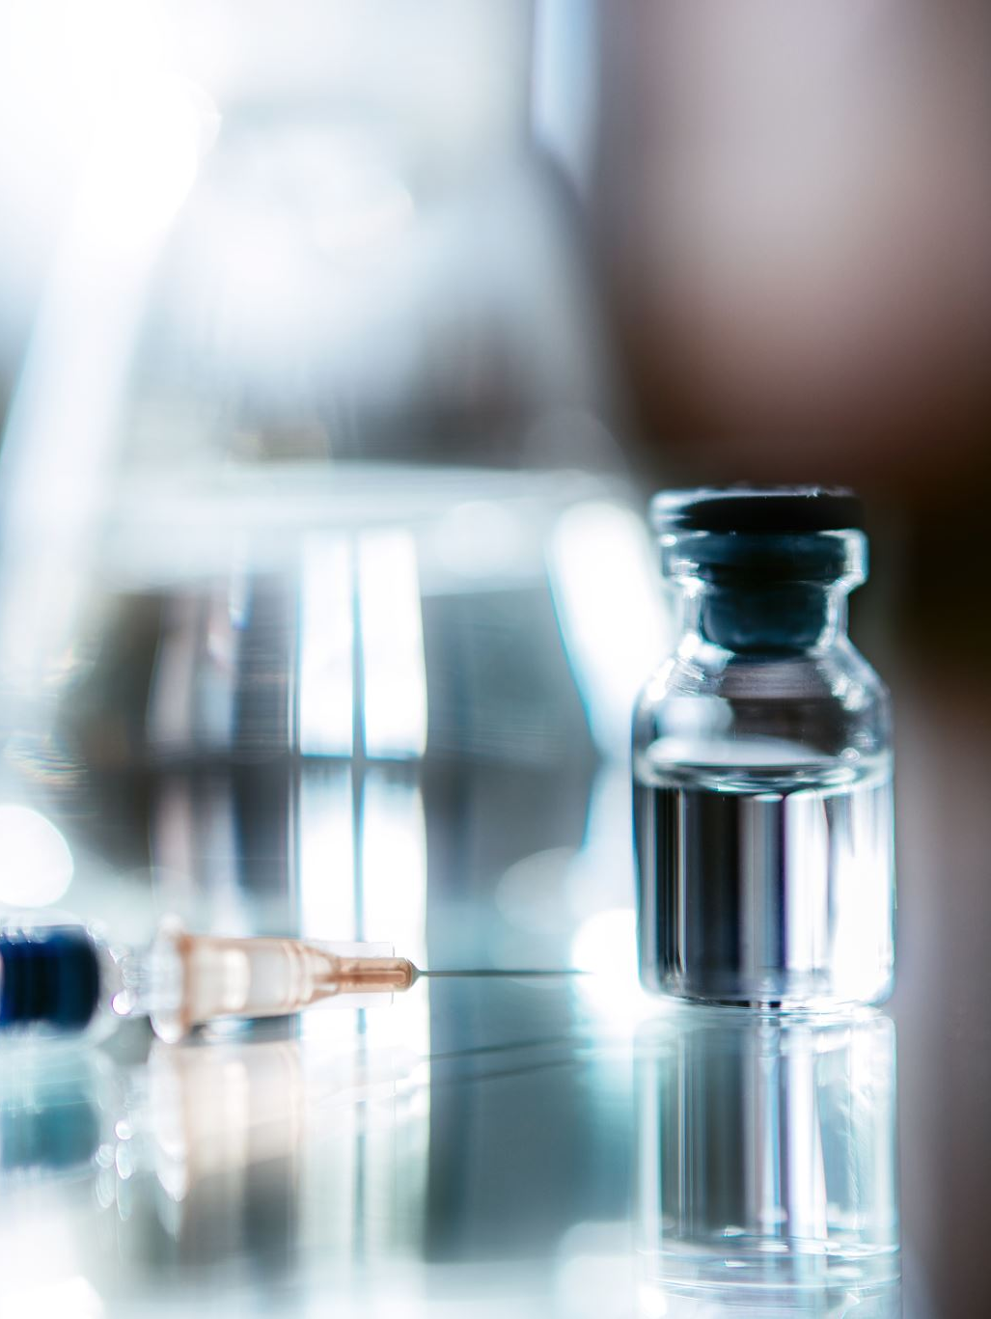
Vaccination awareness
Educating communities during a VDPV2 outbreak is critical in preventing transmission, increasing immunisation and reassuring the public. Ensure the information provided is concise and in simple language.
Key messages should be aimed at neighbourhoods, parents and healthcare providers.
There is no cure for polio; therefore, prevention through vaccination is critical.
Emphasis on the importance of full vaccination of adults and children against polio to protect individuals from serious complications, such as paralysis.
Advocate and promote the UK polio vaccination scheme, the Inactivated Polio Vaccine(IPV).
The immunisation is available as part of the 6-in-1 vaccine offered during infancy (ages 0-12 months). Followed by booster doses in later childhood, to maintain immunity.
Highlight that IPVs are safe and protect against paralysis, offering long-term protection.
Encourage Catch-up vaccinations for children who missed doses.
Explain that high vaccination coverage prevents the virus from spreading.
(NHS, 2023)

Slide 24
Hygiene and sanitation practices
Another key area of education is personal hygiene. Polio mainly spreads through the faecal–oral route, meaning the virus can be transmitted through contaminated hands, food or water. This type of transmission often occurs due to poor hygiene practices and overcrowding.
Because of this, communities should be educated about proper hand hygiene technique. People should wash their hands regularly with soap and water, especially after using the toilet and before preparing or eating food. Handwashing is a simple and effective way of preventing many infectious diseases. Public health campaigns in schools, workplaces and community centres can help promote good hygiene practices and encourage people to develop healthy habits.
Improving hygiene behaviours can significantly reduce the transmission of infectious diseases, including polio (World Health Organization, 2023). Health education programmes may also include information about safe food preparation, proper sanitation and the importance of clean water in preventing the spread of infection.

Slide 25
Community Awareness and Communication
Effective health education should include community engagement and communication.
Local authorities, healthcare providers and public health agencies can share information through leaflets, posters, social media campaigns and community meetings. Offer information in multiple languages for inclusivity.
Engage communities: Collaboration with local enterprises, schools, GP practices, and community leaders can provide educational materials about vaccination and disease prevention. Ensure information reaches a wide population.
Providing clear and reliable information helps communities understand the risks and encourages responsible health practices (UK Health Security Agency, 2022). In addition, communication campaigns can help address misinformation about polio and increase public trust in health services, alleviating fear and vaccination hesitancy.
Explain that cVDPV2 is rare and results when a weakened virus mutates and circulates in under-vaccinated communities. Clarify that it is not the same as WPW, but it can cause illness if immunity is low.

Slide 26
Community Awareness and Communication.
Educate the public about the symptoms of Poliomyelitis:
Fever, fatigue, headache, vomiting, stiff neck and sudden weakness or paralysis in limbs.
Advocate for prompt reporting and medical attention if symptoms occur.
Promote hygiene and sanitation, stressing regular handwashing with soap and water, safe food handling, and proper sanitation, as the poliovirus is primarily spread via the oral-faecal route.
Emphasise the importance of decontamination before disinfection and highlight that chemicals such as bleach are inactivated by contact with body fluids. Hence, made ineffective with improper use.

Slide 27
Encouraging early medical advice and cooperation with public health guidance
Health education should also encourage residents to seek medical advice if symptoms appear and to cooperate with public health guidance during an outbreak. Early reporting of symptoms allows healthcare professionals and public health authorities to monitor the situation and implement control measures such as vaccination campaigns or additional surveillance.
For example, individuals who experience symptoms such as fever, muscle weakness or unusual fatigue should seek advice from their GP or local health services. Early identification of possible cases allows health authorities to respond quickly and reduce the risk of further transmission within the community.
Community cooperation plays an important role in preventing the spread of infectious diseases (World Health Organization, 2023). When individuals follow public health advice and participate in vaccination programmes, they contribute to protecting not only themselves but also the wider community.

Slide 28
Conclusion
Effective techniques and approaches for measuring, monitoring and controlling poliomyelitis caused by vaccine-derived strain 2 are dependent on robust surveillance, prompt outbreak response and high vaccination uptake.
Fundamental strategies, including Enhanced AFP surveillance, environmental monitoring, targeted vaccination crusades (mop-up and catch-up) using IPV, and heightened routine vaccination programs, form the pillar of the public health management of VDPV2 outbreaks.
Supportive elements, such as sound government policies, strong leadership, funding, and coordination, facilitate effective outbreak action plans. Public health education, especially community engagement and awareness, drives vaccination coverage and reporting.
The combination of these approaches allows countries to mitigate the risks of poliomyelitis caused by cVDPV2 and actively progress towards global poliomyelitis eradication.

Slide 29
Reference List:
British Society for Immunology (2023) Polio vaccination infographic. Available at: https://www.immunology.org/public-information/vaccine-resources/childhood-vaccines/vaccine-infographics/polio (Accessed: 4 March 2026).
Centres for Disease Control and Prevention (2023), Polio. Available at: https://www.cdc.gov/polio (Accessed 11 March 20206)
Centres for Disease Control and Prevention(2024), Surveillance to track progress toward polio eradi cation. Morbidity and Mortality Weekly Report(MMWR).
Global Polio Eradication Initiative(2023), Polio surveillance.https://polioeradication.org/polio-today/polio-now/surveillance indicators. (Accessed 11 March 2026)
Global Polio Eradication Initiative (2024), Polio eradication strategy. Available at: https://polioeradication.org.(Accessed 8 March 2026)
NHS (2023) Polio. Available at: https://www.nhs.uk/conditions/polio/ (Accessed: 4 March 2026).
OpenAI (2026) Global fight against paralysis [AI-generated image]. Created using ChatGPT (DALL·E), 15 March. Available at: https://chat.openai.com/ (Accessed: 15 March 2026).
UK (2025). Vaccination coverage statistics for children aged up to 5 years, England (COVER programme) report: April 2024 to March 2025. [online] GOV.UK. Available at: https://www.gov.uk/government/statistics/cover-of-vaccination-evaluated-rapidly-cover-programme-annual-reports/vaccination-coverage-statistics-for-children-aged-up-to-5-years-england-cover-programme-report-april-2024-to-march-2025. (Accessed: 15 March 2026)
UK Health Security Agency (2022) Polio information and guidance. Available at: https://www.gov.uk/government/publications/polio-information-and-guidance (Accessed: 4 March 2026).
UK (2026). Environmental surveillance for polio. [online] GOV.UK. Available at: https://www.gov.uk/government/publications/polio-global-eradication-nac-and-environmental-surveillance/environmental-surveillance-for-polio,(Accessed 7 March 2026)
WHO (2022). Detection of circulating vaccine derived polio virus 2 (cVDPV2) in environmental samples– the United Kingdom of Great Britain and Northern Ireland and the United States of America. [online] www.who.int. Available at: https://www.who.int/emergencies/disease-outbreak-news/item/2022-DON408 [Accessed 4 March 2026].78e6
World Health Organisation 2023) Poliomyelitis (polio). Available at: https://www.who.int/news-room/fact-sheets/detail/poliomyelitis (Accessed: 4 March 2026).
World Health Organisation(2023), Polio surveillance. https://www.emro.who.int/polio-eradication/about-eradication/surveillance.html. (Accessed: 11 March 2026)
World Health Organisation(2024), Poliomyelitis(polio).https://www.who.int/health-topics/poliomyelitis (Accessed: 6 March 2026)

