Slide 1



Does Innovation and Creativity provide a business advantage?

Slide 2
Introduction
Student name: Adrian- Gigi Ciacareanu
Student number: 1710292
Lecturer: Davina Wyn Evans
Host: University of Wales Trinity Saint David
Due date: 23/04/20201
BrewDog – crafted beer company.
Founded in 2007 by Martin Dickie and James Watt in Fraserburgh, Scotland. (Our History, 2021)

Slide 3
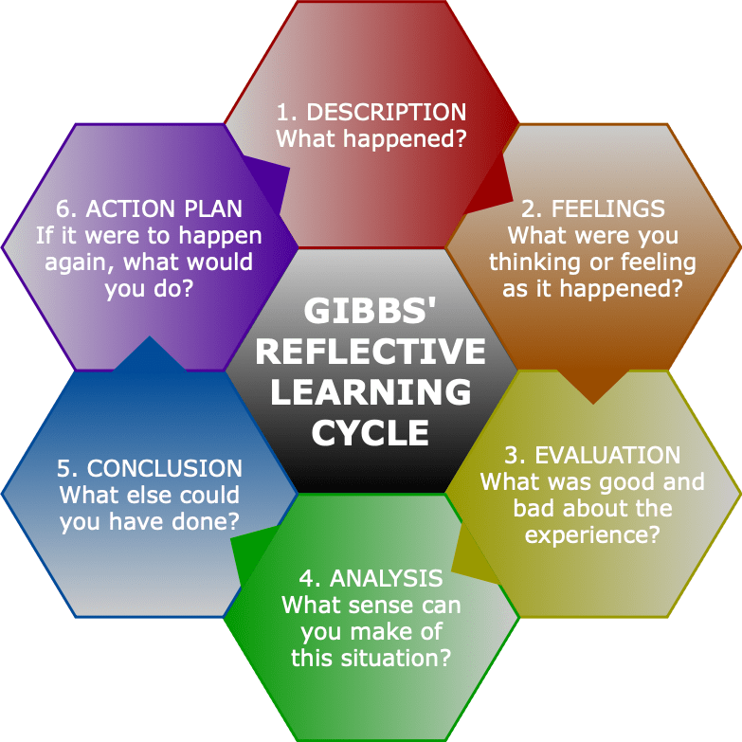
Models of Reflection
Gibbs Model of reflection
One of the most well-known cyclical models of contemplation, it guides you through six stages of exploration: explanation, emotions, assessment, interpretation, conclusion, and action plan. (Gibb’s Reflective Cycle, 2020)

Slide 4

Week 1
What is Innovation?
“Innovation is change that creates a new dimension of performance” – Peter Drucker

Slide 5
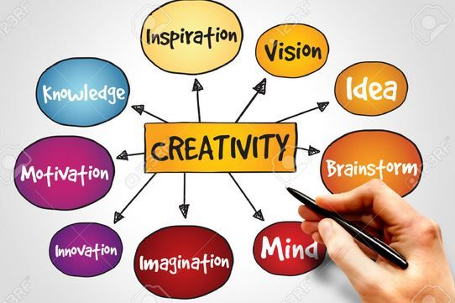
What is Creativity
Creativity is the act of turning new and imaginative ideas into reality. (Naiman, 2014)

Slide 6
Models of Innovation
Open and Closed Innovation
The Innovation Process
4 Ps to Innovation

Slide 7
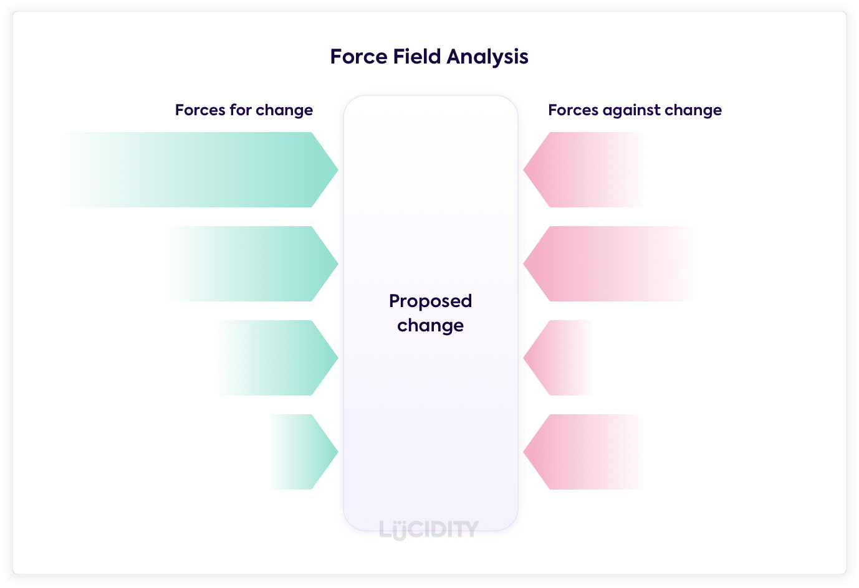
The Innovative Organisation
Force Field Analysis
Is a highly effective strategic method for determining what elements are required for change in both organisational and personal settings. (Connelly, 2020)

Slide 8

Where do Ideas Come From
Ideas usually emerge from conversations in which a person learns about a problem and sees a new way to solve it. (Loeb, 2018)

Slide 9
Leadership Styles
A leader's style refers to the distinctive habits shown by a leader when directing, inspiring, guiding, and handling groups of people. (Cherry, 2020)

Slide 10
Conclusion
Innovation creates competitive advantage for organisations.
Creativity generates: -better teamwork
-improved ability to attract and retain employees
-increased problem-solving

Slide 11
Bibliography
Hudson, K., (2014). What is the best definition of innovation? | Dr Ken Hudson. [online] Available at: <https://drkenhudson.com/best-way-define-innovation/> [Accessed 21 April 2021].
Naiman, L., (2014). What is Creativity? (And why is it a crucial factor for business success?). [online] Available at: <https://www.creativityatwork.com/2014/02/17/what-is-creativity/> [Accessed 21 April 2021].
Loeb, A., (2018). Where Do Ideas Come from?. [online] Available at: <https://blogs.scientificamerican.com/observations/where-do-ideas-come-from/> [Accessed 21 April 2021].
Cherry, K., 92020). What Are Prominent Leadership Styles and Frameworks You Should Know?. [online] Available at: <https://www.verywellmind.com/leadership-styles-2795312> [Accessed 21 April 2021].
Duverge, G., (2015). Fostering Creativity in the Workplace. [online] Available at: <https://www.tuw.edu/business/creativity-in-the-workplace/> [Accessed 21 April 2021].
Connelly, M., (2020). Lewin's Force Field Analysis Explained. [online] Available at: <https://www.change-management-coach.com/force-field-analysis.html> [Accessed 21 April 2021].
Isomäki, A., (2018). Open Innovation – What It Is and How to Do It. [online] Available at: <https://www.viima.com/blog/open-innovation> [Accessed 21 April 2021].
Eliasy, A., 2021. What are some of the examples of Closed Innovations? [online] Available at: <https://www.quora.com/What-are-some-of-the-examples-of-Closed-Innovations> [Accessed 21 April 2021].
Our History, (2021). BrewDog history. Our Beer Journey So Far. [online] Available at: <https://www.brewdog.com/uk/community/culture/our-history> [Accessed 21 April 2021].
Reflection Toolkit, (2020). Gibbs' Reflective Cycle. [online] Available at: <https://www.ed.ac.uk/reflection/reflectors-toolkit/reflecting-on-experience/gibbs-reflective-cycle> [Accessed 21 April 2021].

