Slide 1



BA (Hons) Leadership and Management Skills for the Workplace
Developing and Managing Individuals and Teams
LCLM5002
STUDENT NAME: LOREDANA JOSAN
STUDENT ID: 2332191
LECTURER: GREGORY COWAN

Slide 2
TABLE OF CONTENTS
Introduction
Job analysis as a recruitment process
Job description
Person specification
Behavioural interview
Situational Interview
Case Interview
Probing as an appropriate questioning technique
Leading as an appropriate questioning technique
Socratic as an appropriate questioning technique
Comparison between Face-to-face interview and Online Interview for the Project Manager
Comparison between Face-to-face interview and Online Interview for the Financial Analyst
Comparison between Face-to-face interview and Online Interview for the Change Manager
Conclusion
Reference list

Slide 3
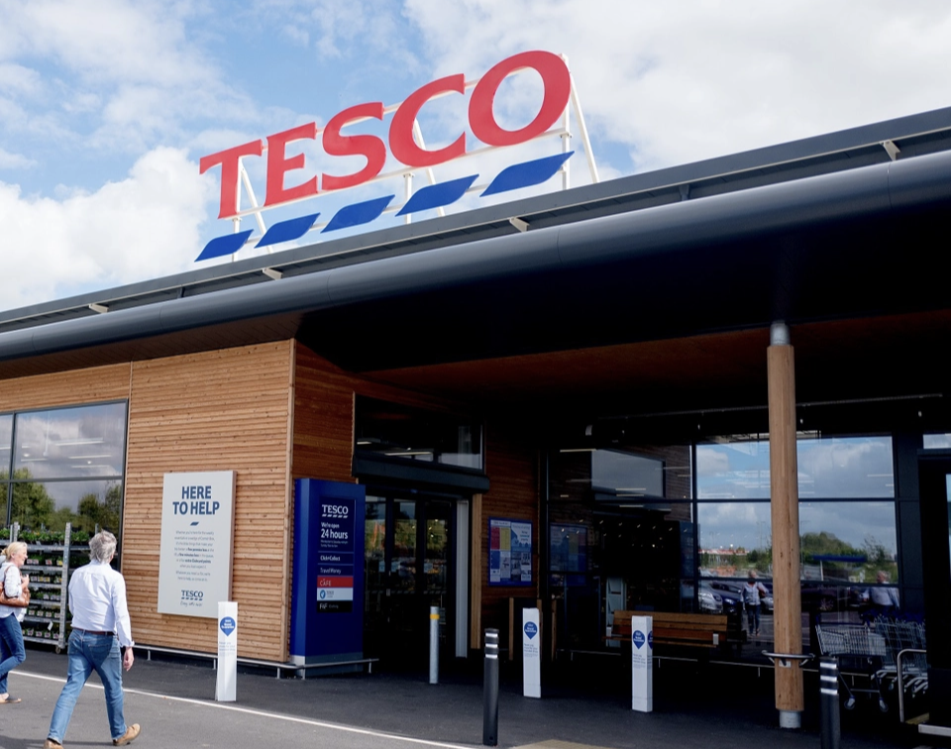
INTRODUCTION
Tesco is considering analysing the recruitment and selection process for the business transformation project.
As one of the leading supermarket retail chains, Tesco has over 330,000 employees (Tesco, n.d.a).
Tesco values Customer perception, continuous improvement, and sustainability (Tesco, n.d.b).
The structured selection and recruitment process of Tesco would help in analysing candidates to ensure a successful digital business transformation.
Figure 1: Tesco store
(Source: Tesco, n.d.a)
Notes:
Good morning. This presentation mainly discusses the effective recruitment and selection procedures by which an organisation such as Tesco can maintain a smooth flow of its business transformation project. The organisation is already established as a leading supermarket retail chain. It has more than 330,000 workers who are continuously prioritising the values regarding continuous improvement, sustainability and customer perception. While analysing the effective recruitment for the digital business transformation, job analysis, job description and person specification will be reviewed as recruitment process. It will also explore the behavioural, situational and case interviews for the team members. Finally, justification for appropriate questioning techniques and a comparative analysis between interview modes will be offered.

Slide 4
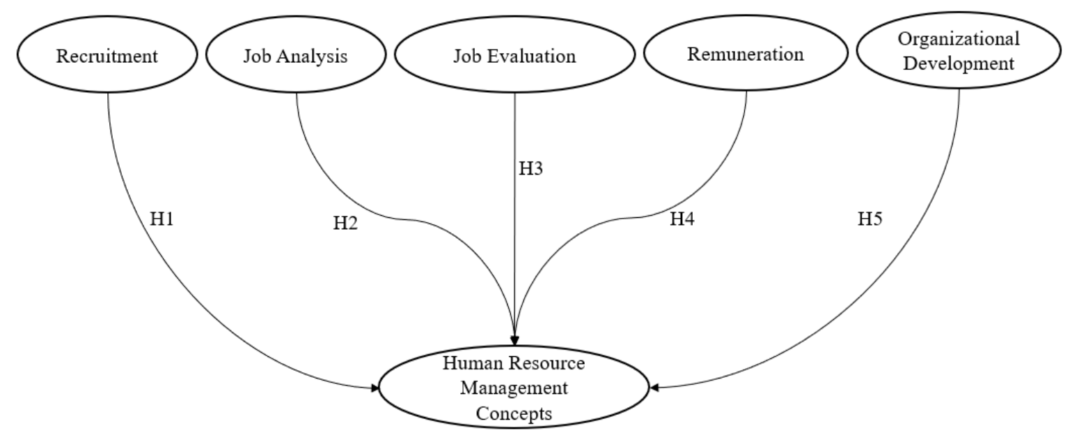
JOB ANALYSIS AS A RECRUITMENT PROCESS
The foundation of the recruitment process is developed from the job analysis.
The detailed job analysis ensures that every role within the organisation is properly demonstrated and effectively managed (Susanto et al., 2024).
It mainly identifies the required skills, major responsibilities and tasks.
Tesco can ensure, through the job analysis, that individuals recruited have the potential to contribute to the digital transformation of the business.
Figure 2: Job Analysis as a HRM process
(Source: Susanto et al., 2024)
Notes:
The use of job analysis is not only the first phase of recruitment, but also an essential part which clearly defines the qualifications, skills and duties required for the position. The detailed analysis of the job role not only helps the candidate to have a better clarity but also allows the interview to ensure that organisations are not experiencing any issues related to a mismatch of job description and functions. Tesco can identify the required skills, tasks, and responsibilities to ensure the potential of recruited candidates for the digital transformation.

Slide 5
JOB DESCRIPTION AS A RECRUITMENT PROCESS
A job description serves multiple functions in the recruitment process.
It can be a tool for the organisation to classify specific jobs and allocate basic compensation (Goulart et al., 2022).
It outlines the primary responsibilities and duties of a particular position.
The clarity is offered through a well-crafted job description so that suitable candidates can be attracted.
Salary range
Job Description
Skills Required
Roles & Duties
Qualifications
Figure 3: Components of Job Description
(Source: Self-developed)
Notes:
Tesco can focus on its job description to demonstrate the main responsibilities and duties of a position. Although it has multiple functions, it mainly clarifies the major duties and is used as a tool by the organisation for allocating basic compensation. For instance, the project manager role in the business transformation of Tesco can include key responsibilities such as managing digital changes in the internal operation from initiation to delivery. The use of a job description can also help in coordinating with other duties.

Slide 6
PERSON SPECIFICATION AS A RECRUITMENT PROCESS
It mainly demonstrates the required skills, attributes, and qualifications to achieve success in a specific role.
It not only analyses the curriculum but also conducts different tests and interviews to identify the coordination of specifications (Portillo and Mancera-Valencia, 2021).
In terms of Tesco, the person specification for a project manager requires PM certification and a degree in management as a qualification.
Notes:
The person specification helps in the recruiting process by analysing the portfolio of candidates objectively on the basis of competency and suitability for the job. It mainly defines the attributes, qualifications and skills required for a specific role. An example of a person specification can be offered by focusing on the project manager to handle the digital business transformation project at Tesco, where a minimum of 3 to 5 years of experience is required in project management, along with the qualification of PM certification, degree in management. Skills essential for a project manager include leadership, communication, and stakeholder engagement.

Slide 7
BEHAVIOURAL INTERVIEW
Behavioural competencies are mainly analysed by the recruiter to evaluate the suitability of the interviewee for a particular position (Susanto et al., 2023).
The STAR technique helps the behavioural interview to identify the alignment between past actions and the leadership competencies and values (Lin-Stephens et al., 2022).
For the team member of Tesco, the behavioural interview helps in revealing reliability and consistency.
Situation
Result
STAR
Task
Action
Figure 4: STAR technique
(Source: Self-developed)
Notes:
The use of a behavioural interview helps in analysing the ability of candidates to handle critical situations by demonstrating a story based on past phenomena. The team members of Tesco can be recruited by interview, where the approach needs to include a question based on the STAR technique, so that the reliability and consistency of the story offered by the candidate can be revealed properly. It can support Tesco to recognise the connection between past activities of the candidate and the existing values and leadership competencies of the organisation.

Slide 8
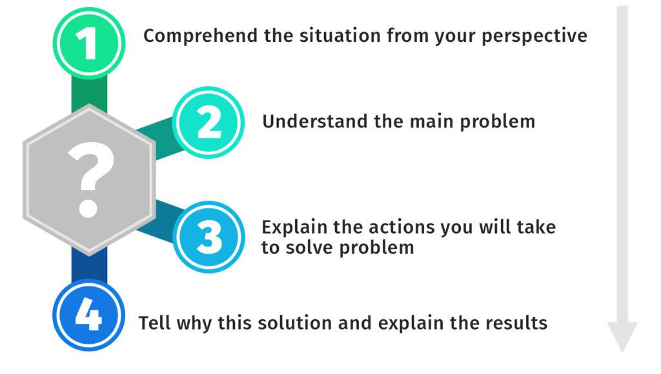
SITUATIONAL INTERVIEW
A situational judgment test or interview evaluates the ability of a candidate to manage a hypothetical scenario by answering the question in a virtual world (Nikolaou, 2021).
The use of situational interviews in Tesco can help in analysing the experience of the change manager.
The professional expertise of the financial analyst can also be evaluated through this type of interview.
Figure 5: Ways to respond in situational interview
(Source: Fechter, n.d.)
Notes:
While focusing on the situation and interview, it mainly assesses the capability of the candidate to demonstrate their responses for a simulated situation, by which the interviewer can perceive the level of knowledge and experience of the candidate. In terms of Tesco, its digital business transformation project can consider the situational interview to evaluate the experience of the change manager and assess their level of knowledge to integrate contingency during a crisis. Additionally, the financial analyst can be hired through a situational interview by asking about a hypothetical situation for managing the overbudget project.

Slide 9
CASE INTERVIEW
In recruitment, the use of a case study offers real-world business problems to be solved by the interviewee (Karim et al., 2021).
It mainly evaluates the analytical thinking and strategic skills of the candidate based on addressing real-world problems.
For Tesco, financial analysts can be recruited through a case interview to assess their capability to gather insights from the interpretation of data.
Capture the problem
Plan your Action
Ask for data
Provide Recommendation
Figure 6: Case interview process
(Source: Self-developed)
Notes:
The use of a case interview helps the recruiter to identify the level of strategic thinking considered by the candidate and use their analytical thinking capability to address real-world problems of the business. While focusing on hiring a financial analyst for the digital transformation project of Tesco, the recruiter of the organisation can evaluate the commercial awareness, analytical ability, creativity, and logical reasoning by offering case studies, from which the candidate needs to develop insights through the interpretation of data. It will support the transformation-related decisions for the business.

Slide 10



PROBING AS AN APPROPRIATE QUESTIONING TECHNIQUE
The probing technique is justified because it takes factual and guiding questions into account (Mohzana et al., 2023).
This technique is applied to enhance the critical thinking of the candidate, by which deeper insights can be generated from the responses of the candidate.
The main purpose is to ensure that the competencies of the candidate are measurable and authentic, which improves the accuracy of the selection.
Notes:
Tesco can focus on using probing as a questioning technique, which not only offers factual answers but also provides enough guidance through which the recruiter can perceive the level of critical thinking considered by the candidate. It mainly generates deeper insights from the responses offered by the candidate, through which authenticity and measurability of the competencies of the candidate can be confirmed while exploring their motivation for the job role offered by Tesco. For instance, the change manager can be asked to elaborate steps to inform and implement the change.

Slide 11



LEADING AS AN APPROPRIATE QUESTIONING TECHNIQUE
Leading questions help the recruiter to assess specific insights provided by the candidate during an interview (Obidovna, 2023).
It mainly focuses on a particular subject or topic where the candidate needs to offer their responses.
It is appropriate because the recruiter can strike a balance with leading questions to align the organisational values and motivation of candidates in Tesco.
Notes:
The effective questioning needs to consider leading questions, which is an appropriate technique because it allows the candidate to focus on a specific topic and use the guidance of the recruiter to demonstrate on this topic. The interview conducted by the recruiter of Tesco can use this technique so that critical competencies of a project manager or a change manager regarding their leadership, communication, or collaboration can be perceived through a long discussion. It can also encourage candidates to enhance their motivation to connect with organisational values.

Slide 12
SOCRATIC AS AN APPROPRIATE QUESTIONING TECHNIQUE
The use of Socratic questioning allows the recruiter to develop intelligent thoughts from candidates and assess their ability to offer recommendations for addressing an incumbent issue (Muhammad and Niazi, 2022).
It mainly uses a set of reflective and logical questions to analyse the depth of reasoning.
In terms of Tesco, the recruiter can perceive the reflective learners and critical thinkers to designate managerial responsibilities for the digital transformation.
Notes:
The justification offered for using the Socratic questioning technique is to generate intelligent thoughts from the candidate so that recommended strategies can properly address the issue encountered in the middle of a project. The recruitment managers of Tesco can identify the critical thinking and reflective reasoning of candidates and differentiate between analytical thought and surface-level responses. It is essential for the strategic roles of the digital business transformation, including financial analyst and change manager.

Slide 13

COMPARISON BETWEEN FACE-TO-FACE INTERVIEW AND ONLINE INTERVIEW FOR THE PROJECT MANAGER
Although face-to-face interviews offer direct interaction to develop rapport, online interviews are more flexible and cost-efficient (Peasgood et al., 2023).
For a project manager, Tesco needs to use a hybrid approach.
Initial screening will be conducted online, and an in-person interview for the final behavioural evaluation of the candidate.
Notes:
There are various areas of difference between the two modes of interview. While the face-to-face interview provides an opportunity to develop communication in a physical space, the online process allows the recruitment to be more convenient and flexible, with cost efficiency. The body language and non-verbal expressions can be observed during face-to-face interviews. However, online interviews limit visual observation. The analysis of the leadership can be conducted by face-to-face interview, while the initial screening of international candidates can be conducted online.

Slide 14
COMPARISON BETWEEN FACE-TO-FACE INTERVIEW AND ONLINE INTERVIEW FOR THE FINANCIAL ANALYST
While the in-person interview focuses on interpretation of information and logical discussion, the online method prioritises digital presentation and testing (Lobe, Morgan and Hoffman, 2022).
For the financial analyst, Tesco needs to consider the online method so that simulation business problem-solving can be assessed.
Online interviews cannot capture the subtle expression, while a face-to-face interview clearly presents the non-verbal cues in communication.
Notes:
Another major difference observed between online and face-to-face interview methods where the physical presence of the respondent and the interviewer helps in developing a clear perception regarding the data interpretation and logical reasoning throughout the discussion. However, online interviews cannot capture the subtle expression. The financial analyst for the digital business transformation project of Tesco can be hired by using the online method, where a simulated business problem-solving will be conducted to assess the financial knowledge and skills of the candidate. capture the subtle expression. The financial analyst for the digital business transformation project of Tesco can be hired by using the online method, where a simulated business problem-solving will be conducted to assess the financial knowledge and skills of the candidate.

Slide 15



COMPARISON BETWEEN FACE-TO-FACE INTERVIEW AND ONLINE INTERVIEW FOR THE CHANGE MANAGER
When an online interview offers flexibility and remote evaluation, the face-to-face method helps the recruiter to perceive empathy and personal engagement level through the communication (Rowen et al., 2022).
Tesco can recruit its change manager by considering an in-person interview session so that both cultural and technical suitability can be evaluated.
An in-person interview is ideal for analysing the emotional intelligence, while an online interview is suitable for discussing change frameworks.
Notes:
The comparison between online and face-to-face interviews has highlighted that the online method provides flexibility, but the face-to-face method is suitable for perceiving the personal engagement level and empathy of the candidate. It can also help in evaluating the emotional intelligence of the candidate through the face-to-face method. Therefore, Tesco needs to hire its change manager through an in-person interview to evaluate the technical and cultural fit of the candidate.

Slide 16



CONCLUSION
The recruitment process for Tesco is developed to confirm proper alignment between the person specification, job description, and the company culture.
The use of structured job analysis and targeted questioning helps Tesco to confirm skills and knowledge-based selection.
Face-to-face and online interview methods should be combined to improve flexibility and maintain the depth of the assessment.
Notes:
After completing the entire presentation, it can be concluded that the recruitment process includes job analysis, job description, and person specification, which have their relevant applications in accordance with the requirements. The consideration of behavioural and situational interviews is essential for the project manager and change manager, while the case interview is suitable for the financial analyst. Different questioning techniques are justified as the online and in-person interviews will be considered to select team members.

Slide 17
REFERENCE LIST
Fechter, J. (n.d.) HR Situational Interview Questions. Available at: https://hr.university/career/hr-situational-interview-questions/ (Accessed: 3 November 2025)
Karim, M.M., Bhuiyan, M.Y.A., Nath, S.K.D. and Latif, W.B. (2021) ‘Conceptual framework of recruitment and selection process’, International journal of business and social research, 11(02), pp.18-25.
Lin-Stephens, S., Manuguerra, M., Tsai, P.J. and Athanasou, J.A. (2022) ‘Stories of employability: improving interview narratives with image-supported past-behaviour storytelling training’, Education+ Training, 64(5), pp.577-597.
Muhammad, N.H.M. and Niazi, J.A. (2022) ‘Socratic questioning: a philosophical approach in developing critical thinking skills’, Al-Hikmah: International Journal of Islamic Studies and Human Sciences, 5(4), pp.143-161.
Nikolaou, I. (2021) ‘What is the Role of Technology in Recruitment and Selection?’. The Spanish journal of psychology, 24, p.e2.
Obidovna, D.Z. (2023) ‘The art of questioning: enhancing critical thinking through effective pedagogical techniques’, International Journal Of Literature And Languages, 3(11), pp.54-60.
Peasgood, T., Bourke, M., Devlin, N., Rowen, D., Yang, Y. and Dalziel, K. (2023) ‘Randomised comparison of online interviews versus face-to-face interviews to value health states’, Social Science & Medicine, 323, p.115818.
Susanto, P.C. Sugiyanto, S., Rachman, S., Saepudin, T.H. and Ismail, D.H. (2024) ‘Human Resource Management Concepts: Recruitment, Job Analysis, Job Evaluation, Remuneration and Organizational Development’, Greenation International Journal of Law and Social Sciences, 2(3), pp.88-104.
Tesco (n.d.a) About Us. Available at: https://www.tescoplc.com/about (Accessed: 3 November 2025).
Tesco (n.d.b) Core Purpose and Values. Available at: https://www.tescoplc.com/about/how-we-do-business/core-purpose-and-values/ (Accessed: 3 November 2025).

Slide 18


