Slide 1

Investigating Inventory Accuracy and Order-Picking Practices in Warehouse Operations Workplace-Based Research Proposal
Name: Karolina Kruczynska
Student ID: 2330380
Module: Developing a Research Proposal
Submission date: 26/06/2026

Slide 2
Background
Warehouses are key to supply chain performance (Lee et al., 2018).
Inventory inaccuracies can lead to operational delays, reduced efficiency, and lower customer satisfaction (Seredyuk, 2024).
🎯 Research Aim
Examine the relationship between inventory accuracy and order picking.
❓ Research Questions
• How does inventory accuracy relate to order picking?
• What factors contribute to inventory inaccuracies?
• How effective are current warehouse systems?
👷 Workplace Importance
Employee experiences help identify:
✓ training gaps ✓ communication issues
✓ scanning discipline ✓ stock location problems

Slide 3

Research Methodology
Research Design | Data Collection | Samplings
Qualitative Interpretivist Inductive (Saunders et al. 2023) | Semi-structure interviews Employee experience Operational issues (Flick, U. 2022) | Purposive samplings Pickers Goods-in staff Managers Stock controllers

Slide 4

Data Collection and Analysis
✅Reliability
Same interview guide for all participants
Follow-up questions when needed
Consistent data collection
✅ Validity
Questions focus on research aims
Real employee experiences
Multiple warehouse roles included
📊 Data Analysis
Thematic analysis
Identify common patterns
Practical recommendations for warehouse improvement (Braun, V. and Clarke, V. 2006).

Slide 5

Ethical Considerations
Informed Consent
Participants will receive an information sheet explaining the study.
Participation will be completely voluntary.
Written consent will be obtained before interviews begin.
Participants can withdraw at any time without giving a reason.
Confidentiality and Anonymity
Participants' names and personal details will not appear in the report.
Interview responses will be anonymised using codes (e.g. Participant 1).
All data will be stored securely and used only for academic purposes.

Slide 6
Protecting Participants & Ethical Compliance
Protecting Participants
Participation is voluntary.
Participants can withdraw at any time without giving a reason.
No pressure from managers or colleagues to take part.
Interviews will be conducted in a respectful and safe environment.
Ethical Compliance
Follow university ethical guidelines.
Interview data will be stored securely.
Information will be used only for academic purposes.
Participants' rights and privacy will be respected.

Slide 7
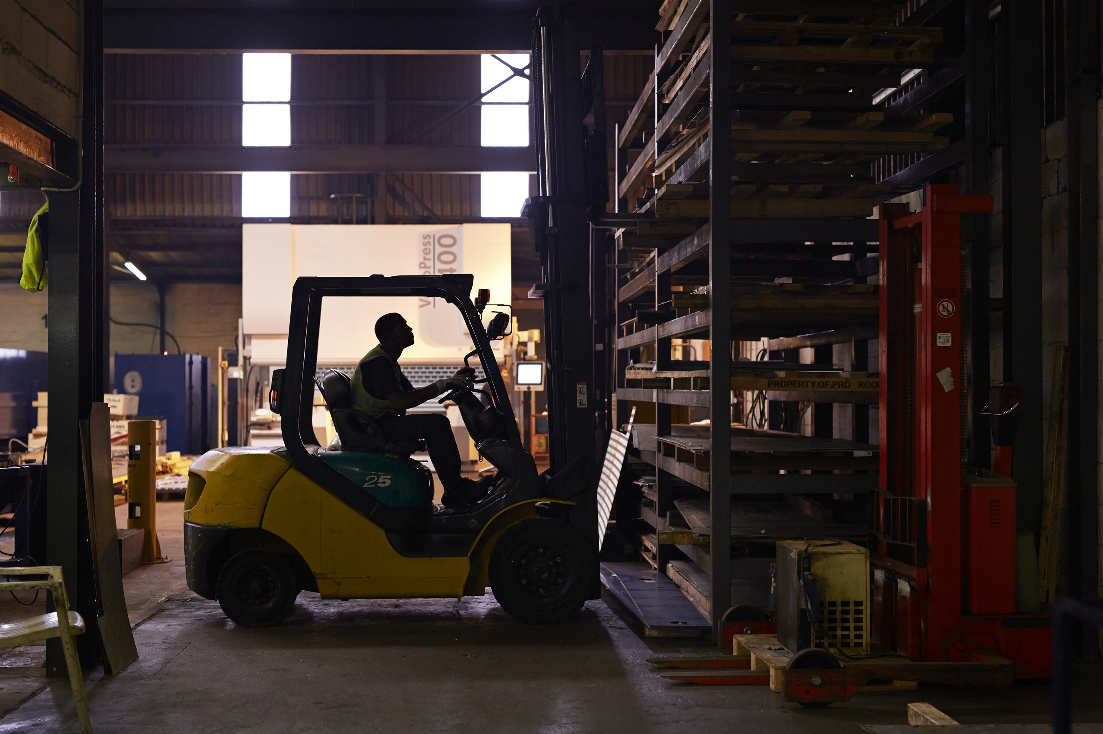
Limitation & Recommendations for Future
Limitations
• Small sample (6–8 participants)
• Research conducted in only one warehouse
• Limited time for data collection
• Access to participants may be restricted
• Some employees may not speak openly due to fear of workplace consequences (Saunders et al. 2023).
Recommendations for Future Research
✅ Include a larger sample of employees
✅ Compare multiple warehouses or organisations
✅ Allow more time for data collection
✅ Use mixed methods
Interviews + surveys
Qualitative + quantitative data

Slide 8

Conclusions
📖 Research Method
Qualitative research
Semi-structured interviews
Purposive sampling
⚖️ Ethics
Informed consent
Confidentiality and anonymity
Voluntary participation
⚠️ Limitations
Small sample size
One warehouse
Limited time and access
🎯 Final Message
The study provides practical insights into inventory accuracy and order-picking practices, supporting
recommendations to improve warehouse operations.

Slide 9
References
Braun, V. and Clarke, V. (2006) ‘Using thematic analysis in psychology’, Qualitative Research in Psychology, 3(2), pp. 77–101. doi: 10.1191/1478088706qp063oa.
Flick, U. (2022) An Introduction to Qualitative Research. 7th edn. London: SAGE Publications.
Lee, C.K.M., Lv, Y., Ng, K.K.H., Ho, W. and Choy, K.L. (2018)
Design and application of Internet of Things-based warehouse management system for smart logistics. International Journal of Production Research, 56(8), pp. 2753–2768. doi:10.1080/00207543.2017.1394592.
Saunders, M.N.K., Lewis, P. and Thornhill, A. (2023) Research Methods for Business Students. 9th edn. Harlow: Pearson. Available at: https://www.researchgate.net/publication/240218229_Research_Methods_for_Business_Students (Accessed: 24 June 2026).
Seredyuk, V., 2024. Improving inventory accuracy through order management processes with DMAIC.

