Slide 1

Student Name : Tamanna Chowdhury Student ID Number:2020854
Module: Problem Solving and Decision Making
Module code: BMSW 4004
Module Coordinator: Chijioke Uba
Assignment Title: Problem Solving and Decision Making
Task 1- Presentation

Slide 2

Staff Shortage in Propercare
Propercare is a UK adult care provider
Currently facing significant staffing issues
Directly impacting on patient care and staff experience

Slide 3
Nature of the Problem
NHS hospitals, mental health and community providers reporting a shortage of FTE staff
Nurses vacancies currently 41,000 (NHS Improvement , 2018)

Slide 4
Nature of the Problem
Adult social care sector vacancies are rising
(Skills for Care, 2018b)
Brexit created additional risk in both the short and the medium term
(NHS Digital, 2018b)
Undergraduate Nurse Training applicants has reduced
(UCAS, 2018)
Workforce problem has a direct impact on people’s care
(Care Quality Commission, 2018)

Slide 5
PESTLE Analysis of the Problem
Political- Brexit , Government Policy
Economical- Unemployment rate, economical growth
Social- Career attitudes
Technological- Technological advancement
Legal- Employment law, Health and Safety law
Environmental- Covid -19, Weather

Slide 6
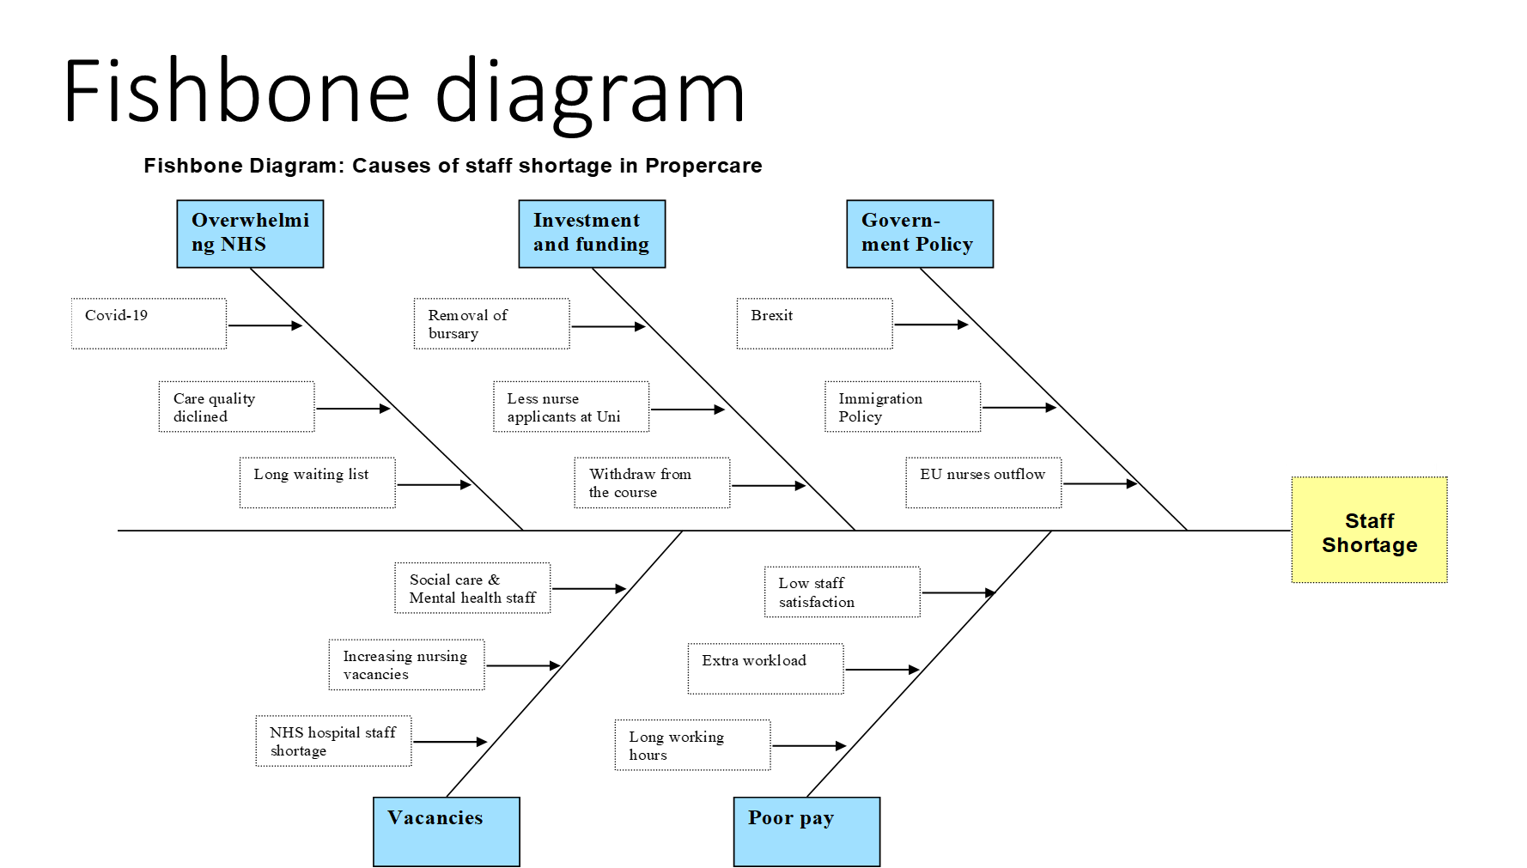

Slide 7

Identified Solution to the Problem
Increasing nursing numbers
Making the NHS a better place to work and build a career for all staff
Workforce planning in the future

Slide 8
PMI analysis for
Solution 1
‘Increasing nursing numbers’

Slide 9
PMI analysis for solution 2
‘Making the NHS a better place to work and build a career for all staff ‘

Slide 10
PMI analysis for solution 3
What’s good (+) | What’s bad (-) | What’s Interesting?
Workforce implementation plan for making the NHS a better employer (+5) Increase staff pay and opportunity (+3) | Long term policy implementation and funding (-5) | Implementation of the plan will increase effective workforce (+5)
Total= 8 | Total= -5 | Total= +5
‘Workforce Planning in the future’

Slide 11
Decision Making
According to PMI score-
Solution 2 ‘Making the NHS a better place to work and build a career for all staff ‘ is the best solution.

Slide 12
Conclusion

Slide 13
References

