Slide 1
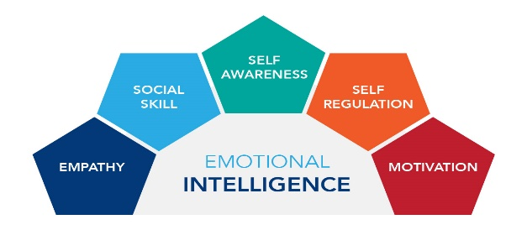
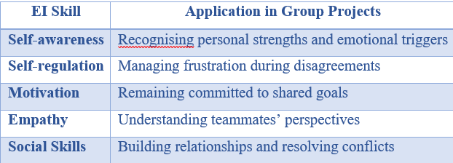
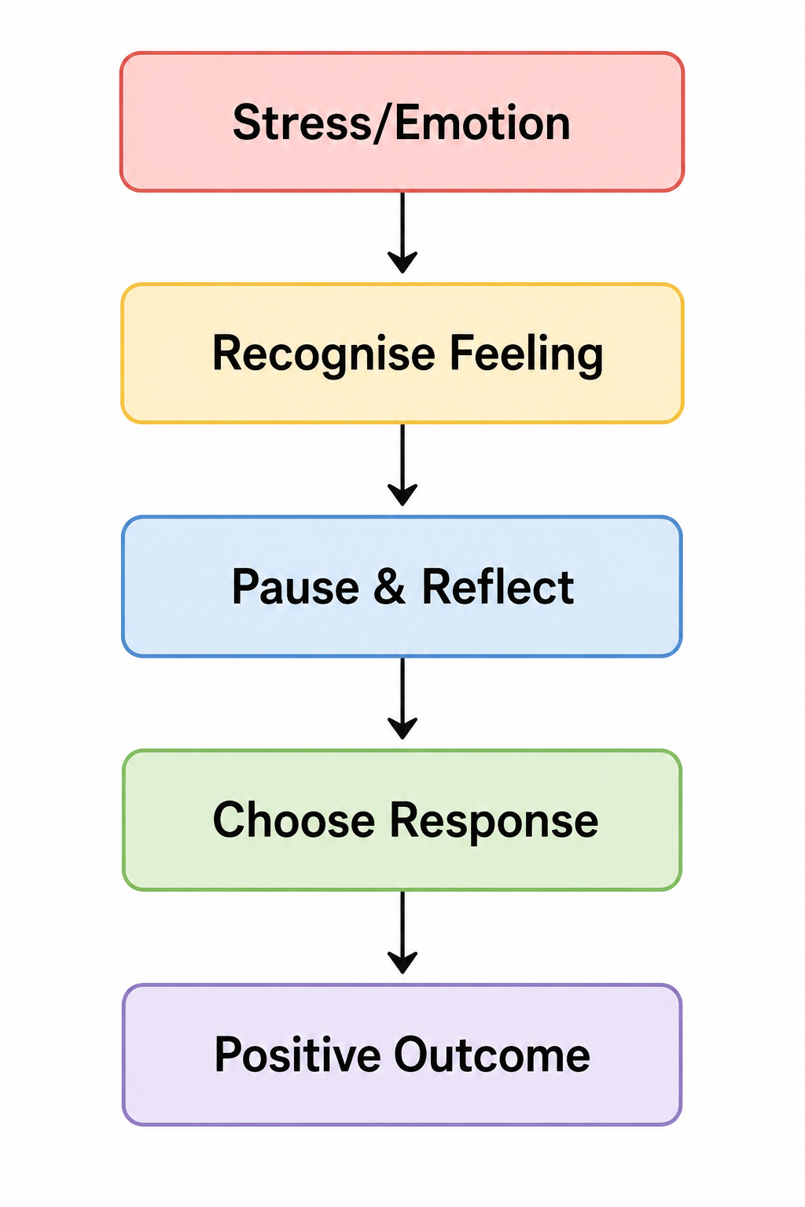
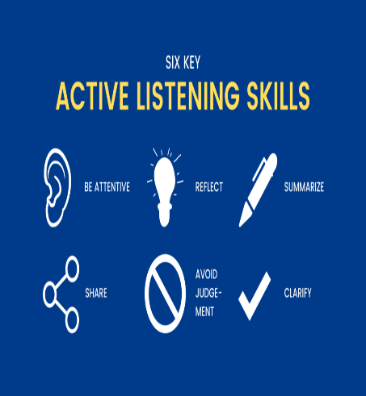

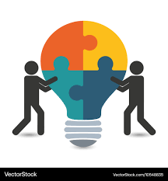
Leading Group Projects with Emotional Intelligence
Student name: Marian Enescu Student ID: 2331652
Introduction
Emotional Intelligence (EI) is the skill of recognising, understanding and controlling emotions in others and self. Some of the issues that affect students in group projects in the university are the difference in opinions, unequal participation, poor communication and pressures in terms of time. These can impact individual performance and the performance of a team as a whole. Emotional intelligence matters since students are able to control their feelings, communicate positively and have constructive working relations with others. Using EI skills, the students will be able to minimise the conflict, increase teamwork, and make the projects successful (Nguyen, 2022).
EI in Teamwork
According to Goleman (1998), The Emotional Intelligence Model singles out five essential skills to help in teamwork: self-awareness, self-regulation, motivation, empathy, and social skills.
In table 1 The skills allow students to cope with the normal issues of teamwork, like conflict, feedback, and meeting deadlines. An example of that is that a student who possesses good self-regulation will be better able to react to criticism in a non-defensive manner instead of becoming defensive, which will keep the team atmosphere positive (Shafique and Naz, 2023).
Table 1: Emotional Intelligence Skills in Teamwork
Managing Own Emotions
According to Mayer and Salovey (1997), The Ability Model postulates that the ability to perceive and manage emotions leads to better decision-making and performance. Self-reflection and being aware of triggers that cause emotional responses make students able to recognise them. Emotional awareness helps people to make positive responses to situations instead of acting out of impulse when faced with a challenging situation.
The following activities and strategies will allow team members to review their feelings:-
• Stress management planning, organising and prioritising of tasks.
• It is preferable to take a pause before responding to disagreements so as to elicit professional and reflective responses.
Using these strategies, students will be able to control their emotions, relieve stress and stay productive in the process of a group project .
Figure 2: Emotional regulation process during group projects
(Source: Self-generated, 2026)
Understanding Others’ Emotions
Empathy assists students in understanding and in the perception of the feelings of their peers. This enhances communication, trust and teamwork within the group.
Such empathetic behaviours are:
• Active listening.
• Considering different viewpoints.
• Providing constructive feedback.
• Helping team members in trouble.
As an example, when a team member is having difficulties meeting a deadline, an appreciative reaction should be used to elicit a discussion and problem-solving as opposed to blaming. This enhances better relationships, increased collaboration and more successful project deliverables (Yang and Wang, 2024).
Conclusion / Recommendations
Emotional intelligence facilitates the best teamwork through improving communication, emotion management, conflict and cooperation. Self awareness, emotional regulation, active listening, and empathy towards others can be used to reinforce EI among students. These are the skills that will aid in ensuring that there is a positive environment in the group and that the project is completed successfully
References
Goleman, D. (1998). Working with emotional intelligence. Bantam.
Mayer, J.D. and Salovey, P. (1997). What is emotional intelligence. Emotional development and emotional intelligence: Educational implications, 3(31), pp.1-16. https://www.researchgate.net/profile/Peter-Salovey/publication/268207442_What_is_Emotional_Intelligence/links/67bf81f98311ce680c760850/What-is-Emotional-Intelligence.pdf
Nguyen, T.P. (2022) A dataset of the relationship between emotional intelligence and teamwork results of university students. Data in Brief, 42, pp.108149-108149. https://doi.org/10.1016/j.dib.2022.108149
Shafique, S. and Naz, I. (2023) A mediating and moderating analysis of the relationship between team emotional intelligence and team performance. Sage Open, 13(1), p.21582440231155074. https://doi.org/10.1177/21582440231155074
Yang, Y. and Wang, C. (2024) The chain mediating effect of empathy and communication ability on emotional intelligence and caring ability of nursing students. Frontiers in psychology, 14, p.1339194. https://doi.org/10.3389/fpsyg.2023.1339194

