Slide 1
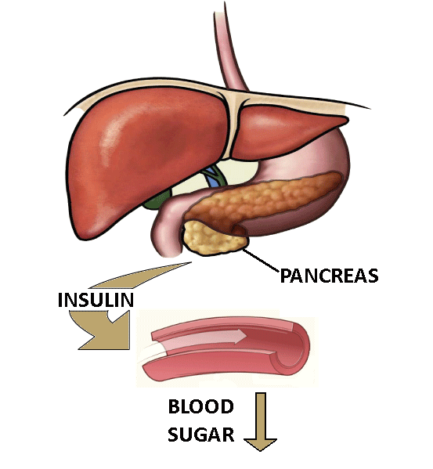
Blood Glucose Control
Use the keywords below to complete the sentences. Some words may be used more than once.
Glucose is in food. It is digested by the small intestine.
Glucose diffuses from the small intestine into the blood.
This causes blood glucose levels to rise. The pancreas produces insulin.
Insulin causes the liver and muscles to store glucose.
Glucose is converted into glycogen.
Other cells take in glucose for respiration, to release energy.
If blood glucose levels are too low the pancreas releases glucagon.
This causes the liver and muscles to convert glycogen into glucose.
And to release glucose into the blood.
liver
glycogen
respiration
energy
small intestine
glucose
blood
pancreas
insulin
glucagon

Slide 2
Blood Glucose Control
Complete the sentences. Some of the keywords have been provided. Others you will have to guess.
Glucose is in food. It is digested by the small intestine.
Glucose diffuses from the small intestine into the blood.
This causes blood glucose levels to rise. The pancreas produces insulin.
Insulin causes the liver and muscles to store glucose.
Glucose is converted into glycogen.
Other cells take in glucose for respiration, to release energy.
If blood glucose levels are too low the pancreas releases glucagon.
This causes the liver and muscles to convert glycogen into glucose.
And to release glucose into the blood.
liver
glycogen
respiration
energy
small intestine

Slide 3
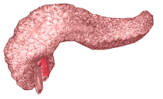
Blood Glucose Control
Complete the sentences
Glucose is in food. It is digested by the small intestine.
Glucose diffuses from the small intestine into the blood.
This causes blood glucose levels to rise. The pancreas produces insulin.
Insulin causes the liver and muscles to store glucose.
Glucose is converted into glycogen.
Other cells take in glucose for respiration, to release energy.
If blood glucose levels are too low the pancreas releases glucagon.
This causes the liver and muscles to convert glycogen into glucose.
And to release glucose into the blood.

Slide 4
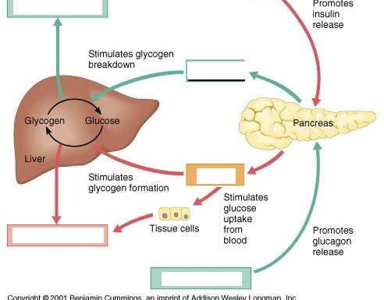
Complete the following

