Slide 1

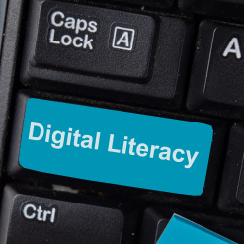
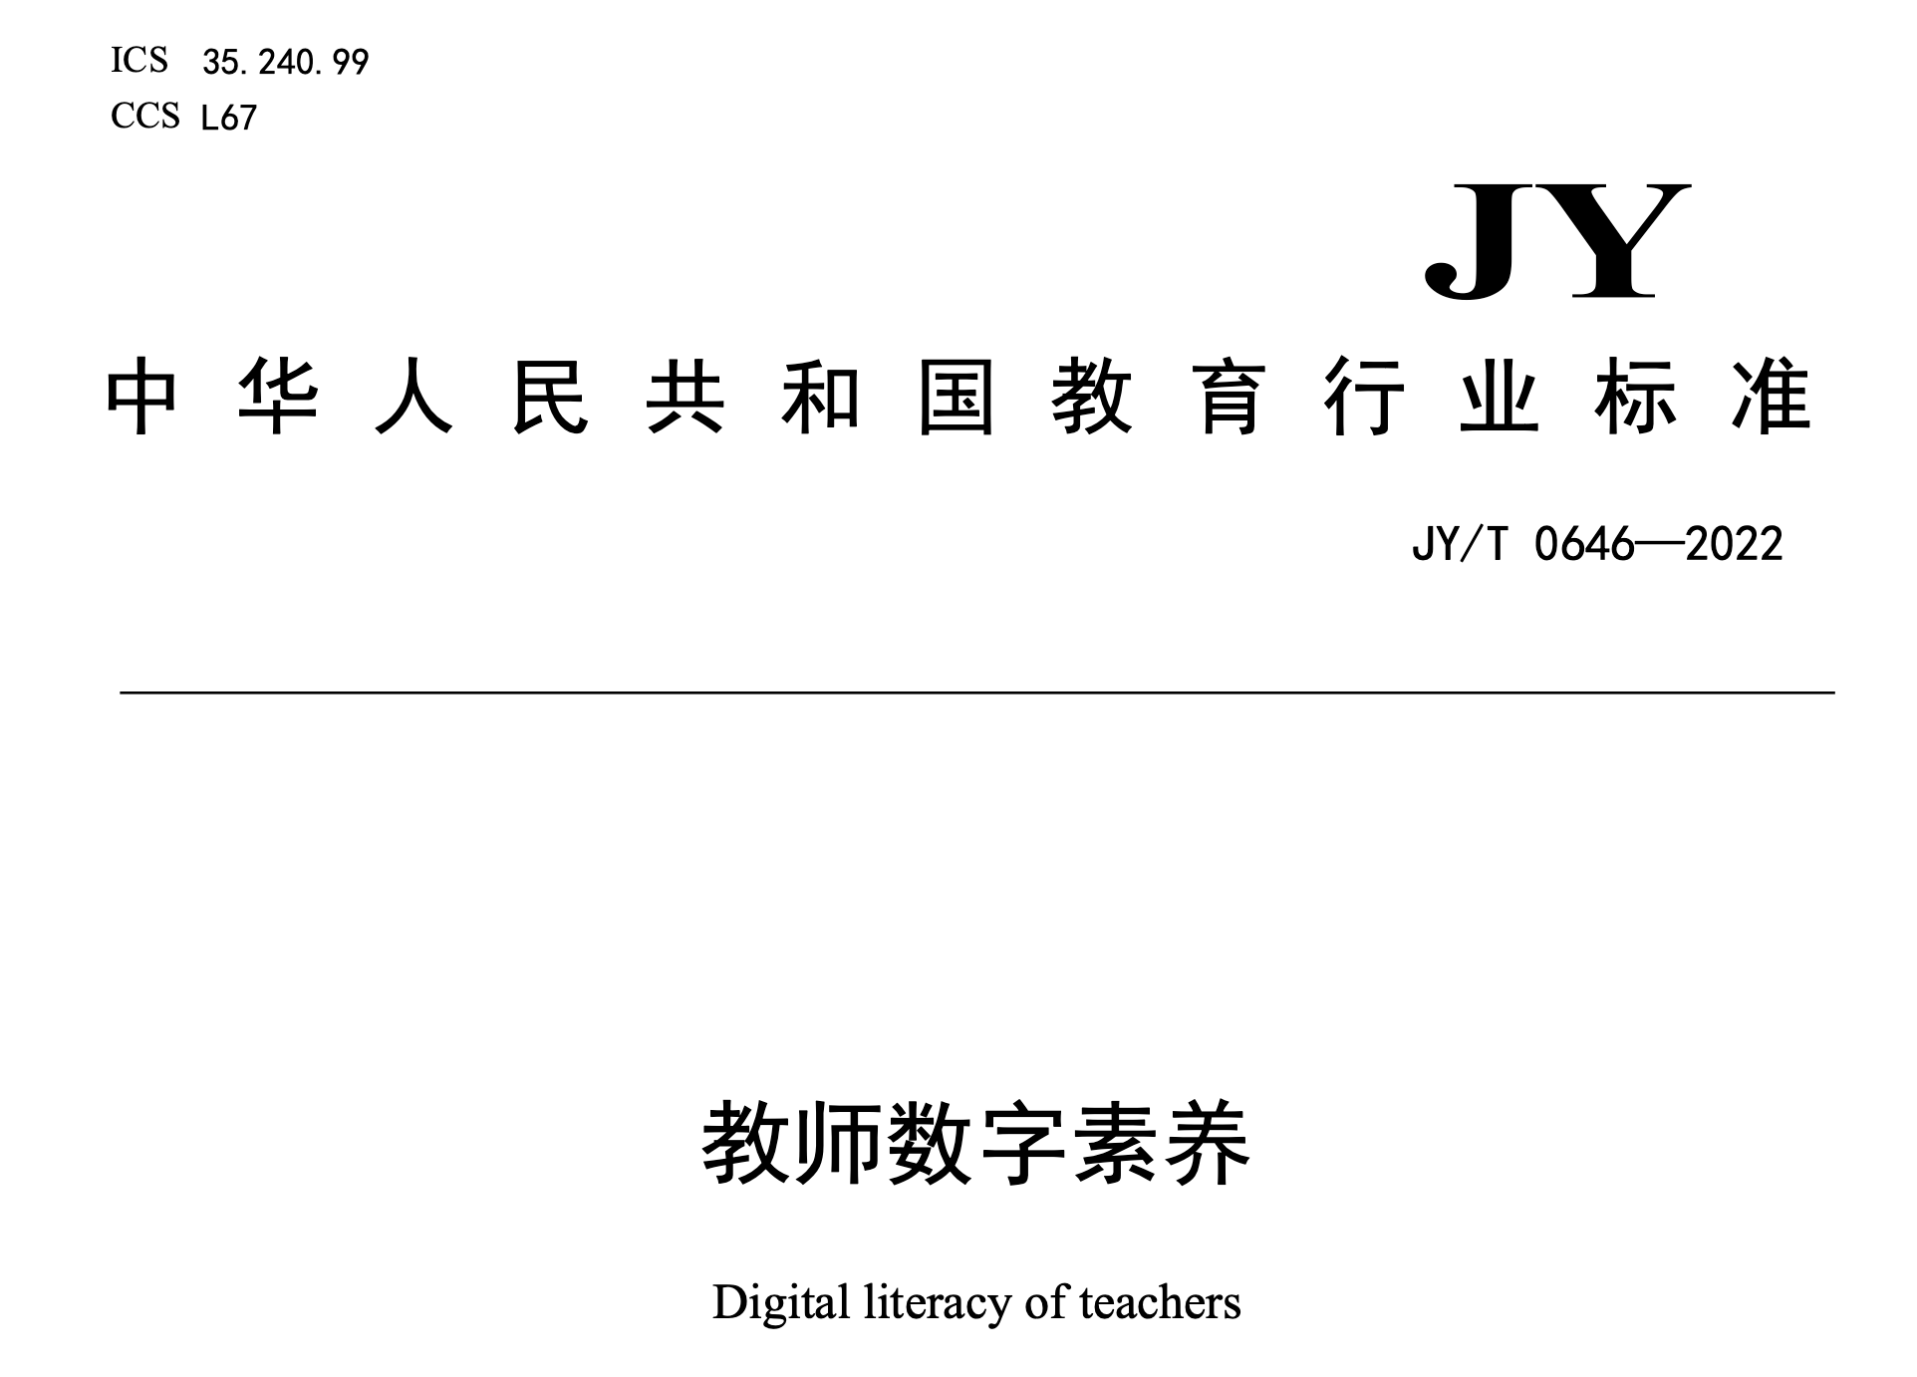
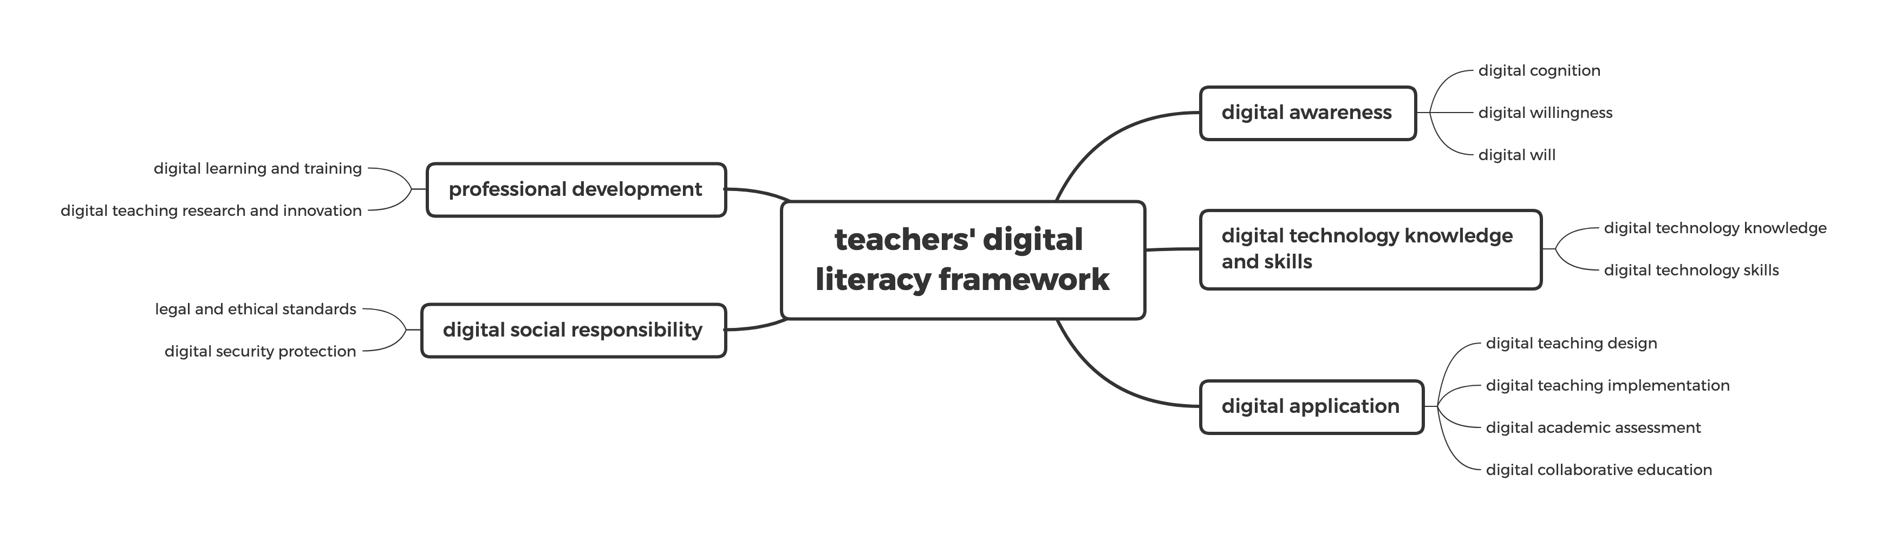
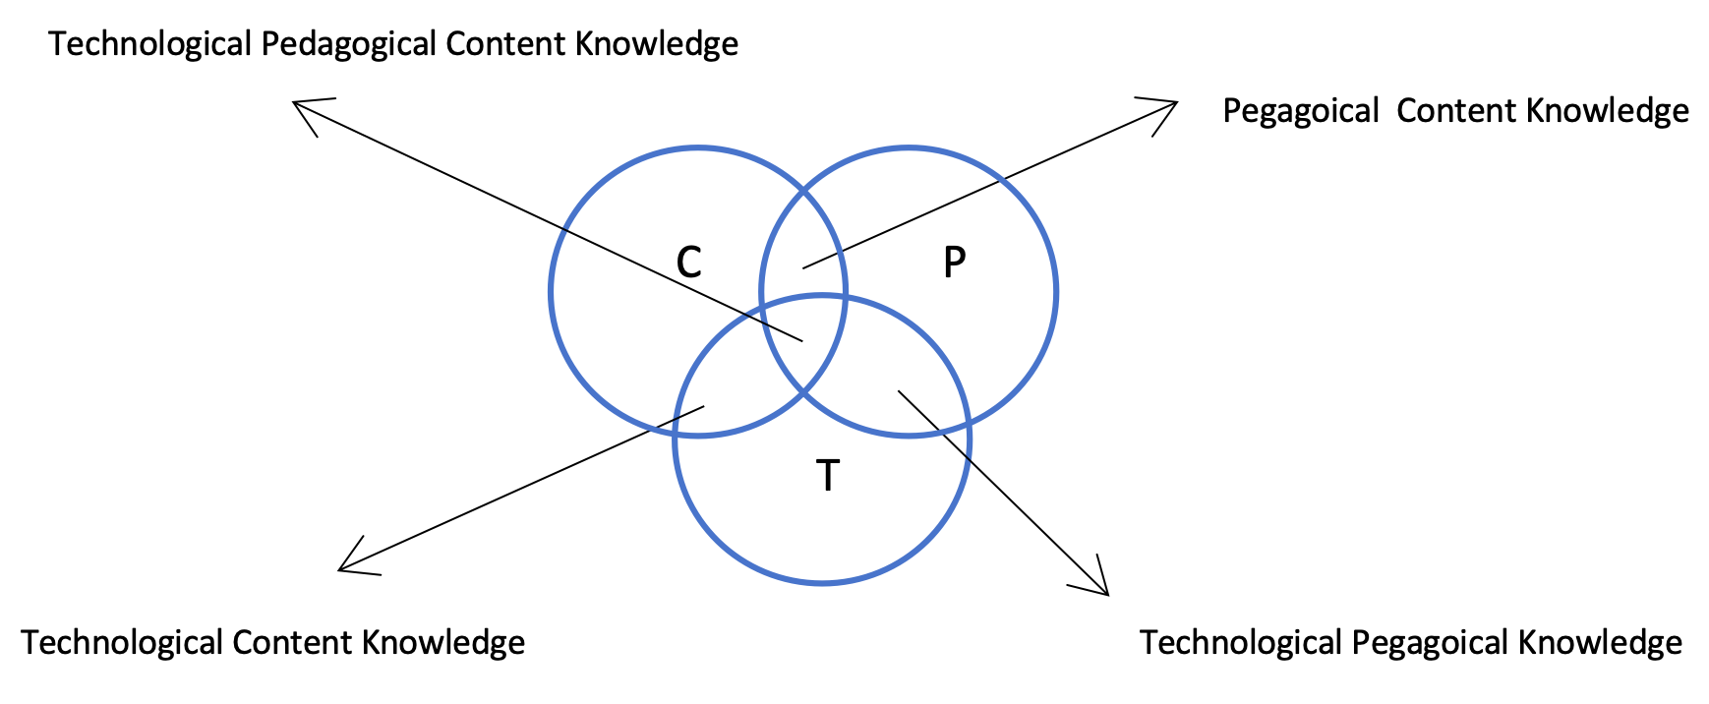
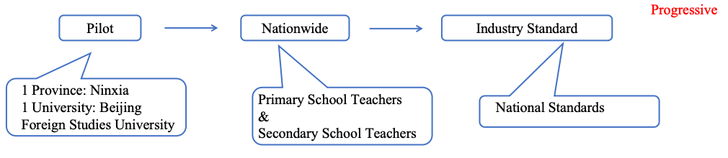
Policy and Practice: Pathways for Enhancing Digital Literacy of Foreign Language Teachers in Chinese Higher Education
Jing Xin (2406841@student. uwtsd.ac.uk)
1. Introduction
2. Aims and Objectives
3.2 Texts
3.3 Consequences
Briefly introduce “teachers’ digital literacy” with the context of Educational informatization and digitalization
Define the key terms related to the issue, including the evolving definition of “literacy” and “digital literacy”
Highlight the necessity to address the issue in light of new trends in educational technology, especially since COVID-19 and the emergence of generative AI tools
Present the unique digital literacy needs in foreign language education and emphasize the need to assess policy support and implementation
Emphasize the importance of addressing gaps between standards and teachers’ expectations and needs, offering pathways to bridge the divide between policy and practice.
Policy analysis framework: “Context, Texts, Consequences” by Taylor et al. (1997)
Approaches: a review of academic literature, an examination of policy documents, and an analysis of media reports
Research Question:
1) What support does current policies in China provide for cultivating
digital literacy among foreign teachers? Are there any gaps, and
what are the challenges?
● 2) What recommendations can be provided for practical pathways to
enhance digital literacy among foreign language teachers in China?
The Industry Standards for Teachers’ Digital Literacy issued in 2022 by Minister of Education, China.
5 primary dimensions, 13 secondary dimensions and 33 tertiary dimensions
Aims and Objectives
“To thoroughly implement the spirit of the 20th National Congress of the Communist Party of China, solidly advance the national education digitalization strategy, improve the education informatization standards system, and enhance teachers’ awareness, capabilities, and responsibilities in utilizing digital technology to optimize, innovate, and transform educational and teaching practices. “ (Ministery of Education, 2022)
Notice on the Issuance of the “Digital Literacy for Teachers”by Ministry of Education, China, 30 November, 2022
Policy Assemblage
1) Technological Support: Smart Education Platform of China
Launch Date: 28 March, 2022
Courses Offering (as of 28 March, 2024)
Award: UNESCO ICT in Education Prize, 2022
2) International Promotion and Collaboration:
World Digital Education Conference, 2023, Beijing
World Digital Education Conference, 2024, Shanghai
What is missing?
1) Absence of guidelines for assessing teachers’ current digital literacy and
progress.
2) Lack of tailored training for different subjects and varying levels of digital
literacy.
Interpretation and implementation
1) Regional: Local Implementation in Zhejiang Province (as an example)
2) Corporate: Foreign Language Teaching Research Press’ Support for
Foreign Language Teachers’ Digital Literacy (as an example)
3) University: Practices at a University in Hangzhou, Zhejiang, China (as
an example)
4) Teachers:
The challenges in teachers’ interpretation and implementation of the policy will be reviewed through a literature review and analyzed together with media reports. Chinese media generally holds a positive attitude on this topic, with relatively less emphasis on the challenges and issues. However, these problems and concerns might be thoroughly addressed in the academic literature.
Literacy
Multi-literacy
Digital literacy
3.1. Contexts
Economical Factors
1) China’s Digital Economy
2) China’s Investment in Educational Digitalization
Social Factors
1) The Driving Force of Global Digitalization
2) The Impact of Post-COVID 2019
3) The Rapid Development of Educational Technology
Political Factors
1) Educational Digitalization
2) Policy Development for Teachers’ Digital Literacy in China:
Notice on Carrying Out Pilot Work of Artificial Intelligence for Promoting the Construction of Teacher Teams from Ministry of Education of China, (2018)
Opinions on Implementing the 2.0 Initiative for Enhancing Information Technology Application Skills of Primary and Secondary School Teachers Nationwide from Ministry of Education of China, (2019)
The Industry Standards on Teachers’ Digital Literacy from Ministry of Education of China, (2022)
3. Policy Analysis Framework
4. International Perspective
Taylor et al. (1977):
Contexts
Texts
Consequences
Selected frameworks for teachers’ digital literacy
1) ISTE Standards: For Educators 2017
2) European Framework for the Digital Competence of Educators:
DigCompEdu (2017)
3) TPACK (Mishra and Koehler, 2006)
Insights for Chinese policies
By comparing the above three frameworks, this section will identify elements that are valuable references for China.
Texts:
content and presentation
aims and objectives
policy assemblage
Texts
Contexts
Consequences
Contexts:
economical factors
social factors
political factors
Consequences:
policy interpretation and implementation
policy refraction
5. Conclusions and Recommendations
Summary of Key Findings
policy summary
Identifying gaps between policy and implementation
pinpointing challenges for teachers
Recommendations
Based on the above summaries, recommendations will be proposed
to bridge the gap between standards and practical implementation,
while offering actionable suggestions for foreign language teachers to
enhance their digital literacy.
References
European Union (2017). European Framework for the Digital Competence of Educators: DigCompEdu. Available at: https://joint-research-centre.ec.europa.eu/digcompedu/digcompedu-framework_en (Accessed: 9 November 2024).
Gilster, P. (1997) Digital Literacy. New York: Wiley Computer Publications.
International Society for Technology in Education (2017). ISTE Standards: For Educators. Available at: https://cdn.iste.org/www-root/Downloads/Downloads/Download-4070.pdf (Accessed: 9 November 2024).
Mishra, P. and Koehler, M.J. (2006) ‘Technological Pedagogical Content Knowledge: A Framework for Teacher Knowledge’, Teachers College Record: The Voice of Scholarship in Education, 108(6), pp. 1017–1054. Available at: https://doi.org/10.1177/016146810610800610
Ministry of Education of China (2018) Notice on Carrying Out Pilot Work of Artificial Intelligence for Promoting the Construction of Teacher Teams. Available at: https://www.gov.cn/zhengce/zhengceku/2018-12/31/content_5441144.htm (Accessed: 9 November 2024). 教育部办公厅关于开展人工智能助推教师队伍建设行动试点工作的通知
Ministry of Education of China (2019) Opinions on Implementing the 2.0 Initiative for Enhancing Information Technology Application Skills of Primary and Secondary School Teachers Nationwide. Available at: http://www.moe.gov.cn/srcsite/A10/s7034/201904/t20190402_376493.html (Accessed: 9 November 2024). 教育部关于实施全国中小学教师信息技术应用能力提升工程2.0
Ministry of Education of China (2022) Notice on the Issuance of the “Digital Literacy for Teachers” Education Industry Standards. Available at: http://www.moe.gov.cn/srcsite/A16/s3342/202302/t20230214_1044634.html
(Assessed: 9 November 2024)
Taylor, S., Rizvi, F., Lingard, R., and Henry, M. (1997). Educational Policy and the Politics of Change. London: Routledge.
The New London Group (1996) ‘A Pedagogy of Multiliteracies: Designing Social Futures’, Harvard Educational Review, 66(1), pp. 60–93.
UNESCO (2018) A Global Framework of Reference on Digital Literacy Skills for Indicator 4.4.2. Available at: https://uis.unesco.org/sites/default/files/documents/ip51-global-framework-reference-digital-literacy-skills-2018-en.pdf (Assessed: 9 November 2024)
Zhejiang Provincial Department of Education (2023) Notice from the Zhejiang Provincial Department of Education on issuing the “Zhejiang Province High-Quality Education Development Action Plan (2024-2027). Available at: http://jyt.zj.gov.cn/art/2023/12/29/art_1532985_58941553.html (Assessed: 9 November 2024)

