Slide 1
e-commerce website builder to create an e-portfolio
Software Solutions for Business

Slide 2

Software Solutions for Business
e-Commerce Website builders

Slide 3

e-Commerce
Q. What is e-Commerce?
> Research and share your answer.
This Photo by Unknown Author is licensed under CC BY-SA-NC

Slide 4

e-Commerce software solutions
Q. What is an e-Commerce website builder / software solution?
> Research and find some examples to share.
This Photo by Unknown Author is licensed under CC BY-NC

Slide 5
e-Commerce software solutions
Q. Name some popular e-Commerce website builders?
> Research, note and share your answer.
This Photo by Unknown Author is licensed under CC BY-NC

Slide 6

e-Commerce solutions
Q. What does an e-Commerce system do?.
> Research and share your answer.
This Photo by Unknown Author is licensed under CC BY-SA-NC

Slide 7

Task
Create an online e-portfolio.
This Photo by Unknown Author is licensed under CC BY-SA-NC

Slide 8

e-portfolio
Q. What is an e-portfolio?
> Research and share your answer.
This Photo by Unknown Author is licensed under CC BY-SA

Slide 9

e-portfolio
Q. How can you create an online e-portfolio?
> Research and share your answer.

Slide 10
Step by step guide for creating an e-portfolio using Wix (Class Activity)
The entire process of portfolio creation is fast and intuitive with Wix – go ahead to explore the main steps below.
Sign Up for Wix. ...
Choose a Website Editing Option. ...
Pick a Portfolio Template. ...
Edit The Theme. ...
Connect the Extensions. ...
Activate the Mobile Mode.
Configure SEO Parameters
Integrate Marketing Tools
Connect the Domain Name
Go live
For any further help please visit: https://superbwebsitebuilders.com/how-to-create-eportfolio-on-wix/

Slide 11
One example e-portfolio
Created using Wix

Slide 12
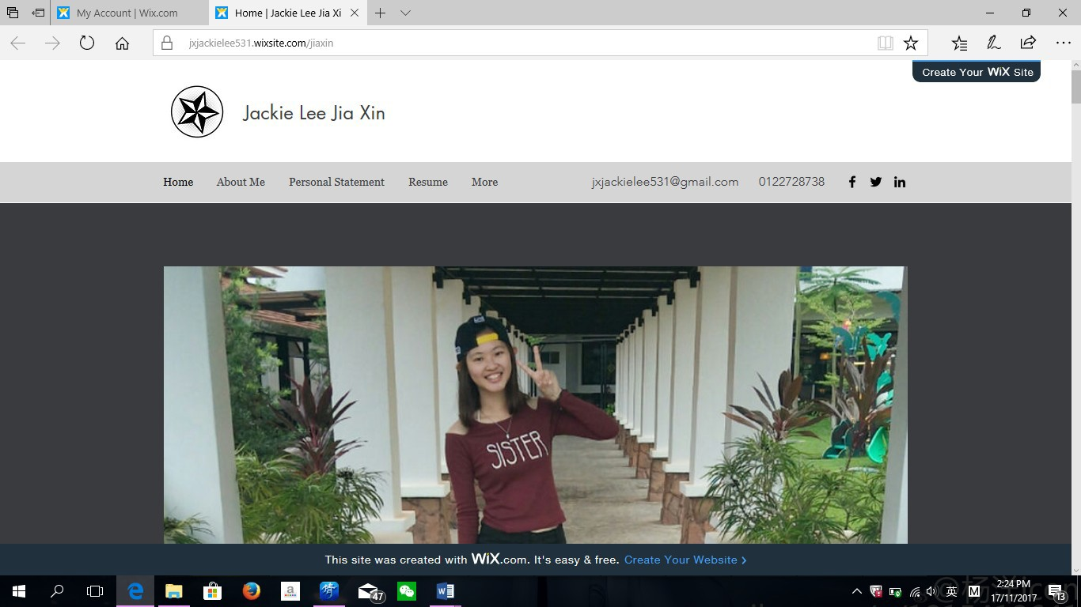

BIOGRAPHY

Slide 13
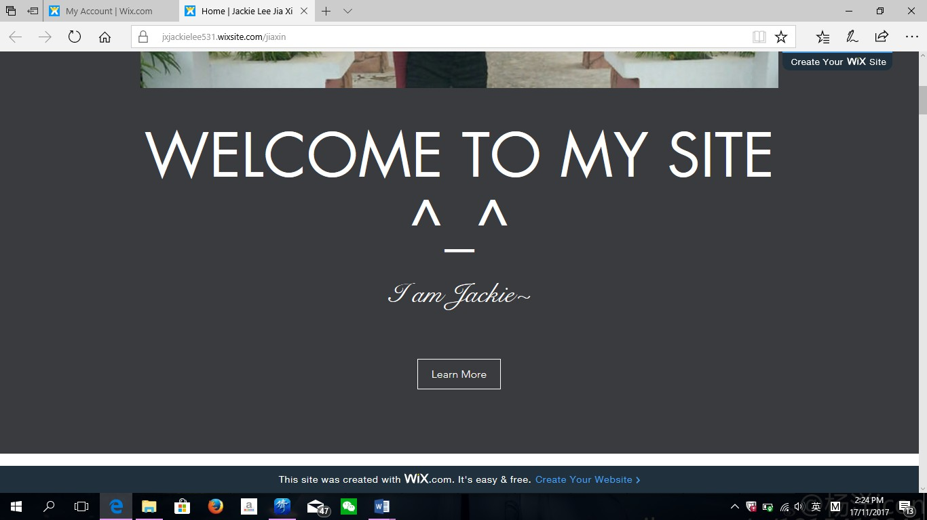
CONTACT DETAILS

Slide 14
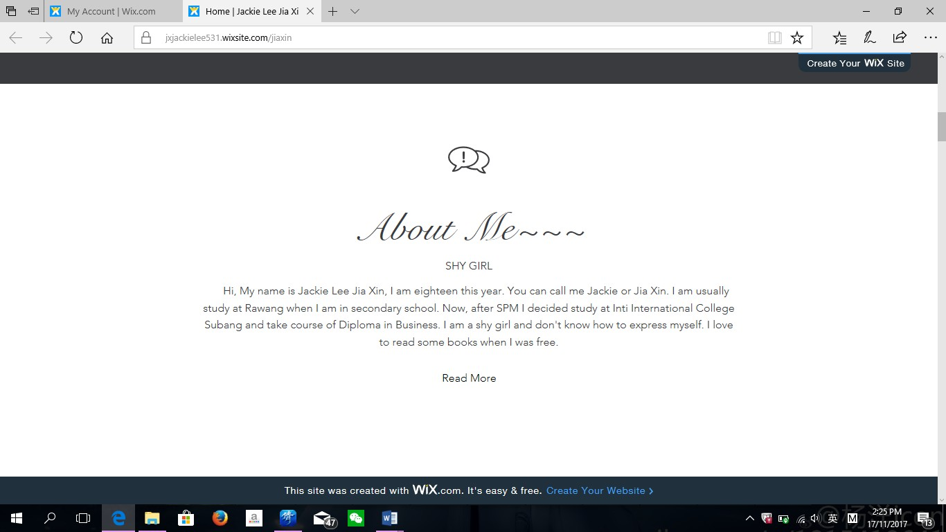
SELF INTRO

Slide 15

WORKING EXPERIENCE
WORKING EXPERIENCE OR ANY PROJECTS/VOLUNTEER SERVICE

Slide 16
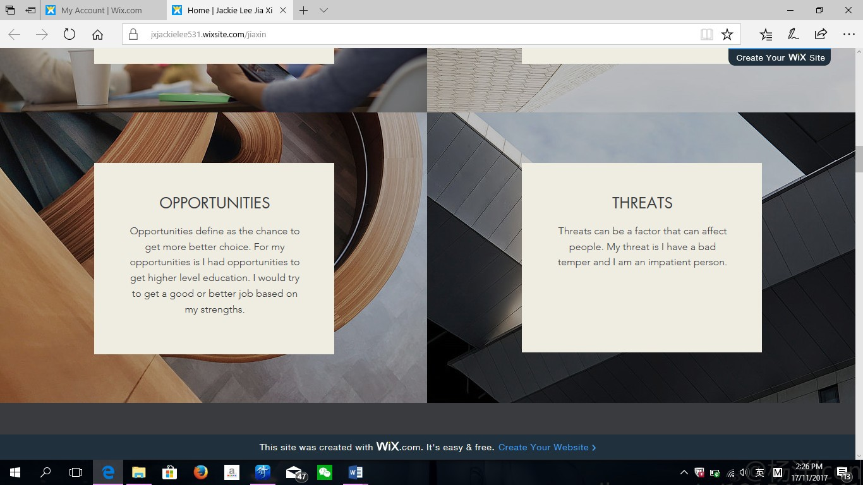
PERSONAL CHARACTERISTICS

Slide 17
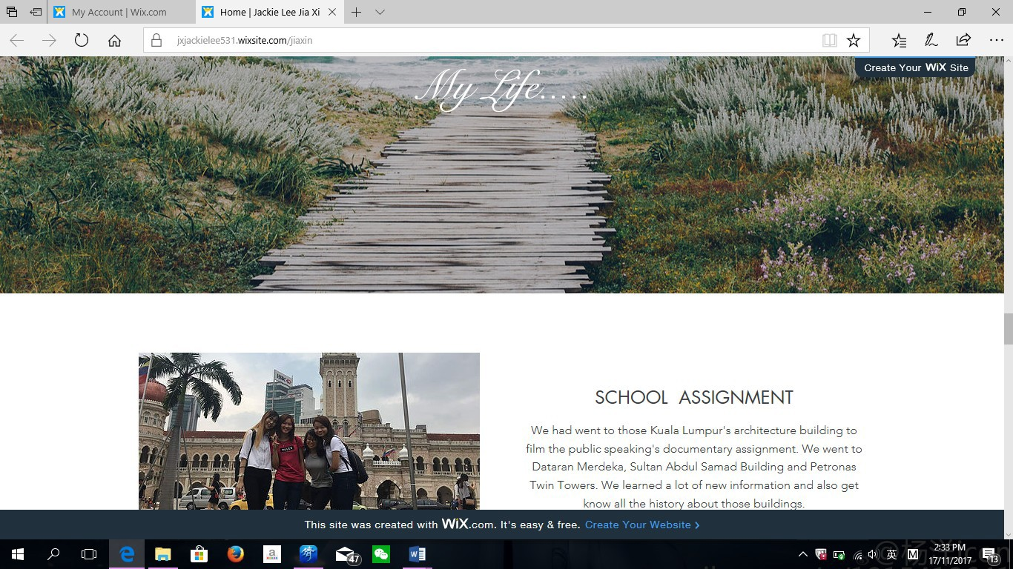
AWARDS & RECOGNITION/BEST ASSIGNMENTS

Slide 18
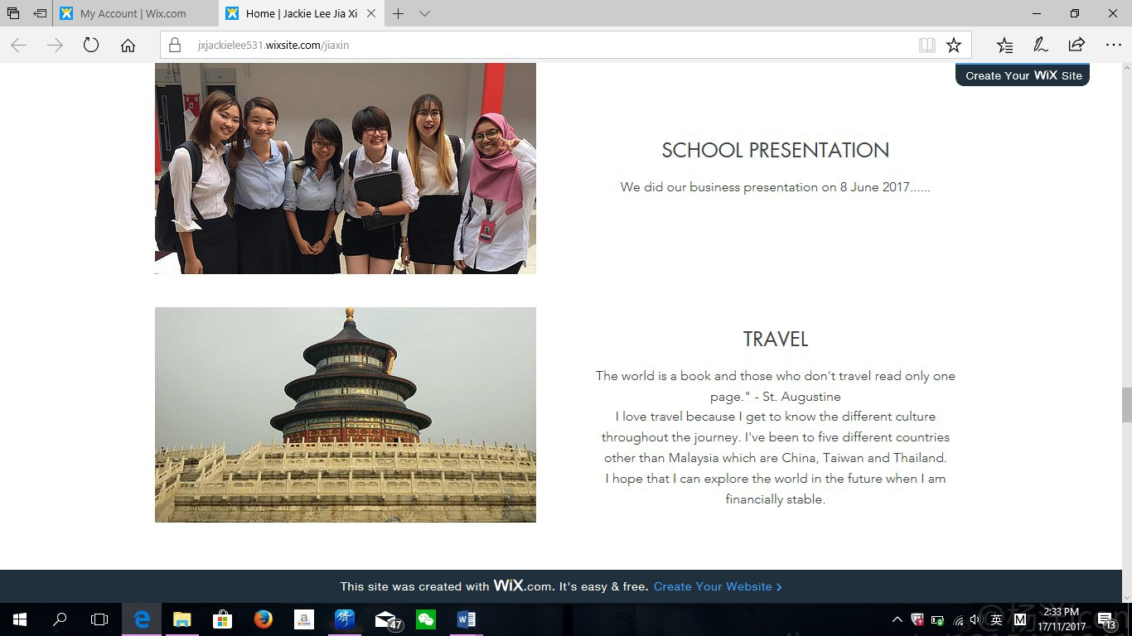
General Activities

Slide 19
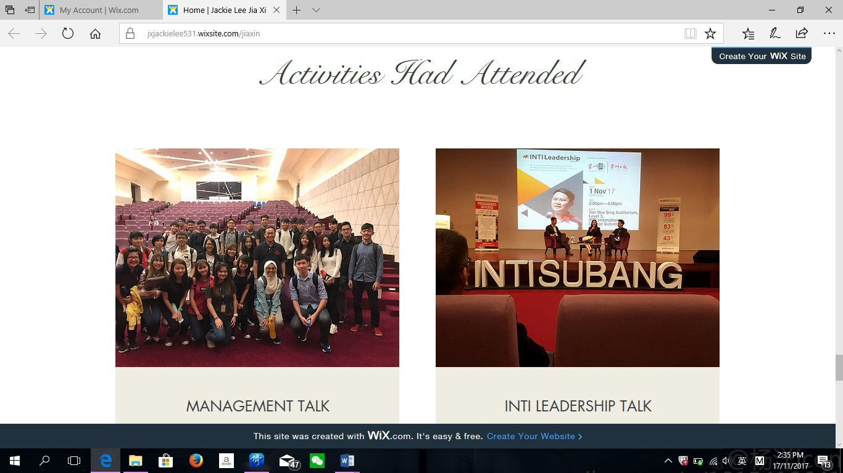
WORKSHOP

Slide 20

2 MIN VIDEO ABOUT YOU LIFE FUTURE PLAN

Slide 21
platforms to create
Online e-portfolio
Google Sites
Wix
Weebly
Canva
Adobe Spark
an Office 365 App. such as OneNote or Sway

Slide 22
E-portfolio Tips
Publish the site (e.g., wix).
Keep the design simple and consistent.
Use 2/3 colours.
Consistent font face and sizes for text titles and body text throughout.
Consistent Navigation menu throughout.
View the e-portfolio in an incognito tab and test you can access it as the marker would.

Slide 23
E-portfolio Creation
(Class Activity)
If you are not sure how to create the e-portfolio or if you are struggling with the task, go to YouTube and search for:
  How to create an e-portfolio online using wix … or weebly, google sites, Sway etc.
You will find 5-minute tutorials to help you complete the task with ease.
You must ensure your lecturer is able to easily view the e-portfolio and all the task answers for marking purposes.
Please make sure the e-portfolio is either shared so other people with the link can view it (in the case of OneNote) or published in the case of a web builder such as wix/weebly/Google sites and NOT set to private.
For assessment purposes only include the Assignment task answers.

Slide 24
The end.

