Slide 1
LCBB4009
Understanding Organisational Structure and Culture (UOS)
Week 7: Session 1
Communication

Slide 2
What we did the last time
What did you learn last class?
What were the key terms?
Do you have any questions?
Notes:
The lecturer can ask students to take turn writing key words on the board, read their notes, give examples, show their homework, or do case studies.
Can link the student’s answer to the content of this week – what organisational structure would best fit this company?

Slide 3
Lesson Aims
By the end of this session, students should be aware of important aspects of communication:
The nature and functions of communication
Methods of interpersonal communication
Effective interpersonal communication
Notes:
Robbins and Coulter (2021), chapter 14.

Slide 4

What is Communication?
Communication: the transfer and understanding of meaning
Interpersonal communication: communication between two or more people
Organizational communication: all the patterns, networks, and systems of communication within an organization
Notes:
Communication is the transfer and understanding of meaning. Note the emphasis on the transfer of meaning: If information or ideas have not been conveyed, communication hasn’t taken place. The speaker who isn’t heard or the writer whose materials aren’t read hasn’t communicated. More importantly, however, communication involves the understanding of meaning.
Communication encompasses both interpersonal communication—communication between two or more people—and organizational communication, which is all the patterns, networks, and systems of communication within an organization. Both types are important to managers.

Slide 5
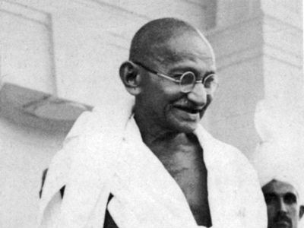






What make them great communicators?
Notes:
These are examples of people who are benefited greatly from their communication skills.
Who are the best at controlling? Motivating? Expression emotion? Provide information?
What make them great communicators?

Slide 6

Functions of Communication
Control
Motivation
Emotional expression
Information
What functions/purposes did one of your recent communication have?
Notes:
Communication acts to control employee behavior in several ways. As we know from Chapter 11, organizations have authority hierarchies and formal guidelines that employees are expected to follow. Informal communication also controls behavior. When a work group teases a member who’s ignoring the norms by working too hard, they’re informally controlling the member’s behavior.
Communication acts to motivate by clarifying to employees what is to be done, how well they’re doing, and what can be done to improve performance if it’s not up to par. As employees set specific goals, work toward those goals, and receive feedback on progress toward goals, communication is required.
For many employees, their work group is a primary source of social interaction. The communication that takes place within the group is a fundamental mechanism by which members share frustrations and feelings of satisfaction. Communication, therefore, provides a release for emotional expression of feelings and for fulfillment of social needs.
Finally, individuals and groups need information to get things done in organizations. Communication provides that information.
In relation

Slide 7

Functions of Communication
Activity
Watch one clip below:
Flight attendant performs funniest safety routine (4:50): https://www.youtube.com/watch?v=JEyp2p-bzcU
OR
World's Funniest Flight Attendant Leaves Passengers In Hysterics (1:57)
https://www.youtube.com/watch?v=DfaYKYFYHBk
Discussion questions:
What are the functions (purposes) of the communications?
What do you think about the effectiveness of communication?

Slide 8
Communication process
Communication process: the seven elements involved in transferring meaning from one person to another.
They are sender, message, channel, encoding, decoding, receiver, and feedback
Notes:
Note that the entire communication process is susceptible to noise—disturbances that interfere with the transmission, receipt, or feedback of a message. Typical examples of noise include illegible print, phone static, inattention by the receiver, or background sounds of machinery or coworkers. However, anything that interferes with understanding can be noise, and noise can create distortion at any point in the communication process.

Slide 9
Methods
Message: a purpose to be conveyed
Encoding: converting a message into symbols
Channel: the medium a message travels along
Decoding: retranslating a sender’s message
Feedback: the response to the message, can also show if the message was successfully received and understood
Noise: any disturbances that interfere with the transmission, receipt, or feedback of a message
Notes:
Before communication can take place, a purpose, expressed as a message to be conveyed, must exist. It passes between a source (the sender) and a receiver. The message is converted to symbolic form (called encoding) and passed by way of some medium (channel) to the receiver, who retranslates the sender’s message (called decoding). The result is the transfer of meaning from one person to another.
“Today is a good day”

Slide 10
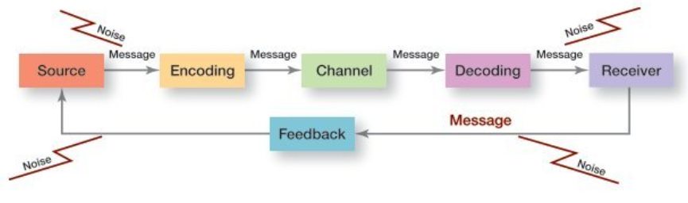
The Communication Process
Source: Robbins and Coulter (2021, p. 394)
What are some examples of noises?
Notes:
Long Description:
The chart shows 3 steps in sequence between “Source” and “Receiver.” The steps are “Encoding”, “Channel”, and “Decoding.”
The map shows the message being transferred from “Source” to “Receiver.”
The chart also shows “Feedback” message going from “Receiver” to “Source.”
“Noise” is seen in the process of message communication as well as in the “Feedback” process.

Slide 11
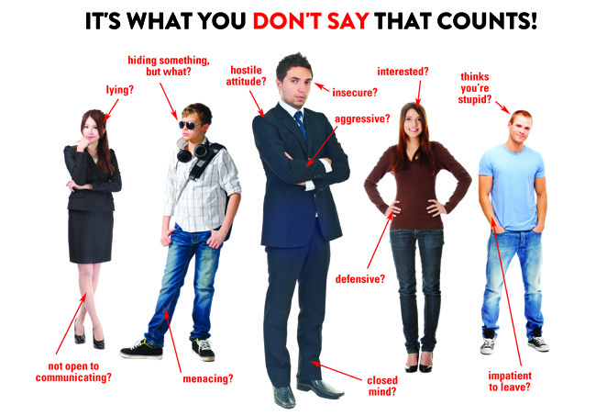

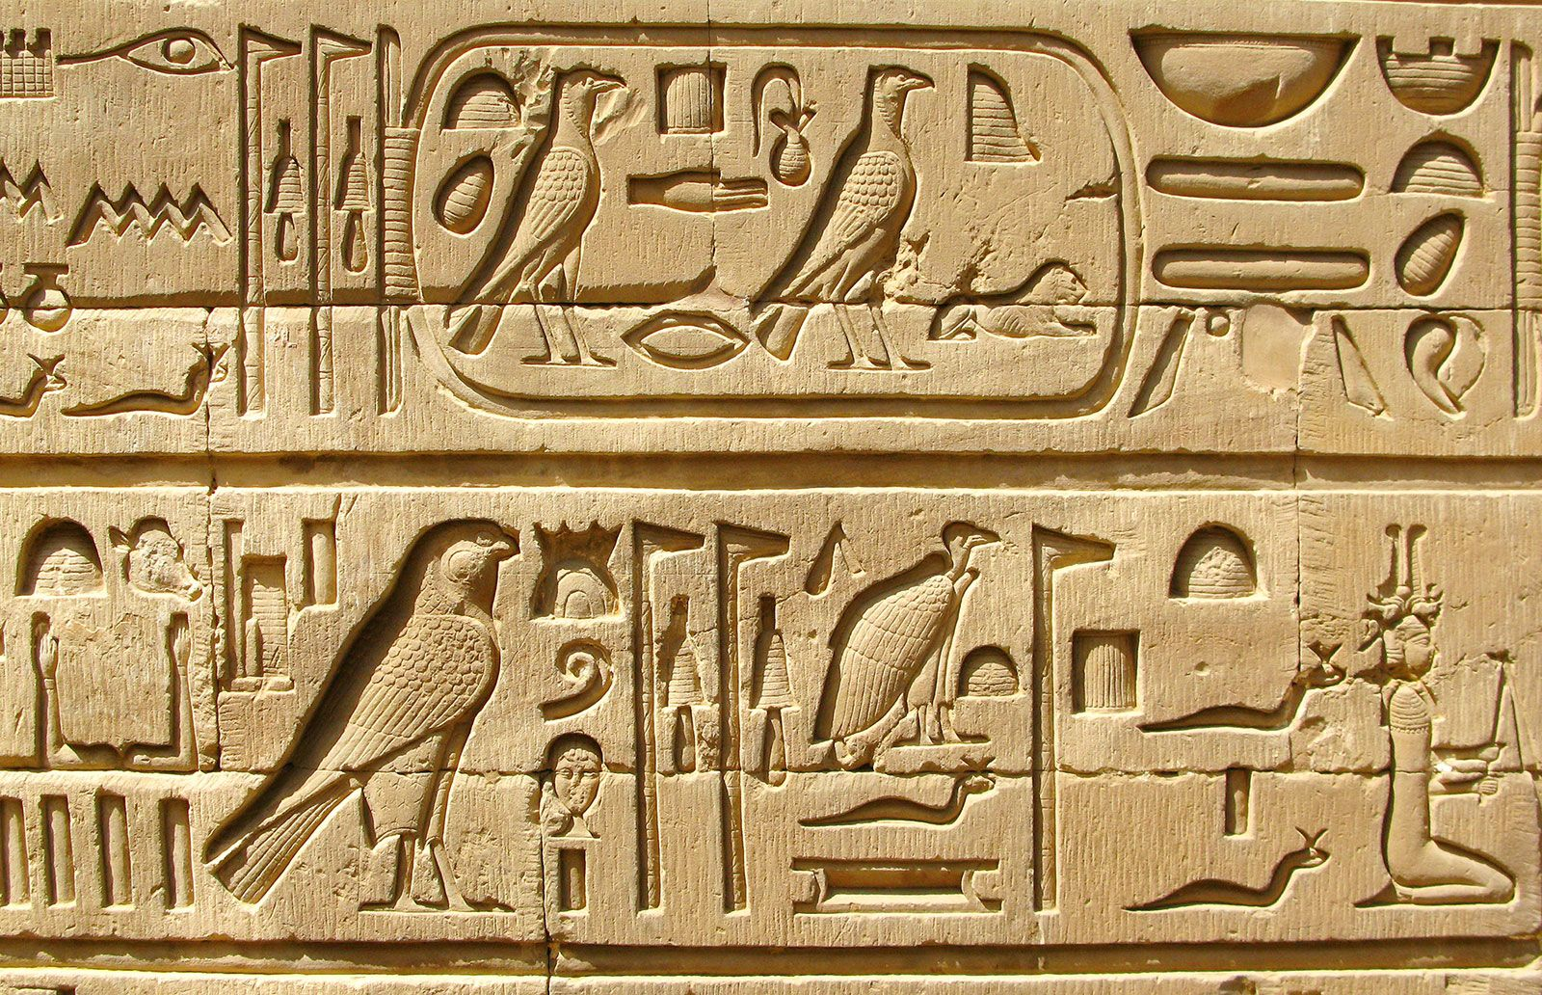
Encoding
Notes:
Body language (body posture/gesture), sign language, hieroglyph
Others: Speech (voice, tone, speed, emphasis, etc.), facial expression, attire, space/location, etc.

Slide 12
Modes of Communication
Oral Communication
Written Communication
Nonverbal communication: communication transmitted without words
  Body language: gestures, facial configurations, and other body movements that convey meaning
  Verbal intonation: an emphasis given to words or phrases that conveys meaning
What are some nonverbal communication examples that you know?
Notes:
Modes of communication include the encoding and the channel used by communication.
There are three primary ways that people communicate; oral communication, written communication, and nonverbal communication. The advantages of oral communication are speed, feedback, and exchange. This is a primary means of communicating. However, if one message must pass through several people it will become distorted. Written communication includes letters, email, blogs, and any other written form. Nonverbal communication is conveyed by our body language, intonations, and facial expressions. This form of communicating can carry a powerful message.

Slide 13
Which methods of Communication is the best?
12 questions to evaluate the communication methods:
1. Feedback: How quickly can the receiver respond to the message?
2. Complexity capacity: Can the method effectively process complex messages?
3. Breadth potential: How many different messages can be transmitted using this method?
4. Confidentiality: Can communicators be reasonably sure their messages are received only by those intended?
5. Encoding ease: Can sender easily and quickly use this channel?
6. Decoding ease: Can receiver easily and quickly decode messages?
Notes:
12 questions to help them evaluate these methods.
1. Feedback: How quickly can the receiver respond to the message? 2. Complexity capacity: Can the method effectively process complex messages? 3. Breadth potential: How many different messages can be transmitted using this method? 4. Confidentiality: Can communicators be reasonably sure their messages are received only by those intended? 5. Encoding ease: Can sender easily and quickly use this channel? 6. Decoding ease: Can receiver easily and quickly decode messages? 7. Time-space constraint: Do senders and receivers need to communicate at the same time and in the same space? 8. Cost: How much does it cost to use this method? 9. Interpersonal warmth: How well does this method convey interpersonal warmth? 10. Formality: Does this method have the needed amount of formality? 11. Scanability: Does this method allow the message to be easily browsed or scanned for relevant information? 12. Time of consumption: Does the sender or receiver exercise the most control over when the message is dealt with?

Slide 14
Which methods of Communication is the best?
12 questions to evaluate the communication methods:
7. Time-space constraint: Do senders and receivers need to communicate at the same time and in the same space?
8. Cost: How much does it cost to use this method?
9. Interpersonal warmth: How well does this method convey interpersonal warmth?
10. Formality: Does this method have the needed amount of formality?
11. Scanability: Does this method allow the message to be easily browsed or scanned for relevant information?
12. Time of consumption: Does the sender or receiver exercise the most control over when the message is dealt with?
Notes:
12 questions to help them evaluate these methods.
1. Feedback: How quickly can the receiver respond to the message? 2. Complexity capacity: Can the method effectively process complex messages? 3. Breadth potential: How many different messages can be transmitted using this method? 4. Confidentiality: Can communicators be reasonably sure their messages are received only by those intended? 5. Encoding ease: Can sender easily and quickly use this channel? 6. Decoding ease: Can receiver easily and quickly decode messages? 7. Time-space constraint: Do senders and receivers need to communicate at the same time and in the same space? 8. Cost: How much does it cost to use this method? 9. Interpersonal warmth: How well does this method convey interpersonal warmth? 10. Formality: Does this method have the needed amount of formality? 11. Scanability: Does this method allow the message to be easily browsed or scanned for relevant information? 12. Time of consumption: Does the sender or receiver exercise the most control over when the message is dealt with?

Slide 15
Which method is the best for a given situation?
Activity
Group work. 10 minutes.
What might be the best communication method for the following scenarios:
An IT technician is to explain how the printers work to all staff.
The company is facing some difficulties, the CEO want to inform the staff and collect their suggestions.
The company want to discuss the collaboration opportunity with a potential supplier.
The CEO want to introduce a new work ethos to the company.
Notes:
Methods: emails, face-to-face, memo, fax, letter, etc.

Slide 16

Barriers to Effective Communication
Information overload: when information exceeds our processing capacity
Filtering: the deliberate manipulation of information to make it appear more favorable to the receiver
Emotions: How a receiver feels influences how he or she interprets it.
Can you find some examples to illustrate them?
Notes:
Let’s look at barriers to effective communication:
It’s not possible to fully read and respond to each message without facing information overload, which is when information exceeds our processing capacity. Today’s employees frequently complain of information overload. Statistics show that 87 percent of employees use email and that the average business email user devotes 107 minutes a day to email—about 25 percent of the workday.
Filtering is the deliberate manipulation of information to make it appear more favorable to the receiver. For example, when a person tells his or her manager what the manager wants to hear, information is being filtered. Or if information being communicated up through organizational levels is condensed by senders, that’s filtering.
Emotions: For example, when someone feels threatened it hinders effective communication because it can disrupt our rational and objective thinking processes. (Defensiveness challenge)

Slide 17
Barriers to Effective Communication
Language: Even in the same language, words mean different things to different people.
Silence: is the absence of information. It can also be a message of noninterest, unwillingness, information overload, a feeling of unfairness or other negative feelings, a preparation of a response, or even information withholding. Therefore, silence can be confusing.
National culture: different culture may favour different communication channels.
Can you find some examples to illustrate them?
Notes:
Language, silence, and national culture can also influence how the message is received and interpreted.
Language: In an organization, employees come from diverse backgrounds and have different patterns of speech. Even employees who work for the same organization but in different departments often have different. For example, jargon—specialized terminology or technical language that members of a group use to communicate among themselves.
Silence is easy to ignore but it can convey a significant message. Someone may remain silent if they feel they are being mistreated or they are unwilling to deal with the topic.
National culture influences the communication. For example, the Japanese rely more on face-to-face communication while in the US we rely more on written communication.

Slide 18
Overcoming the Barriers
Use feedback
Simplify language
Listen actively
  Active listening: listening for full meaning without making premature judgments or interpretations
Constrain emotions
Watch nonverbal cues
How can one practice these solutions?
Notes:
Many communication problems are directly attributed to misunderstanding and inaccuracies. These problems are less likely to occur if the manager gets feedback, both verbal and nonverbal. A manager can ask questions about a message to determine whether it was received and understood as intended.
Because language can be a barrier, managers should consider the audience to whom the message is directed and tailor the language to them. Remember, effective communication is achieved when a message is both received and understood.
Many of us are poor listeners. Why? Because it’s difficult, and most of us would rather do the talking. Listening, in fact, is often more tiring than talking. Unlike hearing, active listening, which is listening for full meaning without making premature judgments or interpretations, demands total concentration.

Slide 19
Barriers of communication
Activity
Pair - work. 10-15 minutes.
Each student attempt to answer the following questions individually for 3-5 minutes, then use the remaining time to discuss with their partners their answers.
What are the main barriers of communications that you have? What make you think so?
How to overcome those barrier?
Notes:
The questions can be answered by thinking about your worst/best communication experiences.

Slide 20

Key terms
Communication
Interpersonal communication
Organisational communication
Control
Sender
Message
Channel
Encoding
Decoding
Receiver
Feedback
Noise
Oral communication
Written communication
Nonverbal communication
Barriers to effective communication
Information overload
Filtering
Emotions
Language
Silence
National culture

Slide 21
References
Mullins, L. J. and McLean, J.E. (2019) Organisational behaviour in the workplace. 12th edn. Harlow: Pearson Education Limited.
Huczynski, A. and Buchanan, D.A. (2019) Organizational behaviour. 10th edn. Harlow: Pearson
Robbins, S. and Coulter, M. (2021) Management, Global Edition. 15th edn. Pearson.
Cole, G. A. and Kelly, P. (2020) Management theory and practice. 9th edn. Hampshire: Cengage Learning EMEA.

Slide 22

I have a question…

