Slide 1
CertHE Applied Leadership and Management in the Workplace
Module: BMSK5011
Developing Workplace Critical Thinking

Slide 2
Blended Learning ​
Session 4

Slide 3


Agenda
Research & Report – Feedback/Discussion
The Assignment
Review and Reflection
A Reading Exercise
Research & Report

Slide 4



Research & Report - Feedback
Tutor/Group feedback and discussion
What do we think Critical thinking is?
How can it be applied within the workplace?
Notes:
The key thing here is to develop a depth of understanding of your chosen management theory, otherwise it will be very difficult to critically assess its impact. Tutor to challenge understanding of key theories and offer feedback. Begin probing over impact upon beliefs, values, etc. How will they use this theory, and illustrate their arguments?

Slide 5
Module Task Assessment
TASK
Generic Assessment Criteria
Identify a management theory relevant to your role and critically assess its impact on your own beliefs, attitudes and values
Critically assess the impact of beliefs, attitudes, and values on your own workplace behaviour.
Ensure the report is structured as a formal report and ‘Harvard’ referencing is used
Engagement with Literature Skills. (20)
Knowledge and Understanding Skills (30)
Cognitive and Intellectual Skills (30)
Practical Application Skills (10)
Transferable Skills for Life and Professional Practice (10)
Notes:
Stress the assessment criteria are applied to how you complete the tasks.
The marks are weighted this way for a purpose – reading and research begets knowledge and understanding, which enables us to use our minds and intellects to develop arguments and draw conclusions, whilst checking out our reasoning by looking at real life workplace examples….and appropriate case studies, in order to write a compelling, professional report that is well structured, and fully referenced, so as to inform the reader of the strength of our sources, the logic of our reasoning, and the insights we have developed.

Slide 6

Critical Thinking
What are the benefits to each of you in developing your critical thinking skills?
What are the benefits to your organisations?
What could be the benefit to your colleagues?
What model/s could help you develop your skills?
What is stopping/could stop you from using critical thinking consistently?
Notes:
Explore student understanding – depth of their own reading and research – what conclusions are they drawing about the topic? Based upon what evidence? Practical experience/s? Weight of evidence? How lucid were the responses to the questions above. Tutors to suggest remedial actions where weak areas are obvious.
Verify that students understand the need to develop arguments…and arguments need conclusions…..and evidence to support the lines of reasoning/premises/propsoitions.

Slide 7

Critical Thinking
What role has reading and research got in developing your critical thinking?
Discussion
Notes:
Facilitate a discussion. Explore how much they have done or are planning to do? Coach the group through how they can improve this aspect of their performance.

Slide 8

Further Review and Reflection
Some additional questions…
Are beliefs and values important? If yes/no, why?
What is the relationship between beliefs, values, attitudes and behaviours?
Why do we need to understand our own beliefs and values?
How might our own beliefs and values impact negatively in the workplace?
How can we prevent this?
Take a few minutes to think critically about these questions and prepare to discuss your responses.
Notes:
An opportunity to discuss the groups understanding of these concepts. Facilitate by exploring additional questions that will come from student responses top the above, and drive additional/supplementary learning..

Slide 9

Critical Thinking: Reading Critically
Read the ‘Antibiotics on trial’ article and answer all the questions
Notes:
Distribute the ‘Antibiotics on Trial’ exercise prior to the session – use this session to take response from students and discuss their findings.

Slide 10
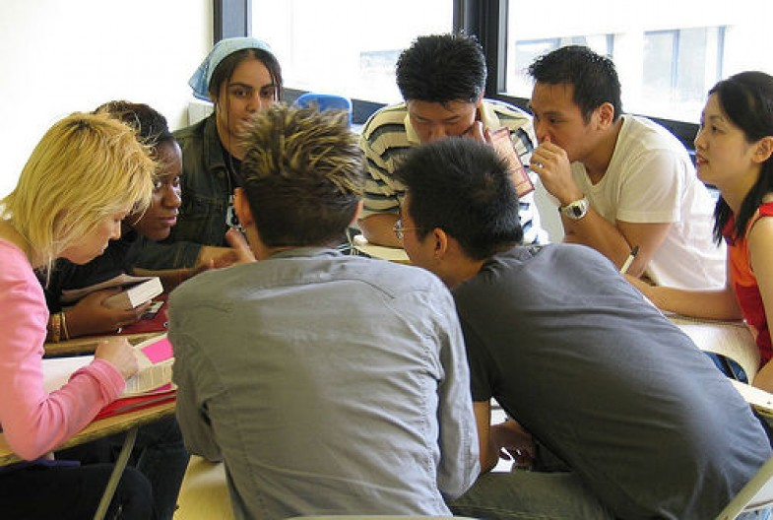
Discussion
Feedback, and discussion, of your findings…
Notes:
Explore differences of opinion – ask about what evidence they identified/used.
Main learning point – how ‘critical and insightful’ are their responses…or are they just ‘firing from the hip’?

Slide 11

Summary
Take 5 minutes to reflect upon this session – what have you learnt?
Any key areas you want to research further?
What can help you with your assignment?
What can help you in your career?
Engage with your tutors on the topics

Slide 12


Reading & Research
For next week’s session:
Conduct research on Values, Beliefs, and Attitudes

