Slide 1

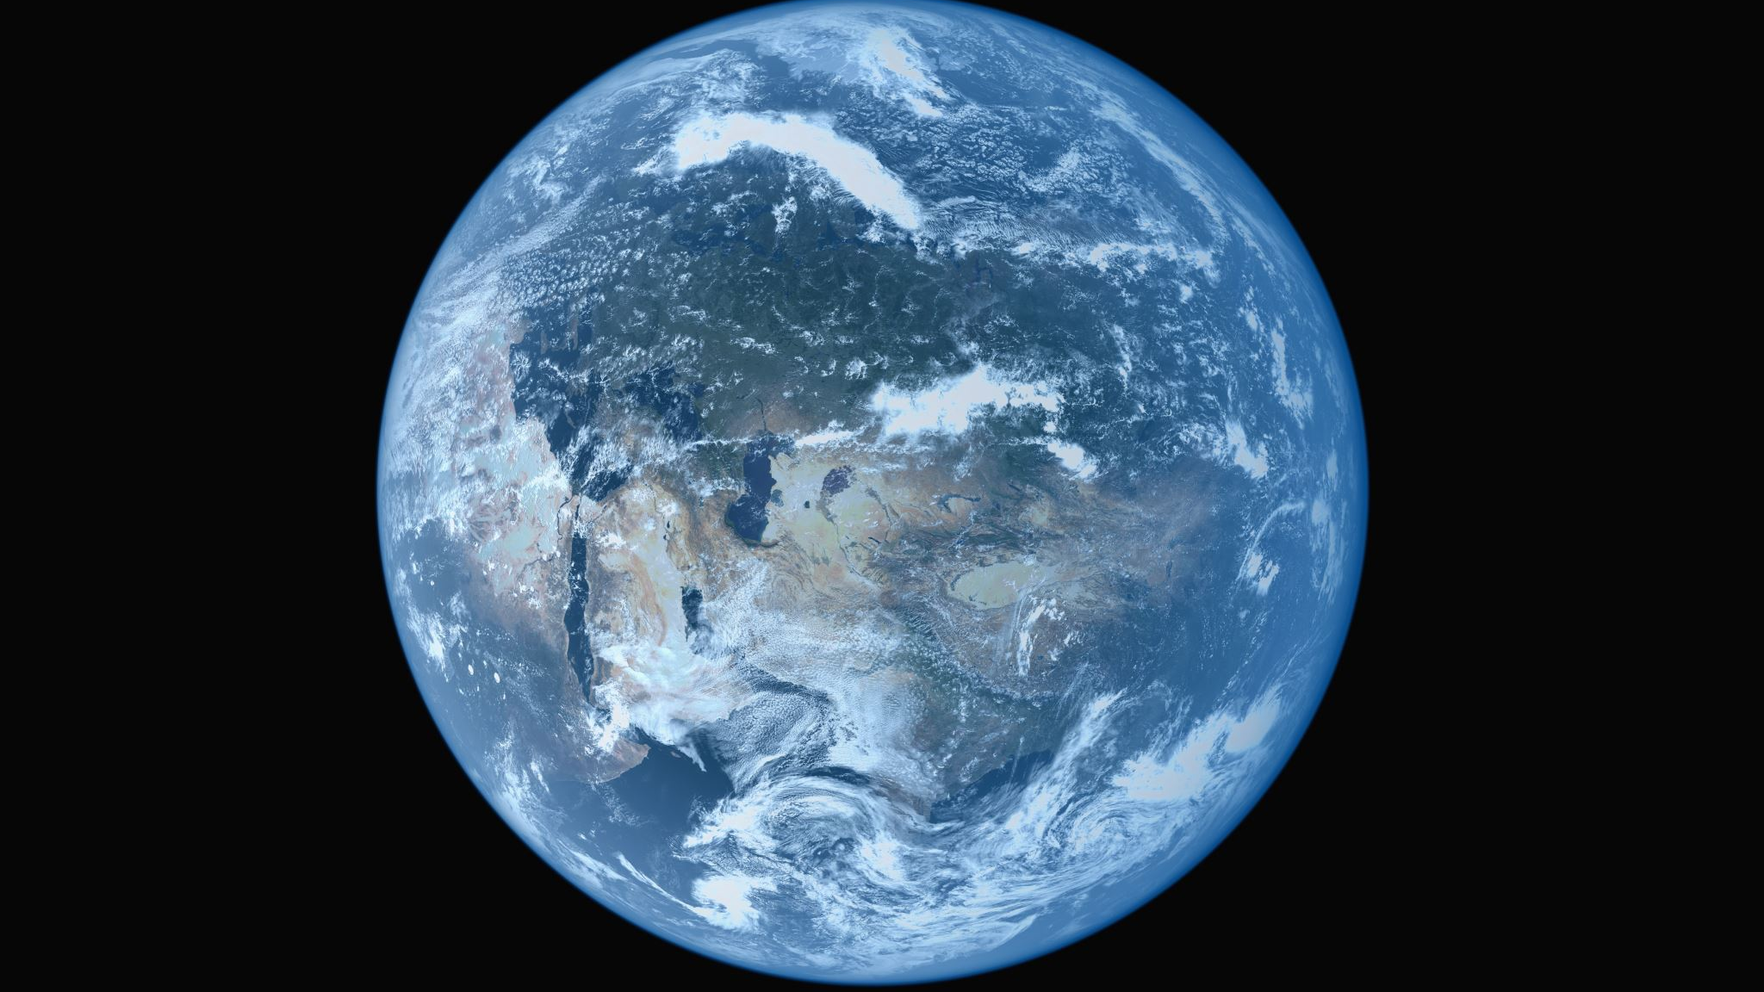

Global Perspectives in Education
SJIE6006
Laura Lynch
1707998

Slide 2
Education for Sustainable Development and Global Citizenship
(ESDGC)
Education to prepare young people for life in the 21st century!
Links society, the economy and environment between ourselves and people throughout the world.
The rights and needs of the present and future generations.
The actions that ourselves and organizations take in response to local and global implications of everything we do.
The understanding of relationships between human rights, power and resources.
common-understanding-for-school.pdf (gov.wales)
Welsh assembly, (2008)

Slide 3
The OECD PISA global competence framework
The four dimensions of global competence
Knowledge
Skills
Attitudes
Values
Effective education for global competence creates opportunities for students to use their knowledge, attitudes, skills and values to develop and exchange ideas on global issues in and outside the classroom and interacting with others from different culture backgrounds.
Oecd.org, (2018)

Slide 4
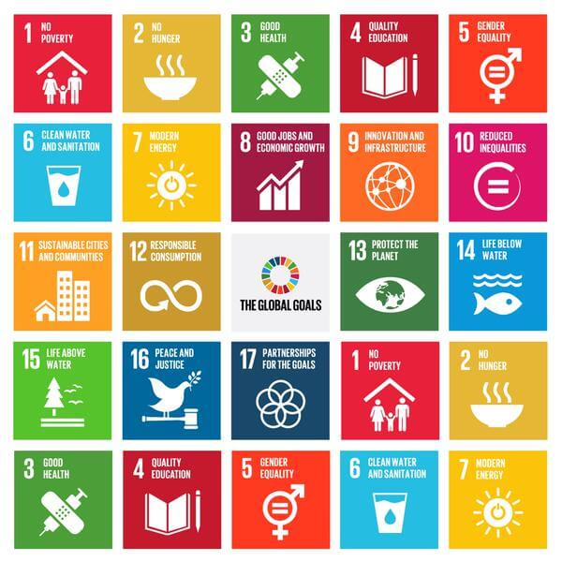
The Global Goals for Sustainable Development
United Nations Members adopted the sustainable development goals (SDGs) in 2015. The SDGs identify poverty is a main barrier and to end poverty strategies must be in place to improve education, reduce inequality and encourage economic growth whilst working to preserve the oceans, forests and work towards tackling climate change.
Globalgoals.org, (N.D)

Slide 5
The United nations convention on the rights of the child (UNCRC)
Article
27
24
28
29
Children have the right to an education where each child SHOULD DEVELOP TO THEIR FULL POTENTIAL. RESPECT SHOULD BE ENCOURAGED TOWARDS PARENTS, THEIR OWN AND OTHER CULTURES. Living standards must be good enough to meet physical and mental needs as children have the right to good quality health care, clean water and nutritious food.
Gov.wales, (2011)

Slide 6

How can schools promote global issues through the ESDGC?
Partnerships are fundamental to the delivery of ESDGC to help develop global awareness within education
Welsh Assembly , (2008)
https://allsoulsshreveport.org/site/wp-content/uploads/2019/11/UnityHands.png

Slide 7
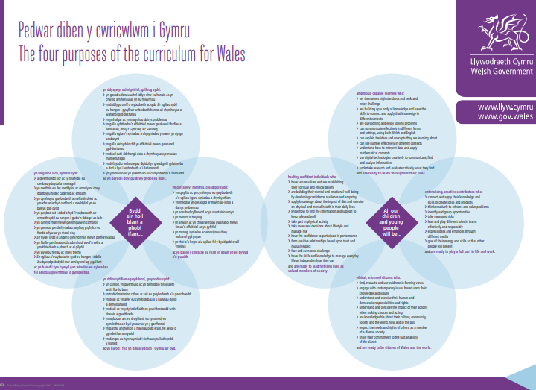
The Four purposes of the curriculum for wales
Ambitious, capable learners
healthy, confident individuals
enterprising, creative contributors
ethical, informed citizens
Welsh.gov, (2018)

Slide 8

Personal and social education framework
(2008)
Education should offer opportunities to all students to promote their health and emotional well-being, to become actively involved citizens to prepare students for live long learning whilst promoting sustainable development and global citizenship.
hwb.gov.wales, (2008)

Slide 9
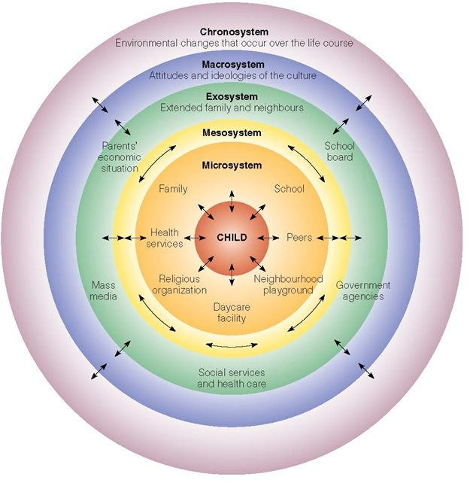
Bronfenbrenner (1979)
Ecological systems theory
This theory suggests everything in the surrounding ENVIRONMENT to EFFECT ON A PERSON’S DEVELOPMENT, THROUGH encountering different environments throughout life which influence on behaviours. Bronfenbrenner suggests within his theory that interactions between people, culture and the environments has great significance in cognitive development. Highlighting the importance of partnerships, The Global Goals for Sustainable Development, The OECD PISA global competence framework, the four purposes of the curriculum for wales, personal and social education framework (2008) and the importance of the roles education plays in creating experiences and using or preparing for all the above.
Guy-Evens, (2020)
Guy-Evans, (2020)

Slide 10


RIGHT’S RESPECTING, PIONEER, eco SCHOOL
Platinum Eco school
Silver and gold woodland trust award- green tree schools.
Sustrains bronze award
Esdgc gold award
Rights respecting school Gold award
WORKING TOGETHER
Blogspot.com

Slide 11
Reference’s
Pierson, J, (2010) Tackling Social Exclusion 2nd edition, Great Britain, TJ International Ltd.
Jensen, E (2009) Teaching with Poverty in Mind, United States of America, ASCD publications.
Leicester, M (2008 Creating An Inclusive School, Great Britain, Continuum International Publishing Group.
A Wales first for Pembroke Dock Community School | Western Telegraph
https://www.westerntelegraph.co.uk/news/15783547.a-wales-first-for-pembroke-dock-community-school
Accessed 6-2-21
Bronfenbrenner’s Ecological systems Theory
Guy-Evens, (2020) imply Psychology
https://www.simplypsychology.org/Bronfenbrenner.html
Accessed 13-2-21
Common understanding-for-school-pdf (gov.wales)
https://hwb.gov.wales/api/storage/eaf467e6-30fe-45c9-93ef-cb30f31f1c90/common-understanding-for-school.pdf
Accessed 12-1-21
Eco Pembroke Dock Community School
https://www.pembrokedockcommunityschool.co.uk/eco/
Accessed 1-2-21
Handbook- PISA 2018-Global-Competence.pdf (oecd.org)
https://www.oecd.org/pisa/Handbook-PISA-2018-Global-Competence.pdf
Accessed 12-1-21
Inspection Report Template (primarysite-prod-sorted.s3.amazonaws.com)
https://primarysite-prod-sorted.s3.amazonaws.com/pembrokedockcp/UploadedDocument/18826fe0e20541c0a488004f06371042/pembroke-dock-cp-school.pdf
Accessed 7-2-21
Pembroke and Pembroke Dock Observer
Paul Evans, (2020)
https://www.westerntelegraph.co.uk/news/15181159.international-schools-award-for-pembroke-dock-community-school/
Accessed 12-2-21
PSE Framework 2008 (E) (gov.wales)
https://hwb.gov.wales/api/storage/35fae761-054b-4e9b-928c-03e86b3e207f/personal-and-social-education-framework.pdf
Accessed 15-2-21
Rights Respecting Schools Pembroke Dock Community School
https://www.pembrokedockcommunityschool.co.uk/rights-respecting-schools-1/
Accessed 17-1-21

Slide 12
Reference’s
stock-photo-global-issues-in-word-collage-97061114-450x340.jpg (450×340) (coplacdigital.org)
https://geneseo.napla.coplacdigital.org/wp-content/uploads/2016/11/stock-photo-global-issues-in-word-collage-97061114-450x340.jpg
Accessed 12-2-21
Sustrans Bike It/ JRSOs | Pembroke Dock Community School
https://www.pembrokedockcommunityschool.co.uk/sustrans-bike-it-jrsos/
Accessed 7-2-21
Targets-and-strategies-for-priority-areas-summary-2019.pdf (primarysite-prod-sorted.s3.amazonws.com)
https://primarysite-prod-sorted.s3.amazonaws.com/pembrokedockcp/UploadedDocument/a59dd6df42f84f7c92c81978e0b417ac/targets-and-strategies-for-priority-areas-parent-summary-2019.pdf
Accessed 3-2-21
The global goals
https://www.globalgoals.org
Accesses 12-1-21
UNCRC Rights EN (1).pdf (gov.wales)
https://gov.wales/sites/default/files/inline-documents/2019-03/1_UNCRC%20Rights_En%20%281%29.pdf
Accessed 23-1-21
UNDP-Annual-Report-2019-en.pdf
UNDP-Annual-Report-2019-en.pdf
Accessed 29121
Unityhands.png (882x761) (allsoulshreveport.org)
https://allsoulsshreveport.org/site/wp-content/uploads/2019/11/UnityHands.png
Accessed 14-2-21
What is Erasmus And Are You Eligible? UCAS
https://www.ucas.com/undergraduate/what-and-where-study/studying-overseas/what-erasmus
Accessed 29-1-21
What is international development concern worldwide
https://www.concern.org.uk/what-is-international-development?gclid=EAIaIQobChMI7pPdssL07gIV4-jtCh1loA8gEAAYAiAAEgKklvD_BwE
Accessed 10-1-21

