Slide 1
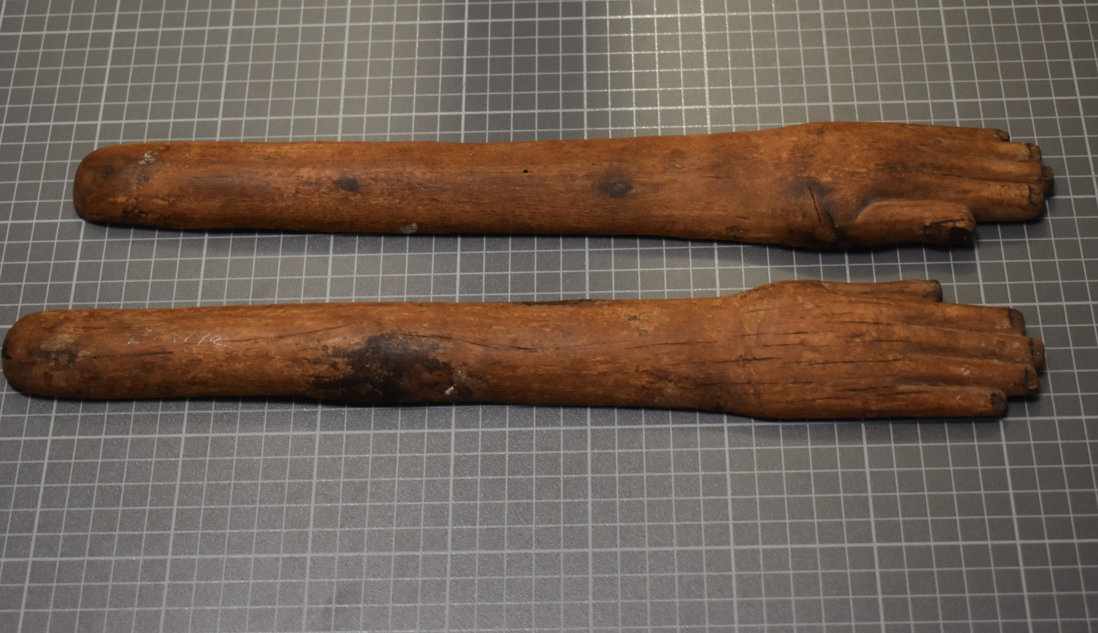
Item: CCM 2018.994
Egyptian ‘clappers’
An Object Analysis
Thomas Clarke (1900472)
BA Ancient Civilisations

Slide 2
“Death was a constant presence in ancient Egypt….an ambivalent attitude towards death; while they hated it for depriving them of the joys of life…it was a threshold that had to be crossed if the eternal afterlife was to be reached.” (Taylor 2010: 82)

Slide 3
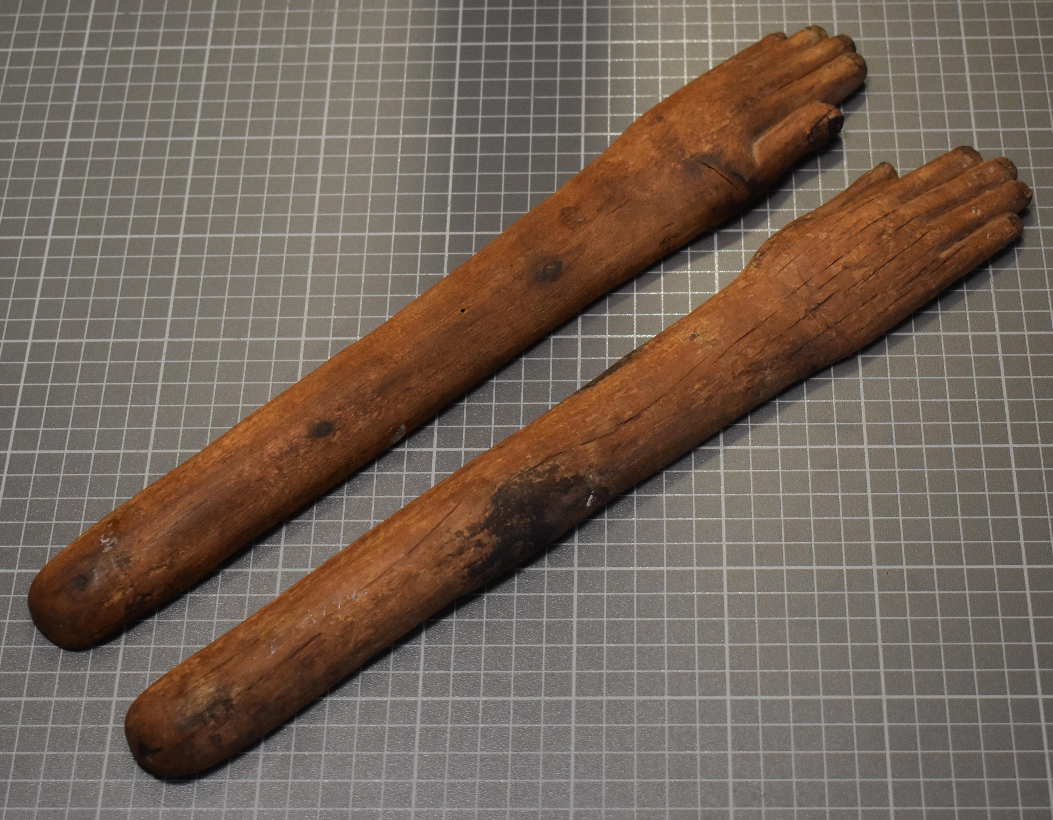
Measurements and General Information
Item No. : CCM 2018.994
Material: Wood (unknown type)
Dimensions:
Left Hand:
L: 39.5 cm
W (at widest): 5.5 cm
C: 9.6 cm
Right Hand:
L: 40 cm
W (at widest): 5.5 cm
C: 9.5 cm
Clappers are in isolation and the context in which they were found is unclear
Fig. 1 - © Dr Katharina Zinn

Slide 4
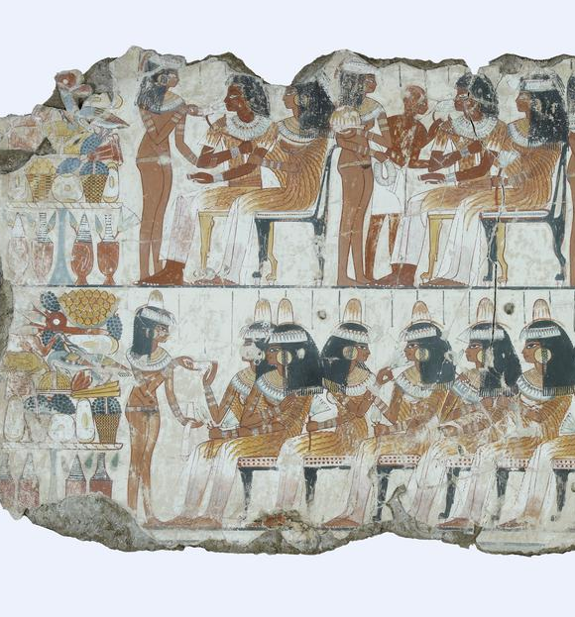
What are clappers?
Clappers were musical instruments with evidence of their use dating back to Predynastic Egypt
Originally, their function may have been for hunting, (adopted from throwsticks) used for scaring wild-fowl
As an instrument, they would have been found at large gatherings accompanying other instruments such as harps and flutes, as well as singers and dancers
Fig 2. - Banquet Scene from the Tomb of Nebamun (BM EA 37986)

Slide 5
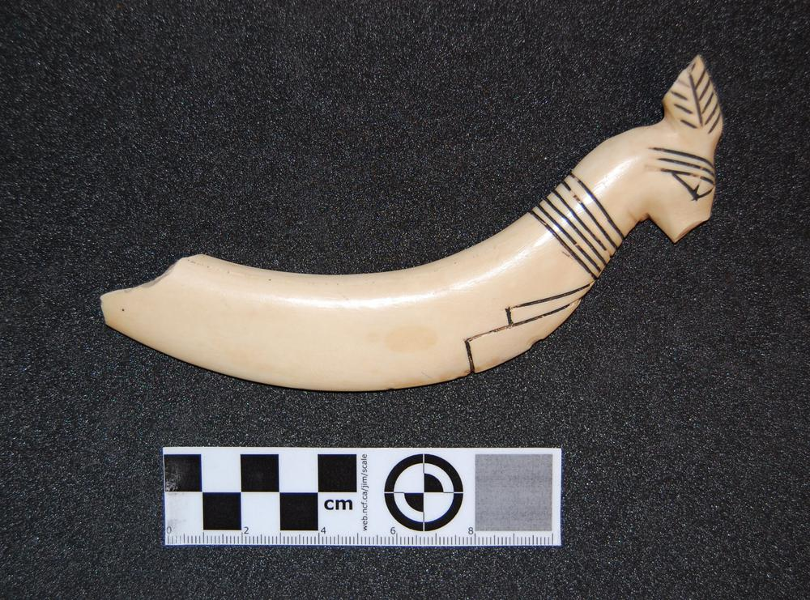
What form did they take?
They were constructed from wood or bone, but seemingly more often, ivory (hippo canine)
Many ivory examples curved, due to the source material. Straight, forearm shaped clappers were a common design of the Middle Kingdom (Morris 2014: 290)
Decoration often took the form of bracelets, roundels, human heads, and detailed carving of the fingers/fingernails
As well as hand features, some culminated in heads (either human/animal) – this seems to be an element that revolves around the date of manufacture
Fig 3. - 1st Dynasty Theban Ivory Clapper. Features animalistic head – thought to be a rabbit or hare – a commonly used feature of the dynasty (BM EA 18186)

Slide 6
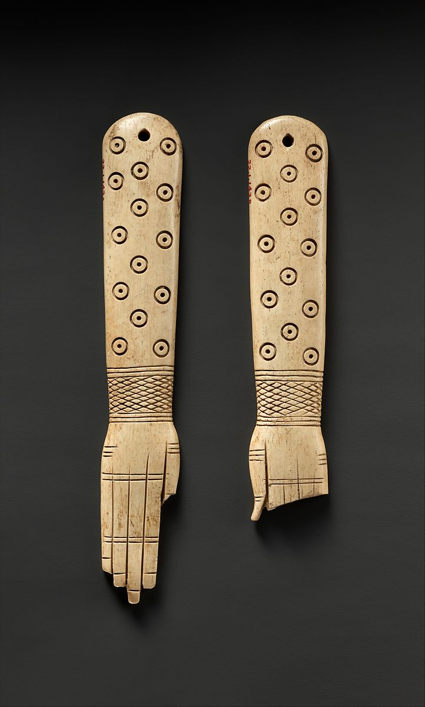
How does CCM 2018.994 compare to other examples?
Our object is a pair of two unadorned wooden (type unknown) clappers with a rounded edge, and a carved hand opposite
The underside of each clapper is flat and undecorated
Some examples display holes near the rounded edge, signs of wear indicate they were fastened together with string/twine (Oppenheimer et al 2015: 105, Hickman 1949)
This is not evident on our example
Fig 4. - 12-13th Dynasty Memphite Ivory Clappers Evident holes – joined and held in one hand (MMA 22.1.143a,b)

Slide 7
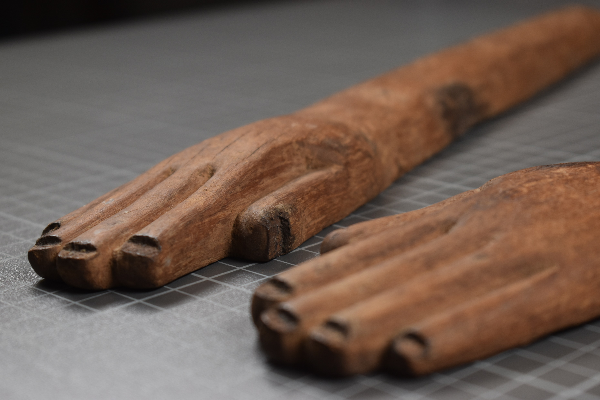
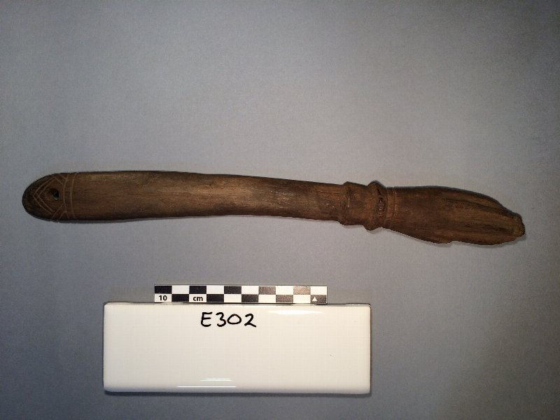
Comparative Study Continued
Unlike others, CCM 2019.994 shows no inscriptions (of jewellery or Hathoric depictions), except for anatomical studies of fingers and fingertips
Morris (2014: 286) suggests that similar examples (with very little inscription) were seen within the Sixth Dynasty lasting through most of the Thirteenth Dynasty
Fig 5. - © Dr Katharina Zinn
Fig 6. - 18-19th Dynasty Wooden Clapper from Gurob. Penn Museum (E302)

Slide 8

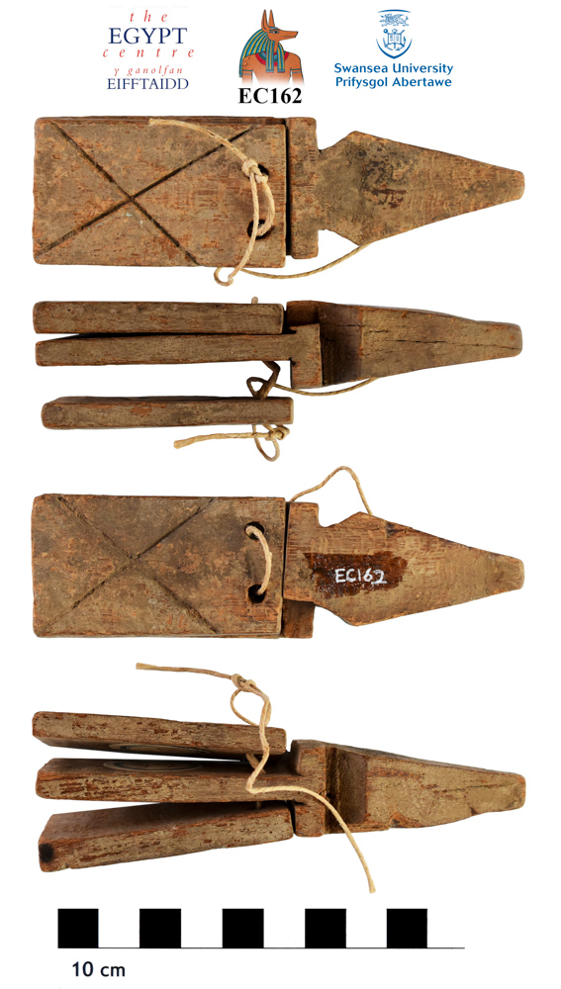
Thoughts On The Clappers’ Length
Relatively long in length (39.5 cm and 40 cm) compared to other examples I have seen
Assessing a Hathoric dancing scene from the Tomb of Mereruka, Sourdive estimates similar at approximately 30-38 cm in length (Sourdive 1984: 195)
But this may have been overemphasized in art to convey the symbolism of the hand
Larger than most examples = EA63114 at Mostagedda 1008 for example
EC162 (with a short handle), measures at 11.5 cm – potentially for a child
Can we argue then that its size is indicative of the user?
Fig 7. – 6th Dynasty Ivory Clapper from Mostagedda 1008. Length: 11.4cm (BM EA63114)
Fig 8. - A wooden Graeco-Roman clapper (EC162)

Slide 9
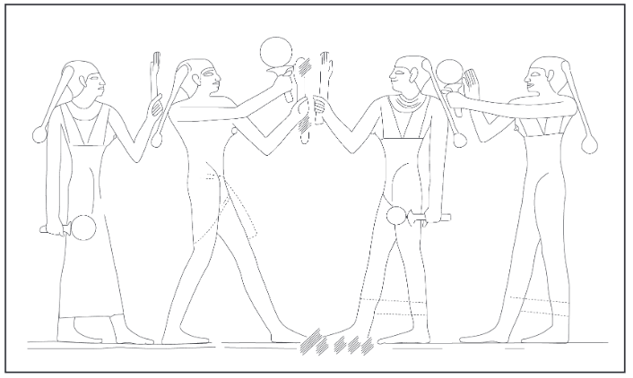
Fig 9. - The Hathoric ‘Dancing’ Scene
‘The Mastaba of Mereruka Part II: Chamber A 11-13, Doorjambs and Inscriptions of Chambers A 1-21, Tomb Chamber, Exterior, Plates 104-219’
Plate. 164

Slide 10
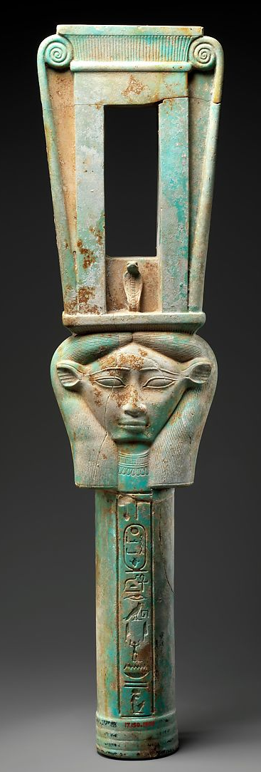
Brief Introduction to Hathor
Egyptian mythology tells of creation’s birth when Atum (the ’creator god’) performed an act of self-copulation, resulting in the creation of Shu and Tefnut. Hathor was said to personify his hand, and her epithet of the ’hand of Atum’ was created
Therefore, great symbolism is generated in the human hand. It was a protective force
Epithets include: ‘Goddess of Women, Female Sexuality and Motherhood’ and the ‘Goddess of Joy, Music and Happiness’ (Wilkinson 2003: 141 - 143)
‘Lady of the Sycamore’ - provides “food and drink for the deceased in the afterlife” (Ikram 2003: 187) life-giving/life-sustaining powers
Fig. 10: 26th Dynasty Faience Naos Sistrum depicting Bat. Inscriptions relate to Pharaoh Apries (MMA 17.190.1959)

Slide 11
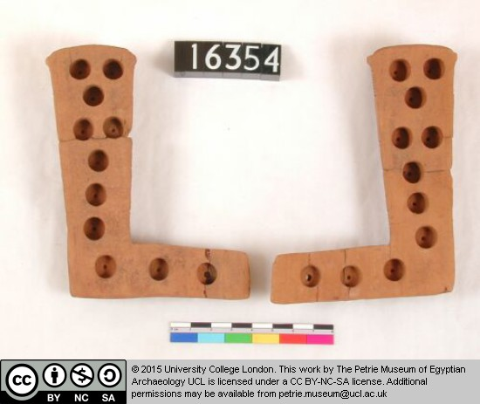
Egyptian Clappers and Music
An ‘idiophone’ (through vibration makes its own sound) used to keep time alongside harps and flutes, setting a rhythm for chanting/dancing
Musicians, singers and dancers performed at temple festivals - the Opet festival (renewal of King’s Ka) and Sed festival (renewal of King’s vitality)
Tomb relief of Nebkaure proclaims ‘beautiful dancing for your ka everyday’ (Nord 1981: 141)
Clappers generated more volume than hand-clapping (this could relate to coherence in musical performances, or the ever-present preoccupation of driving away ‘evil’ forces)
Fig. 11 - Wooden Clappers (date unknown) featuring bored holes into underside – amplifying the noise when struck. The Petrie Museum (UC16354)

Slide 12
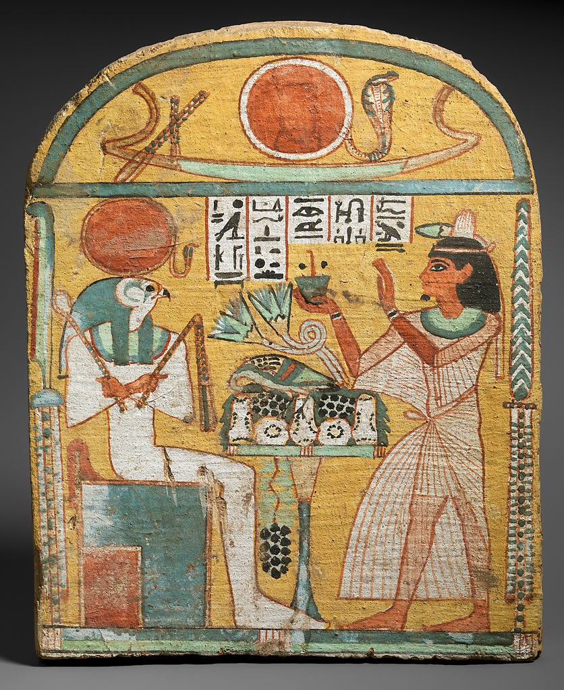
The Egyptian Funerary Sphere
Pyramid Texts, Coffin Texts and the Book of The Dead all contributed to the general ideology - “Hymns, prayers, litanies and magical spells” (Munro 2010: 54) reiterated the idea of protection/guidance for the deceased, in the afterlife
Burials were formal and celebrated occasions with music and dancing playing a large part in the funerary rites; Opening of the Mouth included: “chanted invocations to the deity, singing, dancing and the playing of musical instruments.” (Pinch 1993: 340)
As mortuary banquets continued through the night, efforts to ward off “demons and the malevolent dead” (Harrington 2016: 24) achieved through the creation of loud noises
Khener dancers, imitating Hathor, often involved in Hathoric rites for the deceased, and were attached to funerary estates (Nord 1981: 141)
Fig. 12: 22nd Dynasty wooden stela of Aafenmut from Thebes. Offerings are presented to Re-Harakhty. Metropolitan Museum of Art (MMA 28.3.35)

Slide 13
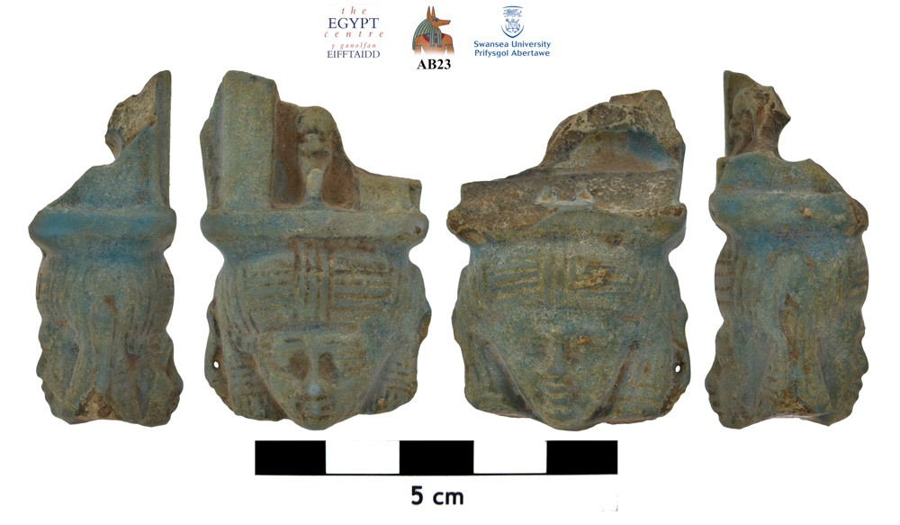
How does this item fit into the Egyptian funerary sphere?
Funerary processions incorporated singers and dancers - “… the dances and songs that called upon her asked for her to bestow the deceased with immortality in the afterlife in her function as a goddess of rebirth” (Johnson 2015: 7)
‘Performative magic’ (Pinch 1994: 86) meant deity assistance for deceased and provided a base upon which an individual’s soul was guarded
Shaking of sistra (as Hathor did herself) drove away malevolent forces and fortified the gods, it was a medium through which they could communicate
AB23 – Evidence that sistra were left at Hathoric shrines. Items they left, a desired source of alleviation, it was hoped that their ‘evils’ would be lifted
Fig. 13 - Late Period faience sistrum fragment. Found within a shrine to Hathor at Abydos. Egypt Centre (AB23)

Slide 14
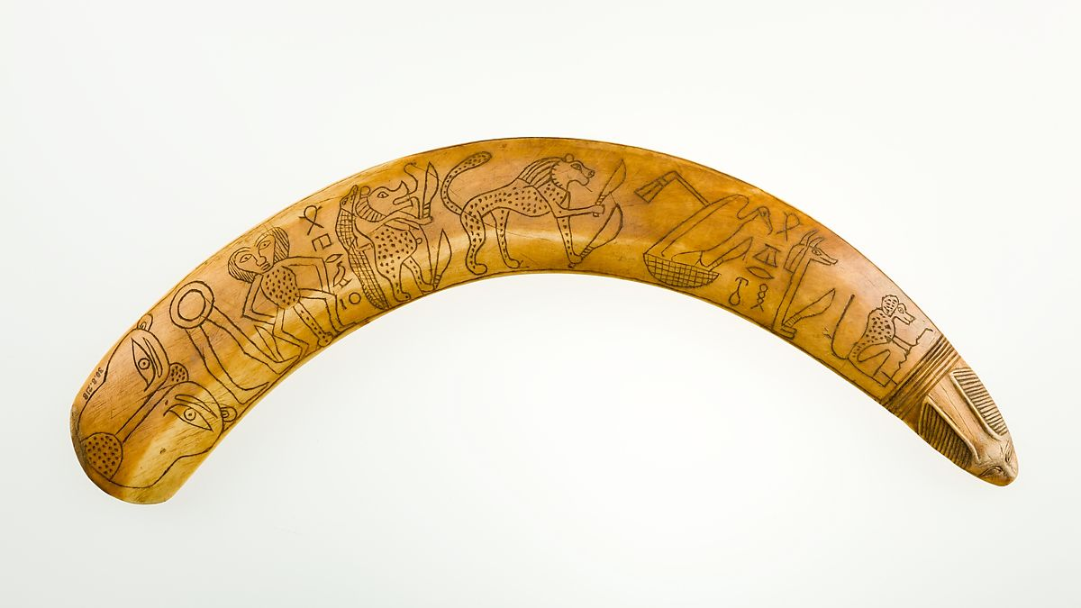
Clappers in the Context of Burial
Found in larger concentration near mortuary temples
Items accompanied clappers, apotropaic wands, faience figurines and bronze mirrors – I feel the theme of renewal/rebirth runs collectively
Wands a symbol of birth/re-birth – drawn around the mother and newborn child as a ‘barrier’. Signifies protection for the ‘reborn’ individual in the next life
Rebirth vital concept – one aspect ensured protection for children “a time of great joy” (Brewer & Teeter 2007: 114) in the face of such adversity – but also an aversion of death, something they so feared
“… a rod or staff was a token of authority, carried by kings, priests and officials… probably used to establish the magician's authority over the creatures depicted on them” (Pinch 1994: 42)
Fig. 14 - 12-13th Dynasty Ivory apotropaic wand. On either side is inscribed: ‘protection for the day’ and ‘protection for the night’. An ivory item meant they had ‘conquered’ the hippo, a fearsome enemy to the Egyptians. (MMA 30.8.218)

Slide 15
Conclusion
The context I feel we find item CCM 2018.994 in, is its use in invoking ‘otherworldly’ forces both in life and death. Its resonance drove away that which Egyptians feared and was a vessel for the transition into the Underworld
The ‘Hand of Atum’ was inception; inherently signified birth, its place in the tomb meant Hathor (who guarded the Underworld) heard the appeals of those who ‘clapped’ for their rebirth and longevity
Might it have been in the tomb of a Priestess of Hathor? Or someone who was concerned with their eternal status?
Fig. 15 - © Dr Katharina Zinn

Slide 16
Bibliography
Brewer, D.J and Teeter, E (2007) ‘Egypt and the Egyptians’; Cambridge: Cambridge University Press, pg 114
Harrington, N (2016) ‘The Eighteenth Dynasty Egyptian Banquet: Ideas and Realities’ in Draycott, C.M et al ‘Dining and Death: Interdisciplinary Perspectives on the ‘Funerary Banquet’ in Ancient Art, Burial and Belief’; Leuven: Peeters Publishers, pg 24
Hickman, H (1949) ‘Instruments de musiqué’, Cataloue général due Musée du Cairo; Cairo: Le Caire, Impr. de l’Institut français d’archéologie orientale
Ikram, S (2003) ‘Death and Burial in Ancient Egypt’; Cairo: The American University in Cairo Press, pg 187
Johnson, H (2015) ‘Women’s Roles in Old Kingdom Funerals: A Preliminary Study’; PhD Thesis, Bloomington: Indiana University Press, pg 7, https://www.academia.edu/15150512/Women_and_the_Old_Kingdom_Funeral [date accessed: 26/1/2021]
Morris, E (2014) ‘Middle Kingdom, clappers, dancers, birth magic, and the reinvention of ritual’, ‘Company of Images: Modelling the Imaginary World of Middle Kingdom Egypt (2000 – 1500BC), Proceedings of the International Conference of the EPOCHS Project held 18th – 20th September 2014 at UCL, London; Leuven: Peeters Publishers, pg 286
Morris, E (2014) ‘Middle Kingdom, clappers, dancers, birth magic, and the reinvention of ritual’, ‘Company of Images: Modelling the Imaginary World of Middle Kingdom Egypt (2000 – 1500BC), Proceedings of the International Conference of the EPOCHS Project held 18th – 20th September 2014 at UCL, London; Leuven: Peeters Press, pg 290
Munro, I (2010) ‘The Evolution of the Book of the Dead’ in Taylor, J.H (2010) ‘Journey Through The Afterlife: Ancient Egyptian Book of the Dead’; Cambridge, Massachussetts: Harvard University Press, pg 54
Nord, D (1981) ‘The term Xnr: “Harem” or “Musical Performers?” in Simpson, W.K and Davis, W (eds), ‘Studies in Honor of Dows Dunham, Studies in Ancient Egypt and the Sudan’; Boston: Museum of Fine Art Boston, pg 141
Nord, D (1981) ‘The term Xnr: “Harem” or “Musical Performers?” in Simpson, W.K and Davis, W (eds), ‘Studies in Honor of Dows Dunham, Studies in Ancient Egypt and the Sudan’; Boston: Museum of Fine Art Boston, pg 141

Slide 17
Bibliography continued …
Oppenheimer, A et al (2015) ‘Ancient Egypt Transformed: The Middle Kingdom’; New York: Metropolitan Museum of Art Publication, pg 105
Pinch, G (1993) ‘Votive Offerings to Hathor’; Oxford: Griffith Institute, pg 340
Pinch, G (1994) ‘Magic in Ancient Egypt’; Avon: The Bath Press, pg 42
Pinch, G (1994) ‘Magic in Ancient Egypt’; Avon: The Bath Press, pg 86
Sourdive, C (1984) ‘La main dans l’Égypte pharonique. Recherches de morphologie structural sur les objects égyptiens comportant une main’; Berne-New York: Peter Lang Gmbh, Internationaler Verlag der Wissenschaften, pg 195
Taylor, J.H (2010) ‘Journey Through The Afterlife: Ancient Egyptian Book of the Dead’; Cambridge, Massachussetts: Harvard University Press, pg 82
Wilkinson, R.H (2013) ‘The Complete Gods and Goddesses of Ancient Egypt’; London: Thames and Hudson Ltd, pgs 141 – 143

Slide 18
Illustration Credits
Cover Slide Image: © Dr Katharina Zinn, UWTSD [date accessed: 25th-27th January 2021]
Fig. 1: © Dr Katharina Zinn [date accessed: 25th-27th January 2021]
Fig. 2: Tomb of Nebamun: https://www.britishmuseum.org/collection/galleries/egyptian-life-and-death#&gid=1&pid=2 [date accessed: 25th-27th January 2021]
Fig. 3: Theban Ivory Clapper: https://www.britishmuseum.org/collection/object/Y_EA18186 [date accessed: 25th-27th January 2021]
Fig. 4: Ivory Memphite Clappers: https://www.metmuseum.org/art/collection/search/546840 [date accessed: 25th-27th January 2021]
Fig. 5: © Dr Katharina Zinn [date accessed: 25th-27th January 2021]
Fig. 6: Wooden Clapper from Gurob: https://www.penn.museum/collections/object/259690 [date accessed: 25th-27th January 2021]
Fig. 7: Drawing of Mostagedda 1008 Clapper: Morris, E (2014) ‘Middle Kingdom, clappers, dancers, birth magic, and the reinvention of ritual’, ‘Company of Images: Modelling the Imaginary World of Middle Kingdom Egypt (2000 – 1500BC), Proceedings of the International Conference of the EPOCHS Project held 18th – 20th September 2014 at UCL, London; Leuven: Peeters Publishers, pg 292
Fig. 8: Wooden Graeco-Roman Clapper: https://egyptcentre.abasetcollections.com/Objects/Details/5196?SavedSelections=$Search-EC162$Page-1 [date accessed: 25th-27th January 2021]
Fig. 9: Hathoric Dancing Scene: The Saqqara Expedition (1938): ‘The Mastaba of Mereruka Part II: Chamber A 11-13, Doorjambs and Inscriptions of Chambers A 1-21, Tomb Chamber, Exterior, Plates 104-219’ Chicago, The University of Chicago Oriental Institute Publications, Pl. 164

Slide 19
Illustration Credits continued….
Fig. 10: Bat Naos Sistrum: https://www.metmuseum.org/art/collection/search/549513 [date accessed: 25th-27th January 2021]
Fig. 11: Bored Wooden Clappers: https://petriecat.museums.ucl.ac.uk/detail.aspx [date accessed: 25th-27th January 2021]
Fig. 12: Stela of Aafenmut: https://www.metmuseum.org/art/collection/search/548518 [date accessed: 25th-27th January 2021]
Fig. 13: Hathor Sistrum Fragment: https://www.egypt.swan.ac.uk/the-collection-2/the-collection/ab23/ [date accessed: 25th-27th January 2021]
Fig. 14: Apotropaic Wand: https://www.metmuseum.org/art/collection/search/545740 [date accessed: 25th-27th January 2021]
Fig. 15: © Dr Katharina Zinn [date accessed: 25th-27th January 2021]

