Slide 1
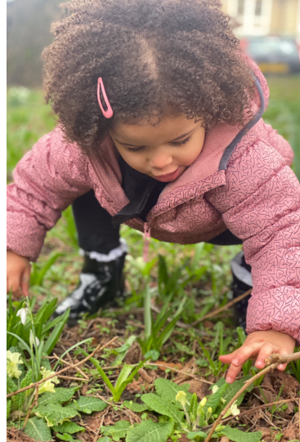
Mental Health and
Emotional Well-being in Children
Rebecca Oaten
Figure 1: Welsh Government (2022), Curriculum for Non-Maintained Nursery Settings. Image

Slide 2
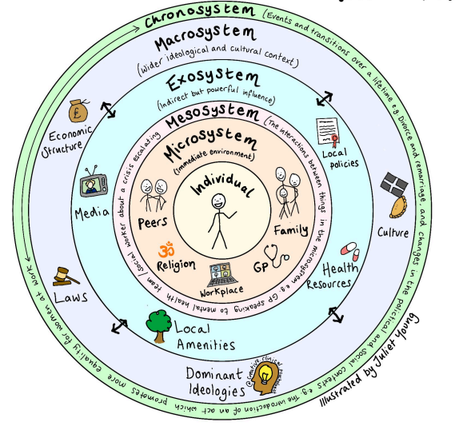
Mental health difficulties among children and young people are increasing (Public Health Wales, 2025)
Anxiety and depression have shown the largest rise
The increase began before COVID-19
Factors such as poverty, inequality, academic pressure, and parental mental health can negatively affect well-being
Early intervention and strong support networks are essential (Public Health Wales, 2026)
Rising Mental Health Difficulties in Young People
Figure 2. Bronfenbrenner's ecological systems
Notes:
Bronfenbrenner-This theory supports the idea that children’s wellbeing is shaped by environmental factors, as development occurs through everyday interactions within family, school and community contexts, all of which are influenced by cultural practices)

Slide 3
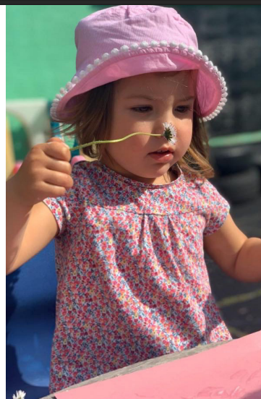
Relationships Matter
Safe, nurturing adults who provide emotional security
(Stoyanov, 2017)
Enabling adults who notice and respond
(Welsh Government, 2022)
Play as a shared experience
(Froebel Trust, n.d.)
Strong connection between home and settings
(Welsh Government, 2023)
Figure 3: Welsh Government (2022), Curriculum for Non-Maintained Nursery Settings (Online image).

Slide 4
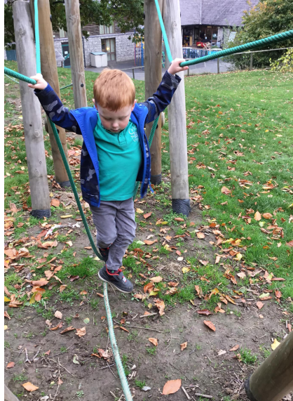
Figure 4: Welsh Government (2023) Assessment arrangements for non-maintained nursery settings (online image).
Understanding the Child
All behaviour is communication (Boxall, n.d.)
Observation is key
(Welsh Government, 2023)
Focus on what the child might be experiencing
(NHS, 2025)

Slide 5
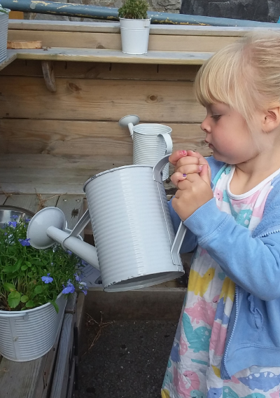
From Understanding to Action
‘The best start’ Early intervention, including Flying Start which provides targeted support for families and children.
(Flying Start, n.d.)
Targeted emotional support (ELSA, n.d.)
Nurture approaches, prioritising emotional security (Nurture, 2023)
Multi agency working to support the whole child (Welsh Government, 2025)
Figure 5: Welsh Government (2023) Assessment arrangements for non-maintained nursery settings (online image).

Slide 6
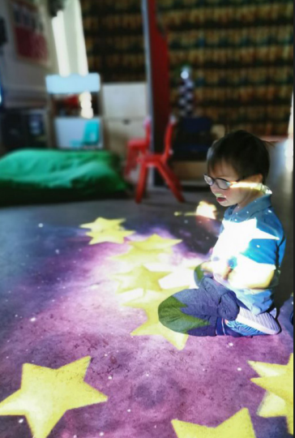
Rights and Well-being
The UNCRC (1989) Every child has the right to develop and thrive
Well-being as a rights based issue, not a need
The right to play, relationships and support
Adults have a responsibility to uphold children's rights (Welsh Government, 2015)
Figure 6: Welsh Government (2022), Curriculum for Non-Maintained Nursery Settings. Image

Slide 7
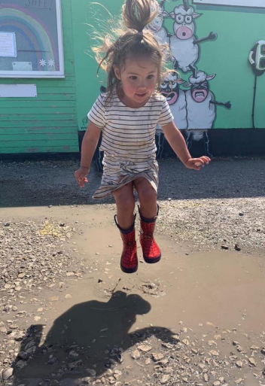
Early years matter
Relationships are key
Understanding to support
Every child’s well-being is a right
Figure 7: Welsh Government (2022), Curriculum for Non-Maintained Nursery Settings. Image

Slide 8
References
Boxall Profile (n.d.) The Six Principles of Nurture. Available at: https://www.boxallprofile.org (Accessed 8 June 2026).
Early Years Coalition (2021) Birth to Five Matters. Available at: https://birthto5matters.org.uk/birth-to-5-matters-to-be-updated-in-a-second-edition/ (Accessed 6 June 2026).
ELSA Support (n.d.) ELSA Support. Available at: https://www.elsa-support.co.uk/ (Accessed 10 June 2026).
Flying Start (n.d.) Flying Start Cardiff. Available at: https://www.flyingstartcardiff.co.uk/?cn-reloaded=1 (Accessed 10 June 2026).
Frobel Trust (n.d.) Froebelian Principles. Available at: https://www.froebel.org.uk/about-us/froebelian-principles (Accessed 8 June 2026).
NHS Safeguarding (2025) The context of NHS safeguarding. Available at: https://safeguarding-guide.nhs.uk/context-of-NHS-safeguarding/s2-07/ (Accessed 8 June 2026).
Nurture UK (2022) Nurture groups. Available at: https://www.nurtureuk.org/supporting-you/nurture-groups/ (Accessed 10 June 2026).
Public Health Wales (2025) Joint Statement on Children and Young People’s Mental Health and Wellbeing. Available at: https://phw.nhs.wales/app/uploads/sites/2/2026/06/Joint-Statement-on-Children-and-Young-People.pdf (Accessed 7 June 2026).
Public Health Wales (2025) Rise in mental health difficulties among children and young people highlight need for early action. Available at: https://phw.nhs.wales/2025/11/25/rise-in-mental-health-difficulties-among-children-and-young-people-highlight-need-for-early-action/ (Accessed 7 June 2026).
Ross, T. and Cook, G. (n.d.) Bronfenbrenner's Ecological Systems Theory (Online image). Available at: https://edtechbooks.s3.us-west-2.amazonaws.com/pdfs/538/11086.pdf (Accessed 2 June 2026).
Stoyanov, S. (2017) An Analysis of Abraham H. Maslow's Theory of Human Motivation. Milton: Macat International Limited. Available from: ProQuest Ebook Central (7 June 2026).
UNICEF (1989) Convention on the Rights of the Child. Available at: https://www.unicef.org/child-rights-convention/convention-text-childrens-version (Accessed 10 June 2026).
Vélez-Agosto, N.M. et al. (2017) “Bronfenbrenner’s Bioecological Theory Revision: Moving Culture from the Macro Into the Micro,” Perspectives on Psychological Science, 12(5), pp. 900–910. Available at: https://doi.org/10.1177/1745691617704397.

Slide 9
Welsh Government (2015) Children and Young People Wellbeing Monitor. Available at: https://www.gov.wales/children-and-young-peoples-wellbeing-monitor-wales-2015 (Accessed 10 June 2026).
Welsh Government (2022) Curriculum for Non-Maintained Nursery Settings. Available at: https://hwb.gov.wales/curriculum-for-wales/curriculum-for-funded-non-maintained-nursery-settings (Accessed 6 June 2026).
Welsh Government (2023) Annex 3: Developing family engagement in Community Focused Schools. Available at: https://www.gov.wales/annex-3-developing-family-engagement-community-focused-schools-html (Accessed 6 June 2026).
Welsh Government (2023) Assessment arrangements for funded non-maintained nursery settings. Available at: https://hwb.gov.wales/api/storage/c05430f0-b9d3-4d5e-92a3-8ec30a60ddf1/assessment-arrangements-for-funded-non-maintained-nursery-settings.pdf (Accessed 9 June 2026).
Welsh Government (2025) Early Childhood Play, Learning and Care Plan in Wales. Available at: https://www.gov.wales/sites/default/files/publications/2024-03/early-childhood-play-learning-care-plan-high-level.pdf (Accessed 9 June 2026).
Welsh Government (2025) National multi-agency practice framework for children’s services. Available at: https://www.gov.wales/national-multi-agency-practice-framework-childrens-services-html (Accessed 9 June 2026).

