Slide 1

Strategic and Agile Business ManagementBMMB7027
Strategic Capabilities
Daniela Hellyer
May 2026

Slide 2
This week we will focus on…
Topics:
  Welcome
  Introduction to strategy and strategic management
  Strategic analysis
  Competitive strategy
  Strategic capabilities

Slide 3

Resources and capabilities
The resources and capabilities of an organisation contribute to its long-term survival and potentially to competitive advantage.
Resources are the assets that organisations have or can call upon (e.g. from partners or suppliers), that is ‘what we have’.
Capabilities (sometimes referred to as competences) are the ways those assets are used or deployed, that is ‘what we do well’ .

Slide 4
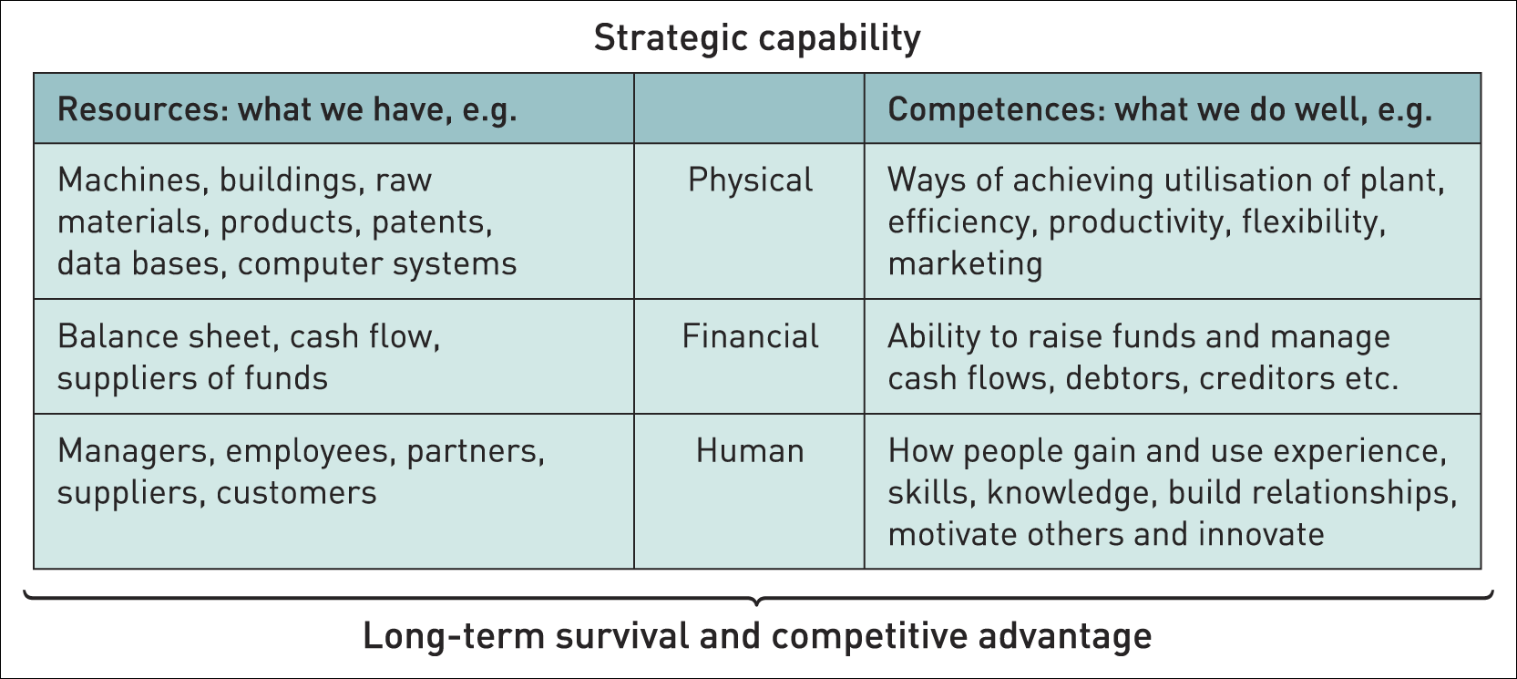
Strategic capabilities – resources & competences

Slide 5

Redundant capabilities
Capabilities, however effective in the past, can become less relevant as industries evolve and change.
Such ‘capabilities’ can become ‘rigidities’ that inhibit change and become a weakness.
It is important for an organisation to recognise such redundant capabilities and to eliminate them.

Slide 6

Core competencies / capabilities
Core competences¹ are the linked set of skills, activities and resources that together:
deliver customer value
differentiate a business from its competitors
potentially, can be extended and developed as markets change or new opportunities arise.

Slide 7

Finding your company’s Core competencies
What are Core Competencies?
Watch this video and take notes:
  What are the key messages that you take away from this?
  We will discuss this together after the video.
https://youtu.be/Abl6b71H2Mc
The Explainer: Finding Your Company's Core Competencies

Slide 8
New strategy sets out future of science and engineering capability across government
The Government Science and Engineering profession strategy 2026 describes how the Government Science and Engineering (GSE) profession will strengthen capability and leadership across departments, building on progress made since the 2021 strategy.
The new strategy places greater emphasis on how science and engineering capability is developed and sustained across government, with clearer priorities for existing programmes.
Professor Dame Angela McLean, Government Chief Scientific Adviser and Head of the GSE profession, said:
Science and engineering equip us with the tools to help us understand our changing world and shape decisions to create a more resilient future for the United Kingdom.
This strategy sets out how the Government Science and Engineering profession will put science and engineering at the heart of government decision making, ensuring we have the very best expertise to ask the right questions, provide evidence, and make decisions that will stand the test of time.
The strategy introduces new and strengthened initiatives, including a mid‑career leadership offer for scientists and engineers, work to improve skills, recognition and reward, and continued development of existing programmes such as the Science and Engineering Fast Stream.

Slide 9

benchmarking
Benchmarking is a means of understanding how an organisation compares with others – typically competitors.
Two approaches to benchmarking:
Industry/sector benchmarking – comparing performance against other organisations in the same industry/sector against a set of performance indicators.
Best-in-class benchmarking – comparing an organisation’s performance or capabilities against ‘best-in-class’ performance – wherever that is found even in a very different industry. (e.g. BA benchmarked its refuelling operations against Formula 1).

Slide 10
The resource-based view (rbv) of strategy and
Achieving sustainable competitive advantage
The resource-based view (RBV) of strategy asserts that the competitive advantage and superior performance of an organisation is explained by the distinctiveness of its capabilities.
The four key criteria by which capabilities can be assessed in terms of providing a basis for achieving sustainable competitive advantage are:
V – value
R – rarity
I – inimitability and
O – organisational support

Slide 11
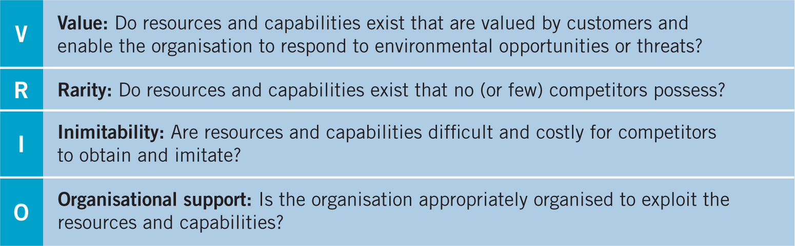
Achieving sustainable competitive advantage

Slide 12

V – Value
V – Value of resources and capabilities
Strategic capabilities are of value when they:
take advantage of opportunities and neutralise threats;
provide value to customers;
are provided at a cost that still allows an organisation to make an acceptable return.

Slide 13

R – rarity
R – Rarity
Rare capabilities are those possessed uniquely by one organisation or only by a few others.
(e.g. a company may have patented products, have supremely talented people or a powerful brand.)
Rarity could be temporary.
(e.g. patents expire, key individuals can leave or brands can be de-valued by adverse publicity.)

Slide 14

I – Inimitability
Inimitable capabilities are those that competitors find difficult and costly to imitate, to obtain or to substitute.
Competitive advantage can be built on unique resources (a key individual or IT system) but these may not always be sustainable (key people leave or others acquire the same systems).
Sustainable advantage is more often found in competences (the way resources are managed, developed and deployed) and the way competences are linked together and integrated.
I – inimitability

Slide 15

O – organisational support
O – Organisational support
The organisation must be suitably organised to support the valuable, rare and inimitable capabilities that it has. This includes appropriate processes and systems.
Organisational knowledge is organisation-specific, collective intelligence, accumulated through both formal systems and people’s shared experience.
‘Explicit’ knowledge or ‘objective’ knowledge is transmitted in formal systematic ways, e.g. systems manuals or market research.
‘Tacit’ knowledge is more personal, context-specific, hard to formalise and communicate and is difficult to imitate, e.g. the knowledge and relationships in a top R&D team.

Slide 16
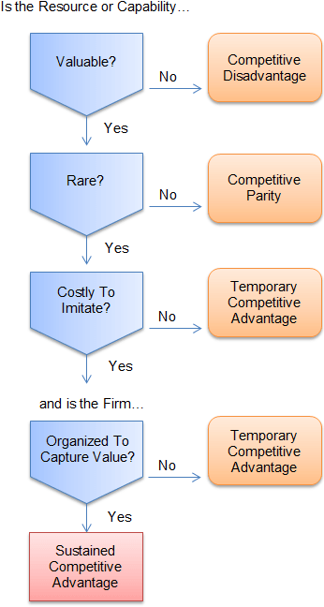
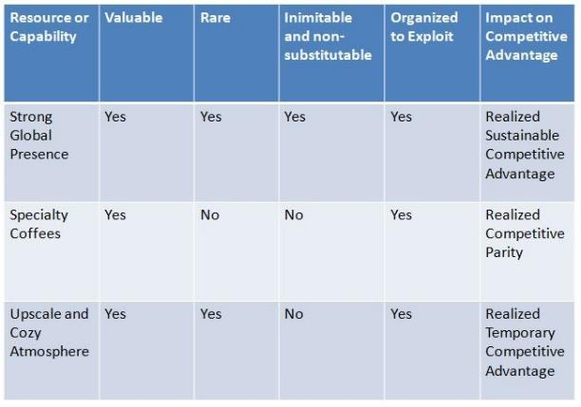
Vrio framework – levels of competitive advantage
Example of framework applied to Starbucks

Slide 17
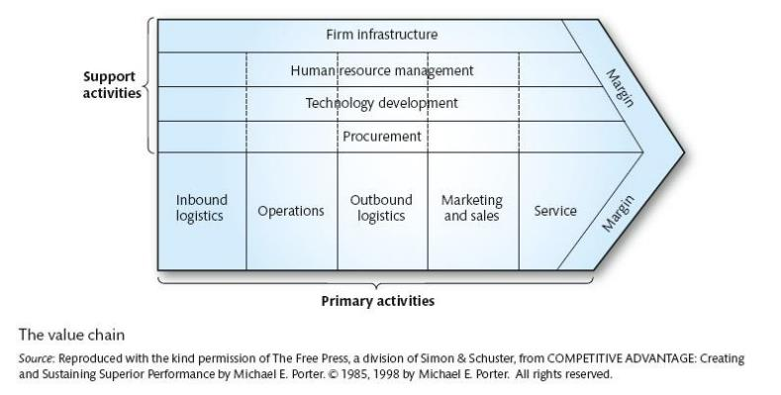
The value chain
Selling organisations compete for business by trying to offer enhanced value, and they do this through a coordinated chain of activities.
These include product design, production, marketing, delivery and support.
Porter (1985) referred these activities as the Value Chain.

Slide 18
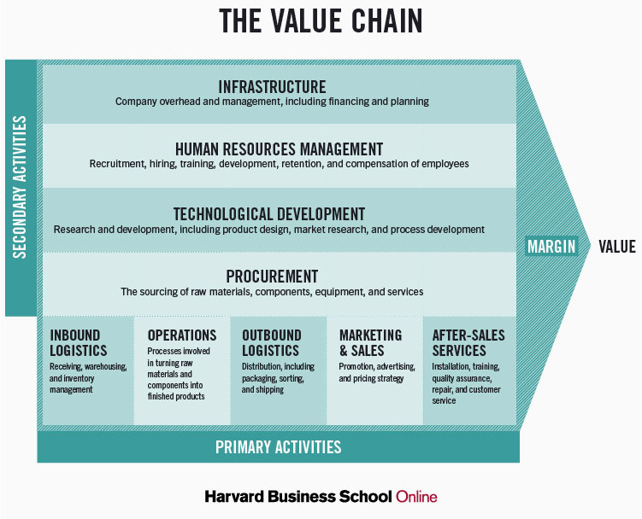
The value chain
Describes the categories of activities within an organisation, which, together, create a product or service.
Consists of five primary activities (which are directly concerned with the creation or delivery of a product or service)
Also consists of four support activities (which help to improve the effectiveness or efficiency of primary activities).
Competitive advantage can be analysed in any of these activities.

Slide 19
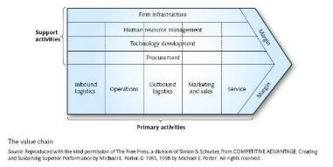
Benefits of value chain analysis
A generic description of activities – understanding how the discrete activities (or clusters of linked activities) contribute to customer benefit.
Identifying activities where the organisation has particular strengths or weaknesses.
Analysing the competitive position of the organisation using the VRIO criteria – thus identifying sources of sustainable advantage.
Looking for ways to enhance value or decrease cost in value activities (e.g. outsourcing).

Slide 20
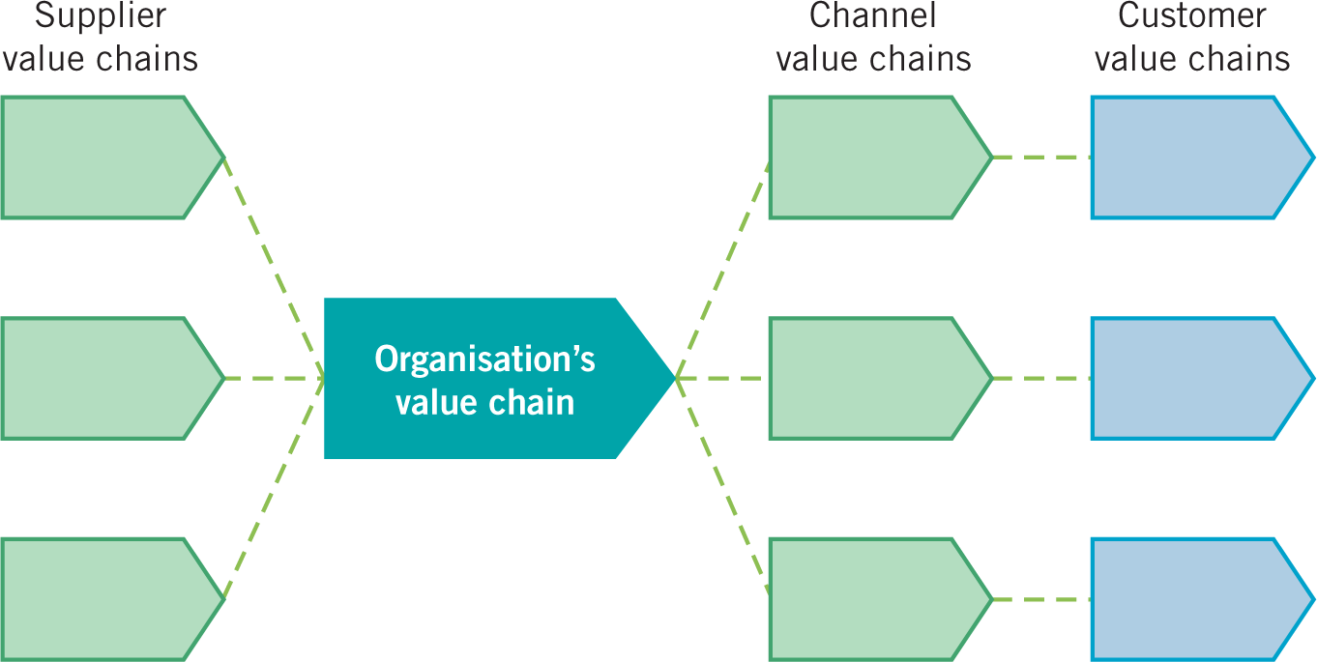
The value system
Important to understand:
Which activities need to be part of the Organisation’s value chain because they are key to achieving competitive advantage?
The value system comprises the set of inter-organisational links and relationships that are necessary to create a product or service.
It looks at an organisation’s value chain in the context of links to other value chains.
Competitive advantage can be derived from linkages within the value system.

Slide 21
Benefits of value system analysis
Understanding cost/price structures across the value system – analysing the best area of focus and the best business model.
Identifying ‘profit pools’ (i.e. levels of profit in different parts of the system) – seeking ways to use existing capabilities in order to exploit these.
The ‘make or buy’ decision – which activities to do ‘in-house’ and which to outsource.
Partnering – deciding who to work with and the nature of these relationships.

Slide 22
summary
To be able to achieve sustained competitive advantage resources / capabilities need to be unique and distinctive.
To be distinctive and provide for sustainable competitive advantage, resources and capabilities need to fulfil the VRIO criteria of being Valuable, Rare, Inimitable and supported by the Organisation.
Ways of diagnosing organisational resources and capabilities include:
The resource-based view (RBV) / VRIO analysis of resources and capabilities to evaluate if they contribute to competitive advantage.
Analysing an organisation’s value chain and value system to understand how value to a customer is created and can be developed.
Strategic analysis frameworks such as PESTEL, SWOT etc. drawing together an understanding of the strengths, weaknesses, opportunities and threats an organisation faces.
Benchmarking to understand the relative performance of organisations.
It is important for an organisation to recognise such redundant capabilities and to eliminate them.

Slide 23
This is the end of our session ☺

